Slide 1
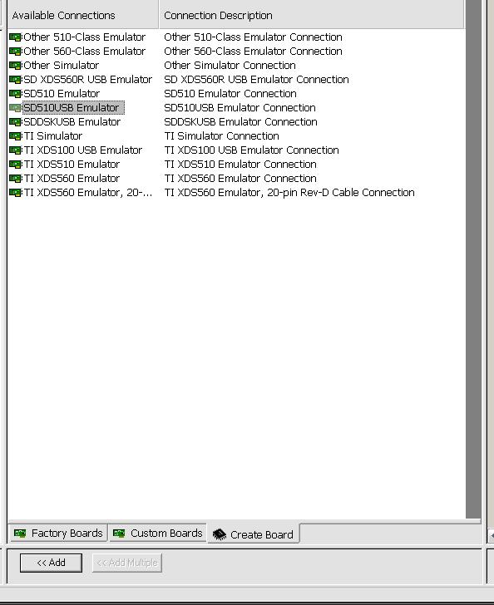
Select the emulator you want to use
Here I have selected the SD XDS 510 USB emulator
Click on “Add” below

Slide 2
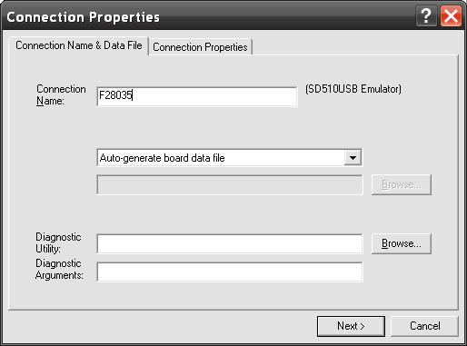
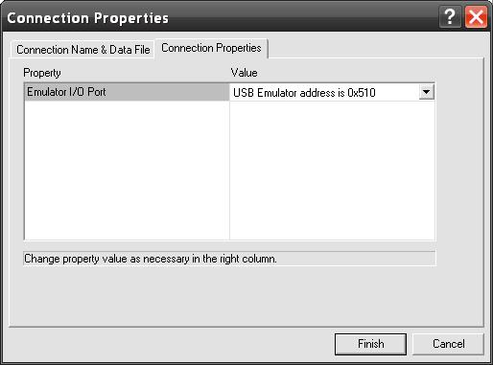
Specify the connection name
Make sure the address is selected in the Connection Properties TAB
Click finish

Slide 3
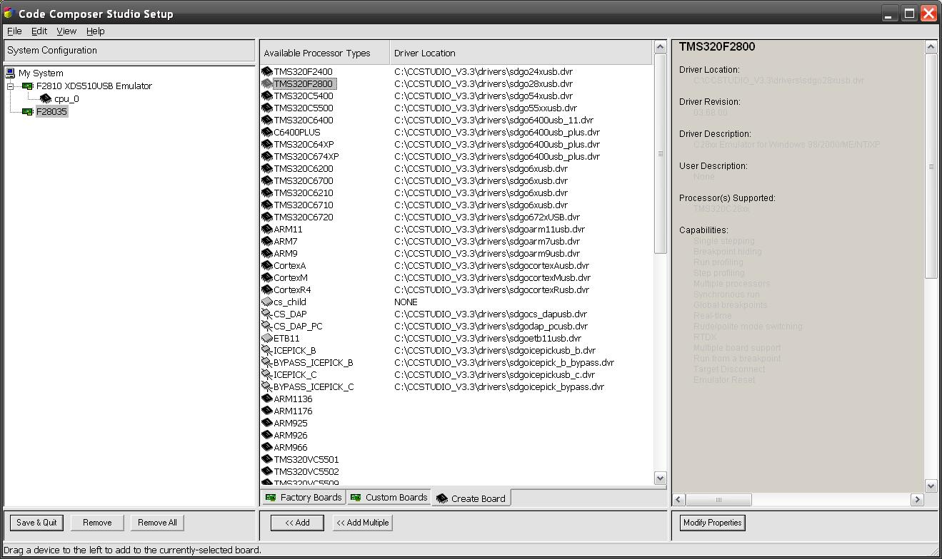
You will find the board you created appear on the left
The list of processors will appear on right
Select F2800
Select Add below

Slide 4
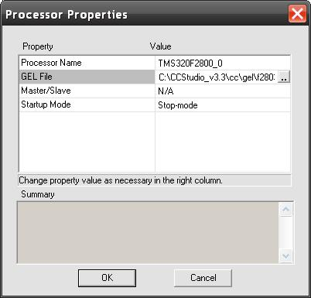
You’ll see this box appear
Select the gel file location and hit OK

Slide 5
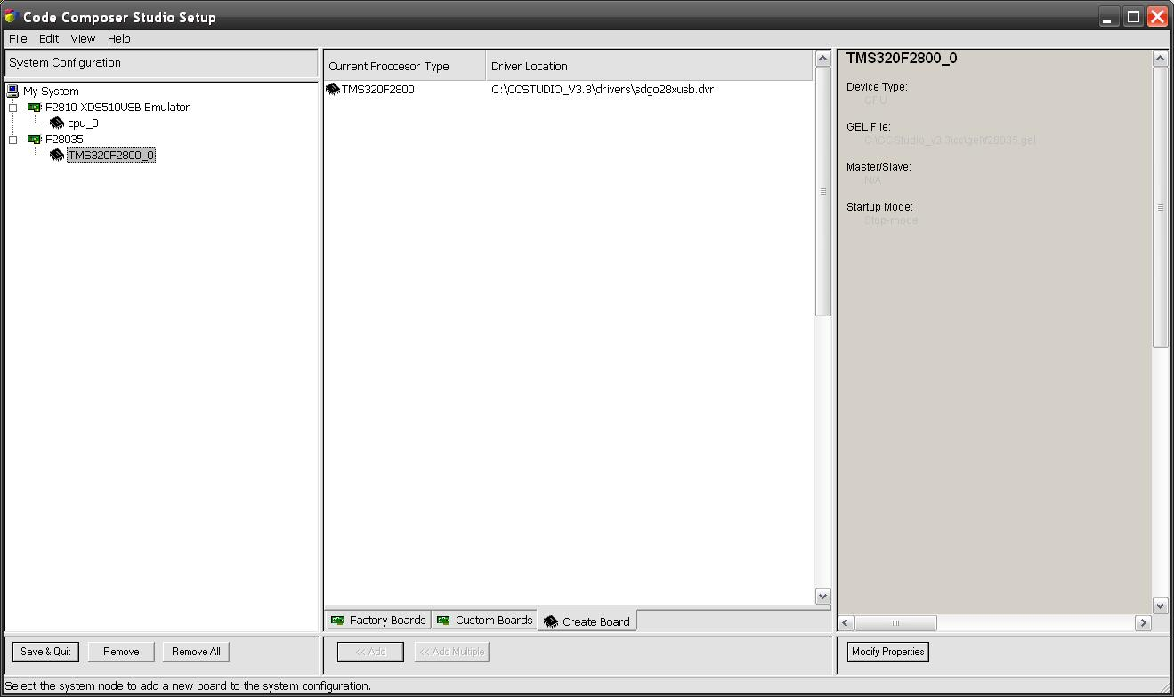
Now the board and processor have been created.
Hit Save and Quit

Slide 6
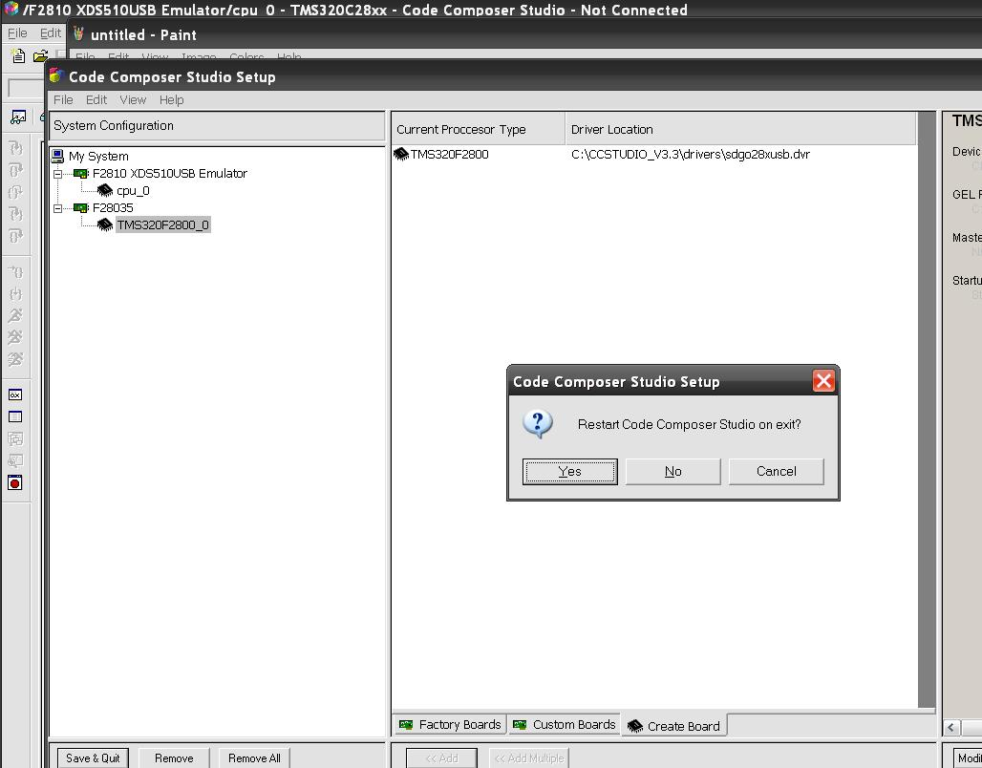

Slide 7
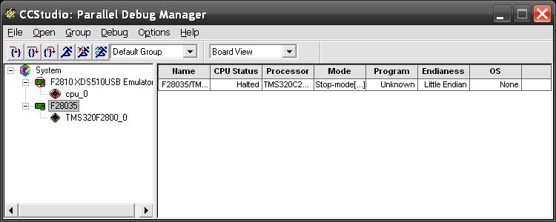
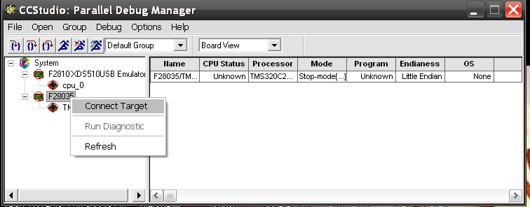

Slide 8
