Slide 1
Power Management for Altera Stratix V

Slide 2
FPGA Power Requirements

Slide 3
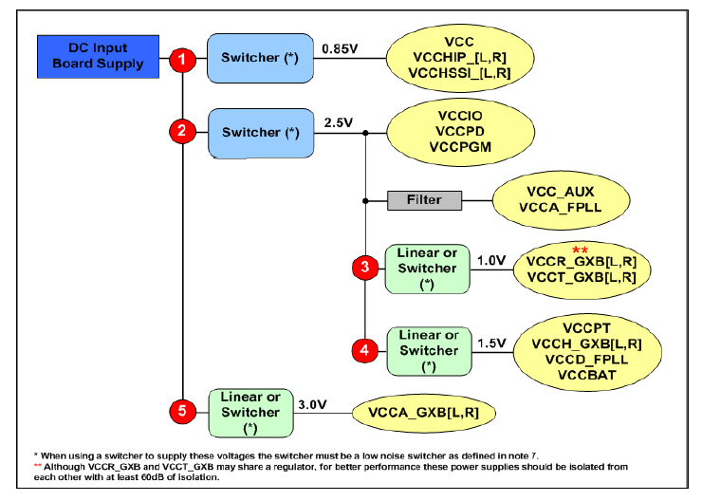
Power Management for Stratix FPGAs
TPS56221, TPS53353, or TPS53355
TPS84620/1 or TPS54622/0
TPS7A7xxx
TLV70430, TPS62150, or TPS54320

Slide 4
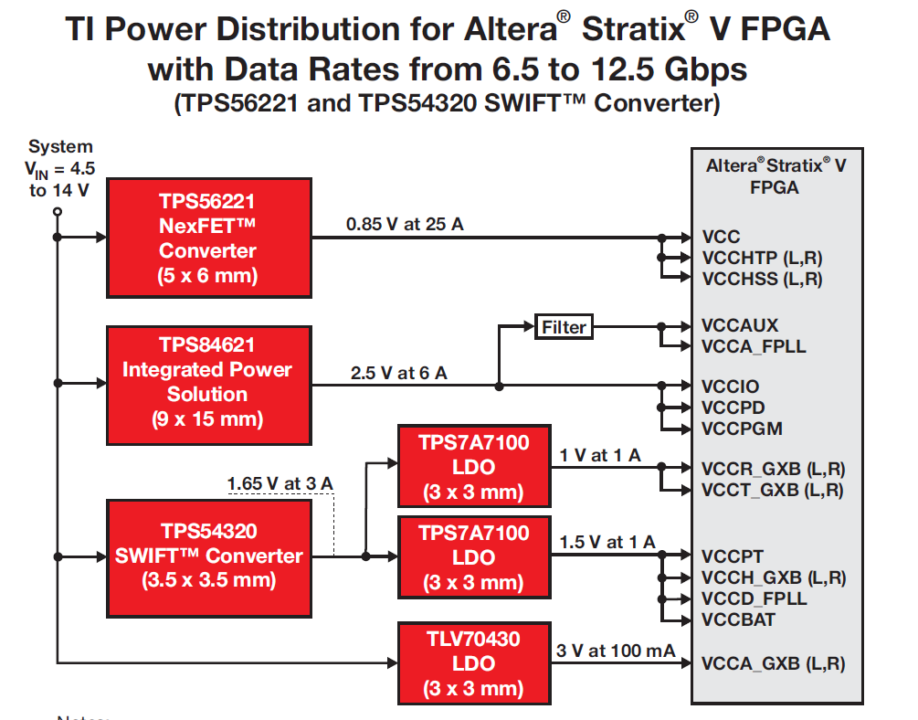
Power Management for Stratix V

Slide 5
FPGA Core and I/O Power

Slide 6
TPS56221/121
4.5V to 14V Input, 25/15-A, Step-Down SWIFT™ Converter
Features
Benefits
90% efficiency at full load
Easy to solder with a single thermal pad on the bottom of the package
Integrated NexFETs in 22 pin 5x6mm QFN package
300/500/1000kHz selectable fsw, adj. soft-start & programmable current limit
5% more efficient than similar 25-A products in the market
30% less power dissipation than similar 25A converters in the industry- less thermal stress
30% Smaller than 25A discrete solutions, delivers 200W/in³ with easy layout
Provides the design flexibility of a discrete solution
Applications
Point-of-Load in Networking/Telecomm Equipment
Non-isolated DCDC Power Module
Data Storage & Servers
Industrial Test and Measurement equipment
Power for Stratix core and I/O requirements
Notes:
6
6

Slide 7
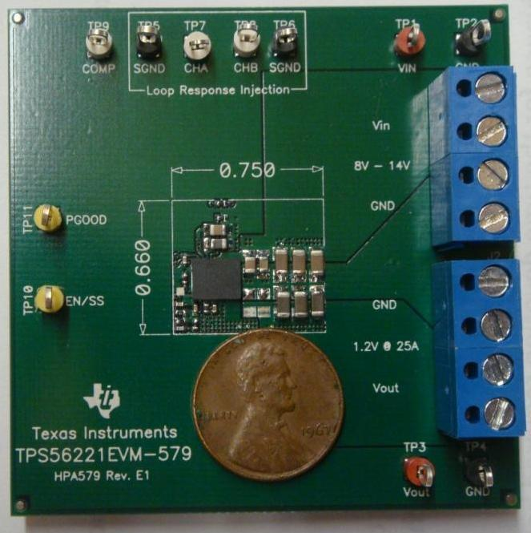
TPS56221 Converter Performance
Size
Solution Area 0.5in² at 25A, 30% smaller than discrete solutions
High Power Density 200W/in³
Tiny 5x6mm QFN Package
mm
TPS56221 double sided reference board
Notes:
7
7

Slide 8
High Current Integrated FET Converters
-Device are released or have samples available-
-These are the newest devices under promotion-
Targeted
Application
TPS53355 – 30A (DCAP)
TPS56221 – 25A (VM)
Use PowerStack™
Consumer
25-30A
TPS53353 – 20A (DCAP)
Computing/Storage
Communications
TPS54620 & TPS54622 – 6A (CM)
TPS54521 – 5A (CM)
Output Current (I_{OUT})
TPS84620 – 6A (Integrated Inductor)
TPS51317 – 6A (DCAP+)
5-6A
TPS54618 – 6A (CM)
TPS51461 – 6A (DCAP+, 2 bit VID)
Topologies:
CM – Current Mode
VM – Voltage Mode
DCAP Mode – Adaptive on –time
  DCAP – Requires ripple on Vout
  DCAP2 – Ripple injection inside DC/DC
  DCAP+ – DCAP with Droop Compensation
TPS53317 – 6A (DCAP+, DDR, samples)
TPS53321 – 5A (VM)
TPS53316 – 5A (VM, Prog OCP) (samples)
1.0V
2.95V
4.5V
6.0V
14V
17V
18V
Input Voltage (VIN)

Slide 9
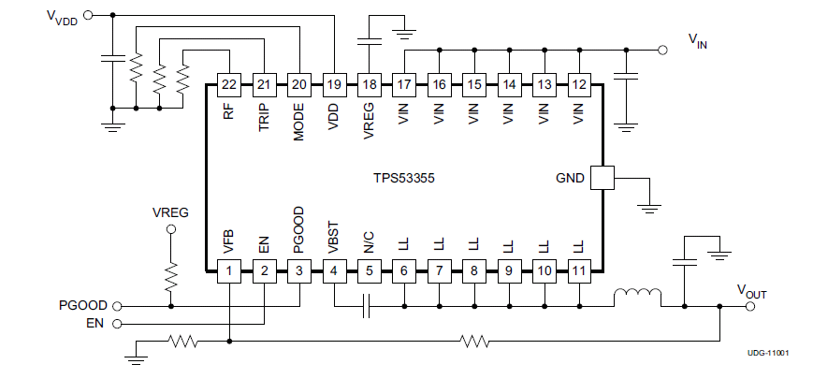
TPS53353
20A Step-down Integrated FET Converter
Features | Benefits
Conversion Input Voltage Range: 3V to 15V VDD Input Voltage Range: 4.5V to 25V Output Voltage Range: 0.6V to 5.5V Built in LDO D-CAPTM Mode Control Topology Switching Frequency from 250k to 1MHz with External PowerStack™ packaging technology Selectable Auto-Skip or PWM-Only Operation 0.6V, 1% Reference Accuracy Remote Sense Support Internal Soft-Start with Selectable SS Time OVP, UVP, UVLO, OTP, ENABLE, PGOOD Pin-to-pin compatible with TPS53355 (30A version) | Single IC can convert from 3.3V, 5V, and 12V bus rails Single supply operation from 4.5V to 25V Supports ASIC core, I/O, and DDR core regulation No external IC bias voltage required Only 4x100uF MLCCs needed for 20A load transient Eliminates 5-6 loop compensation components vs. Voltage Mode control ($0.03-$0.05 BOM cost savings) High Fsw enables total power supply area of <1.3in² 90% Efficiency at 20A Out @ 500KHz 57°C maximum case temperature with no air flow 82% Efficiency at light load (<100mA) High Accuracy Output Voltage Regulation within 1% Improved System Voltage Accuracy Flexible design; Eliminates one (1) Soft Start capacitor Complete System Protection, Power Sequencing Design flexibility, Time-To-Market reduction
Applications
Notebook Computers Server and Desktop Computers Telecommunication Equipments
Notes:
This is the template! The template, along with this presentation, are available for download on the HPA Internal Marketing website. Go to the ‘Content Repository’ tab and they are located on the ‘Field/Factory Communication’ page at
http://tid-us.itg.ti.com/mslp/hpamktg.nsf/FieldMisc?OpenView&count=1000.

Slide 10
TPS53355
30A Step-down Integrated FET Converter
Features | Benefits
Conversion Input Voltage Range: 3V to 15V VDD Input Voltage Range: 4.5V to 25V Output Voltage Range: 0.6V to 5.5V Built in LDO D-CAPTM Mode Control Topology D-CAPTM Mode Control Topology Switching Frequency from 250k to 1MHz with External PowerStack™ packaging technology PowerStack™ packaging technology Selectable Auto-Skip or PWM-Only Operation 0.6V, 1% Reference Accuracy Remote Sense Support Internal Soft-Start with Selectable SS Time OVP, UVP, UVLO, OTP, ENABLE, PGOOD Pin-to-pin compatible with TPS53353 (20A version) | Single IC can convert from 3.3V, 5V, and 12V bus rails Single supply operation from 4.5V to 25V Supports ASIC core, I/O, and DDR core regulation No external IC bias voltage required Only 5x100uF MLCCs needed for 30A load transient Eliminates 5-6 loop compensation components vs. Voltage Mode control ($0.03-$0.05 BOM cost savings) High Fsw enables total power supply area of <1.3in² 90% Efficiency (12VIN, 1.5Vout/30A, 500KHz frequency) 88°C maximum case temperature at 12VIN, 1.5Vout/30A, 500KHz Fsw, Tambient = 25°C, no airflow 82% Efficiency at light load (<100mA) Only 5x100uF MLCCs required for ASIC 30A regulation Improved System Voltage Accuracy Flexible design; Eliminates one (1) Soft Start capacitor Complete System Protection, Power Sequencing Design flexibility, Time-To-Market reduction
Applications
Notebook Computers Server and Desktop Computers Telecommunication Equipments
Notes:
This is the template! The template, along with this presentation, are available for download on the HPA Internal Marketing website. Go to the ‘Content Repository’ tab and they are located on the ‘Field/Factory Communication’ page at
http://tid-us.itg.ti.com/mslp/hpamktg.nsf/FieldMisc?OpenView&count=1000.

Slide 11
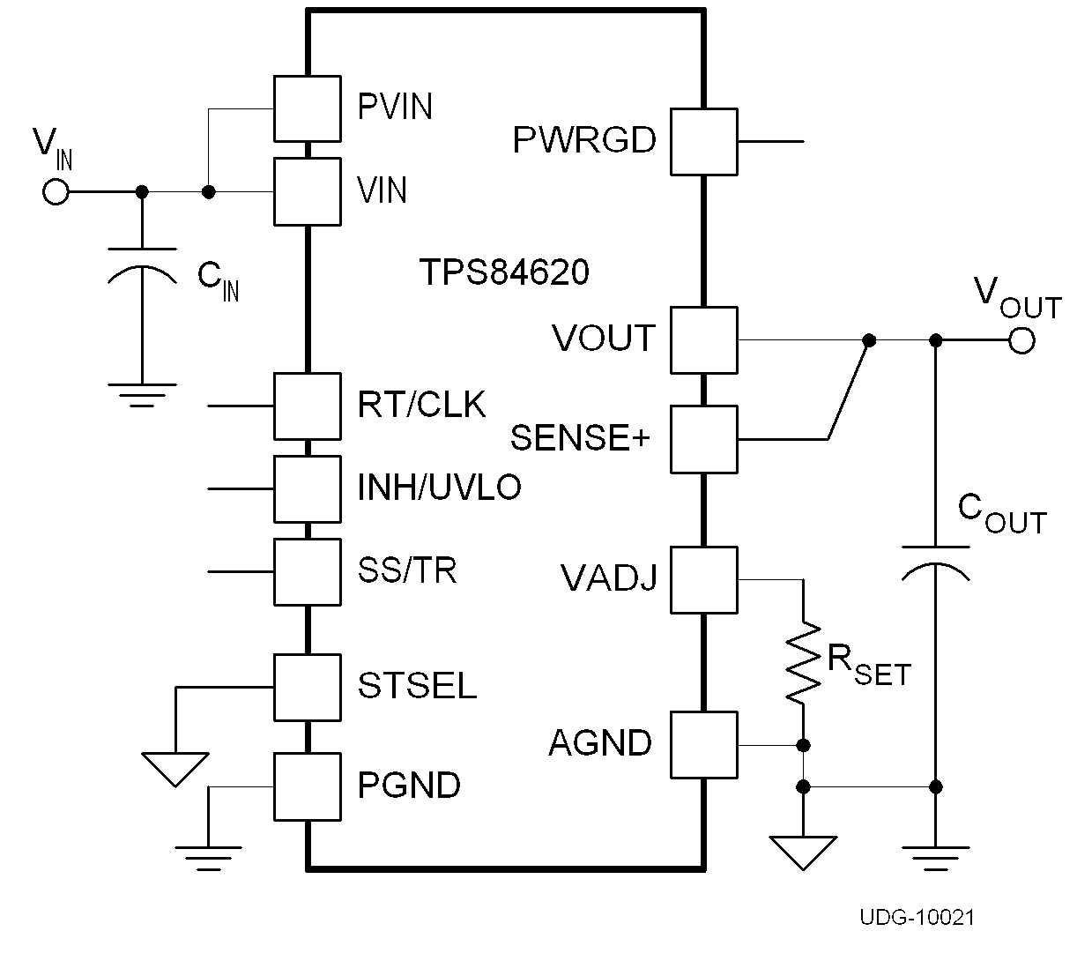

TPS84621/0
4.5V to 14.5V Input, 6-A Synchronous Buck Integrated Power Solution
Features
Benefits
Integrated Inductor and Passives
Easy to Mount 9 x 15 x 2.8mm QFN Package Delivers 800W/in³ Solution
95% Peak Efficiency and 13°C/W Ө_{JA} Thermal Resistance
Adjustable Frequency, Soft Start, & UVLO with Track, Clock and PG pins
Adjustable Output Voltage
  621 – 0.6 to 5.5-V
  620 – 1.2 to 5.5-V
Only 3 External Components Required
40% Smaller Package than Competitive 12V, 6A Integrated Inductor Solutions
Low Thermal Resistance Delivers Full 6-A Rated Current without Airflow
Provides the Design Flexibility of a Discrete Solution
Applications
Broadband & Communication Infrastructure
Automated Test and Medical Equipment
Compact PCI / PCI Express / PXI Express
DSP & FPGA Point of Load Applications
1.2V to 5.5Vout
TPS84620EVM-692
SwitcherPro Software
Power for Stratix I/O requirements

Slide 12
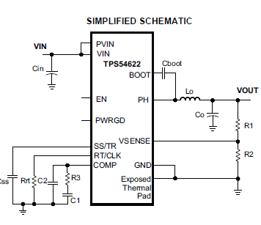
TPS54622
4.5V to 17V Input 6-A Synchronous Buck Converter with Hiccup Current Limit
Features
Benefits
Integrated Monolithic 26mΩ High Side and 19mΩ Low Side MOSFETs
200KHz to 1.6MHz Adjustable Switching Frequency
0.6V Reference with 1% Accuracy over Temperature
Synchronizes to External Clock
Integrated Tracking Function
3.5 x 3.5mm 14 pin QFN Package
95% Peak Efficiency; Optimized for Low Output Voltages
High Frequency Supports Small Output Inductor and Capacitor Size
Ideal for Powering New Deep Sub-Micron DSPs, FPGAs, and ASICs
Eliminates Beat Noise for Sensitive Applications
Easily Implement Sequencing Schemes
60% Smaller Package than other 12V / 6A Converters with Integrated FETs
Applications
Broadband, Networking & Communication Infrastructure
Servers and Work Stations
Compact PCI / PCI Express / PXI Express Applications
TPS54622EVM
Power Stage PVIN: 1.6 to 17V
Input Voltage VIN: 4.5 to 17V
Power for Stratix I/O requirements
Notes:
12

Slide 13
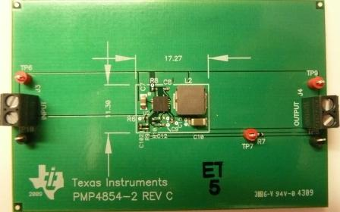
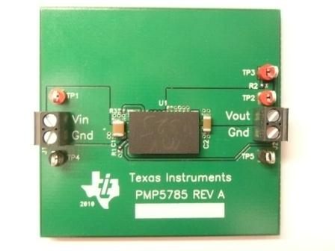
TPS84621/0 & Discrete Solution Positioning
Discrete with Integrated FETs
Optimize the design with loop compensation and inductors selection
Very small solution size possible with layout and loop compensation expertise
Integrated Power Solution
No loop compensation or inductors selection process – Fewer components
Very small solution size possible with little power expertise needed
QFN package is easy to mount
Feature set of a discrete solution
TPS54622/0
TPS84621/0
12Vin
6A out
3.3Vout
12Vin
6A out
3.3Vout
~195mm²
~195mm²
Achieve the performance of a discrete solution without the effort or extra components using the TPS84620 integrated power solution

Slide 14
FPGA Transceiver Power
Linear Regulators

Slide 15
TPS7A71xx/2xx/3xx
1A - 3A Wide V_{IN} LDO with SS & PG
New!!!
4Q11 RTM
Sampling Now!!
Features
Benefits
Factory EEPROM programmable V_{OUT}
Wide Vin range 1.5V – 7.0V(TBD)
TPS737xx/796xx Similar Pinout
2% Accuracy
Low Output Noise/ High PSRR
  30mV_{RMS}(TBD)
  PSRR 55dB @ 1kHz(TBD)
Programmable SoftStart
Power Good Output
20-Pin 5x5mm RGW (QFN) Package(TBD)
10-Pin 3x3mm DRC (SON 10) Package
Quickly sample/release new custom versions
Applications requiring V_{IN} > 5.5V & V_{IN} < 2.0V
Easy upgrade path for existing designs
Applications requiring stable Vout
RF/Audio Noise Sensitive Applications
Reduces in-rush current
Application requiring sequencing
Enhanced thermal performance
65% smaller than 5 x 5mm QFN package
Applications
Wireless Infrastructure (Tx/Rx, FPGA&DSP)
RF: 5V components, VCOs, Receivers, ADCs
SetTopBox (Amp,AD/DA,FPGA&DSP)
Wireless LAN, Bluetooth
PC & Printers
Audio and Visual
Device | V_{IN} | I_{OUT} | V_{DO} | I_{Q} | Package
TPS7A71xx | 1.5 – 7.0V | 1A | 100mV | 2mA | RGW, DRC
TPS7A72xx | 1.5 – 7.0V | 2A | 200mV | 2.5mA | RGW, DRC
TPS7A73xx | 1.5 – 7.0V | 3A | 300mV | 3mA | RGW, DRC
15
Power for VCCx_GXB transceiver requirements

Slide 16
VCCA Transceiver Power

Slide 17
TLV704xx
24Vin, 100mA Ultra-Low I_{Q} LDO
Features | Benefits
Iq – ~3uA; <5uA for -40 < Ta < 125C V_{IN} Range 2.5 – 24V Vout: 3.0, 3.3V Stable with > 0.47μF Ceramic Output Cap Standard SOT23-5 & SOT89-3 packages | Power Sensitive Applications Applications requiring high V_{IN} & Low Power Small Solution Size & low cost Low cost and industry standard pinouts
Applications
E-Metering Remote Controllers Portable electronics powered from 9V-12V battery Smoke Detectors
Device | V_{IN} | I_{OUT} | V_{DO} | I_{Q} | ESD | Package
TLV704xx | 2.5 – 24V | 100mA | 85mV typ @ 10mA | 3.6uA max | HBM 2KV CDM 500V | DBV, PK
TLV70430 - Power for VCCA transceiver requirements
Notes:
17
This is the template! The template, along with this presentation, are available for download on the HPA Internal Marketing website. Go to the ‘Content Repository’ tab and they are located on the ‘Field/Factory Communication’ page at
http://tid-us.itg.ti.com/mslp/hpamktg.nsf/FieldMisc?OpenView&count=1000.

Slide 18
TPS6213x/4x/5x:
3 .. 17V V_{IN}, 1-3A, 3MHz Step-Down Converters in 3x3mm QFN
Target RTP:
October 2011
Features
Benefits
High Efficiency Step Down Converter with DCS-ControlTM
VIN range from 3 to 17V
Adjustable VOUT from 0.9 to 6.0V
Fixed VOUT options: 1.8V, 3.3V, 5.0V
Output current up to: 3A (TPS62130)
2A (TPS62140)
1A (TPS62150)
Seamless transition to Power Save Mode
Pin-selectable switching frequency (full, half)
100% Duty Cycle Mode
Programmable Soft Start and Tracking
Quiescent current of 17uA (typ.)
Power Good
High VIN step down converter with small solution size
12V @ 3.3V / 3A utilizing a 1uH inductor
DCS-ControlTM regulation is fast and accurate
Low quiescent current and selectable switching frequency for high efficiency
VFB control allows current source applications
Applications
Cstart | Adjustable Startup
TR | FB Voltage Control
DEF | Pin Selectable Output Voltage
FSW | Pin Selectable Switching Frequency
General Purpose POL
Solid State Disk Drives
Embedded and mobile Computing
Industrial applications
TPS62130EVM-505
TPS62140EVM-505
TPS62150EVM-505
Power for Stratix VCCA requirement
Notes:
18

Slide 19
TPS54320
4.5V to 17V Input 3-A Synchronous Buck Converter
Features
Benefits
Integrated Monolithic 57mΩ High Side and 50mΩ Low Side MOSFETs
200KHz to 1.2MHz Adjustable Switching Frequency
0.8V Reference with 1% Accuracy over Temperature
Synchronizes to External Clock
Integrated Tracking Function
3.5 x 3.5mm 14 pin QFN Package
95% Peak Efficiency: Optimized for Low Output Voltages
High Switching Frequency allows a Small Form Factor: Less than 170mm² for all Components
Ideal for Powering New Deep Sub-Micron DSPs, FPGAs, and ASICs
Eliminates Beat Noise in Sensitive Applications
Easily Implement Sequencing Schemes
Pin Compatible with 6-A TPS54620 for Scalability
Applications
Broadband, Networking & Communication Infrastructure
Servers and Work Stations
Compact PCI / PCI Express / PXI Express Applications
TPS54320EVM-513
Power Stage PVIN: 1.6 to 17V
Input Voltage VIN: 4.5 to 17V

Slide 20
Selection Guide

Slide 21
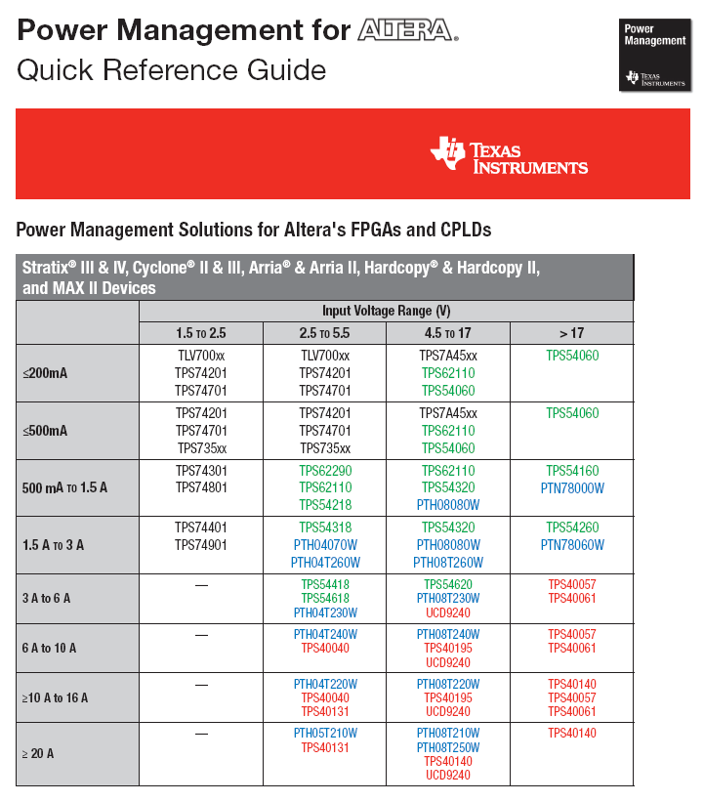
Power Management Selection Guide
Features our best DC/DC conversion products
SLYT351

