Slide 1
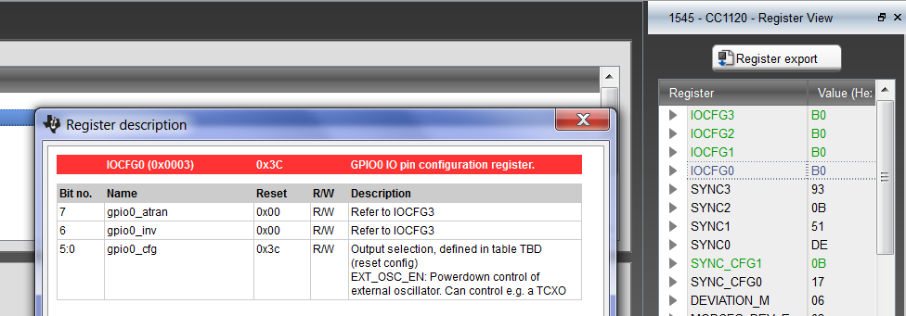
configure SmartRF Studio
`2E`

Slide 2
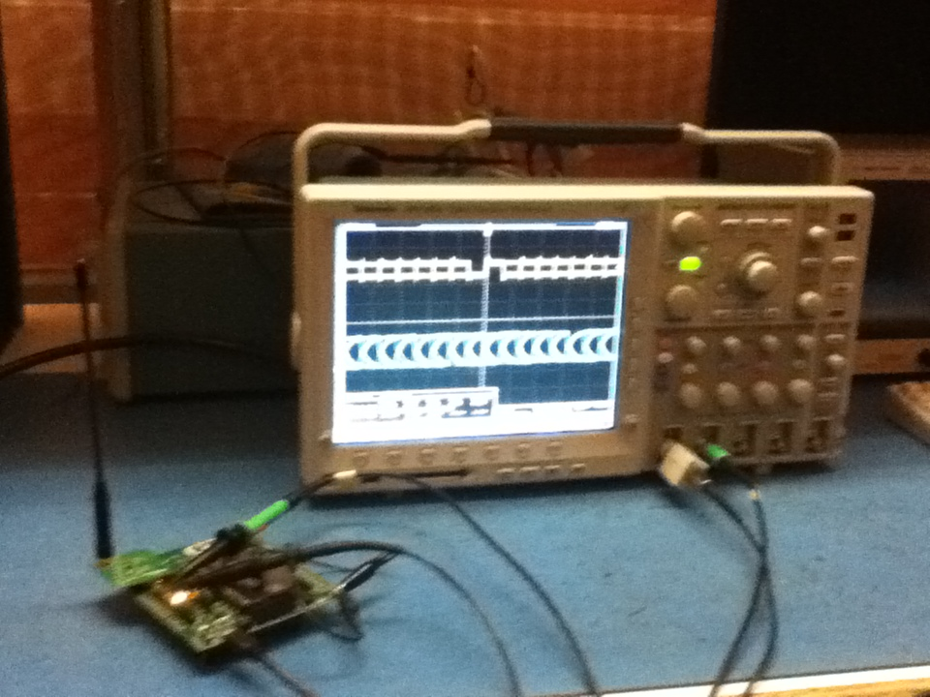
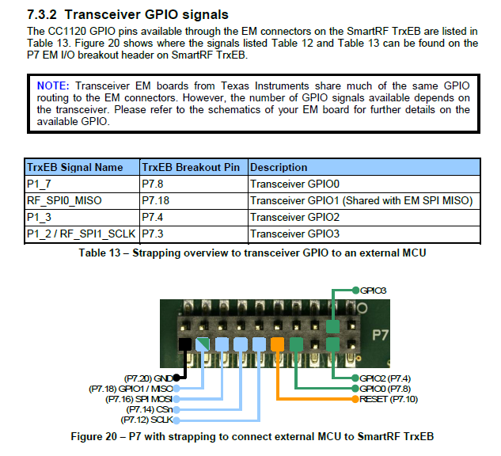
NO TX, only one RX

Slide 4
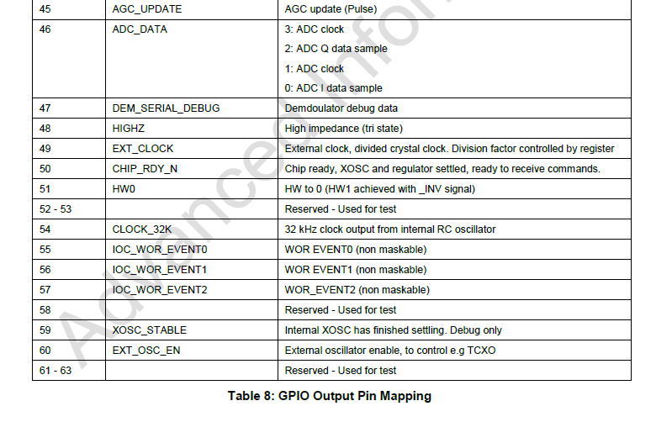

46 is 0010 1110 = 2E (Hex)

Slide 5
46 is 0010 1110 = 2E (Hex)
So need change IOCFG0 to ``2E``

