Slide 1
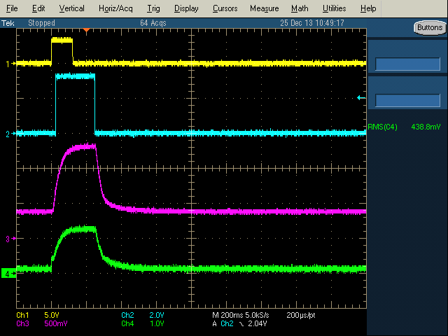
Phenomenon
There are few voltages (approximately 0.4V) on ANA_LDO line even though C5515 is RTC-only mode(i.e. the internal LDOs were disabled.)
  Please see the following waveform.
I reproduced this phenomenon on C5515EVM and summarized the reproduced way to next slides.
CH1: Wake-up
CH2: XF pin
CH3: ANA_LDO
CH4: CVDD
0.4V

Slide 2
Condition
Tools
  C5515EVM
  SD card
  RTC only mode code (& boot image)
  Oscilloscope

Slide 3
Procedure
Connect the JP16(1-2)
Connect the JP15 pin2 to JP16(1-2)
  * i.e. Supply the voltage of ANA_LDO to USB_LDO_IN
Insert the SD card which put on the RTC-only mode boot image
Power-on the EVM
Push the wake-up pin
*Note: Other jumpers are default position.

Slide 4

For your information
I have gotten the waveform which we expected if not connect the ANA_LDO to USB_LDO.
CH1: Wake-up
CH2: XF pin
CH3: ANA_LDO
CH4: CVDD

Slide 5
Background for connecting the ANA_LDO to USB_VDD_IN
We have used the special C5532 device which can work the USB oscillator(12MHz). However, this device did not support the USB_LDO. So, they need to supply the 1.3V for USB_VDD_IN in order to use this Oscillator.
This is why they use the ANA_LDO voltage instead of USB_LDO.

