Slide 1
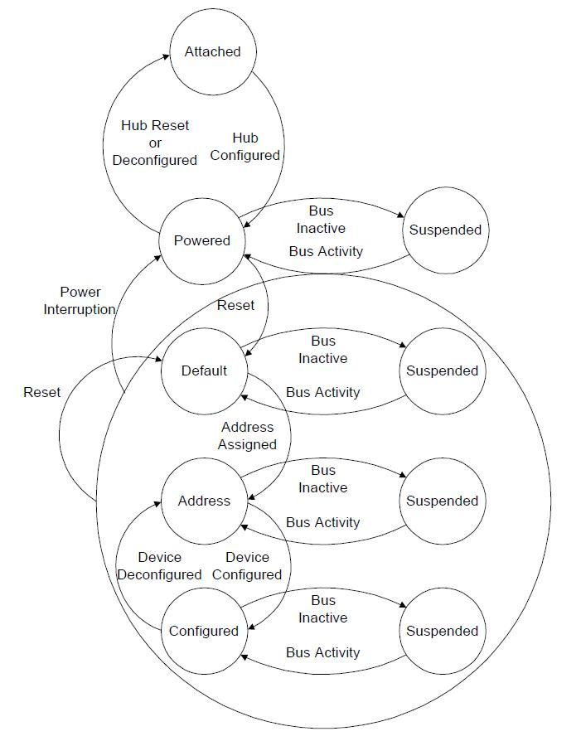

Slide 2
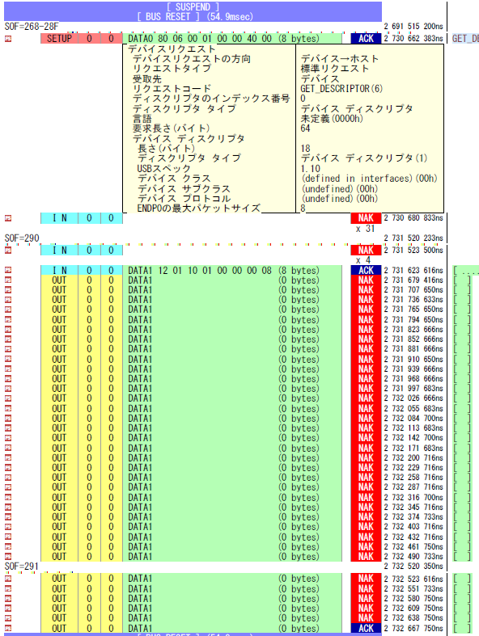
succeed example
with USB3.0
get “configured” after “Attached”
within
1ms
between
ACKs

Slide 3
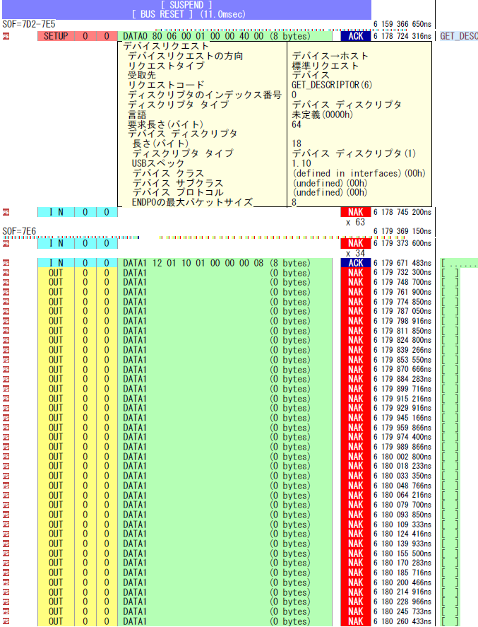
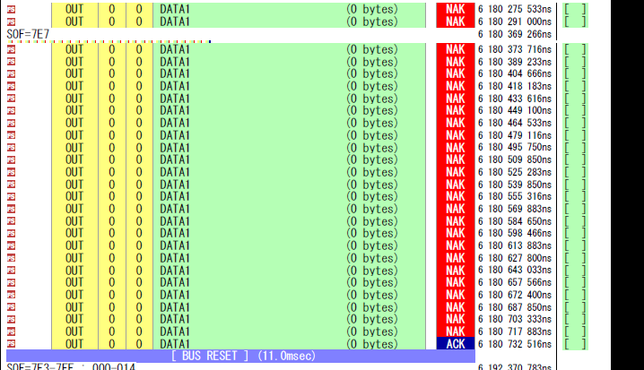
longer
than
1ms
between
ACKs
failure example with USB2.0
did not get “configured”
after “Attached”

