Slide 1
ppc8548E
Pci bridge
Back Plane with cPCI Connector
V-6 FPGA PCI device
V-6 FPGA PCI device
cPCI Connector
Board 2
Board 1
Note: Here Power PC 8548E running on Integrity RTOS and PCI Bridge PCI 2050B are in one board and V-6 FPGA as target PCI device in another board. Between these two Boards the communication is through Back Plane where both these two boards sit on cPCI connector.
Same time in Power PC is directly connected to the another V-6 FPGA in same board and here Power PC able to configure and communicate properly as PCI interface.

Slide 2
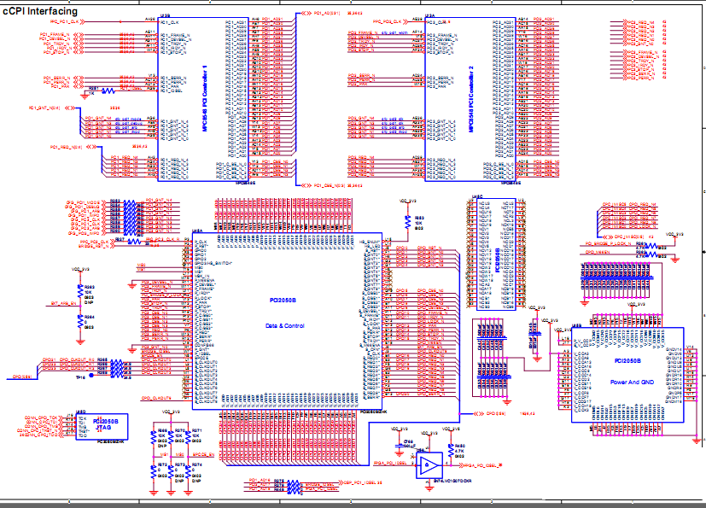
Schematic

Slide 3
Observations
As per schematic PCI Controller 1 is for configuring the V-6 FPGA which is available in same board ‘Board1” and PCI Controller 2 is for configuring the V-6 FPGA which is available in another board ‘Board2”
So Power PC able to configure V-6 present in same board but not another one through PCI Bridge which is present in another board “Board2”.

Slide 4
Cont..
Whenever Power PC is writing something on V-6 of another board thru PCI Bridge address and data cycles are not coming as per specifications.
In chip scope during write cycle at FPGA side, after address in place of valid data for one cycle first 32 bit junk data is coming then only valid data is coming.
Snap shot of chip scope is attached for your reference.

Slide 5
Cont..
PCI bridge is running on 33 MHz on primary and secondary both side.
PCI is having part no. PCI2050B.
As per schematic signal of PCI Controller 1 are connected with V-6 of same board.

Slide 6
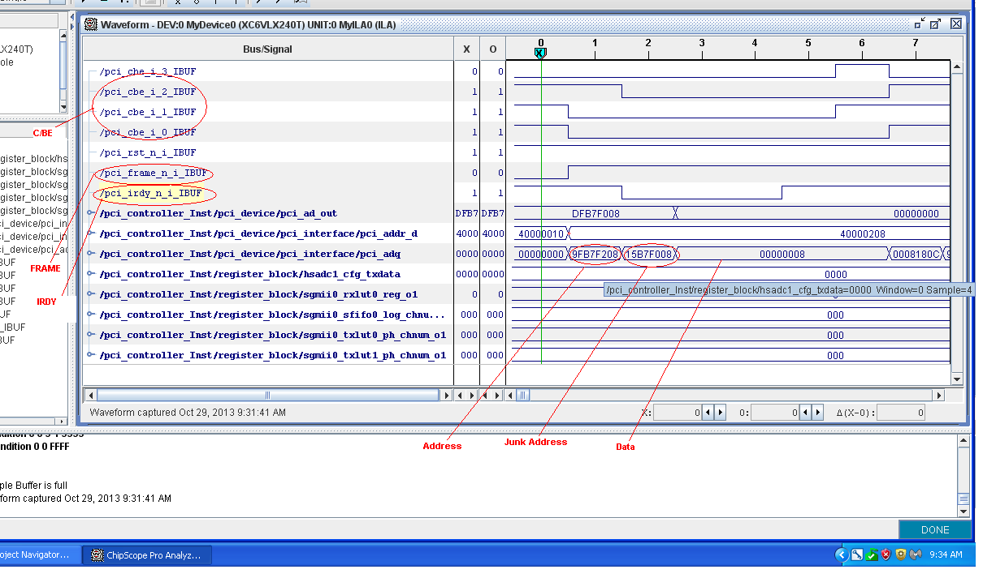
Cont..

