Slide 1
DS90UB913_4
FPD-Link III Serializer/Deserializer
Nov/21, 2014

Slide 2
DS90UB913_4
Customer Issue
part : DS90UB913QSQ&914QSQ
Description : Full-HD(frony) & HD(rear), Blackbox for CAR
Sensor : IMX122LQ2 (Front)
SER : DS90UB913,
DES : DS90UB914,
ISP : MV9351
AP : CLM972x
Sensor : ?? (ZeeAnn) (Rear)
Problem :
Occurred DES, LOCK is low. (4page)
DES-> SER->Sensor,initial and Seneor,PLCK out and then DES, Lock is Low.
2. ISP(MV9351)_I2C_SCL is Low. (5page)

Slide 3
Customer Block
SENSOR
(IMX122LQ2)
SER
(UB913)
DES
(UB914)
ISP
(MV9351)
I2C
AP
(CLM972x)
SENSOR PCLK
LOCK
SENSOR
(ZeeAnn)
SER
(UB913)
DES
(UB914)
I2C

Slide 4
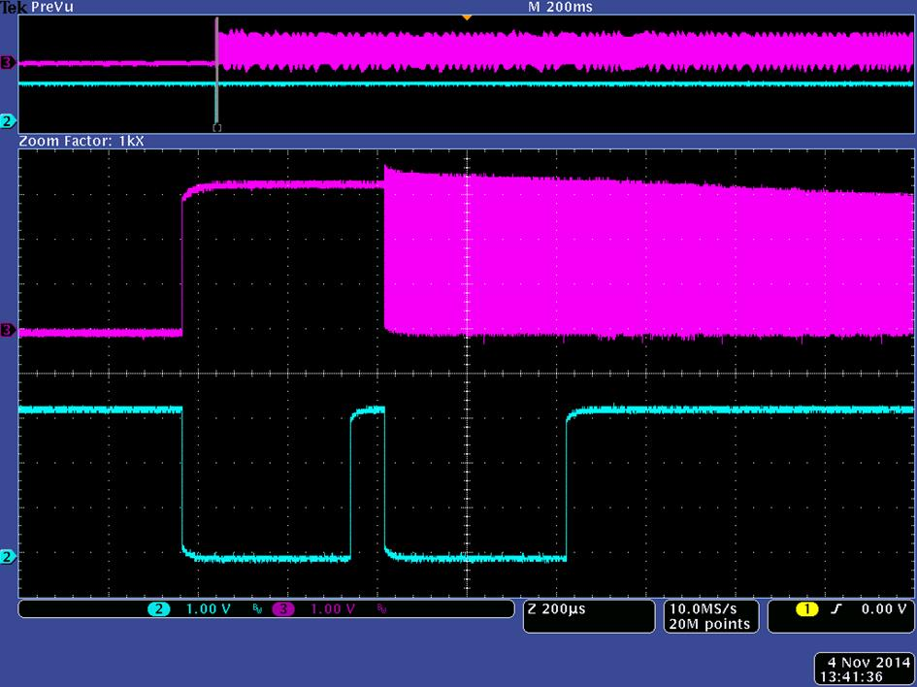
Sensor PCLK & DES_Lock

Slide 5
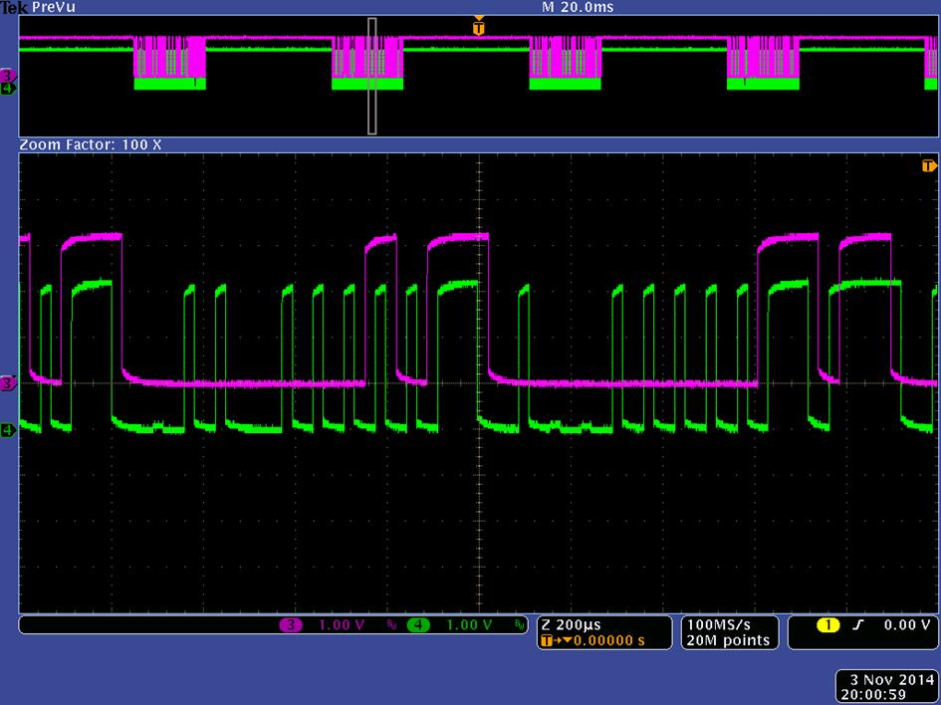
ISP(MV9351)_DES(SCL)

