Slide 1
MIPI HS to SN65LVDS100
FPGA
SN65LVDS100DGK
MIPI HS
LVDS
The simple block of this question is the above.

Slide 2
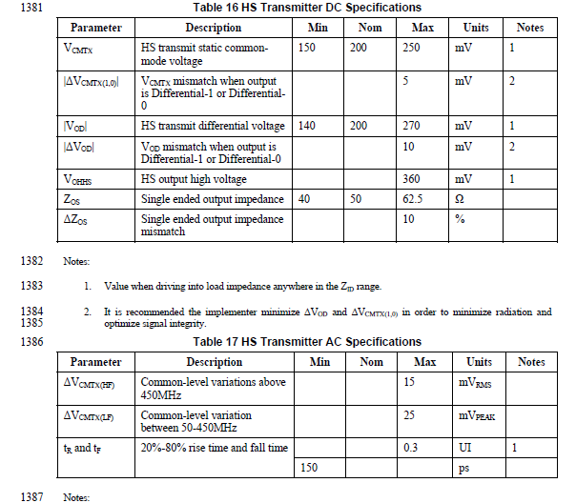
MIPI HS D-PHY specification .
Would you tell me if SN65LVDS100 is able to receive MIPI HD output with no AC coupled ?

