Slide 1
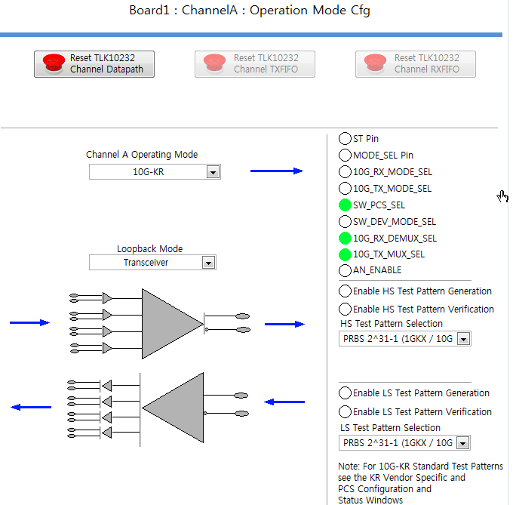
Config 1)
Disable the HS TP
that you are using now

Slide 2
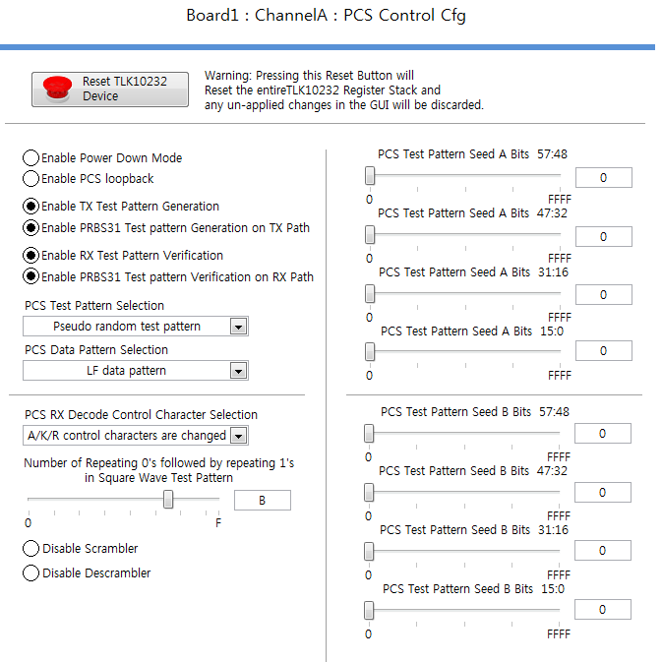
Config 2)
go to the PCS Control Cfg tab within the
GUI and active either the TX/RX Test
Pattern Generation or the PRBS31
Test Pattern Generation on TX/RX path.

Slide 3
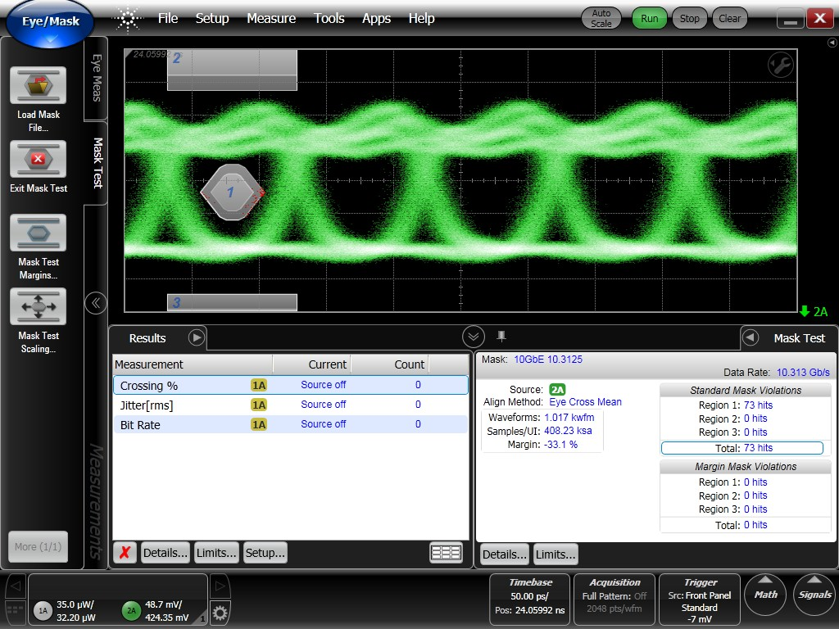
Eye pattern
Comments : A little better than before

