Slide 1
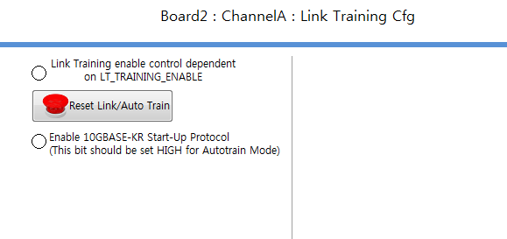
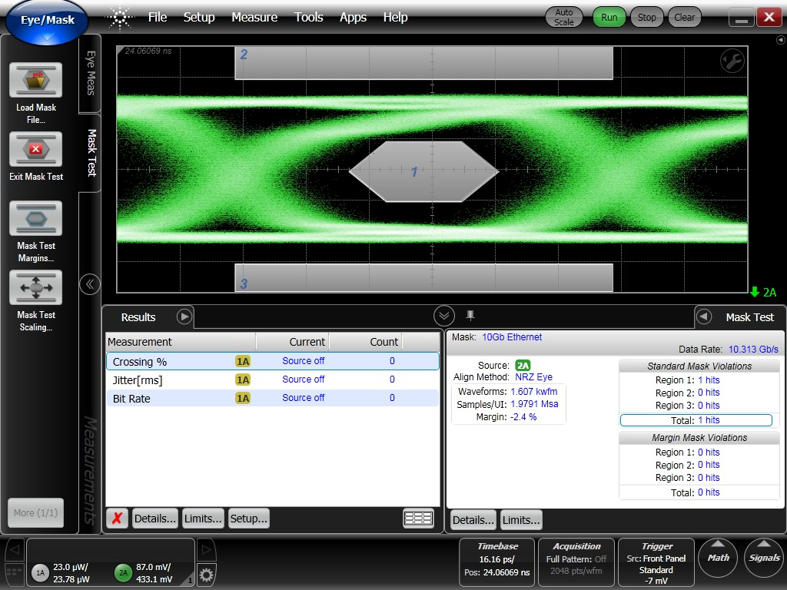
Config
disable CL72 from the high level in the Link Training Cfg tab

Slide 2
Read register 0x0f (answer)

