Slide 1
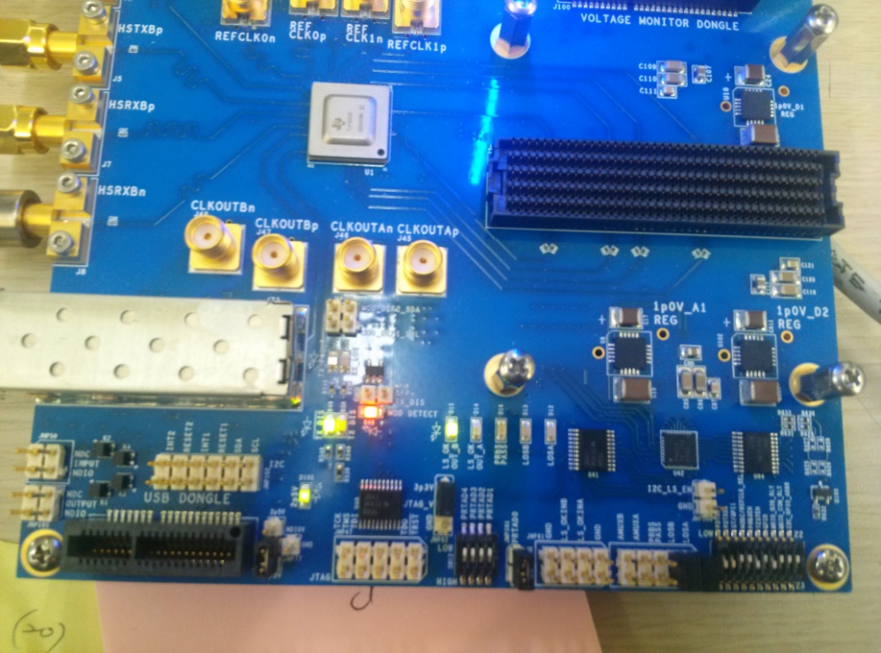
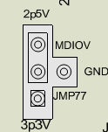
TLK10232 hardware config
a.
PDTRXA : high
PDTRXB : high
ST/GPI1 : high
MODE/RERCLK_SEL : Low
PRBSEN : Low
TESTEN : Low
GPIO : Low
MDIO_B2B_RLY : Low
MDIO_CON_RLY : Low
I2C_GPI)_ADDR : Low
Red : change config
h
g
f
e
d
c
b
a
b.
AMUXB : Open
AMUXA : Open
PRBS PASS : Open
LOSB : Short
LOSA : Short
c.
GND : Open
LX_OKINB : Open
LX_OKINA : Open
GND : Open
d.
PRTAD0 : short
PRTAD1 : Low
PRTAD2 : Low
PRTAD3 : Low
PRTAD4 : Low
e.
TCK: Open
TSM : Open
TDI : Open
TDD : Open
/TRST : Open
f.
g.
MDC: Open
INPUT: Open
MDIO: Open
MDC: Open
OUTPUT : Open
MDIC : Open
h.
INT2: Open
RESET2: Open
INT1: Open
RESET1: Open
SDA : Open
SCL : Open

Slide 2
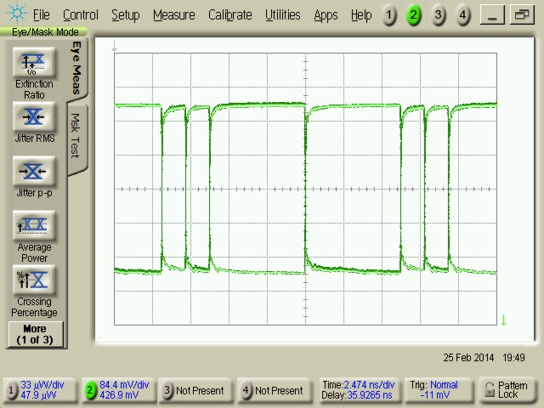
TLK10232 ( HSTXBn pattern signal)
Turn on TLK 10232 EVM (just supply voltage on EVM board )

Slide 3
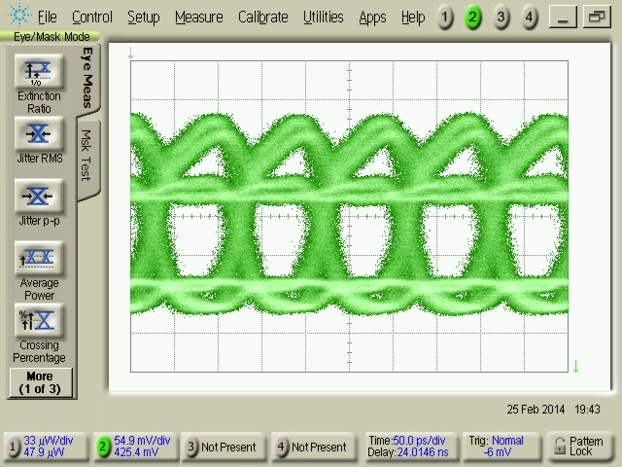
TLK10232 ( HSTXBn pattern signal)
Loading your config

Slide 4
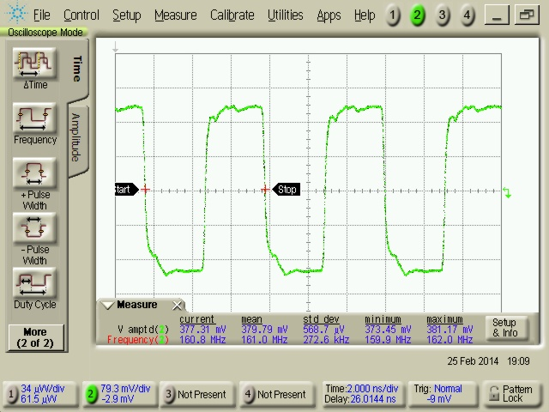
TLK10232 ( pattern signal)
Clock

Slide 5
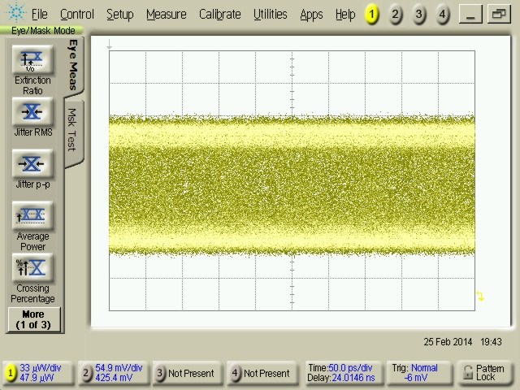
TLK10232 ( pattern signal)
SFP+ eye pattern

Slide 6
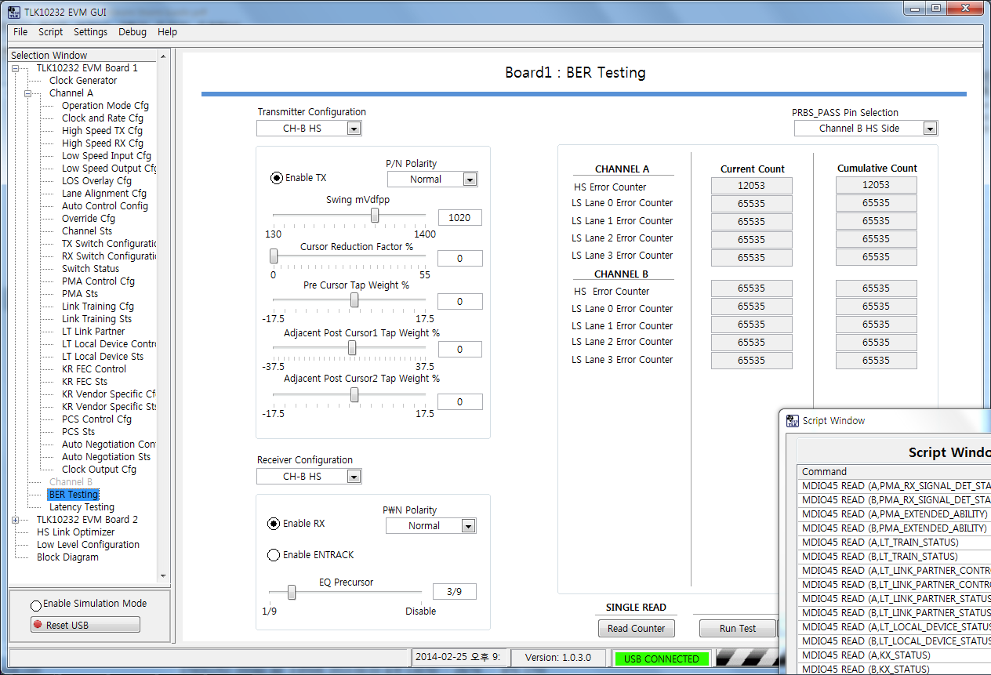
TLK10232 ( BER_Test)
I can not check BER

