Slide 1
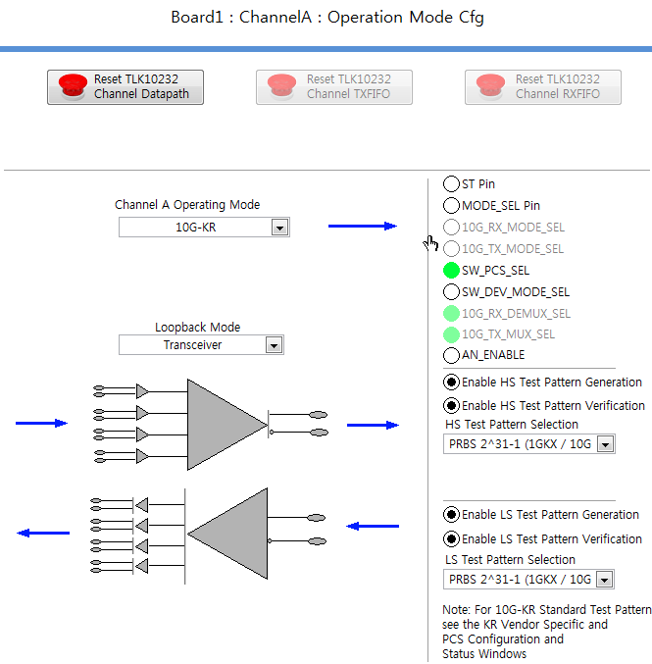
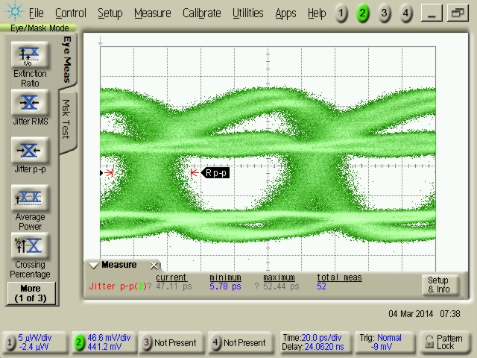
Eye pattern (10G-KR)
Auto negotiation mode have
abnormal eye pattern such as upper picture.

Slide 2
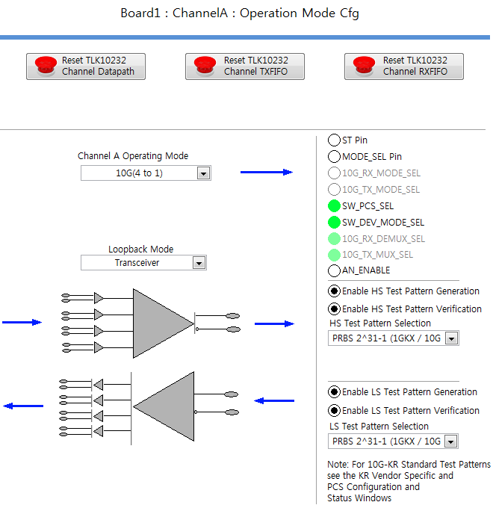
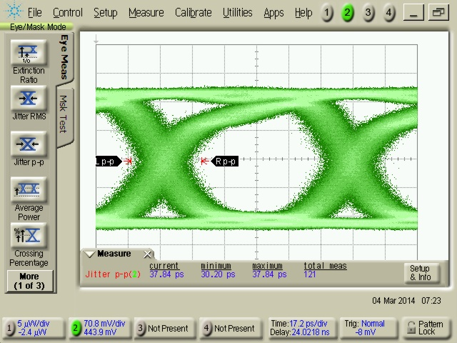
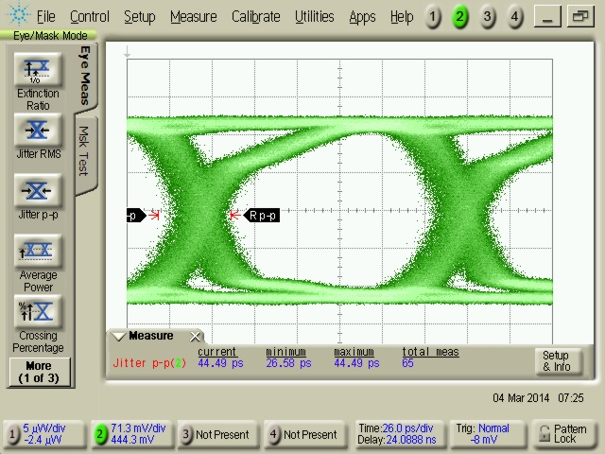
Eye pattern (10G(4 to 1)
6.144Gbps

Slide 3
Summary
Operating Mode
1) 10_KR , Auto Negotiation
=> have abnormal eye pattern
2) 10G( 4 to 1, 2to1 , 1to1 )
=> a) have normal eye pattern but there are jitter a lot
so I will test again with CDR
b) Have error bit even though connect is direct.
I will test again according to the your suggestion method.
2. Question
10_KR and Auto Negotiation have abnormal eye pattern
=> Is the hardware no problem ?

