Slide 1
DS90UB913_4 FPD-Link III Serializer/Deserializer
Nov/28, 2014

Slide 2
DS90UB913_4
Customer Issue
part : DS90UB913QSQ&914QSQ
Description : Full-HD(frony) & HD(rear), Blackbox for CAR
Sensor : IMX122LQ2 (sony) (front)
SER : DS90UB913,
DES : DS90UB914,
ISP : MV9351 (mtekvision)
AP : CLM972x (corelogic)
Sensor : ?? (ZeeAnn) (rear)
Problem :
Occurred DES, LOCK is low. (4page)
DES-> SER->Sensor,initial and Seneor,PLCK out and then DES, Lock is Low.
2. ISP(MV9351)_I2C_SCL is Low. (5page)
3. ISP(MV9351)_I2C_SCL is Low. 550~600msec. (6page)
➔ISP is not control and programming.
4.Ti-EVM & Sensor & ISP connection is same problem. (7page)

Slide 3
Customer Block
SENSOR
(IMX122LQ2)
SER
(UB913)
DES
(UB914)
ISP
(MV9351)
I2C
AP
(CLM972x)
SENSOR PCLK
LOCK
SENSOR
(ZeeAnn)
SER
(UB913)
DES
(UB914)
I2C

Slide 4
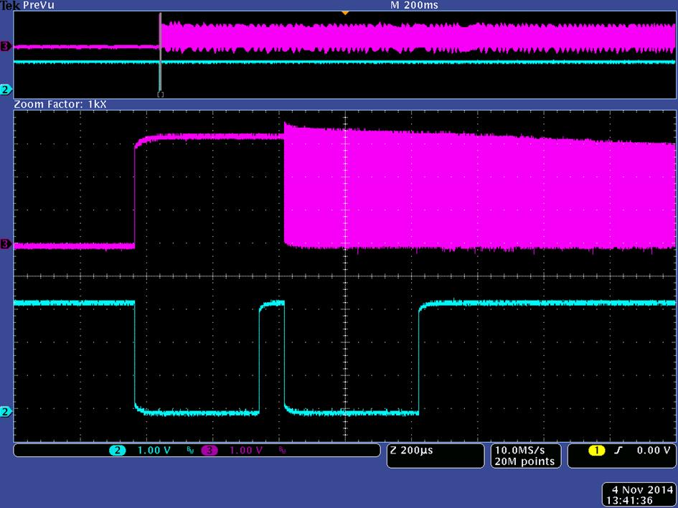
Sensor PCLK & DES_Lock
Notes:
Problem : LOCK is low.
-> I don’t know, whether this operation is right or wrong.

Slide 5
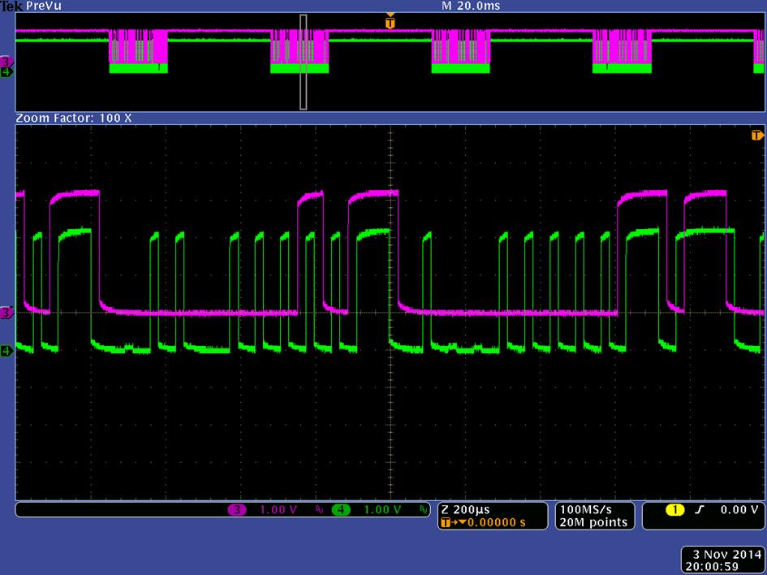
ISP(MV9351)_DES(SCL)
Notes:
Problem : ISP(MV9351),SCL is low
-> I don’t know this problem. And I doubt something wrong working of DES.

Slide 6
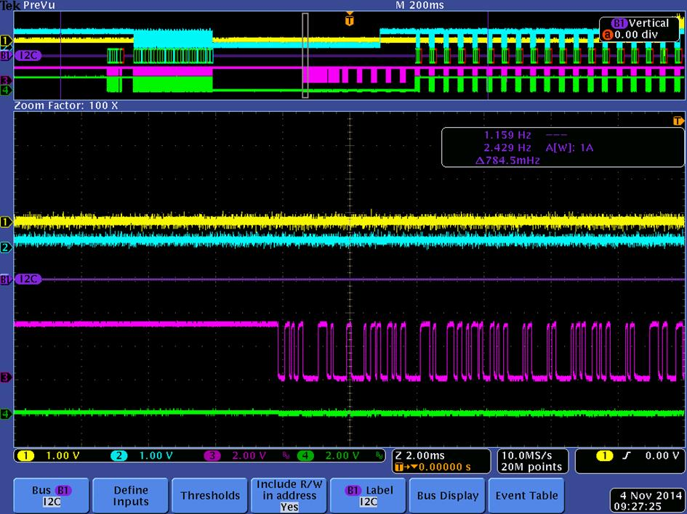
ISP(MV9351)_DES(SCL)
Notes:
Problem : ISP(SCL)
->Sensor,PCLK(on) and then ISP(MV9351),SCL is low,550~600msec.

Slide 7
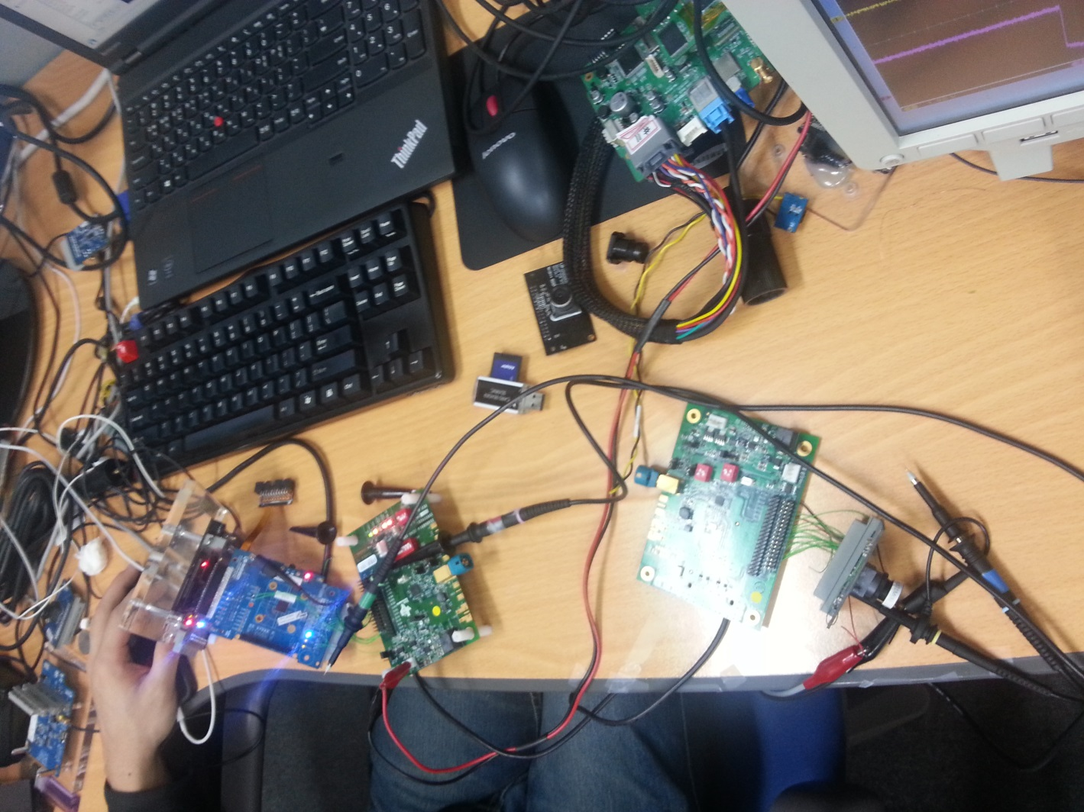
Ti-EVM & Sensor & ISP bd test

