Slide 1
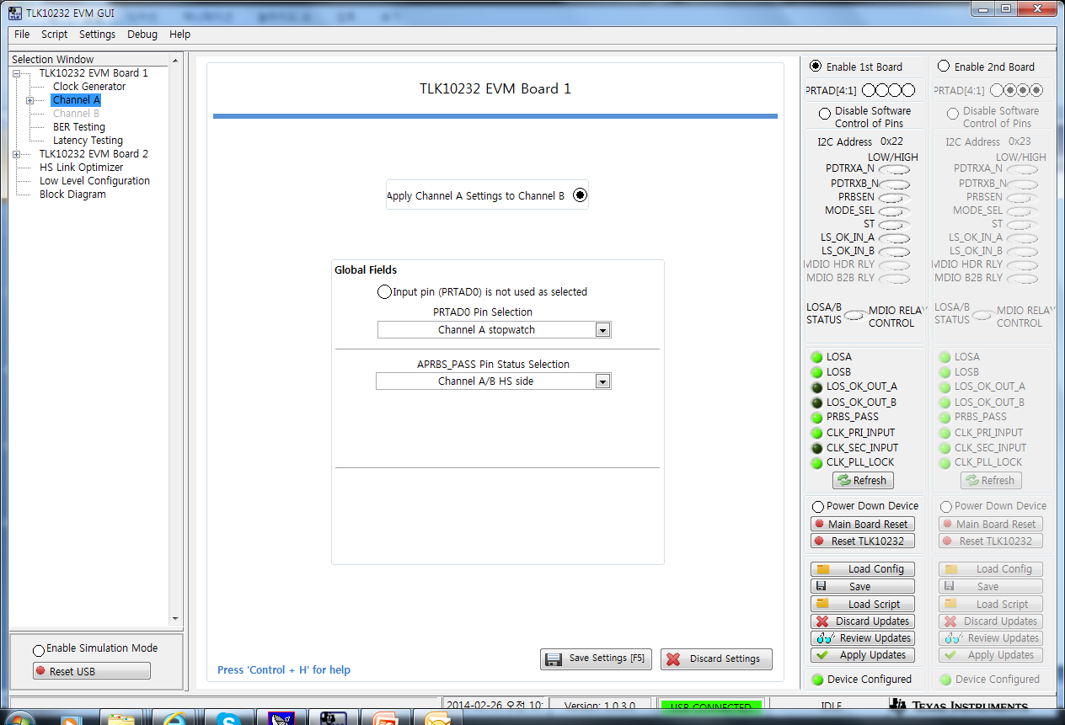
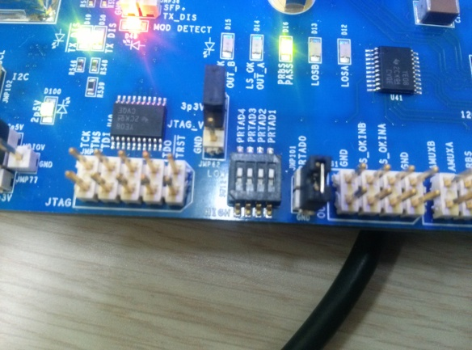
Channel sync (answer)
Check this function
PRTAD0 : short

Slide 2
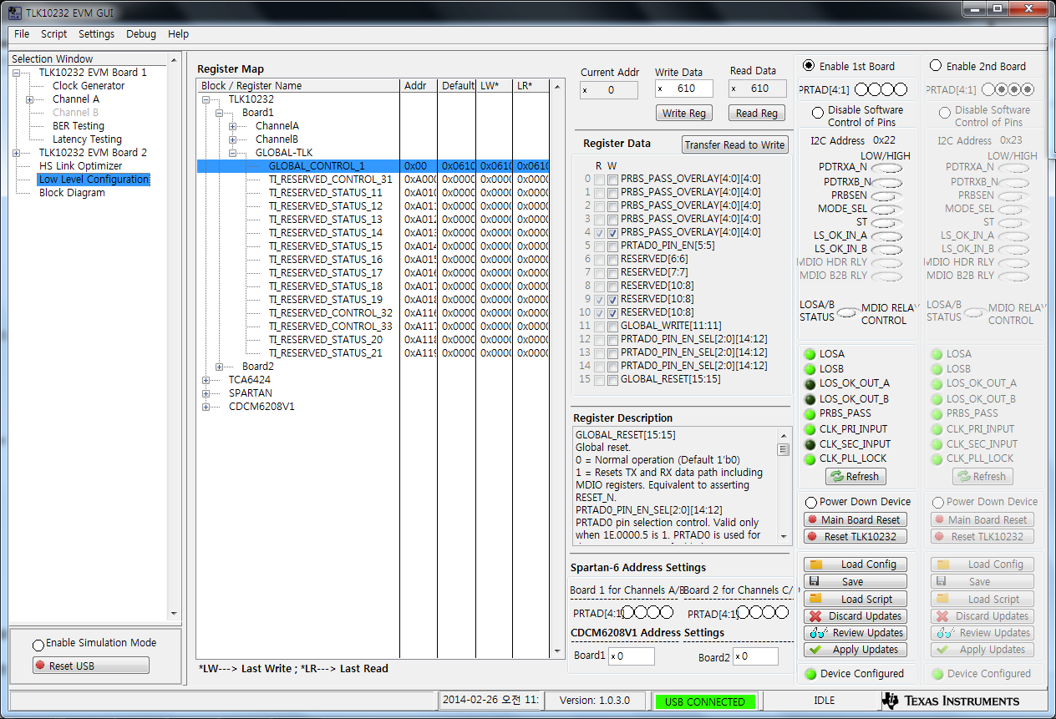
Read register 0x0f (answer)
Receiving PLL Lock

Slide 3
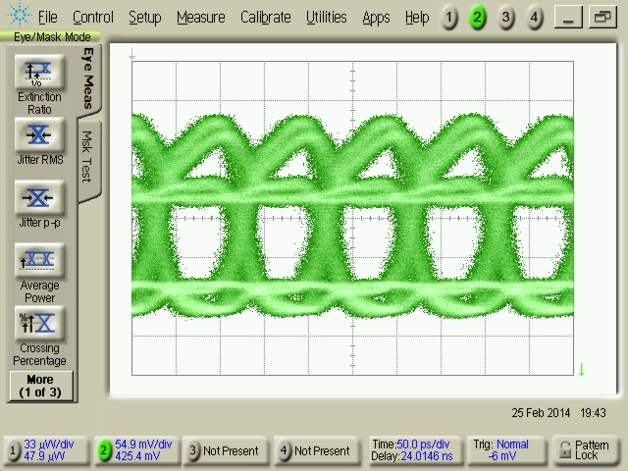
TLK10232 ( question )
Loading your config => can improve pattern signal ???
I will check again but I’d like to know your opinion that can improve ?

Slide 4
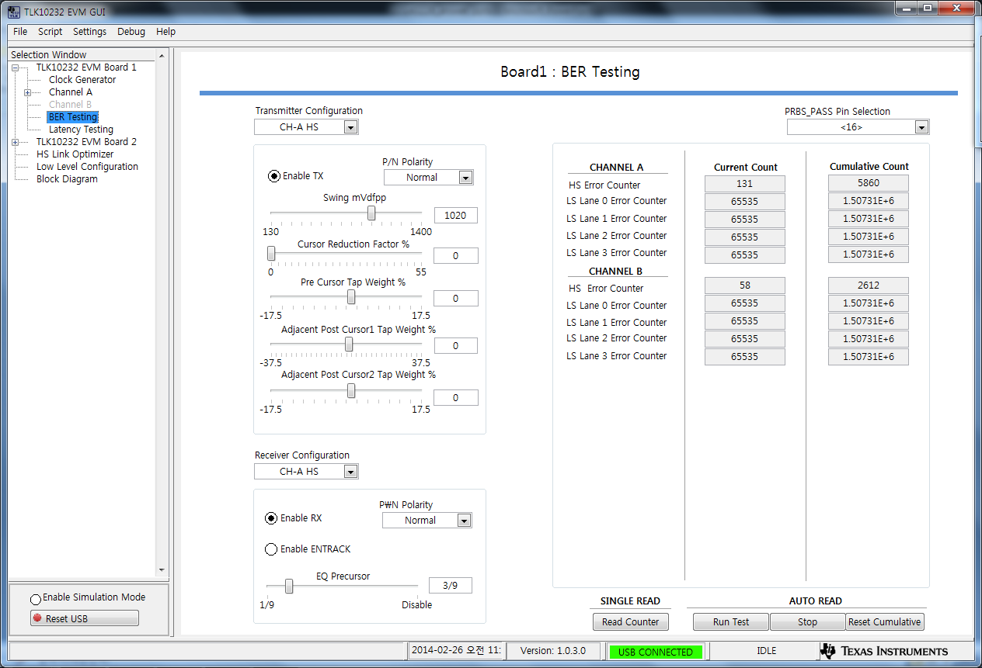
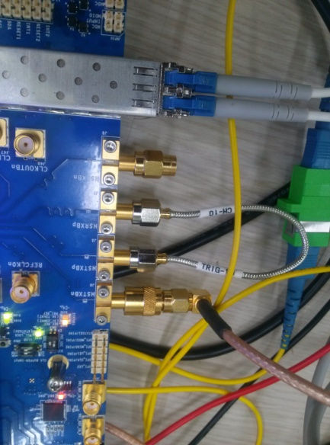
TLK10232 ( BER_Test)
Current count
I think,
Should be no error count
When I use direct connection method.
Direct Connection
HSTXBp and HSRXBp

Slide 5
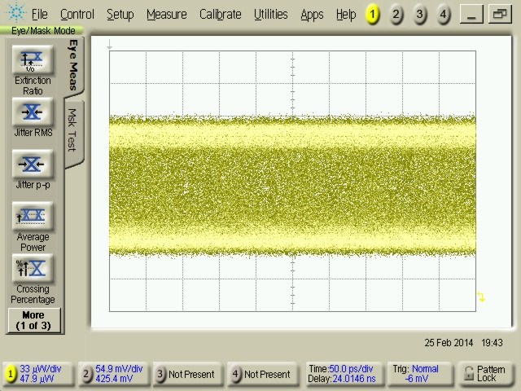
TLK10232 ( answer)
SFP+ eye pattern
Test method
DCA trigger : using TLK10232 EVM clock
Put SFP+'s Tx part(optics) in DCA optical module part.

