Slide 1
AM26LV31E Evaluation
The purpose of this experiment is to demonstrate that the AM26LV31E running at 3.3V can produce waveforms similar to AM26C31 running at 5.0V. The received signal at the termination resistor will be measured using cable lengths of 10m, 20m, and 30m. The test signal is a 10MHz 50% duty cycle clock. This is equivalent to a 20Mb/s alternating bit pattern. The test cables are standard category 5 Ethernet cables. The waveforms captured are the “A”, “B”, and “A-B” signals on oscilloscope channels “1”, “2”, and “M1” respectively.

Slide 2
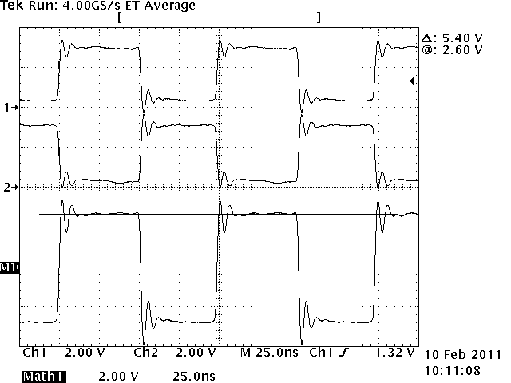
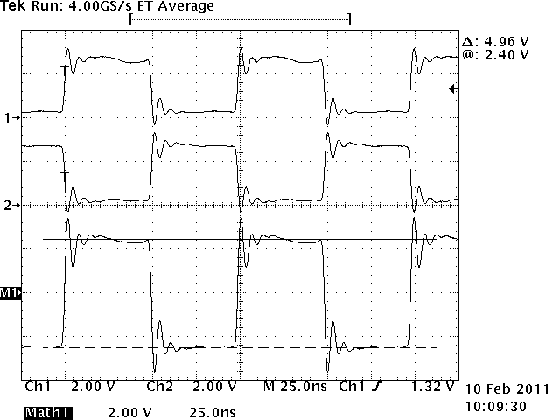
Signal Waveforms at 10 meters
AM26C31 (VCC=5.0V)
V_{OD} = +2.60V & -2.80V
Power = 165.0mW
CH1 = A input
CH2 = B input
M1 = A-B Math
AM26LV31E (VCC=3.3V)
V_{OD} = +2.40V & -2.56V
Power = 91.7mW (-44%)

Slide 3
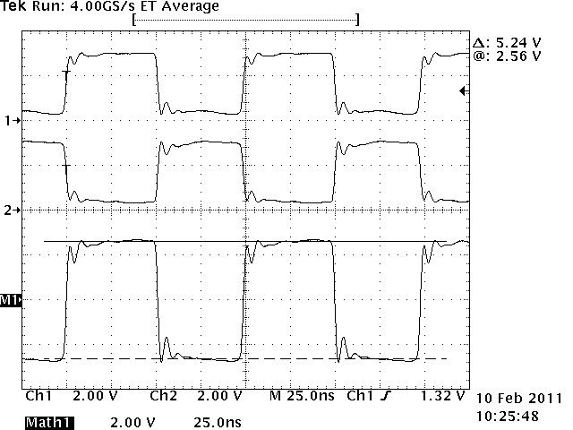

Signal Waveforms at 20 meters
AM26C31 (VCC=5.0V)
V_{OD} = +2.56V & -2.68V
Power = 163.5mW
CH1 = A input
CH2 = B input
M1 = A-B Math
AM26LV31E (VCC=3.3V)
V_{OD} = +2.32V & -2.44V
Power = 91.4mW (-44%)

Slide 4
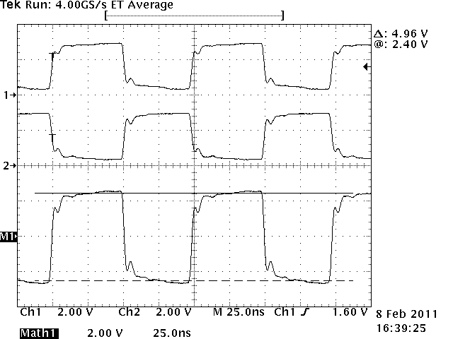
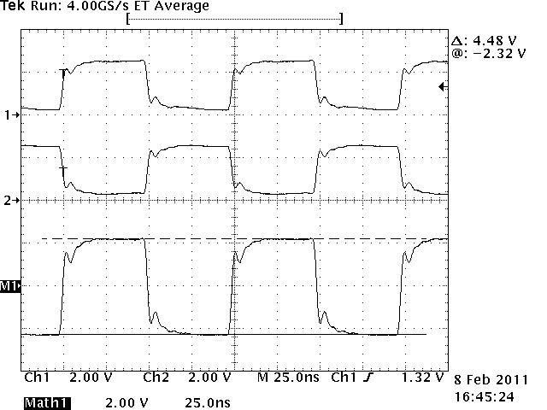
Signal Waveforms at 30 meters
AM26C31 (VCC=5.0V)
V_{OD} = +2.40V & -2.56V
Power = 170.5mW
CH1 = A input
CH2 = B input
M1 = A-B Math
AM26LV31E (VCC=3.3V)
V_{OD} = +2.16V & -2.32V
Power = 93.4mW (-45%)

Slide 5
AM26LV31E Conclusion
The supply voltage is 1.7V less on the AM26LV31E which lowers the power requirement by 44% compared to the AM26C31. The driver circuitry of the AM26LV31E provides an output signal that is RS422 compliant. The AM26LV31E output voltage levels are within a quarter of a volt from the AM26C31 levels. Even with the 30 meter cable the signal has a large voltage margin for the standard RS422 receiver sensitivity of +/-200mV.

Slide 6
Thank You!

