Slide 1


Low Power RF
RF Basics and Getting Started
May 2012
everything
Wirelessly connecting everywhere.
Notes:
1

Slide 2
Abstract
This presentation serves as an overview of the parameters and considerations a designer would use to select a low-power wireless solution.
It also highlights the devices and tools from TI and how they fit in a typical design.

Slide 3
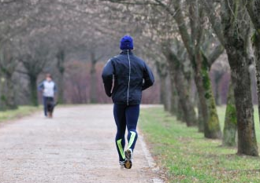



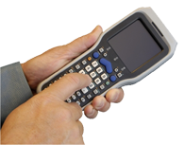


Broad range of applications
Consumer /
personal networking
Industrial remote monitoring
Shipment
monitoring
Watch/shoe combination
for monitoring of miles
and calories
Enough processing for wireless networking and batteries that 10+ years
Low power sensor networks for innovative applications like remote monitoring for stress cracks
Harvest energy from motion, vibration and heat
Information transmitted wirelessly is protected via encryption for more secure systems
Location, tamper detection and temperature monitoring
3
Notes:
3
3

Slide 4





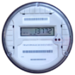






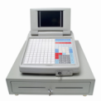
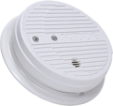
















TI’s portfolio: The industry’s broadest
13.4KHz /13.56MHz
Sub 1GHz
2.4GHz to 5GHz
Satellite
RFID
NFC
ISO14443A/B
ISO15693
SimpliciTI
6LoWPAN
W-MBus
SimpliciTI
PurePath™ Wireless
ZigBee®
6LoWPAN
RF4CE
Bluetooth® technology
Bluetooth® low energy
ANT™
Wi-Fi 802.11a/b/g/n
Wi-Fi + Bluetooth® technology
GPS
Example applications
Product line up
TMS37157
TRF796x
TRF7970
CC1101
CC1110
CC430
CC1190
CC11xL
CC112x
CC2500
CC2510
CC2590 /91
CC8520 /21
CC8530 /31
CC2520
CC2530
CC2530ZNP
CC2531
CC2533
CC2560/7
CC2540
CC2570/1
WL1271/3
WL1281/3
WL1281/3
NL5500
Notes:
4
4
4
4
4
4
4
4
4
Product portfolio
This presentation is focused on the LPRF devices (CC11xx, CC25xx)

Slide 5
Agenda
Definitions
RF Systems
Introduction to digital communication
Radio Frequency: Spectrum
Tools
Notes:
5

Slide 6
Basic system parameter definitions
RF power
  RF power is typically measured in dBm (dB relative to 1mW)
Link budget
  Difference between input sensitivity and output power in (dB)
PER
  Packet Error Rate, % of packets not successfully received
Sensitivity
  Lowest input power with acceptable link quality, typically 1% PER
Blocking/selectivity
  How well a chip works in an environment with interference
Deviation/separation
  Frequency offset between a logic ‘0’ and ‘1’ using FSK modulation
Notes:
6
RF power
Output power of LPRF systems are somewhere between -10dBm and +36dBm (0.1mW to 4000mW). Therefore measuring everything in dBm is a convenient scale and has become the “norm”
dBm (m) stands for dB as referred to mW. Therefore 0dBm becomes 1mW and 10dBm become 10mW and so on.
Link Budget
Link budget = Output power – sensitivity.
Packet Error Rate (PER)
Since most systems are packet based it is most relevant to state the sensitivity limit as Packet Error Rate. Another term used when testing the sensitivity is BER, Bit Error Rate. Typically the sensitivity limit is given for 1*E-3 bit errors.
The relation between BER and PER is: PER = 1-(1-BER)^(Packet length)
Sensitivity
Selectivity defines how well the receiver can tollerate an interferer close to the operating frequency.
Blocking/Selectivity
Blocking defines how well the receiver can tollerate an interferer far away from the operating frequency.
Deviation/separation (FDEV)
The data rate will affect the required deviation in an FSK system. Higher data rate will require higher deviation
Since the data rate affect the choice of deviation it will also affect the required RX filter bandwidth. A higher deviation requires a larger RX filter bandwidth to fit the sina. The RX filter bandwidth affects the blocking and and selectivity properties. Larger bandwitdh reduces the blocking and selectivity performance.

Slide 7
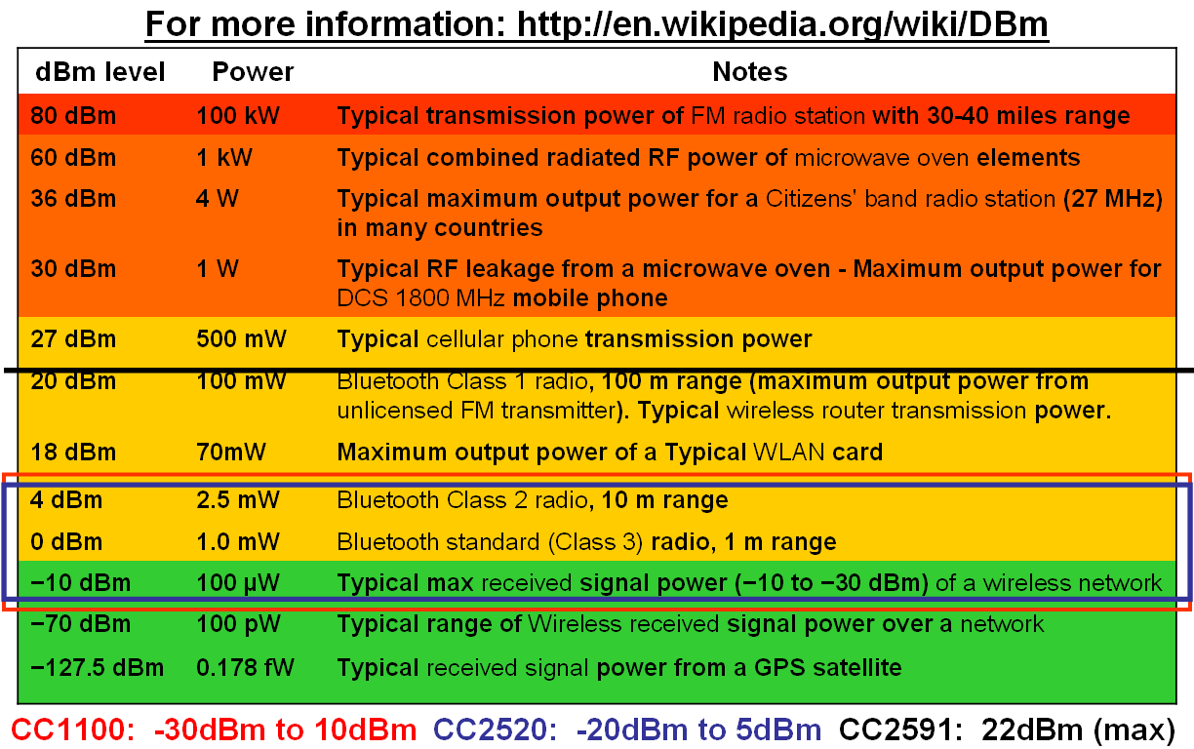
Typical power levels
dBm – power referred to 1 mW, P_{dBm}=10log(P/1mW)
  6dB increase in link budget => twice the range
Notes:
7
dBm
The key is that dBm (m) stands for dB as refered to mW. Therefore 0dBm becomes 1mW and 10dBm become 10mW and so on

Slide 8
Sensitivity and Saturation
Sensitivity
CC1120 (868/915 MHz)
Receiver Sensitivity
The minimum signal power required by receiver to demodulate the received information with less than 1% bit error rate (BER)
-103 dBm @200 kbps
-110 dBm @50 kbps
-114 dBm @4.8 kbps
-123 dBm @1.2 kbps
Saturation
Highest input power level the receiver can demodulate correctly
Data rate
Minimum useable sensitivity (ETSI EN 300 V2.3.1 limit)
10log[RX BW_{kHz}/16] – 107 dBm
Dynamic Range = Saturation - Sensitivity
Notes:
8
Receiver sensitivity
Figure to the right shows the receiver sensitivity for different datarate. Increasing the data rate reduces sensitivity.
Sensivity can be improved by narrowing the receiver bandwidth as this reduces noise coming into the receiver. However,
the datarate affects the bandwidth of the signal. Data sent with high datarates therefore requires larger RX filter bandwidth
to fit the signal. A narrow RX filter bandwidth also demands good frequency control and therefore a more expensive crystal.
The RX filter bandwidth further affects the blocking and and selectivity properties. Larger bandwidth reduces the blocking and
selectivity performance.
Saturation
Largest input power possible for the receiver. What usually happens is the input amplifier goes into saturation. Note: that the
saturation and the largest input level the receiver can tolerate before it breaks down is different.
Dynamic Range
The Dynamic range of an receiver is descirbed by ”Dynamic range=Saturation – sensitivity”.

Slide 9
Selectivity / Blocking
Describes how well interfering signals are rejected
For a receiver with very poor selectivity, frequency hopping will not help much, as even off-frequency interference is not attenuated sufficiently
Jamming signal
CC2500 performance: 31dB
Jammer is 1259 times stronger than the wanted signal
Selectivity
Desired channel
-89 dBm
Simple FM, wide bandwidth: 0dB
Frequency
31 dB ~ 36 times the distance
Frequency offset (1 MHz)
Notes:
9
Receiver Selectivity and Blocking
Adjacent and alternate channel selectivity measure the receiver’s ability to process a desired signal
while rejecting a strong signal in an adjacent channel (one channel away) or alternate channel (usually two
channels away). The selectivity tests are very important for communications receivers in which channel
spacings are narrow and adjacent and alternate channel power is hard to control (for example, Specialized
Mobile Radio, or SMR). An adjacent and alternate channel selectivity test setup is shown in Figure 14. One signal
generator inputs a test signal at the desired channel frequency at a level relative to the sensitivity of the
receiver (usually 3 dB above). (http://cp.literature.agilent.com/litweb/pdf/5968-3579E.pdf )

Slide 10
Agenda
Definitions
RF Systems
Introduction to digital communication
Radio Frequency: Spectrum
Tools
Notes:
10

Slide 11


Typical Decision Parameters
Highest Data Rate
  WLAN/UWB (Video)
  CC8520 wireless audio
  Bluetooth (Audio)
Highest Battery Life
  CC430/SimpliciTI
  ZigBee/802.15.4
  Bluetooth Low Energy
  ANT+
Longest Range
  CC112x based Sub1GHz solutions
  CC430/CC1101 based Sub1GHz solutions
Notes:
11

Slide 12
Basic Building Blocks
RF-IC
  Transmitter/Reciever
  Transceiver
  System-on-Chip (SoC); typically
  transceiver with integrated
  microcontroller
Crystal
  Reference frequency for the LO and the carrier frequency
Balun and Matching
  Balanced to unbalanced
  Impedance matching circuit
Filter
  Used if needed to pass regulatory requirements / improve selectivity
Antenna
Notes:
12
RF-IC. Several factors should be considered when chosing which RF-IC to use.
Available board space -> SoC or two chip solution
One or two way protocol -> Transnmitter or tranceiver
Required range -> Operating frequency
Where is the product going to be sold. The frequency bands that can be used for SRD and ISM band devices differ around the world -> Operating frequecny
Standard or propriatary system -> IEEE 15.4 compliant radio or propriatary radio
Choise of crystal.
Accuracy
Load capasitance
Frequency
See data sheet for requirements
Balun, Matching and Filter
Texas Instruments provides a reference design for all Chipcon products.
The reference design shows how the balun, matching and filter should be implemented
Make an exact copy of the reference desingn to ensure optimum performance
Antenna
Mainly three different antenna types are being used, chip antenna, PCB antenna and whip antenna
Several antenna reference designs can be found on www.ti.com/lpw

Slide 13
Typical RF-IC block diagram
16 bit ULP MCU running from ROM
=>new performance features: RX sniff mode, eWor
Full digital signal processing
=>stable performance over temperature, voltage and process variation
Ultra low phasenoise synth
=> Full RF regulatory compliance
90dB dynamic range ADC
=> Enables filtering of strong interferers with accurate digital filters
Notes:
13

Slide 14
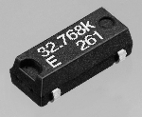


Crystals
Provides reference frequency for Local Oscillator (LO) and the carrier frequency
Important characteristics:
  Price, often a price vs. performance trade-off
  Size
  Tolerance[ppm], both initial spread, ageing and over temperature
Notes:
14
To express Crystal parameters a standard notation of the following form is often used:
A/B/C/D-E
A = Calibration tolerance, expressed in parts per million (ppm)
B = Temperature stability over the temperature range, expressed in parts per million (ppm)
C = Operating temperature range
0 = 0 to +50°C
10 = -10 to +60°C
20 = -20 to +70°C
30 = -30 to +80°C
40 = -40 to +90°C
55 = -55 to +105°C
D = Circuit condition. A number specifies parallel resonance with a load capacitance in pF. SR denotes Series Resonance.
E = Operating mode of crystal, where:
F = fundamental mode
3 = third overtone
Examples
30/50/10/30-F denotes a crystal with ±30ppm calibration tolerance, a temperature stability of ±50ppm over temperature range -10+60°C, 30pF load capacitance and operating in fundamental mode.
Cost vs. performance
Using inaccurate crystals will require larger RX bandwidth to compensate for frequency drift. Larger RX bandwidth results in more noise in the receiver chain and thus reduced sensitivity. Accurate crystals are expensive, thus choosing a crystal is a trade off between cost and performance.
The inaccuracy of a device operating 868 MHz with a ± 10 ppm crystal is: 868 * 10 = ± 8.68 kHz

Slide 15
Crystal Accuracy
Compromise between RF performance and crystal cost
Receiver channel filter BW
-2·X ppm
0
+2·X ppm
Frequency offset
Total error of 4·X ppm
Less expensive crystals can be used IF the system employs a frequency calibration / correction
Notes:
15
Wider RX filter BW means reduced sensitivity and close-in selectivity
Wider RX filter BW also means that temperature compensation might not neccessary
Wider receiver filter bandwidth allows cheaper (i.e. less accurate) crystal to be used
Note: for true narrowband systems (ARIB and ETSI) the crystal accuracy is set by regulations (±4 ppm and ±5.7/2.8 ppm respectively)

Slide 16
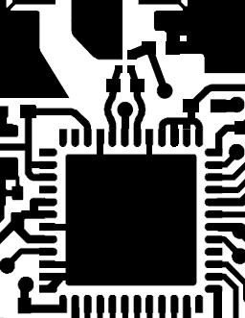
Balun and Matching circuit
Microstrip delay line
There are different balun implementations
  Trade-off: PCB area versus cost
Discrete balun
IC balun
Notes:
16
Balun and matching circuit
There are three common ways of matching any LPRF device into an antenna.
Discrete balun
Reference design includes a discrete balun, this approach is a compromise between performance,
Ease of use and price. They are implemented using a matched series of L’s and C’s.
IC balun
The easiest solution is to use an IC balun from vendors like Johanson, Murata or Anaren. They tend to have
Very good performance (most of the time still does not beat the discrete solution) and are by far the smallest
Solution. However they are also typically the most expensive solution to implement.
Microstip delay line balun
Not very common, very depending on PCB technology and typically very large. (Consumes too much board space)
However if size is not an issue and PCB cost is low (Simple FR4) this option could become very cheap.

Slide 17
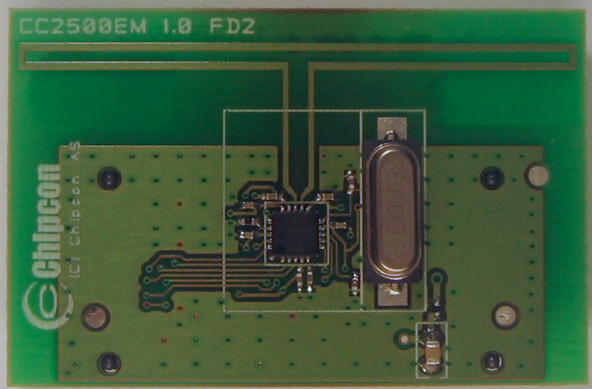
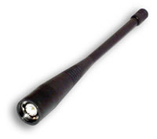
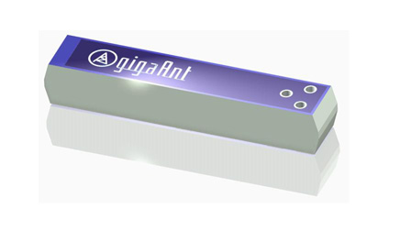
Antennas, commonly used
PCB antennas
  Little extra cost (PCB)
  Size demanding at low frequencies
  Good performance possible
  Complicated to make good designs
Whip antennas
  Expensive (unless piece of wire)
  Good performance
  Hard to fit in may applications
Chip antennas
  Expensive
  OK performance
  Small size
Notes:
17
The antenna is VERY important if long range is required
A quarter wave antenna is an easy and good solution, but it is not small, 16.4 cm at 433 MHz 8.2 cm
at 868 MHz. It is possible to curl up such an antenna and make a helical antenna. This is often a good
solution since it utilizes unused volume for a product. Another solution if there is little space available
for the antenna is to use a chip antenna.
The cheapest solution is to use a PCB antenna. This is an antenna that is implemented by traces on the
PCB. Texas Instruments offers several PCB antenna reference designs that can be used with Chipcon
products. These reference designs can be downloaded from www.ti.com/lpw.
Designing good antennas can be difficult. It is therefore recommended to contact an antenna expert if
a custom antenna design is needed.

Slide 18
Agenda
Definitions
RF Systems
Introduction to digital communication
Radio Frequency: Spectrum
Tools
Notes:
18

Slide 19
Wireless Communication Systems
Notes:
Block diagram of a Wireless Communications system
Here is very simple block diagram of a typical wireless communication system, the transmitter is on top.
Where you see a data input and RF carrier input to a modulator. The modulation essentialy mixes the two
signals and thereby ”modulates” the RF carrier with the ”wanted signal”. This combined signal is then
amplied and transmitted thru a wireless commulation channel ( typically air, but it could be others too ).
Then the reciever gets a strongly attenuated version of the signal and tries to recover the wanted signal.
First its amplifed, they demodulated (various methods can be used, but now a days its typically done but
high speed ADC and DSP’s...

Slide 20
Modulation Methods
Starting point: We have a low frequency signal and want to send it at a high frequency
Modulation: The process of superimposing a low frequency signal onto a high frequency signal
Three modulation schemes available:
  Amplitude Modulation (AM): the amplitude of the carrier varies in accordance to the information signal
  Frequency Modulation (FM): the frequency of the carrier varies in accordance to the information signal
  Phase Modulation (PM): the phase of the carrier varies in accordance to the information signal
Notes:
There are three basic types of modulation techniques, but we will focus on the two most common in LPRF. (AM and FM modulation)

Slide 21
Digital Modulation – ASK
Amplitude Shift Keying (ASK/OOK):
Pros: simple, duty cycling (FCC), lower transmit current
Cons: susceptible to noise, wide spectrum noise
Rise and fall rates of the carrier's amplitude can be adjusted to reduce the spectrum noise at low to medium data rates.
  This is called Shaped OO
Common Use: Many legacy wireless systems
vcc
0
1
0
1
OOK
ASK
Vm(t)
PA
Signal Space Diagram
Each axis represents a ‘symbol’
OOK has two symbols: carrier & no carrier
Distance between symbols predicts BER
AM = analog message Vm(t)
ASK/OOK = digital message Vm(t)
Notes:
AM modulation
A very simple form of signal modulation. The PA of the transmitting system is turn ‘on’ and ‘off’ with the incoming bits ‘1’ becomes ‘on’ and ‘0’ becomes ‘off’.
OOK (on-off keying) means that the transmitter does not transmit any signal during period of ‘0’ and full power ‘1’
ASK (amplitude shift keying) means the that the transmitter changes between 100% output power and a some values more than 0%, but typically low like 10%. This is typically a little more immune to noise.

Slide 22
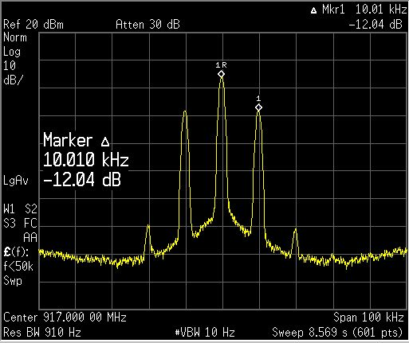
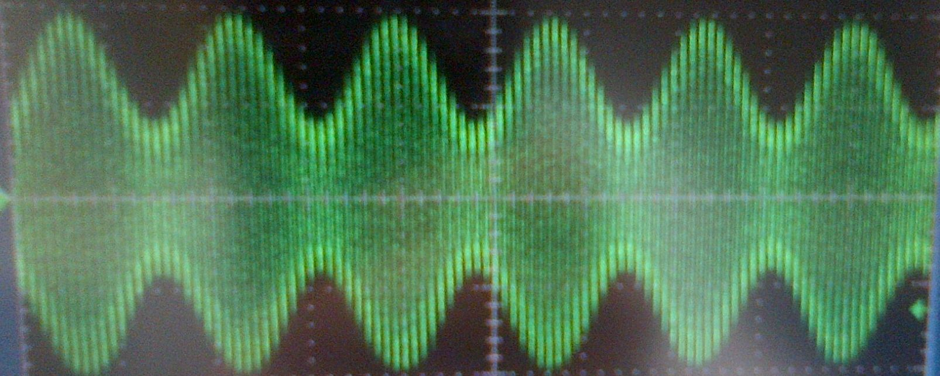
Amplitude Modulation (lab)
Amplitude Modulation
  915MHz, 10kHz modulation sine wave
AM– 50% in Time Domain
AM– 50% in Frequency Domain
22

Slide 23
AM modulator (sim)
250kbps OOK modulation
  99% OCBW = 1754kHz
  90% OCBW = 229kHz
  Average TX current = 50%
  ACI = ~50dBc (1MHz off)
Notes:
AM modulation analysis at 250kbps
Here we have a 250kbps OOk (On-OFF keyed) modulation signal. As seen in the upper right hand
corner the modulation is not filtered and in this case you see instantaneous transitions between “1” and “0” symbols
This leads to spectral re-growth as shown in the lower left hand side. The FFT shows a lot of side lobes.
The last image show what would happen if you had 3 such system operation with a spacing of 1MHz.
Matlab code to make the graphs
clear; %% Clear all variable in memory
%% close all %% Close and delete all figures open
%% Setup the basic modulation parameters
r_b = 250000; %% The symbol rate of the modulator (symbol rate = bit rate for 2FSK/BPSK systems)
freq_dev = 125000; %% For FM modulation this specifies the maximum frequency deviation
channel_spacing = 1000000; %% Defines the channel spacing for ploting adajacent channels
nbits = 200; %% number of bits to be used in each burst of data
nbursts = 100; %% number of bursts to use for averaging (above 10 starts getting slow)
detail_plots = 0; %% Detailed modulation plots for each burst (much slower operation)
discrete_filter = 0; %% uses discrete values filters for the Gaussian filtering
%% Specify the oversampling used for each bit and each IF cycle
OS_rb = 8; %% Specify the oversampling rate of each symbol (BFSK : Bit rate = Symbol rate)
OS_if = 32; %% Specify the oversampling rate of the IF frequency calculation
%% Select which type of modulation to use based on the selection above
%% 1 = 'OOK' 2 = 'ASK' 3 = '2FSK'
%% 4 = '4FSK' 5 = '8FSK' 6 = '16FSK'
%% 7 = 'BPSK' 8 = 'QPSK' 9 = '8PSK'
%% 10 = '16PSK' 11 = 'MSK' 12 = 'O-QPSK
%% 13 = 'O2-QPSK' 14 = '16QAM' 15 = '256QAM'
Modulation_Type = 1;
%% Select which type of IF filtering that is needed
%% 1 = 'None' %% 2 = 'Gaussian'
%% 3 = 'RaisedCosine' %% 4 = 'HalfSine'
%% 5 = 'HalfSine _ Halfwidth'
Transmit_Filter_Type = 1;
%% Select which type of data to be used
%% 1 = 'Random data' %% 2 = 'All ones'
%% 3 = 'All zeros' %% 4 = '1/2*nbits of 0's and 1/2*nbits of 1's'
%% 5 = 'alternating 1,0's of size nbits'
%% 6 = 'Standard GSM burst' %% 7 = 'Standard DECT burst'
%% 8 = 'Zigbee (CCSS 16 codes - O-QPSK)'
InputDataType = 1;
Add_Noise=0; %% 0 = 'No noise added'
%% > 0 = Specify the SNR of the AWGN noise
%% to add
FFT_Windowing = 2; %% 1 = 'None'
%% 2 = 'Hanning'
%% 3 = 'Blackman'
RX_Bandwidth = 0; %% 0 = 'No RX bandwidth limitations = if no noise this should be default'
%% >0 = 'RX Bandwidth in Hertz'
%% Calculate basic modulation paramters based on input given above
OS_G = OS_if*OS_rb; %% Calculates the required oversampling of the filter function
Tb = 1/r_b; %% Calculate the bit time (in seconds)
mi = freq_dev/r_b; %% Calculate the modulation index based on freq dev and bit rate
%% Select whether the IQ modulation scheme is used or just a basic FM transmitter
switch Modulation_Type
case 1
IQ_MOD = 0; %% 1 = 'OOK'
symbol_map = 2;
nsymbols = nbits;
case 2
IQ_MOD = 0; %% 2 = 'ASK'
symbol_map = 2;
nsymbols = nbits;
case 3
IQ_MOD = 0; %% 3 = '2FSK'
symbol_map = 2;
nsymbols = nbits;
case 4
IQ_MOD = 0; %% 4 = '4FSK'
symbol_map = 4;
nsymbols = nbits / 2;
case 5
IQ_MOD = 0; %% 5 = '8FSK'
symbol_map = 8;
nsymbols = nbits / 3;
case 6
IQ_MOD = 0; %% 6 = '16FSK'
symbol_map = 16;
nsymbols = nbits / 4;
case 7
IQ_MOD = 1; %% 7 = 'BPSK'
symbol_map = 2;
nsymbols = nbits;
case 8
IQ_MOD = 1; %% 8 = 'QPSK'
symbol_map = 4;
nsymbols = nbits / 2;
case 9
IQ_MOD = 1; %% 9 = '8PSK'
symbol_map = 8;
nsymbols = nbits / 3;
case 10
IQ_MOD = 1; %% 10 = '16PSK'
symbol_map = 16;
nsymbols = nbits / 4;
case 11
IQ_MOD = 1; %% 11 = 'MSK'
symbol_map = 2;
nsymbols = nbits;
case 12
IQ_MOD = 1; %% 12 = 'O-QPSK'
symbol_map = 4;
nsymbols = nbits / 2;
case 13
IQ_MOD = 1; %% 13 = 'O2-QPSK'
symbol_map = 4;
nsymbols = nbits / 2;
case 14
IQ_MOD = 1; %% 14 = '16QAM'
symbol_map = 16;
nsymbols = nbits / 4;
case 15
IQ_MOD = 1; %% 15 = '256QAM'
symbol_map = 256;
nsymbols = nbits / 8;
end
%% Initialize array to zeros. This speeds up data processing of large arrays of data
if_data = zeros(1,nsymbols*OS_if * OS_rb); %%
tt_data = zeros(1,nsymbols*OS_if * OS_rb); %% time array for if data array
ff_data = zeros(1,nsymbols*OS_if * OS_rb); %% fft array of if data
fm_data = zeros(1,nsymbols*OS_if * OS_rb); %% modulation data
mif_data = zeros(1,nsymbols*OS_if * OS_rb); %% modulation data
IntQfi = zeros(1,nsymbols*OS_if * OS_rb); %% Running integration of modulation data
IntIfi = zeros(1,nsymbols*OS_if * OS_rb); %% Running integration of modulation data
%% Precalculate the filter functions used by the modulation schemes (Gaussian, Box, RaisedCosine, HalfSine)
G_L = 5;
G = Gauss(0.5, Tb, OS_G, G_L); %% Calculate the Gaussian transfer function
G = (pi/2)*OS_rb*G; %% scale the pulse such that we get pi/2 delta for each symbol
RC = RaisedCosine(0.5, G_L, OS_G);
RC = (pi/2)*OS_rb*RC; %% scale the pulse such that we get pi/2 delta for each symbol
HS = HalfSine2(G_L, OS_G);
HS = (pi/2)*OS_rb*HS; %% scale the pulse such that we get pi/2 delta for each symbol
HS2 = HalfSine(G_L, OS_G);
HS2 = (pi/2)*OS_rb*HS2; %% scale the pulse such that we get pi/2 delta for each symbol
figure(1)
for n=1:length(G),
tt(n) = n/OS_G - length(G)/OS_G*0.5;
end
plot(tt,G,'bo-');
hold on
if(discrete_filter == 1)
for n=2:length(G)
if(floor(n/OS_if) ~= n/OS_if)
G(n) = G(n-1);
end
end
plot(tt,G,'mo-');
end
plot(tt,HS(1:length(G)),'g');
plot(tt,RC(1:length(G)),'r');
grid on
xlabel('time, t')
ylabel('amplitude, g(t)')
title('Time domain waveform of pulse shaping filters')
Trim_GL = G_L - 0.5;
box = [zeros(1,Trim_GL*OS_G) ones(1,OS_G) zeros(1,Trim_GL*OS_G)];
box = (pi/2)*OS_rb*box/sum(box); %% scale the pulse such that we get pi/2 delta for each symbol
%% Precalculate the FFT windowing functions to use
%% The final length of the array will be : nsymbols*OS_G
if (FFT_Windowing == 1)
FFT_Window = ones(1,nsymbols*OS_G);
end
if (FFT_Windowing == 2)
FFT_Window = hanning(nsymbols*OS_G)';
end
if (FFT_Windowing == 3)
FFT_Window = blackman(nsymbols*OS_G)';
end
%% For Each burst perform the task of modulating the data and store
%% averages for later analysis
for bb=1:nbursts
fprintf('Burst number : %d\n', bb);
if(InputDataType == 1) %% random data sequence
an = floor(symbol_map*rand(1,nsymbols))/(symbol_map-1);
end
if(InputDataType == 2) %% 1/2 sequence of 1's and 1/2 sequence of 0's
for i=1:nsymbols
an(i) = 1;
end
end
if(InputDataType == 3) %% 1/2 sequence of 1's and 1/2 sequence of 0's
for i=1:nsymbols
an(i) = 0;
end
end
if(InputDataType == 4) %% 1/2 sequence of 1's and 1/2 sequence of 0's
for i=1:nsymbols/2
an(i) = 1;
end
for i=nsymbols/2:nsymbols
an(i) = 0;
end
end
if(InputDataType == 5) %% Alternating 1,0,1,0 sequence of nsymbols
for i=1:2:nsymbols
an(i) = 0;
an(i+1) = 1;
end;
end
if(InputDataType == 6) %% GSM formatted data sequence
nsymbols = 144;
D_field1 = round(rand(1,58));
D_field2 = round(rand(1,58));
%% Definition of the 8 different training sequnces
%% (including control bits) used in the normal burst.
%% These training sequences are defined in GSM 05.02 on page 12.
%% {{0,0,0,1,0,0,1,0,1,1,1,0,0,0,0,1,0,0,0,1,0,0,1,0,1,1,1,0},
%% {0,0,0,1,0,1,1,0,1,1,1,0,1,1,1,1,0,0,0,1,0,1,1,0,1,1,1,0},
%% {0,0,1,0,0,0,0,1,1,1,0,1,1,1,0,1,0,0,1,0,0,0,0,1,1,1,0,0},
%% {0,0,1,0,0,0,1,1,1,1,0,1,1,0,1,0,0,0,1,0,0,0,1,1,1,1,0,0},
%% {0,0,0,0,1,1,0,1,0,1,1,1,0,0,1,0,0,0,0,0,1,1,0,1,0,1,1,0},
%% {0,0,1,0,0,1,1,1,0,1,0,1,1,0,0,0,0,0,1,0,0,1,1,1,0,1,0,0},
%% {0,1,0,1,0,0,1,1,1,1,1,0,1,1,0,0,0,1,0,1,0,0,1,1,1,1,1,0},
%% {0,1,1,1,0,1,1,1,1,0,0,0,1,0,0,1,0,1,1,1,0,1,1,1,1,0,0,0}};
%% we are only using the first sequence in the following demostration
SyncWord = [0 0 0 1 0 0 1 0 1 1 1 0 0 0 0 1 0 0 0 1 0 0 1 0 1 1 1 0];
an = [D_field1 SyncWord D_field2];
end
if(InputDataType == 7) %% DECT formatted data sequence
%% 2FSK modulator with 1152kb/s bit rate
%% 288kHz deviation and 0.5Tb Gaussian filter
%% The following setting have been tested
%% r_b = 1152000;
%% freq_dev = 288000;
%% channel_spacing = 2000000;
%% nbits = 434;
%% Modulation_Type = 3;
%% Transmit_Filter_Type = 2;
D_field = round(rand(1,388));
SyncWord = [0 1 0 0 0 1 0 1 0 1 1 0 1 1 1 1 1 1];
Preamble = [0 1 0 1 0 1 0 1 0 1 0 1 0 1 0 1 0 1 0 1 0 1 0 1 0 1 0 1];
an = [Preamble SyncWord D_field];
end
if(InputDataType == 8) %% Zigbee formatted data sequence
zigbee_bits = nsymbols/8;
n_nibble = ceil(zigbee_bits/4); %% we need to make sure that we have 4 bits aligned data
D_field = round(rand(1,4*n_nibble)); %% aligning to 4 bits
an = 0;
for jj=1:4:zigbee_bits
ss = 8*D_field(jj) + 4*D_field(jj+1) + 2*D_field(jj+2) + D_field(jj+3);
switch ss
case 0; an = [an 1 1 0 1 1 0 0 1 1 1 0 0 0 0 1 1 0 1 0 1 0 0 1 0 0 0 1 0 1 1 1 0 ];
case 1; an = [an 1 1 1 0 1 1 0 1 1 0 0 1 1 1 0 0 0 0 1 1 0 1 0 1 0 0 1 0 0 0 1 0 ];
case 2; an = [an 0 0 1 0 1 1 1 0 1 1 0 1 1 0 0 1 1 1 0 0 0 0 1 1 0 1 0 1 0 0 1 0 ];
case 3; an = [an 0 0 1 0 0 0 1 0 1 1 1 0 1 1 0 1 1 0 0 1 1 1 0 0 0 0 1 1 0 1 0 1 ];
case 4; an = [an 0 1 0 1 0 0 1 0 0 0 1 0 1 1 1 0 1 1 0 1 1 0 0 1 1 1 0 0 0 0 1 1 ];
case 5; an = [an 0 0 1 1 0 1 0 1 0 0 1 0 0 0 1 0 1 1 1 0 1 1 0 1 1 0 0 1 1 1 0 0 ];
case 6; an = [an 1 1 0 0 0 0 1 1 0 1 0 1 0 0 1 0 0 0 1 0 1 1 1 0 1 1 0 1 1 0 0 1 ];
case 7; an = [an 1 0 0 1 1 1 0 0 0 0 1 1 0 1 0 1 0 0 1 0 0 0 1 0 1 1 1 0 1 1 0 1 ];
case 8; an = [an 1 0 0 0 1 1 0 0 1 0 0 1 0 1 1 0 0 0 0 0 0 1 1 1 0 1 1 1 1 0 1 1 ];
case 9; an = [an 1 0 1 1 1 0 0 0 1 1 0 0 1 0 0 1 0 1 1 0 0 0 0 0 0 1 1 1 0 1 1 1 ];
case 10; an = [an 0 1 1 1 1 0 1 1 1 0 0 0 1 1 0 0 1 0 0 1 0 1 1 0 0 0 0 0 0 1 1 1 ];
case 11; an = [an 0 1 1 1 0 1 1 1 1 0 1 1 1 0 0 0 1 1 0 0 1 0 0 1 0 1 1 0 0 0 0 0 ];
case 12; an = [an 0 0 0 0 0 1 1 1 0 1 1 1 1 0 1 1 1 0 0 0 1 1 0 0 1 0 0 1 0 1 1 0 ];
case 13; an = [an 0 1 1 0 0 0 0 0 0 1 1 1 0 1 1 1 1 0 1 1 1 0 0 0 1 1 0 0 1 0 0 1 ];
case 14; an = [an 1 0 0 1 0 1 1 0 0 0 0 0 0 1 1 1 0 1 1 1 1 0 1 1 1 0 0 0 1 1 0 0 ];
case 15; an = [an 1 1 0 0 1 0 0 1 0 1 1 0 0 0 0 0 0 1 1 1 0 1 1 1 1 0 1 1 1 0 0 0 ];
end
end
an = an(2:length(an));
end
%%%%%%%%%% TX modulation using a complete IQ modulation scheme %%%%%%%%
%% 1 = 'OOK' %% 2 = 'ASK' %% 3 = '2FSK'
%% 4 = '4FSK' %% 5 = '8FSK' %% 6 = '16FSK'
%% 7 = 'BPSK' %% 8 = 'QPSK' %% 9 = '8PSK'
%% 10 = '16PSK' %% 11 = 'MSK' %% 12 = 'O-QPSK
%% 13 = 'O2-QPSK'
if(IQ_MOD == 1) %% TX modulation using a complete IQ modulation scheme
if (Modulation_Type == 7) %% BPSK symbol mapping
nul = zeros(1,OS_G-1);
Qdata = [round(100*cos(pi*an(1)))/100 nul]; %% incomming data array in 'an'
Idata = [round(100*sin(pi*an(1)))/100 nul];
for i=1:length(an)
Qdata = [Qdata round(100*cos(pi*an(i)))/100 nul]; %% incomming data array in 'an'
Idata = [Idata round(100*sin(pi*an(i)))/100 nul];
end
end
if (Modulation_Type == 8) %% QPSK symbol mapping
nul = zeros(1,OS_G-1);
Qdata = [round(100*cos(1.5*pi*an(1)))/100 nul]; %% incomming data array in 'an'
Idata = [round(100*sin(1.5*pi*an(1)))/100 nul];
for i=1:length(an)
Qdata = [Qdata round(100*cos(1.5*pi*an(i)))/100 nul]; %% incomming data array in 'an'
Idata = [Idata round(100*sin(1.5*pi*an(i)))/100 nul];
end
end
if (Modulation_Type == 9) %% 8PSK symbol mapping
nul = zeros(1,OS_G-1);
Qdata = [round(100*cos(1.75*pi*an(1)))/100 nul]; %% incomming data array in 'an'
Idata = [round(100*sin(1.75*pi*an(1)))/100 nul];
for i=1:length(an)
Qdata = [Qdata round(100*cos(1.75*pi*an(i)))/100 nul]; %% incomming data array in 'an'
Idata = [Idata round(100*sin(1.75*pi*an(i)))/100 nul];
end
end
if (Modulation_Type == 10) %% 16PSK symbol mapping
nul = zeros(1,OS_G-1);
Qdata = [round(100*cos(1.8750*pi*an(1)))/100 nul]; %% incomming data array in 'an'
Idata = [round(100*sin(1.8750*pi*an(1)))/100 nul];
for i=1:length(an)
Qdata = [Qdata round(100*cos(1.8750*pi*an(i)))/100 nul]; %% incomming data array in 'an'
Idata = [Idata round(100*sin(1.8750*pi*an(i)))/100 nul];
end
end
if (Modulation_Type == 11) %% MSK symbol mapping
nul = zeros(1,OS_G-1);
Qdata = [-2*an(1)+1 nul]; %% incomming data array in 'an'
Idata = [2*an(1)-1 nul];
for i=1:length(an)
Qdata = [Qdata -2*an(i)+1 nul];
Idata = [Idata 2*an(i)-1 nul];
end;
end
if(Modulation_Type == 12) %% pi/4 Offset QPSK symbol mapping
nul = zeros(1,OS_G-1);
Qdata = [0 nul]; %% incomming data array in 'an'
Idata = [-1.4142 nul]; %% incomming data array in 'an'
for k=1:length(an)
state = 3*an(k);
if (state == 0)
Qdata = [Qdata 0 nul];
Idata = [Idata -1.4142 nul];
end
if (state == 1)
Qdata = [Qdata 1.4142 nul];
Idata = [Idata 0 nul];
end
if (state == 2)
Qdata = [Qdata -1.4142 nul];
Idata = [Idata 0 nul];
end
if (state == 3)
Qdata = [Qdata 0 nul];
Idata = [Idata 1.4142 nul];
end
end
end
if (Modulation_Type == 13) %% Offset QPSK symbol mapping
nul = zeros(1,OS_G-1);
nul2 = zeros(1, OS_G/2-1);
Qdata = [round(100*cos(1.5*pi*an(1)+0.25*pi))/100 nul]; %% incomming data array in 'an'
Idata = [0 nul2 round(100*sin(1.5*pi*an(1)+0.25*pi))/100 nul2];
for i=1:length(an)
Qdata = [Qdata round(100*cos(1.5*pi*an(i)+0.25*pi))/100 nul]; %% incomming data array in 'an'
Idata = [Idata 0 nul2 round(100*sin(1.5*pi*an(i)+0.25*pi))/100 nul2];
end
end
if (Modulation_Type == 14) %% Offset 16QAM symbol mapping
nul = zeros(1,OS_G-1);
nul2 = zeros(1, OS_G/2-1);
qd = floor((15*an(1))/4);
id = (15*an(1))-4*qd;
Qdata = [0.6666*qd-1 nul]; %% incomming data array in 'an'
Idata = [0.6666*id-1 nul];
for i=1:length(an)
qd = floor((15*an(i))/4);
id = (15*an(i))-4*qd;
Qdata = [Qdata 0.6666*qd-1 nul]; %% incomming data array in 'an'
Idata = [Idata 0.6666*id-1 nul];
end
end
if (Modulation_Type == 15) %% Offset 255QAM symbol mapping
nul = zeros(1,OS_G-1);
nul2 = zeros(1, OS_G/2-1);
qd = floor((255*an(1))/16);
id = (255*an(1))-16*qd;
Qdata = [0.1333*qd-1 nul]; %% incomming data array in 'an'
Idata = [0.1333*id-1 nul];
for i=1:length(an)
qd = floor((255*an(i))/16);
id = (255*an(i))-16*qd;
Qdata = [Qdata 0.1333*qd-1 nul]; %% incomming data array in 'an'
Idata = [Idata 0.1333*id-1 nul];
end
end
if(detail_plots == 1)
figure(3); clf; subplot(2,1,1); stem(Qdata); subplot(2,1,2); stem(Idata);
end
if (Transmit_Filter_Type == 1 ) %% No prefilting of data sequence selected
Qfi = conv(Qdata, box);
Ifi = conv(Idata, box);
end
if (Transmit_Filter_Type == 2 ) %% Gaussian filtering of data sequence
Qfi = conv(Qdata,G);
Ifi = conv(Idata,G);
end
if (Transmit_Filter_Type == 3 ) %% Raised Cosine filtering of data sequence
Qfi = conv(Qdata,RC);
Ifi = conv(Idata,RC);
end
if (Transmit_Filter_Type == 4 ) %% Half Sine filtering of data sequence
Qfi = conv(Qdata,HS);
Ifi = conv(Idata,HS);
end
if (Transmit_Filter_Type == 5 ) %% Half Sine filtering of data sequence
Qfi = conv(Qdata,HS2);
Ifi = conv(Idata,HS2);
end
%% Trim the filtered data sequence to remove "extra" data from convolution operation
Qfi = Qfi(OS_G*Trim_GL:nsymbols*OS_G+OS_G*Trim_GL-1);
Ifi = Ifi(OS_G*Trim_GL:nsymbols*OS_G+OS_G*Trim_GL-1);
if(detail_plots == 1)
figure(4); clf; subplot(2,1,1); plot(Qfi); subplot(2,1,2); plot(Ifi);
end
%% Integrate the data sequence ( initialize data array )
IntQfi(1) = Qfi(1)/OS_rb;
IntIfi(1) = Ifi(1)/OS_rb;
for ii=2:length(Qfi) %% run an integrate on the dataset
IntQfi(ii) = IntQfi(ii-1) + Qfi(ii)/OS_rb;
IntIfi(ii) = IntIfi(ii-1) + Ifi(ii)/OS_rb;
end
if(detail_plots == 1)
figure(6); clf; subplot(2,1,1); plot(tt_data, IntQfi); subplot(2,1,2); plot(tt_data, IntIfi);
end
if((Modulation_Type == 11)) %% trap for MSK
Qfi = sin(IntQfi);
Ifi = cos(IntIfi);
else
if((max(Qfi)~=0)&(max(Ifi)~=0))
scale = 1/max(Ifi+Qfi);
Ifi = Ifi*scale*sqrt(2);
Qfi = Qfi*scale*sqrt(2);
else
if((max(Qfi)~=0))
Qfi = Qfi/max(abs(Qfi));
end
if(max(Ifi)~=0)
Ifi = Ifi/max(abs(Ifi));
end
end
end
if(detail_plots == 1)
figure(5); clf; plot(Qfi(2:end),Ifi(2:end),'ob-');
figure(7); clf; subplot(2,1,1); plot(Qfi); subplot(2,1,2); plot(Ifi);
end
for ii=1:length(Qfi) %
tt_data(ii) = 1000 * ii/(r_b * OS_rb * OS_if); %% generate an array with time data
ff_data(ii) = ii * (r_b * OS_if * OS_rb)/length(Qfi); %% generate an array with frequency data (for plots later)
mif_data(ii) = Ifi(ii) * sin(2*pi*ii/OS_rb) + Qfi(ii) * cos(2*pi*ii/OS_rb); %% IQ modulation
end
else
%%%%%%%% TX modulation using a simple FM modulator engine %%%%%%%
%% 1 = 'OOK' %% 2 = 'ASK' %% 3 = '2FSK'
%% 4 = '4FSK' %% 5 = '8FSK' %% 6 = '16FSK'
%% 7 = 'BPSK' %% 8 = 'QPSK' %% 9 = '8PSK'
%% 10 = '16PSK' %% 11 = 'MSK' %% 12 = 'O-QPSK
%% 13 = 'O2-QPSK'
an = 2*an-1; %% Incomming array is 0,1 we need NRZ a sequence for the FM modulator
nul = zeros(1,OS_G-1); %% generate a IF data array with each data point inserted for every location based on oversampling
data = [an(1) nul];
for i=2:length(an)
data = [data an(i) nul];
end
if (detail_plots == 1)
%% figure(3); clf; stem(data); %% makes Octave very slow.
end
if (Transmit_Filter_Type == 1 ) %% No prefilting of data sequence selected
fi = conv(data, box);
end
if (Transmit_Filter_Type == 2 ) %% Gaussian filtering of data sequence
fi = conv(data,G);
end
if (Transmit_Filter_Type == 3 ) %% Raised Cosine filtering of data sequence
fi = conv(data,RC);
end
if (Transmit_Filter_Type == 4 ) %% Half Sine filtering of data sequence
fi = conv(data,HS);
end
if (Transmit_Filter_Type == 4 ) %% Half Sine filtering of data sequence
fi = conv(data,HS2);
end
fi = fi/max(abs(fi)); %% scale the filter data to +/- 1
fi = fi(OS_G*Trim_GL:nsymbols*OS_G+OS_G*Trim_GL-1); %% trim the filter data
if(detail_plots == 1)
figure(4); clf; plot(fi);
end
Intfi(1) = fi(1)/OS_G;
for ii=2:length(fi) %% run an integrate on the dataset
Intfi(ii) = Intfi(ii-1) + fi(ii)/OS_G;
end
%% 1 = 'OOK' %% 2 = 'ASK' %% 3 = '2FSK'
%% 4 = '4FSK' %% 5 = '8FSK' %% 6 = '16FSK'
%% 7 = 'BPSK' %% 8 = 'QPSK' %% 9 = '8PSK'
%% 10 = '16PSK' %% 11 = 'MSK' %% 12 = 'O-QPSK
%% 13 = 'O2-QPSK'
for ii=1:length(fi) %
tt_data(ii) = 1000 * ii/(r_b * OS_rb * OS_if);
ff_data(ii) = ii * (r_b * OS_if * OS_rb)/length(if_data);
if(Modulation_Type == 1)
mif_data(ii) = (0.5*fi(ii)+0.5) * sin(2*pi*ii/OS_rb); % OOK modulation
end
if(Modulation_Type == 2)
mif_data(ii) = (0.4*fi(ii)+0.6) * sin(2*pi*ii/OS_rb); % ASK modulation
end
if(Modulation_Type == 3)
mif_data(ii) = sin(2*pi*ii/OS_rb + mi*2*pi*Intfi(ii)); % 2FSK modulation
end
if(Modulation_Type == 4)
mif_data(ii) = sin(2*pi*ii/OS_rb + mi*2*pi*Intfi(ii)); % 4FSK modulation
end
if(Modulation_Type == 5)
mif_data(ii) = sin(2*pi*ii/OS_rb + mi*2*pi*Intfi(ii)); % 8FSK modulation
end
if(Modulation_Type == 6)
mif_data(ii) = sin(2*pi*ii/OS_rb + mi*2*pi*Intfi(ii)); % 16FSK modulation
end
end
end
if (Add_Noise > 0)
mif_data = awgn(mif_data, Add_Noise);
end
if bb==1
fft_mif_sum = 20*log10(abs(fft(FFT_Window.*mif_data)));
else
fft_mif_sum = fft_mif_sum + 20*log10(abs(fft(FFT_Window.*mif_data)));
end
end
%% fft_mif_sum = fft_mif_sum/bb; %% Find the maximum response and scale it to 0dB
fft_mif_sum = fft_mif_sum/bb - max(fft_mif_sum/bb); %% Find the maximum response and scale it to 0dB
if IQ_MOD == 1
figure(6);
clf;
%% subplot(2,1,1); plot(IntQfi); subplot(2,1,2); plot(IntIfi);
subplot(2,1,1); plot(tt_data, Qfi); subplot(2,1,2); plot(tt_data, Ifi);
xlabel('Time [ms]');
title('Time domain plot of data (Filtered)');
grid on;
figure(7);
clf;
plot(ff_data, 20*log10(abs(fft(Qfi))));
axis([0 3*r_b 30 80]);
title('Frequency domain plot of data (Filtered)');
grid on;
else
figure(6);
clf;
plot(tt_data,fi);
xlabel('Time [ms]');
title('Time domain plot of data (Filtered)');
grid on;
figure(7);
clf;
plot(ff_data, 20*log10(abs(fft(fi))));
axis([0 3*r_b 30 80]);
title('Frequency domain plot of data (Filtered)');
grid on;
end
figure(8);
clf;
plot(tt_data, mif_data);
title('Time plot of IF signal (RANDOM, BURST, PREAMPLE)');
xlabel('Time [ms]');
grid on;
figure(9);
clf;
plot(ff_data, 20*log10(abs(fft(mif_data))));
f2 = 0.1 * r_b * OS_if * OS_rb;
axis([0.75*r_b*OS_if 1.25*r_b*OS_if 10 70]);
xlabel('Frequency [Hz]');
title('Modulation bandwidth of 1 burst (RANDOM, BURST, PREAMPLE)');
grid on;
figure(10);
clf;
ff_step = ff_data(2)-ff_data(1);
if(RX_Bandwidth>0)
[fft_max fft_max_index] = max(fft_mif_sum(1:length(fft_mif_sum)/2));
RX_BDW_index = floor(0.5*RX_Bandwidth / ff_step);
fft_mif_sum = [-200*ones(1, fft_max_index-RX_BDW_index) fft_mif_sum(fft_max_index-RX_BDW_index:fft_max_index+RX_BDW_index) -200*ones(1, length(fft_mif_sum)-fft_max_index-RX_BDW_index-1)];
end
plot(ff_data,fft_mif_sum);
hold on;
f2 = 0.1 * r_b * OS_if * OS_rb;
axis([0.75*r_b*OS_if 1.25*r_b*OS_if -80 0]);
xlabel('Frequency [Hz]');
title('Average modulation bandwidth using specified signal (RANDOM, BURST, PREAMPLE)');
grid on;
%% Bandwidth calculations and presentations
real_fft_mif_sum = 10.^(fft_mif_sum/10);
fft_max_index = nsymbols*OS_if; %% point to the center of the signal
int_fft = zeros(1,nsymbols*OS_if);
int_fft(1) = real_fft_mif_sum(1);
for kk=2:2*fft_max_index %% start from maximum
int_fft(kk) = int_fft(kk-1) + real_fft_mif_sum(kk);
end
int_fft = int_fft / int_fft(2*nsymbols*OS_if); %% scale the integral to 1
index_5p = find(int_fft>0.05);
index_5p = index_5p(1);
index_95p = find(int_fft>0.95);
index_95p = index_95p(1);
index_0p5 = find(int_fft>0.005);
index_0p5 = index_0p5(1);
index_99p5 = find(int_fft>0.995);
index_99p5 = index_99p5(1);
power_p90_freq = (index_95p - index_5p) * ff_step;
power_p99_freq = (index_99p5 - index_0p5) * ff_step;
t_ss = sprintf('90 power bandwitdh = %5.0f [Hz]',power_p90_freq);
text(1.05*r_b*OS_if,-8,t_ss);
t_ss = sprintf('99 power bandwitdh = %5.0f [Hz]',power_p99_freq);
text(1.05*r_b*OS_if,-18,t_ss);
if((index_95p - index_5p)>0)
plot([ff_data(index_5p) ff_data(index_95p)], [-10 -10],'-bo','LineWidth',2)
end
if((index_99p5 - index_0p5)>0)
plot([ff_data(index_0p5) ff_data(index_99p5)], [-20 -20],'-ro','LineWidth',2)
end
figure(11);
clf;
nbins_ch_space = floor(channel_spacing / ((r_b * OS_if * OS_rb)/length(if_data)));
plot(ff_data(1:length(ff_data)-nbins_ch_space+1),fft_mif_sum(nbins_ch_space:length(fft_mif_sum)),'r');
hold on;
nn = [zeros(1,nbins_ch_space) fft_mif_sum(1:length(fft_mif_sum)-nbins_ch_space)];
plot(ff_data, nn,'g');
plot(ff_data,fft_mif_sum);
axis([0.75*r_b*OS_if 1.25*r_b*OS_if -80 0]);
xlabel('Frequency [Hz]');
title('Adjacent channel performance');
grid on;
figure(12);
clf;
nbins_ch_space = 2 * nbins_ch_space;
plot(ff_data(1:length(ff_data)- nbins_ch_space+1),fft_mif_sum(nbins_ch_space:length(fft_mif_sum)),'r');
hold on;
nn = [zeros(1,nbins_ch_space) fft_mif_sum(1:length(fft_mif_sum)-nbins_ch_space)];
plot(ff_data, nn,'g');
plot(ff_data,fft_mif_sum);
axis([0.75*r_b*OS_if 1.25*r_b*OS_if -80 0]);
xlabel('Frequency [Hz]');
title('Next to adjacent channel performance');
grid on;
%% plot eye diagram
if IQ_MOD == 0
figure(13);
clf;
plot(tt_data(1:1+4*OS_G),fi(1:1+4*OS_G));
hold on;
for ii=1:4*OS_G:length(fi)-4*OS_G
plot(tt_data(1:1+4*OS_G),fi(ii:ii+4*OS_G));
end
axis([tt_data(1) tt_data(4*OS_G) -1.1 1.1])
xlabel('Time [ms]');
title('Eye diagram of 4 symbols before upconversion to IF');
grid on;
else
figure(13);
clf;
for ii=1:4*OS_G:length(Qfi)-4*OS_G
subplot(2,1,1);plot(tt_data(1:1+4*OS_G),Qfi(ii:ii+4*OS_G)); hold on;
subplot(2,1,2);plot(tt_data(1:1+4*OS_G),Ifi(ii:ii+4*OS_G)); hold on;
end
grid on;
axis([tt_data(1) tt_data(4*OS_G) -1.1 1.1])
xlabel('Time [ms]');
subplot(2,1,1);
grid on;
axis([tt_data(1) tt_data(4*OS_G) -1.1 1.1])
xlabel('Time [ms]');
title('Eye diagram of 4 symbols before upconversion to IF');
end

Slide 24
Digital Modulation - FSK
Frequency Shift Keying (FSK):
  Pros: Less susceptible to noise
  Cons: can take more bandwidth/bit than ASK
  Popular in modern systems
  Gaussian FSK (GFSK) has better spectral density than 2-FSK
Voltage Controlled Oscillator
0
PA
1
Vm(t)
Signal Space Diagram / Signal Constellation
Each axis represents a ‘symbol’
Each basis function is ‘orthogonal’
Distance between symbols predicts BER
Notes:
FM modulation analysis at 250kbps
Frequency shift keying, means the the transmitter changes between two frequencies depending on the modulation data
’0’ becomes f1
’1’ becomes f2
The difference between f2 and f1 become (2 * frequency deviation) and the modulation index of a FM transmitter is
determined by the frequency deviation divided by the symbol rate of the transmission. In the example on the next slide
We use a modulation index of of 0.5.

Slide 25
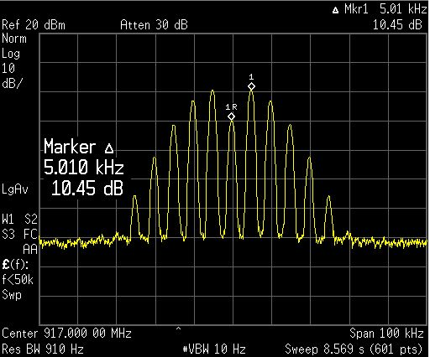
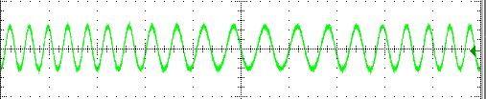
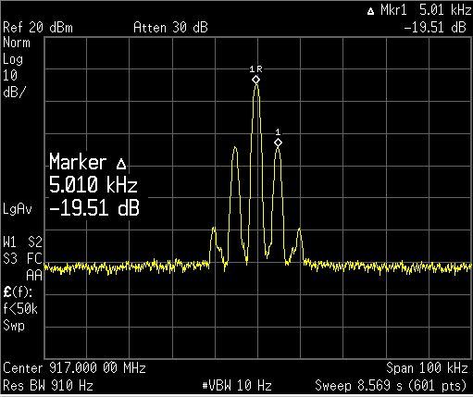
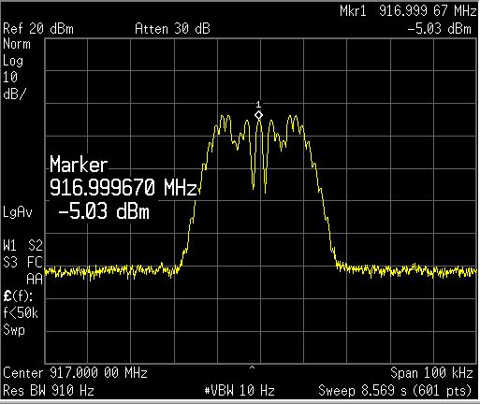
Frequency Modulation (lab)
Frequency Modulation -
FM – Time Domain Waveform
FM – Freq Domain Waveform at m=2
FM – Freq Domain Waveform at m=10
FM – Freq Domain Waveform at m=0.2
25

Slide 26
FM modulator
250kbps 2FSK modulation
  99% OCBW = 508kHz
  90% OCBW = 268kHz
  Average TX current = 100%
  ACI = ~57dBc (1MHz off)
Notes:
FM modulation analysis at 250kbps
Frequency shift keying, means the the transmitter changes between two frequencies depending on the modulation data
’0’ becomes f1, ’1’ becomes f2
The difference between f2 and f1 become (2 * frequency deviation) and the modulation index of a FM transmitter is
determined by the frequency deviation divided by the symbol rate of the transmission. In the example on the next slide
We use a modulation index of of 0.5. The means that the frequency deviation is 125KHz in this example. It also means that
a ’0’ is transmitter by lowering the RF carrier frequency by 125kHz and a ’1’ is transmitted by increasing the RF carrier
Frequency by 125kHz.
Matlab code to make the graphs
clear; %% Clear all variable in memory
%% close all %% Close and delete all figures open
%% Setup the basic modulation parameters
r_b = 250000; %% The symbol rate of the modulator (symbol rate = bit rate for 2FSK/BPSK systems)
freq_dev = 125000; %% For FM modulation this specifies the maximum frequency deviation
channel_spacing = 1000000; %% Defines the channel spacing for ploting adajacent channels
nbits = 200; %% number of bits to be used in each burst of data
nbursts = 100; %% number of bursts to use for averaging (above 10 starts getting slow)
detail_plots = 0; %% Detailed modulation plots for each burst (much slower operation)
discrete_filter = 0; %% uses discrete values filters for the Gaussian filtering
%% Specify the oversampling used for each bit and each IF cycle
OS_rb = 8; %% Specify the oversampling rate of each symbol (BFSK : Bit rate = Symbol rate)
OS_if = 32; %% Specify the oversampling rate of the IF frequency calculation
%% Select which type of modulation to use based on the selection above
%% 1 = 'OOK' 2 = 'ASK' 3 = '2FSK'
%% 4 = '4FSK' 5 = '8FSK' 6 = '16FSK'
%% 7 = 'BPSK' 8 = 'QPSK' 9 = '8PSK'
%% 10 = '16PSK' 11 = 'MSK' 12 = 'O-QPSK
%% 13 = 'O2-QPSK' 14 = '16QAM' 15 = '256QAM'
Modulation_Type = 3;
%% Select which type of IF filtering that is needed
%% 1 = 'None' %% 2 = 'Gaussian'
%% 3 = 'RaisedCosine' %% 4 = 'HalfSine'
%% 5 = 'HalfSine _ Halfwidth'
Transmit_Filter_Type = 1;
%% Select which type of data to be used
%% 1 = 'Random data' %% 2 = 'All ones'
%% 3 = 'All zeros' %% 4 = '1/2*nbits of 0's and 1/2*nbits of 1's'
%% 5 = 'alternating 1,0's of size nbits'
%% 6 = 'Standard GSM burst' %% 7 = 'Standard DECT burst'
%% 8 = 'Zigbee (CCSS 16 codes - O-QPSK)'
InputDataType = 1;
Add_Noise=0; %% 0 = 'No noise added'
%% > 0 = Specify the SNR of the AWGN noise
%% to add
FFT_Windowing = 2; %% 1 = 'None'
%% 2 = 'Hanning'
%% 3 = 'Blackman'
RX_Bandwidth = 0; %% 0 = 'No RX bandwidth limitations = if no noise this should be default'
%% >0 = 'RX Bandwidth in Hertz'
%% Calculate basic modulation paramters based on input given above
OS_G = OS_if*OS_rb; %% Calculates the required oversampling of the filter function
Tb = 1/r_b; %% Calculate the bit time (in seconds)
mi = freq_dev/r_b; %% Calculate the modulation index based on freq dev and bit rate
%% Select whether the IQ modulation scheme is used or just a basic FM transmitter
switch Modulation_Type
case 1
IQ_MOD = 0; %% 1 = 'OOK'
symbol_map = 2;
nsymbols = nbits;
case 2
IQ_MOD = 0; %% 2 = 'ASK'
symbol_map = 2;
nsymbols = nbits;
case 3
IQ_MOD = 0; %% 3 = '2FSK'
symbol_map = 2;
nsymbols = nbits;
case 4
IQ_MOD = 0; %% 4 = '4FSK'
symbol_map = 4;
nsymbols = nbits / 2;
case 5
IQ_MOD = 0; %% 5 = '8FSK'
symbol_map = 8;
nsymbols = nbits / 3;
case 6
IQ_MOD = 0; %% 6 = '16FSK'
symbol_map = 16;
nsymbols = nbits / 4;
case 7
IQ_MOD = 1; %% 7 = 'BPSK'
symbol_map = 2;
nsymbols = nbits;
case 8
IQ_MOD = 1; %% 8 = 'QPSK'
symbol_map = 4;
nsymbols = nbits / 2;
case 9
IQ_MOD = 1; %% 9 = '8PSK'
symbol_map = 8;
nsymbols = nbits / 3;
case 10
IQ_MOD = 1; %% 10 = '16PSK'
symbol_map = 16;
nsymbols = nbits / 4;
case 11
IQ_MOD = 1; %% 11 = 'MSK'
symbol_map = 2;
nsymbols = nbits;
case 12
IQ_MOD = 1; %% 12 = 'O-QPSK'
symbol_map = 4;
nsymbols = nbits / 2;
case 13
IQ_MOD = 1; %% 13 = 'O2-QPSK'
symbol_map = 4;
nsymbols = nbits / 2;
case 14
IQ_MOD = 1; %% 14 = '16QAM'
symbol_map = 16;
nsymbols = nbits / 4;
case 15
IQ_MOD = 1; %% 15 = '256QAM'
symbol_map = 256;
nsymbols = nbits / 8;
end
%% Initialize array to zeros. This speeds up data processing of large arrays of data
if_data = zeros(1,nsymbols*OS_if * OS_rb); %%
tt_data = zeros(1,nsymbols*OS_if * OS_rb); %% time array for if data array
ff_data = zeros(1,nsymbols*OS_if * OS_rb); %% fft array of if data
fm_data = zeros(1,nsymbols*OS_if * OS_rb); %% modulation data
mif_data = zeros(1,nsymbols*OS_if * OS_rb); %% modulation data
IntQfi = zeros(1,nsymbols*OS_if * OS_rb); %% Running integration of modulation data
IntIfi = zeros(1,nsymbols*OS_if * OS_rb); %% Running integration of modulation data
%% Precalculate the filter functions used by the modulation schemes (Gaussian, Box, RaisedCosine, HalfSine)
G_L = 5;
G = Gauss(0.5, Tb, OS_G, G_L); %% Calculate the Gaussian transfer function
G = (pi/2)*OS_rb*G; %% scale the pulse such that we get pi/2 delta for each symbol
RC = RaisedCosine(0.5, G_L, OS_G);
RC = (pi/2)*OS_rb*RC; %% scale the pulse such that we get pi/2 delta for each symbol
HS = HalfSine2(G_L, OS_G);
HS = (pi/2)*OS_rb*HS; %% scale the pulse such that we get pi/2 delta for each symbol
HS2 = HalfSine(G_L, OS_G);
HS2 = (pi/2)*OS_rb*HS2; %% scale the pulse such that we get pi/2 delta for each symbol
figure(1)
for n=1:length(G),
tt(n) = n/OS_G - length(G)/OS_G*0.5;
end
plot(tt,G,'bo-');
hold on
if(discrete_filter == 1)
for n=2:length(G)
if(floor(n/OS_if) ~= n/OS_if)
G(n) = G(n-1);
end
end
plot(tt,G,'mo-');
end
plot(tt,HS(1:length(G)),'g');
plot(tt,RC(1:length(G)),'r');
grid on
xlabel('time, t')
ylabel('amplitude, g(t)')
title('Time domain waveform of pulse shaping filters')
Trim_GL = G_L - 0.5;
box = [zeros(1,Trim_GL*OS_G) ones(1,OS_G) zeros(1,Trim_GL*OS_G)];
box = (pi/2)*OS_rb*box/sum(box); %% scale the pulse such that we get pi/2 delta for each symbol
%% Precalculate the FFT windowing functions to use
%% The final length of the array will be : nsymbols*OS_G
if (FFT_Windowing == 1)
FFT_Window = ones(1,nsymbols*OS_G);
end
if (FFT_Windowing == 2)
FFT_Window = hanning(nsymbols*OS_G)';
end
if (FFT_Windowing == 3)
FFT_Window = blackman(nsymbols*OS_G)';
end
%% For Each burst perform the task of modulating the data and store
%% averages for later analysis
for bb=1:nbursts
fprintf('Burst number : %d\n', bb);
if(InputDataType == 1) %% random data sequence
an = floor(symbol_map*rand(1,nsymbols))/(symbol_map-1);
end
if(InputDataType == 2) %% 1/2 sequence of 1's and 1/2 sequence of 0's
for i=1:nsymbols
an(i) = 1;
end
end
if(InputDataType == 3) %% 1/2 sequence of 1's and 1/2 sequence of 0's
for i=1:nsymbols
an(i) = 0;
end
end
if(InputDataType == 4) %% 1/2 sequence of 1's and 1/2 sequence of 0's
for i=1:nsymbols/2
an(i) = 1;
end
for i=nsymbols/2:nsymbols
an(i) = 0;
end
end
if(InputDataType == 5) %% Alternating 1,0,1,0 sequence of nsymbols
for i=1:2:nsymbols
an(i) = 0;
an(i+1) = 1;
end;
end
if(InputDataType == 6) %% GSM formatted data sequence
nsymbols = 144;
D_field1 = round(rand(1,58));
D_field2 = round(rand(1,58));
%% Definition of the 8 different training sequnces
%% (including control bits) used in the normal burst.
%% These training sequences are defined in GSM 05.02 on page 12.
%% {{0,0,0,1,0,0,1,0,1,1,1,0,0,0,0,1,0,0,0,1,0,0,1,0,1,1,1,0},
%% {0,0,0,1,0,1,1,0,1,1,1,0,1,1,1,1,0,0,0,1,0,1,1,0,1,1,1,0},
%% {0,0,1,0,0,0,0,1,1,1,0,1,1,1,0,1,0,0,1,0,0,0,0,1,1,1,0,0},
%% {0,0,1,0,0,0,1,1,1,1,0,1,1,0,1,0,0,0,1,0,0,0,1,1,1,1,0,0},
%% {0,0,0,0,1,1,0,1,0,1,1,1,0,0,1,0,0,0,0,0,1,1,0,1,0,1,1,0},
%% {0,0,1,0,0,1,1,1,0,1,0,1,1,0,0,0,0,0,1,0,0,1,1,1,0,1,0,0},
%% {0,1,0,1,0,0,1,1,1,1,1,0,1,1,0,0,0,1,0,1,0,0,1,1,1,1,1,0},
%% {0,1,1,1,0,1,1,1,1,0,0,0,1,0,0,1,0,1,1,1,0,1,1,1,1,0,0,0}};
%% we are only using the first sequence in the following demostration
SyncWord = [0 0 0 1 0 0 1 0 1 1 1 0 0 0 0 1 0 0 0 1 0 0 1 0 1 1 1 0];
an = [D_field1 SyncWord D_field2];
end
if(InputDataType == 7) %% DECT formatted data sequence
%% 2FSK modulator with 1152kb/s bit rate
%% 288kHz deviation and 0.5Tb Gaussian filter
%% The following setting have been tested
%% r_b = 1152000;
%% freq_dev = 288000;
%% channel_spacing = 2000000;
%% nbits = 434;
%% Modulation_Type = 3;
%% Transmit_Filter_Type = 2;
D_field = round(rand(1,388));
SyncWord = [0 1 0 0 0 1 0 1 0 1 1 0 1 1 1 1 1 1];
Preamble = [0 1 0 1 0 1 0 1 0 1 0 1 0 1 0 1 0 1 0 1 0 1 0 1 0 1 0 1];
an = [Preamble SyncWord D_field];
end
if(InputDataType == 8) %% Zigbee formatted data sequence
zigbee_bits = nsymbols/8;
n_nibble = ceil(zigbee_bits/4); %% we need to make sure that we have 4 bits aligned data
D_field = round(rand(1,4*n_nibble)); %% aligning to 4 bits
an = 0;
for jj=1:4:zigbee_bits
ss = 8*D_field(jj) + 4*D_field(jj+1) + 2*D_field(jj+2) + D_field(jj+3);
switch ss
case 0; an = [an 1 1 0 1 1 0 0 1 1 1 0 0 0 0 1 1 0 1 0 1 0 0 1 0 0 0 1 0 1 1 1 0 ];
case 1; an = [an 1 1 1 0 1 1 0 1 1 0 0 1 1 1 0 0 0 0 1 1 0 1 0 1 0 0 1 0 0 0 1 0 ];
case 2; an = [an 0 0 1 0 1 1 1 0 1 1 0 1 1 0 0 1 1 1 0 0 0 0 1 1 0 1 0 1 0 0 1 0 ];
case 3; an = [an 0 0 1 0 0 0 1 0 1 1 1 0 1 1 0 1 1 0 0 1 1 1 0 0 0 0 1 1 0 1 0 1 ];
case 4; an = [an 0 1 0 1 0 0 1 0 0 0 1 0 1 1 1 0 1 1 0 1 1 0 0 1 1 1 0 0 0 0 1 1 ];
case 5; an = [an 0 0 1 1 0 1 0 1 0 0 1 0 0 0 1 0 1 1 1 0 1 1 0 1 1 0 0 1 1 1 0 0 ];
case 6; an = [an 1 1 0 0 0 0 1 1 0 1 0 1 0 0 1 0 0 0 1 0 1 1 1 0 1 1 0 1 1 0 0 1 ];
case 7; an = [an 1 0 0 1 1 1 0 0 0 0 1 1 0 1 0 1 0 0 1 0 0 0 1 0 1 1 1 0 1 1 0 1 ];
case 8; an = [an 1 0 0 0 1 1 0 0 1 0 0 1 0 1 1 0 0 0 0 0 0 1 1 1 0 1 1 1 1 0 1 1 ];
case 9; an = [an 1 0 1 1 1 0 0 0 1 1 0 0 1 0 0 1 0 1 1 0 0 0 0 0 0 1 1 1 0 1 1 1 ];
case 10; an = [an 0 1 1 1 1 0 1 1 1 0 0 0 1 1 0 0 1 0 0 1 0 1 1 0 0 0 0 0 0 1 1 1 ];
case 11; an = [an 0 1 1 1 0 1 1 1 1 0 1 1 1 0 0 0 1 1 0 0 1 0 0 1 0 1 1 0 0 0 0 0 ];
case 12; an = [an 0 0 0 0 0 1 1 1 0 1 1 1 1 0 1 1 1 0 0 0 1 1 0 0 1 0 0 1 0 1 1 0 ];
case 13; an = [an 0 1 1 0 0 0 0 0 0 1 1 1 0 1 1 1 1 0 1 1 1 0 0 0 1 1 0 0 1 0 0 1 ];
case 14; an = [an 1 0 0 1 0 1 1 0 0 0 0 0 0 1 1 1 0 1 1 1 1 0 1 1 1 0 0 0 1 1 0 0 ];
case 15; an = [an 1 1 0 0 1 0 0 1 0 1 1 0 0 0 0 0 0 1 1 1 0 1 1 1 1 0 1 1 1 0 0 0 ];
end
end
an = an(2:length(an));
end
%%%%%%%%%% TX modulation using a complete IQ modulation scheme %%%%%%%%
%% 1 = 'OOK' %% 2 = 'ASK' %% 3 = '2FSK'
%% 4 = '4FSK' %% 5 = '8FSK' %% 6 = '16FSK'
%% 7 = 'BPSK' %% 8 = 'QPSK' %% 9 = '8PSK'
%% 10 = '16PSK' %% 11 = 'MSK' %% 12 = 'O-QPSK
%% 13 = 'O2-QPSK'
if(IQ_MOD == 1) %% TX modulation using a complete IQ modulation scheme
if (Modulation_Type == 7) %% BPSK symbol mapping
nul = zeros(1,OS_G-1);
Qdata = [round(100*cos(pi*an(1)))/100 nul]; %% incomming data array in 'an'
Idata = [round(100*sin(pi*an(1)))/100 nul];
for i=1:length(an)
Qdata = [Qdata round(100*cos(pi*an(i)))/100 nul]; %% incomming data array in 'an'
Idata = [Idata round(100*sin(pi*an(i)))/100 nul];
end
end
if (Modulation_Type == 8) %% QPSK symbol mapping
nul = zeros(1,OS_G-1);
Qdata = [round(100*cos(1.5*pi*an(1)))/100 nul]; %% incomming data array in 'an'
Idata = [round(100*sin(1.5*pi*an(1)))/100 nul];
for i=1:length(an)
Qdata = [Qdata round(100*cos(1.5*pi*an(i)))/100 nul]; %% incomming data array in 'an'
Idata = [Idata round(100*sin(1.5*pi*an(i)))/100 nul];
end
end
if (Modulation_Type == 9) %% 8PSK symbol mapping
nul = zeros(1,OS_G-1);
Qdata = [round(100*cos(1.75*pi*an(1)))/100 nul]; %% incomming data array in 'an'
Idata = [round(100*sin(1.75*pi*an(1)))/100 nul];
for i=1:length(an)
Qdata = [Qdata round(100*cos(1.75*pi*an(i)))/100 nul]; %% incomming data array in 'an'
Idata = [Idata round(100*sin(1.75*pi*an(i)))/100 nul];
end
end
if (Modulation_Type == 10) %% 16PSK symbol mapping
nul = zeros(1,OS_G-1);
Qdata = [round(100*cos(1.8750*pi*an(1)))/100 nul]; %% incomming data array in 'an'
Idata = [round(100*sin(1.8750*pi*an(1)))/100 nul];
for i=1:length(an)
Qdata = [Qdata round(100*cos(1.8750*pi*an(i)))/100 nul]; %% incomming data array in 'an'
Idata = [Idata round(100*sin(1.8750*pi*an(i)))/100 nul];
end
end
if (Modulation_Type == 11) %% MSK symbol mapping
nul = zeros(1,OS_G-1);
Qdata = [-2*an(1)+1 nul]; %% incomming data array in 'an'
Idata = [2*an(1)-1 nul];
for i=1:length(an)
Qdata = [Qdata -2*an(i)+1 nul];
Idata = [Idata 2*an(i)-1 nul];
end;
end
if(Modulation_Type == 12) %% pi/4 Offset QPSK symbol mapping
nul = zeros(1,OS_G-1);
Qdata = [0 nul]; %% incomming data array in 'an'
Idata = [-1.4142 nul]; %% incomming data array in 'an'
for k=1:length(an)
state = 3*an(k);
if (state == 0)
Qdata = [Qdata 0 nul];
Idata = [Idata -1.4142 nul];
end
if (state == 1)
Qdata = [Qdata 1.4142 nul];
Idata = [Idata 0 nul];
end
if (state == 2)
Qdata = [Qdata -1.4142 nul];
Idata = [Idata 0 nul];
end
if (state == 3)
Qdata = [Qdata 0 nul];
Idata = [Idata 1.4142 nul];
end
end
end
if (Modulation_Type == 13) %% Offset QPSK symbol mapping
nul = zeros(1,OS_G-1);
nul2 = zeros(1, OS_G/2-1);
Qdata = [round(100*cos(1.5*pi*an(1)+0.25*pi))/100 nul]; %% incomming data array in 'an'
Idata = [0 nul2 round(100*sin(1.5*pi*an(1)+0.25*pi))/100 nul2];
for i=1:length(an)
Qdata = [Qdata round(100*cos(1.5*pi*an(i)+0.25*pi))/100 nul]; %% incomming data array in 'an'
Idata = [Idata 0 nul2 round(100*sin(1.5*pi*an(i)+0.25*pi))/100 nul2];
end
end
if (Modulation_Type == 14) %% Offset 16QAM symbol mapping
nul = zeros(1,OS_G-1);
nul2 = zeros(1, OS_G/2-1);
qd = floor((15*an(1))/4);
id = (15*an(1))-4*qd;
Qdata = [0.6666*qd-1 nul]; %% incomming data array in 'an'
Idata = [0.6666*id-1 nul];
for i=1:length(an)
qd = floor((15*an(i))/4);
id = (15*an(i))-4*qd;
Qdata = [Qdata 0.6666*qd-1 nul]; %% incomming data array in 'an'
Idata = [Idata 0.6666*id-1 nul];
end
end
if (Modulation_Type == 15) %% Offset 255QAM symbol mapping
nul = zeros(1,OS_G-1);
nul2 = zeros(1, OS_G/2-1);
qd = floor((255*an(1))/16);
id = (255*an(1))-16*qd;
Qdata = [0.1333*qd-1 nul]; %% incomming data array in 'an'
Idata = [0.1333*id-1 nul];
for i=1:length(an)
qd = floor((255*an(i))/16);
id = (255*an(i))-16*qd;
Qdata = [Qdata 0.1333*qd-1 nul]; %% incomming data array in 'an'
Idata = [Idata 0.1333*id-1 nul];
end
end
if(detail_plots == 1)
figure(3); clf; subplot(2,1,1); stem(Qdata); subplot(2,1,2); stem(Idata);
end
if (Transmit_Filter_Type == 1 ) %% No prefilting of data sequence selected
Qfi = conv(Qdata, box);
Ifi = conv(Idata, box);
end
if (Transmit_Filter_Type == 2 ) %% Gaussian filtering of data sequence
Qfi = conv(Qdata,G);
Ifi = conv(Idata,G);
end
if (Transmit_Filter_Type == 3 ) %% Raised Cosine filtering of data sequence
Qfi = conv(Qdata,RC);
Ifi = conv(Idata,RC);
end
if (Transmit_Filter_Type == 4 ) %% Half Sine filtering of data sequence
Qfi = conv(Qdata,HS);
Ifi = conv(Idata,HS);
end
if (Transmit_Filter_Type == 5 ) %% Half Sine filtering of data sequence
Qfi = conv(Qdata,HS2);
Ifi = conv(Idata,HS2);
end
%% Trim the filtered data sequence to remove "extra" data from convolution operation
Qfi = Qfi(OS_G*Trim_GL:nsymbols*OS_G+OS_G*Trim_GL-1);
Ifi = Ifi(OS_G*Trim_GL:nsymbols*OS_G+OS_G*Trim_GL-1);
if(detail_plots == 1)
figure(4); clf; subplot(2,1,1); plot(Qfi); subplot(2,1,2); plot(Ifi);
end
%% Integrate the data sequence ( initialize data array )
IntQfi(1) = Qfi(1)/OS_rb;
IntIfi(1) = Ifi(1)/OS_rb;
for ii=2:length(Qfi) %% run an integrate on the dataset
IntQfi(ii) = IntQfi(ii-1) + Qfi(ii)/OS_rb;
IntIfi(ii) = IntIfi(ii-1) + Ifi(ii)/OS_rb;
end
if(detail_plots == 1)
figure(6); clf; subplot(2,1,1); plot(tt_data, IntQfi); subplot(2,1,2); plot(tt_data, IntIfi);
end
if((Modulation_Type == 11)) %% trap for MSK
Qfi = sin(IntQfi);
Ifi = cos(IntIfi);
else
if((max(Qfi)~=0)&(max(Ifi)~=0))
scale = 1/max(Ifi+Qfi);
Ifi = Ifi*scale*sqrt(2);
Qfi = Qfi*scale*sqrt(2);
else
if((max(Qfi)~=0))
Qfi = Qfi/max(abs(Qfi));
end
if(max(Ifi)~=0)
Ifi = Ifi/max(abs(Ifi));
end
end
end
if(detail_plots == 1)
figure(5); clf; plot(Qfi(2:end),Ifi(2:end),'ob-');
figure(7); clf; subplot(2,1,1); plot(Qfi); subplot(2,1,2); plot(Ifi);
end
for ii=1:length(Qfi) %
tt_data(ii) = 1000 * ii/(r_b * OS_rb * OS_if); %% generate an array with time data
ff_data(ii) = ii * (r_b * OS_if * OS_rb)/length(Qfi); %% generate an array with frequency data (for plots later)
mif_data(ii) = Ifi(ii) * sin(2*pi*ii/OS_rb) + Qfi(ii) * cos(2*pi*ii/OS_rb); %% IQ modulation
end
else
%%%%%%%% TX modulation using a simple FM modulator engine %%%%%%%
%% 1 = 'OOK' %% 2 = 'ASK' %% 3 = '2FSK'
%% 4 = '4FSK' %% 5 = '8FSK' %% 6 = '16FSK'
%% 7 = 'BPSK' %% 8 = 'QPSK' %% 9 = '8PSK'
%% 10 = '16PSK' %% 11 = 'MSK' %% 12 = 'O-QPSK
%% 13 = 'O2-QPSK'
an = 2*an-1; %% Incomming array is 0,1 we need NRZ a sequence for the FM modulator
nul = zeros(1,OS_G-1); %% generate a IF data array with each data point inserted for every location based on oversampling
data = [an(1) nul];
for i=2:length(an)
data = [data an(i) nul];
end
if (detail_plots == 1)
%% figure(3); clf; stem(data); %% makes Octave very slow.
end
if (Transmit_Filter_Type == 1 ) %% No prefilting of data sequence selected
fi = conv(data, box);
end
if (Transmit_Filter_Type == 2 ) %% Gaussian filtering of data sequence
fi = conv(data,G);
end
if (Transmit_Filter_Type == 3 ) %% Raised Cosine filtering of data sequence
fi = conv(data,RC);
end
if (Transmit_Filter_Type == 4 ) %% Half Sine filtering of data sequence
fi = conv(data,HS);
end
if (Transmit_Filter_Type == 4 ) %% Half Sine filtering of data sequence
fi = conv(data,HS2);
end
fi = fi/max(abs(fi)); %% scale the filter data to +/- 1
fi = fi(OS_G*Trim_GL:nsymbols*OS_G+OS_G*Trim_GL-1); %% trim the filter data
if(detail_plots == 1)
figure(4); clf; plot(fi);
end
Intfi(1) = fi(1)/OS_G;
for ii=2:length(fi) %% run an integrate on the dataset
Intfi(ii) = Intfi(ii-1) + fi(ii)/OS_G;
end
%% 1 = 'OOK' %% 2 = 'ASK' %% 3 = '2FSK'
%% 4 = '4FSK' %% 5 = '8FSK' %% 6 = '16FSK'
%% 7 = 'BPSK' %% 8 = 'QPSK' %% 9 = '8PSK'
%% 10 = '16PSK' %% 11 = 'MSK' %% 12 = 'O-QPSK
%% 13 = 'O2-QPSK'
for ii=1:length(fi) %
tt_data(ii) = 1000 * ii/(r_b * OS_rb * OS_if);
ff_data(ii) = ii * (r_b * OS_if * OS_rb)/length(if_data);
if(Modulation_Type == 1)
mif_data(ii) = (0.5*fi(ii)+0.5) * sin(2*pi*ii/OS_rb); % OOK modulation
end
if(Modulation_Type == 2)
mif_data(ii) = (0.4*fi(ii)+0.6) * sin(2*pi*ii/OS_rb); % ASK modulation
end
if(Modulation_Type == 3)
mif_data(ii) = sin(2*pi*ii/OS_rb + mi*2*pi*Intfi(ii)); % 2FSK modulation
end
if(Modulation_Type == 4)
mif_data(ii) = sin(2*pi*ii/OS_rb + mi*2*pi*Intfi(ii)); % 4FSK modulation
end
if(Modulation_Type == 5)
mif_data(ii) = sin(2*pi*ii/OS_rb + mi*2*pi*Intfi(ii)); % 8FSK modulation
end
if(Modulation_Type == 6)
mif_data(ii) = sin(2*pi*ii/OS_rb + mi*2*pi*Intfi(ii)); % 16FSK modulation
end
end
end
if (Add_Noise > 0)
mif_data = awgn(mif_data, Add_Noise);
end
if bb==1
fft_mif_sum = 20*log10(abs(fft(FFT_Window.*mif_data)));
else
fft_mif_sum = fft_mif_sum + 20*log10(abs(fft(FFT_Window.*mif_data)));
end
end
%% fft_mif_sum = fft_mif_sum/bb; %% Find the maximum response and scale it to 0dB
fft_mif_sum = fft_mif_sum/bb - max(fft_mif_sum/bb); %% Find the maximum response and scale it to 0dB
if IQ_MOD == 1
figure(6);
clf;
%% subplot(2,1,1); plot(IntQfi); subplot(2,1,2); plot(IntIfi);
subplot(2,1,1); plot(tt_data, Qfi); subplot(2,1,2); plot(tt_data, Ifi);
xlabel('Time [ms]');
title('Time domain plot of data (Filtered)');
grid on;
figure(7);
clf;
plot(ff_data, 20*log10(abs(fft(Qfi))));
axis([0 3*r_b 30 80]);
title('Frequency domain plot of data (Filtered)');
grid on;
else
figure(6);
clf;
plot(tt_data,fi);
xlabel('Time [ms]');
title('Time domain plot of data (Filtered)');
grid on;
figure(7);
clf;
plot(ff_data, 20*log10(abs(fft(fi))));
axis([0 3*r_b 30 80]);
title('Frequency domain plot of data (Filtered)');
grid on;
end
figure(8);
clf;
plot(tt_data, mif_data);
title('Time plot of IF signal (RANDOM, BURST, PREAMPLE)');
xlabel('Time [ms]');
grid on;
figure(9);
clf;
plot(ff_data, 20*log10(abs(fft(mif_data))));
f2 = 0.1 * r_b * OS_if * OS_rb;
axis([0.75*r_b*OS_if 1.25*r_b*OS_if 10 70]);
xlabel('Frequency [Hz]');
title('Modulation bandwidth of 1 burst (RANDOM, BURST, PREAMPLE)');
grid on;
figure(10);
clf;
ff_step = ff_data(2)-ff_data(1);
if(RX_Bandwidth>0)
[fft_max fft_max_index] = max(fft_mif_sum(1:length(fft_mif_sum)/2));
RX_BDW_index = floor(0.5*RX_Bandwidth / ff_step);
fft_mif_sum = [-200*ones(1, fft_max_index-RX_BDW_index) fft_mif_sum(fft_max_index-RX_BDW_index:fft_max_index+RX_BDW_index) -200*ones(1, length(fft_mif_sum)-fft_max_index-RX_BDW_index-1)];
end
plot(ff_data,fft_mif_sum);
hold on;
f2 = 0.1 * r_b * OS_if * OS_rb;
axis([0.75*r_b*OS_if 1.25*r_b*OS_if -80 0]);
xlabel('Frequency [Hz]');
title('Average modulation bandwidth using specified signal (RANDOM, BURST, PREAMPLE)');
grid on;
%% Bandwidth calculations and presentations
real_fft_mif_sum = 10.^(fft_mif_sum/10);
fft_max_index = nsymbols*OS_if; %% point to the center of the signal
int_fft = zeros(1,nsymbols*OS_if);
int_fft(1) = real_fft_mif_sum(1);
for kk=2:2*fft_max_index %% start from maximum
int_fft(kk) = int_fft(kk-1) + real_fft_mif_sum(kk);
end
int_fft = int_fft / int_fft(2*nsymbols*OS_if); %% scale the integral to 1
index_5p = find(int_fft>0.05);
index_5p = index_5p(1);
index_95p = find(int_fft>0.95);
index_95p = index_95p(1);
index_0p5 = find(int_fft>0.005);
index_0p5 = index_0p5(1);
index_99p5 = find(int_fft>0.995);
index_99p5 = index_99p5(1);
power_p90_freq = (index_95p - index_5p) * ff_step;
power_p99_freq = (index_99p5 - index_0p5) * ff_step;
t_ss = sprintf('90 power bandwitdh = %5.0f [Hz]',power_p90_freq);
text(1.05*r_b*OS_if,-8,t_ss);
t_ss = sprintf('99 power bandwitdh = %5.0f [Hz]',power_p99_freq);
text(1.05*r_b*OS_if,-18,t_ss);
if((index_95p - index_5p)>0)
plot([ff_data(index_5p) ff_data(index_95p)], [-10 -10],'-bo','LineWidth',2)
end
if((index_99p5 - index_0p5)>0)
plot([ff_data(index_0p5) ff_data(index_99p5)], [-20 -20],'-ro','LineWidth',2)
end
figure(11);
clf;
nbins_ch_space = floor(channel_spacing / ((r_b * OS_if * OS_rb)/length(if_data)));
plot(ff_data(1:length(ff_data)-nbins_ch_space+1),fft_mif_sum(nbins_ch_space:length(fft_mif_sum)),'r');
hold on;
nn = [zeros(1,nbins_ch_space) fft_mif_sum(1:length(fft_mif_sum)-nbins_ch_space)];
plot(ff_data, nn,'g');
plot(ff_data,fft_mif_sum);
axis([0.75*r_b*OS_if 1.25*r_b*OS_if -80 0]);
xlabel('Frequency [Hz]');
title('Adjacent channel performance');
grid on;
figure(12);
clf;
nbins_ch_space = 2 * nbins_ch_space;
plot(ff_data(1:length(ff_data)- nbins_ch_space+1),fft_mif_sum(nbins_ch_space:length(fft_mif_sum)),'r');
hold on;
nn = [zeros(1,nbins_ch_space) fft_mif_sum(1:length(fft_mif_sum)-nbins_ch_space)];
plot(ff_data, nn,'g');
plot(ff_data,fft_mif_sum);
axis([0.75*r_b*OS_if 1.25*r_b*OS_if -80 0]);
xlabel('Frequency [Hz]');
title('Next to adjacent channel performance');
grid on;
%% plot eye diagram
if IQ_MOD == 0
figure(13);
clf;
plot(tt_data(1:1+4*OS_G),fi(1:1+4*OS_G));
hold on;
for ii=1:4*OS_G:length(fi)-4*OS_G
plot(tt_data(1:1+4*OS_G),fi(ii:ii+4*OS_G));
end
axis([tt_data(1) tt_data(4*OS_G) -1.1 1.1])
xlabel('Time [ms]');
title('Eye diagram of 4 symbols before upconversion to IF');
grid on;
else
figure(13);
clf;
for ii=1:4*OS_G:length(Qfi)-4*OS_G
subplot(2,1,1);plot(tt_data(1:1+4*OS_G),Qfi(ii:ii+4*OS_G)); hold on;
subplot(2,1,2);plot(tt_data(1:1+4*OS_G),Ifi(ii:ii+4*OS_G)); hold on;
end
grid on;
axis([tt_data(1) tt_data(4*OS_G) -1.1 1.1])
xlabel('Time [ms]');
subplot(2,1,1);
grid on;
axis([tt_data(1) tt_data(4*OS_G) -1.1 1.1])
xlabel('Time [ms]');
title('Eye diagram of 4 symbols before upconversion to IF');
end

Slide 27
4 level FM modulator
250kbps 4FSK modulation
  99% OCBW = 321kHz
  90% OCBW = 215kHz
  Average TX current = 100%
  ACI = ~55dBc (1MHz off)
Notes:
4 level FM modulation analysis at 250kbps
New mode that is becoming popular in LPRF is multi level FSK modulation. Our radios support 4 level FSK, which
Means that the incoming data sequence has to be mapped into a sequence of symbols. For 4FSK the mapping is
Pretty simple.
Lets call each of the four states 0-3, if this is mapped to binary numbers it becomes 00, 01, 10, 11. Now take two
Consecutive bits and map them to each symbol. ‘0’ ’0’ ->00, ‘0’ ’1’ ->01, ‘1’ ’0’ ->10, ‘1’ ’1’ ->11.
The good this is higher spectral efficiency, but the bad thing is the reduced receiver sensitivity.
Matlab code to make the graphs
clear; %% Clear all variable in memory
%% close all %% Close and delete all figures open
%% Setup the basic modulation parameters
r_b = 125000; %% The symbol rate of the modulator (symbol rate = bit rate for 2FSK/BPSK systems)
freq_dev = 93750; %% For FM modulation this specifies the maximum frequency deviation
channel_spacing = 1000000; %% Defines the channel spacing for ploting adajacent channels
nbits = 200; %% number of bits to be used in each burst of data
nbursts = 100; %% number of bursts to use for averaging (above 10 starts getting slow)
detail_plots = 0; %% Detailed modulation plots for each burst (much slower operation)
discrete_filter = 0; %% uses discrete values filters for the Gaussian filtering
%% Specify the oversampling used for each bit and each IF cycle
OS_rb = 8; %% Specify the oversampling rate of each symbol (BFSK : Bit rate = Symbol rate)
OS_if = 64; %% Specify the oversampling rate of the IF frequency calculation
%% Select which type of modulation to use based on the selection above
%% 1 = 'OOK' 2 = 'ASK' 3 = '2FSK'
%% 4 = '4FSK' 5 = '8FSK' 6 = '16FSK'
%% 7 = 'BPSK' 8 = 'QPSK' 9 = '8PSK'
%% 10 = '16PSK' 11 = 'MSK' 12 = 'O-QPSK
%% 13 = 'O2-QPSK' 14 = '16QAM' 15 = '256QAM'
Modulation_Type = 4;
%% Select which type of IF filtering that is needed
%% 1 = 'None' %% 2 = 'Gaussian'
%% 3 = 'RaisedCosine' %% 4 = 'HalfSine'
%% 5 = 'HalfSine _ Halfwidth'
Transmit_Filter_Type = 1;
%% Select which type of data to be used
%% 1 = 'Random data' %% 2 = 'All ones'
%% 3 = 'All zeros' %% 4 = '1/2*nbits of 0's and 1/2*nbits of 1's'
%% 5 = 'alternating 1,0's of size nbits'
%% 6 = 'Standard GSM burst' %% 7 = 'Standard DECT burst'
%% 8 = 'Zigbee (CCSS 16 codes - O-QPSK)'
InputDataType = 1;
Add_Noise=0; %% 0 = 'No noise added'
%% > 0 = Specify the SNR of the AWGN noise
%% to add
FFT_Windowing = 2; %% 1 = 'None'
%% 2 = 'Hanning'
%% 3 = 'Blackman'
RX_Bandwidth = 0; %% 0 = 'No RX bandwidth limitations = if no noise this should be default'
%% >0 = 'RX Bandwidth in Hertz'
%% Calculate basic modulation paramters based on input given above
OS_G = OS_if*OS_rb; %% Calculates the required oversampling of the filter function
Tb = 1/r_b; %% Calculate the bit time (in seconds)
mi = freq_dev/r_b; %% Calculate the modulation index based on freq dev and bit rate
%% Select whether the IQ modulation scheme is used or just a basic FM transmitter
switch Modulation_Type
case 1
IQ_MOD = 0; %% 1 = 'OOK'
symbol_map = 2;
nsymbols = nbits;
case 2
IQ_MOD = 0; %% 2 = 'ASK'
symbol_map = 2;
nsymbols = nbits;
case 3
IQ_MOD = 0; %% 3 = '2FSK'
symbol_map = 2;
nsymbols = nbits;
case 4
IQ_MOD = 0; %% 4 = '4FSK'
symbol_map = 4;
nsymbols = nbits / 2;
case 5
IQ_MOD = 0; %% 5 = '8FSK'
symbol_map = 8;
nsymbols = nbits / 3;
case 6
IQ_MOD = 0; %% 6 = '16FSK'
symbol_map = 16;
nsymbols = nbits / 4;
case 7
IQ_MOD = 1; %% 7 = 'BPSK'
symbol_map = 2;
nsymbols = nbits;
case 8
IQ_MOD = 1; %% 8 = 'QPSK'
symbol_map = 4;
nsymbols = nbits / 2;
case 9
IQ_MOD = 1; %% 9 = '8PSK'
symbol_map = 8;
nsymbols = nbits / 3;
case 10
IQ_MOD = 1; %% 10 = '16PSK'
symbol_map = 16;
nsymbols = nbits / 4;
case 11
IQ_MOD = 1; %% 11 = 'MSK'
symbol_map = 2;
nsymbols = nbits;
case 12
IQ_MOD = 1; %% 12 = 'O-QPSK'
symbol_map = 4;
nsymbols = nbits / 2;
case 13
IQ_MOD = 1; %% 13 = 'O2-QPSK'
symbol_map = 4;
nsymbols = nbits / 2;
case 14
IQ_MOD = 1; %% 14 = '16QAM'
symbol_map = 16;
nsymbols = nbits / 4;
case 15
IQ_MOD = 1; %% 15 = '256QAM'
symbol_map = 256;
nsymbols = nbits / 8;
end
%% Initialize array to zeros. This speeds up data processing of large arrays of data
if_data = zeros(1,nsymbols*OS_if * OS_rb); %%
tt_data = zeros(1,nsymbols*OS_if * OS_rb); %% time array for if data array
ff_data = zeros(1,nsymbols*OS_if * OS_rb); %% fft array of if data
fm_data = zeros(1,nsymbols*OS_if * OS_rb); %% modulation data
mif_data = zeros(1,nsymbols*OS_if * OS_rb); %% modulation data
IntQfi = zeros(1,nsymbols*OS_if * OS_rb); %% Running integration of modulation data
IntIfi = zeros(1,nsymbols*OS_if * OS_rb); %% Running integration of modulation data
%% Precalculate the filter functions used by the modulation schemes (Gaussian, Box, RaisedCosine, HalfSine)
G_L = 5;
G = Gauss(0.5, Tb, OS_G, G_L); %% Calculate the Gaussian transfer function
G = (pi/2)*OS_rb*G; %% scale the pulse such that we get pi/2 delta for each symbol
RC = RaisedCosine(0.5, G_L, OS_G);
RC = (pi/2)*OS_rb*RC; %% scale the pulse such that we get pi/2 delta for each symbol
HS = HalfSine2(G_L, OS_G);
HS = (pi/2)*OS_rb*HS; %% scale the pulse such that we get pi/2 delta for each symbol
HS2 = HalfSine(G_L, OS_G);
HS2 = (pi/2)*OS_rb*HS2; %% scale the pulse such that we get pi/2 delta for each symbol
figure(1)
for n=1:length(G),
tt(n) = n/OS_G - length(G)/OS_G*0.5;
end
plot(tt,G,'bo-');
hold on
if(discrete_filter == 1)
for n=2:length(G)
if(floor(n/OS_if) ~= n/OS_if)
G(n) = G(n-1);
end
end
plot(tt,G,'mo-');
end
plot(tt,HS(1:length(G)),'g');
plot(tt,RC(1:length(G)),'r');
grid on
xlabel('time, t')
ylabel('amplitude, g(t)')
title('Time domain waveform of pulse shaping filters')
Trim_GL = G_L - 0.5;
box = [zeros(1,Trim_GL*OS_G) ones(1,OS_G) zeros(1,Trim_GL*OS_G)];
box = (pi/2)*OS_rb*box/sum(box); %% scale the pulse such that we get pi/2 delta for each symbol
%% Precalculate the FFT windowing functions to use
%% The final length of the array will be : nsymbols*OS_G
if (FFT_Windowing == 1)
FFT_Window = ones(1,nsymbols*OS_G);
end
if (FFT_Windowing == 2)
FFT_Window = hanning(nsymbols*OS_G)';
end
if (FFT_Windowing == 3)
FFT_Window = blackman(nsymbols*OS_G)';
end
%% For Each burst perform the task of modulating the data and store
%% averages for later analysis
for bb=1:nbursts
fprintf('Burst number : %d\n', bb);
if(InputDataType == 1) %% random data sequence
an = floor(symbol_map*rand(1,nsymbols))/(symbol_map-1);
end
if(InputDataType == 2) %% 1/2 sequence of 1's and 1/2 sequence of 0's
for i=1:nsymbols
an(i) = 1;
end
end
if(InputDataType == 3) %% 1/2 sequence of 1's and 1/2 sequence of 0's
for i=1:nsymbols
an(i) = 0;
end
end
if(InputDataType == 4) %% 1/2 sequence of 1's and 1/2 sequence of 0's
for i=1:nsymbols/2
an(i) = 1;
end
for i=nsymbols/2:nsymbols
an(i) = 0;
end
end
if(InputDataType == 5) %% Alternating 1,0,1,0 sequence of nsymbols
for i=1:2:nsymbols
an(i) = 0;
an(i+1) = 1;
end;
end
if(InputDataType == 6) %% GSM formatted data sequence
nsymbols = 144;
D_field1 = round(rand(1,58));
D_field2 = round(rand(1,58));
%% Definition of the 8 different training sequnces
%% (including control bits) used in the normal burst.
%% These training sequences are defined in GSM 05.02 on page 12.
%% {{0,0,0,1,0,0,1,0,1,1,1,0,0,0,0,1,0,0,0,1,0,0,1,0,1,1,1,0},
%% {0,0,0,1,0,1,1,0,1,1,1,0,1,1,1,1,0,0,0,1,0,1,1,0,1,1,1,0},
%% {0,0,1,0,0,0,0,1,1,1,0,1,1,1,0,1,0,0,1,0,0,0,0,1,1,1,0,0},
%% {0,0,1,0,0,0,1,1,1,1,0,1,1,0,1,0,0,0,1,0,0,0,1,1,1,1,0,0},
%% {0,0,0,0,1,1,0,1,0,1,1,1,0,0,1,0,0,0,0,0,1,1,0,1,0,1,1,0},
%% {0,0,1,0,0,1,1,1,0,1,0,1,1,0,0,0,0,0,1,0,0,1,1,1,0,1,0,0},
%% {0,1,0,1,0,0,1,1,1,1,1,0,1,1,0,0,0,1,0,1,0,0,1,1,1,1,1,0},
%% {0,1,1,1,0,1,1,1,1,0,0,0,1,0,0,1,0,1,1,1,0,1,1,1,1,0,0,0}};
%% we are only using the first sequence in the following demostration
SyncWord = [0 0 0 1 0 0 1 0 1 1 1 0 0 0 0 1 0 0 0 1 0 0 1 0 1 1 1 0];
an = [D_field1 SyncWord D_field2];
end
if(InputDataType == 7) %% DECT formatted data sequence
%% 2FSK modulator with 1152kb/s bit rate
%% 288kHz deviation and 0.5Tb Gaussian filter
%% The following setting have been tested
%% r_b = 1152000;
%% freq_dev = 288000;
%% channel_spacing = 2000000;
%% nbits = 434;
%% Modulation_Type = 3;
%% Transmit_Filter_Type = 2;
D_field = round(rand(1,388));
SyncWord = [0 1 0 0 0 1 0 1 0 1 1 0 1 1 1 1 1 1];
Preamble = [0 1 0 1 0 1 0 1 0 1 0 1 0 1 0 1 0 1 0 1 0 1 0 1 0 1 0 1];
an = [Preamble SyncWord D_field];
end
if(InputDataType == 8) %% Zigbee formatted data sequence
zigbee_bits = nsymbols/8;
n_nibble = ceil(zigbee_bits/4); %% we need to make sure that we have 4 bits aligned data
D_field = round(rand(1,4*n_nibble)); %% aligning to 4 bits
an = 0;
for jj=1:4:zigbee_bits
ss = 8*D_field(jj) + 4*D_field(jj+1) + 2*D_field(jj+2) + D_field(jj+3);
switch ss
case 0; an = [an 1 1 0 1 1 0 0 1 1 1 0 0 0 0 1 1 0 1 0 1 0 0 1 0 0 0 1 0 1 1 1 0 ];
case 1; an = [an 1 1 1 0 1 1 0 1 1 0 0 1 1 1 0 0 0 0 1 1 0 1 0 1 0 0 1 0 0 0 1 0 ];
case 2; an = [an 0 0 1 0 1 1 1 0 1 1 0 1 1 0 0 1 1 1 0 0 0 0 1 1 0 1 0 1 0 0 1 0 ];
case 3; an = [an 0 0 1 0 0 0 1 0 1 1 1 0 1 1 0 1 1 0 0 1 1 1 0 0 0 0 1 1 0 1 0 1 ];
case 4; an = [an 0 1 0 1 0 0 1 0 0 0 1 0 1 1 1 0 1 1 0 1 1 0 0 1 1 1 0 0 0 0 1 1 ];
case 5; an = [an 0 0 1 1 0 1 0 1 0 0 1 0 0 0 1 0 1 1 1 0 1 1 0 1 1 0 0 1 1 1 0 0 ];
case 6; an = [an 1 1 0 0 0 0 1 1 0 1 0 1 0 0 1 0 0 0 1 0 1 1 1 0 1 1 0 1 1 0 0 1 ];
case 7; an = [an 1 0 0 1 1 1 0 0 0 0 1 1 0 1 0 1 0 0 1 0 0 0 1 0 1 1 1 0 1 1 0 1 ];
case 8; an = [an 1 0 0 0 1 1 0 0 1 0 0 1 0 1 1 0 0 0 0 0 0 1 1 1 0 1 1 1 1 0 1 1 ];
case 9; an = [an 1 0 1 1 1 0 0 0 1 1 0 0 1 0 0 1 0 1 1 0 0 0 0 0 0 1 1 1 0 1 1 1 ];
case 10; an = [an 0 1 1 1 1 0 1 1 1 0 0 0 1 1 0 0 1 0 0 1 0 1 1 0 0 0 0 0 0 1 1 1 ];
case 11; an = [an 0 1 1 1 0 1 1 1 1 0 1 1 1 0 0 0 1 1 0 0 1 0 0 1 0 1 1 0 0 0 0 0 ];
case 12; an = [an 0 0 0 0 0 1 1 1 0 1 1 1 1 0 1 1 1 0 0 0 1 1 0 0 1 0 0 1 0 1 1 0 ];
case 13; an = [an 0 1 1 0 0 0 0 0 0 1 1 1 0 1 1 1 1 0 1 1 1 0 0 0 1 1 0 0 1 0 0 1 ];
case 14; an = [an 1 0 0 1 0 1 1 0 0 0 0 0 0 1 1 1 0 1 1 1 1 0 1 1 1 0 0 0 1 1 0 0 ];
case 15; an = [an 1 1 0 0 1 0 0 1 0 1 1 0 0 0 0 0 0 1 1 1 0 1 1 1 1 0 1 1 1 0 0 0 ];
end
end
an = an(2:length(an));
end
%%%%%%%%%% TX modulation using a complete IQ modulation scheme %%%%%%%%
%% 1 = 'OOK' %% 2 = 'ASK' %% 3 = '2FSK'
%% 4 = '4FSK' %% 5 = '8FSK' %% 6 = '16FSK'
%% 7 = 'BPSK' %% 8 = 'QPSK' %% 9 = '8PSK'
%% 10 = '16PSK' %% 11 = 'MSK' %% 12 = 'O-QPSK
%% 13 = 'O2-QPSK'
if(IQ_MOD == 1) %% TX modulation using a complete IQ modulation scheme
if (Modulation_Type == 7) %% BPSK symbol mapping
nul = zeros(1,OS_G-1);
Qdata = [round(100*cos(pi*an(1)))/100 nul]; %% incomming data array in 'an'
Idata = [round(100*sin(pi*an(1)))/100 nul];
for i=1:length(an)
Qdata = [Qdata round(100*cos(pi*an(i)))/100 nul]; %% incomming data array in 'an'
Idata = [Idata round(100*sin(pi*an(i)))/100 nul];
end
end
if (Modulation_Type == 8) %% QPSK symbol mapping
nul = zeros(1,OS_G-1);
Qdata = [round(100*cos(1.5*pi*an(1)))/100 nul]; %% incomming data array in 'an'
Idata = [round(100*sin(1.5*pi*an(1)))/100 nul];
for i=1:length(an)
Qdata = [Qdata round(100*cos(1.5*pi*an(i)))/100 nul]; %% incomming data array in 'an'
Idata = [Idata round(100*sin(1.5*pi*an(i)))/100 nul];
end
end
if (Modulation_Type == 9) %% 8PSK symbol mapping
nul = zeros(1,OS_G-1);
Qdata = [round(100*cos(1.75*pi*an(1)))/100 nul]; %% incomming data array in 'an'
Idata = [round(100*sin(1.75*pi*an(1)))/100 nul];
for i=1:length(an)
Qdata = [Qdata round(100*cos(1.75*pi*an(i)))/100 nul]; %% incomming data array in 'an'
Idata = [Idata round(100*sin(1.75*pi*an(i)))/100 nul];
end
end
if (Modulation_Type == 10) %% 16PSK symbol mapping
nul = zeros(1,OS_G-1);
Qdata = [round(100*cos(1.8750*pi*an(1)))/100 nul]; %% incomming data array in 'an'
Idata = [round(100*sin(1.8750*pi*an(1)))/100 nul];
for i=1:length(an)
Qdata = [Qdata round(100*cos(1.8750*pi*an(i)))/100 nul]; %% incomming data array in 'an'
Idata = [Idata round(100*sin(1.8750*pi*an(i)))/100 nul];
end
end
if (Modulation_Type == 11) %% MSK symbol mapping
nul = zeros(1,OS_G-1);
Qdata = [-2*an(1)+1 nul]; %% incomming data array in 'an'
Idata = [2*an(1)-1 nul];
for i=1:length(an)
Qdata = [Qdata -2*an(i)+1 nul];
Idata = [Idata 2*an(i)-1 nul];
end;
end
if(Modulation_Type == 12) %% pi/4 Offset QPSK symbol mapping
nul = zeros(1,OS_G-1);
Qdata = [0 nul]; %% incomming data array in 'an'
Idata = [-1.4142 nul]; %% incomming data array in 'an'
for k=1:length(an)
state = 3*an(k);
if (state == 0)
Qdata = [Qdata 0 nul];
Idata = [Idata -1.4142 nul];
end
if (state == 1)
Qdata = [Qdata 1.4142 nul];
Idata = [Idata 0 nul];
end
if (state == 2)
Qdata = [Qdata -1.4142 nul];
Idata = [Idata 0 nul];
end
if (state == 3)
Qdata = [Qdata 0 nul];
Idata = [Idata 1.4142 nul];
end
end
end
if (Modulation_Type == 13) %% Offset QPSK symbol mapping
nul = zeros(1,OS_G-1);
nul2 = zeros(1, OS_G/2-1);
Qdata = [round(100*cos(1.5*pi*an(1)+0.25*pi))/100 nul]; %% incomming data array in 'an'
Idata = [0 nul2 round(100*sin(1.5*pi*an(1)+0.25*pi))/100 nul2];
for i=1:length(an)
Qdata = [Qdata round(100*cos(1.5*pi*an(i)+0.25*pi))/100 nul]; %% incomming data array in 'an'
Idata = [Idata 0 nul2 round(100*sin(1.5*pi*an(i)+0.25*pi))/100 nul2];
end
end
if (Modulation_Type == 14) %% Offset 16QAM symbol mapping
nul = zeros(1,OS_G-1);
nul2 = zeros(1, OS_G/2-1);
qd = floor((15*an(1))/4);
id = (15*an(1))-4*qd;
Qdata = [0.6666*qd-1 nul]; %% incomming data array in 'an'
Idata = [0.6666*id-1 nul];
for i=1:length(an)
qd = floor((15*an(i))/4);
id = (15*an(i))-4*qd;
Qdata = [Qdata 0.6666*qd-1 nul]; %% incomming data array in 'an'
Idata = [Idata 0.6666*id-1 nul];
end
end
if (Modulation_Type == 15) %% Offset 255QAM symbol mapping
nul = zeros(1,OS_G-1);
nul2 = zeros(1, OS_G/2-1);
qd = floor((255*an(1))/16);
id = (255*an(1))-16*qd;
Qdata = [0.1333*qd-1 nul]; %% incomming data array in 'an'
Idata = [0.1333*id-1 nul];
for i=1:length(an)
qd = floor((255*an(i))/16);
id = (255*an(i))-16*qd;
Qdata = [Qdata 0.1333*qd-1 nul]; %% incomming data array in 'an'
Idata = [Idata 0.1333*id-1 nul];
end
end
if(detail_plots == 1)
figure(3); clf; subplot(2,1,1); stem(Qdata); subplot(2,1,2); stem(Idata);
end
if (Transmit_Filter_Type == 1 ) %% No prefilting of data sequence selected
Qfi = conv(Qdata, box);
Ifi = conv(Idata, box);
end
if (Transmit_Filter_Type == 2 ) %% Gaussian filtering of data sequence
Qfi = conv(Qdata,G);
Ifi = conv(Idata,G);
end
if (Transmit_Filter_Type == 3 ) %% Raised Cosine filtering of data sequence
Qfi = conv(Qdata,RC);
Ifi = conv(Idata,RC);
end
if (Transmit_Filter_Type == 4 ) %% Half Sine filtering of data sequence
Qfi = conv(Qdata,HS);
Ifi = conv(Idata,HS);
end
if (Transmit_Filter_Type == 5 ) %% Half Sine filtering of data sequence
Qfi = conv(Qdata,HS2);
Ifi = conv(Idata,HS2);
end
%% Trim the filtered data sequence to remove "extra" data from convolution operation
Qfi = Qfi(OS_G*Trim_GL:nsymbols*OS_G+OS_G*Trim_GL-1);
Ifi = Ifi(OS_G*Trim_GL:nsymbols*OS_G+OS_G*Trim_GL-1);
if(detail_plots == 1)
figure(4); clf; subplot(2,1,1); plot(Qfi); subplot(2,1,2); plot(Ifi);
end
%% Integrate the data sequence ( initialize data array )
IntQfi(1) = Qfi(1)/OS_rb;
IntIfi(1) = Ifi(1)/OS_rb;
for ii=2:length(Qfi) %% run an integrate on the dataset
IntQfi(ii) = IntQfi(ii-1) + Qfi(ii)/OS_rb;
IntIfi(ii) = IntIfi(ii-1) + Ifi(ii)/OS_rb;
end
if(detail_plots == 1)
figure(6); clf; subplot(2,1,1); plot(tt_data, IntQfi); subplot(2,1,2); plot(tt_data, IntIfi);
end
if((Modulation_Type == 11)) %% trap for MSK
Qfi = sin(IntQfi);
Ifi = cos(IntIfi);
else
if((max(Qfi)~=0)&(max(Ifi)~=0))
scale = 1/max(Ifi+Qfi);
Ifi = Ifi*scale*sqrt(2);
Qfi = Qfi*scale*sqrt(2);
else
if((max(Qfi)~=0))
Qfi = Qfi/max(abs(Qfi));
end
if(max(Ifi)~=0)
Ifi = Ifi/max(abs(Ifi));
end
end
end
if(detail_plots == 1)
figure(5); clf; plot(Qfi(2:end),Ifi(2:end),'ob-');
figure(7); clf; subplot(2,1,1); plot(Qfi); subplot(2,1,2); plot(Ifi);
end
for ii=1:length(Qfi) %
tt_data(ii) = 1000 * ii/(r_b * OS_rb * OS_if); %% generate an array with time data
ff_data(ii) = ii * (r_b * OS_if * OS_rb)/length(Qfi); %% generate an array with frequency data (for plots later)
mif_data(ii) = Ifi(ii) * sin(2*pi*ii/OS_rb) + Qfi(ii) * cos(2*pi*ii/OS_rb); %% IQ modulation
end
else
%%%%%%%% TX modulation using a simple FM modulator engine %%%%%%%
%% 1 = 'OOK' %% 2 = 'ASK' %% 3 = '2FSK'
%% 4 = '4FSK' %% 5 = '8FSK' %% 6 = '16FSK'
%% 7 = 'BPSK' %% 8 = 'QPSK' %% 9 = '8PSK'
%% 10 = '16PSK' %% 11 = 'MSK' %% 12 = 'O-QPSK
%% 13 = 'O2-QPSK'
an = 2*an-1; %% Incomming array is 0,1 we need NRZ a sequence for the FM modulator
nul = zeros(1,OS_G-1); %% generate a IF data array with each data point inserted for every location based on oversampling
data = [an(1) nul];
for i=2:length(an)
data = [data an(i) nul];
end
if (detail_plots == 1)
%% figure(3); clf; stem(data); %% makes Octave very slow.
end
if (Transmit_Filter_Type == 1 ) %% No prefilting of data sequence selected
fi = conv(data, box);
end
if (Transmit_Filter_Type == 2 ) %% Gaussian filtering of data sequence
fi = conv(data,G);
end
if (Transmit_Filter_Type == 3 ) %% Raised Cosine filtering of data sequence
fi = conv(data,RC);
end
if (Transmit_Filter_Type == 4 ) %% Half Sine filtering of data sequence
fi = conv(data,HS);
end
if (Transmit_Filter_Type == 4 ) %% Half Sine filtering of data sequence
fi = conv(data,HS2);
end
fi = fi/max(abs(fi)); %% scale the filter data to +/- 1
fi = fi(OS_G*Trim_GL:nsymbols*OS_G+OS_G*Trim_GL-1); %% trim the filter data
if(detail_plots == 1)
figure(4); clf; plot(fi);
end
Intfi(1) = fi(1)/OS_G;
for ii=2:length(fi) %% run an integrate on the dataset
Intfi(ii) = Intfi(ii-1) + fi(ii)/OS_G;
end
%% 1 = 'OOK' %% 2 = 'ASK' %% 3 = '2FSK'
%% 4 = '4FSK' %% 5 = '8FSK' %% 6 = '16FSK'
%% 7 = 'BPSK' %% 8 = 'QPSK' %% 9 = '8PSK'
%% 10 = '16PSK' %% 11 = 'MSK' %% 12 = 'O-QPSK
%% 13 = 'O2-QPSK'
for ii=1:length(fi) %
tt_data(ii) = 1000 * ii/(r_b * OS_rb * OS_if);
ff_data(ii) = ii * (r_b * OS_if * OS_rb)/length(if_data);
if(Modulation_Type == 1)
mif_data(ii) = (0.5*fi(ii)+0.5) * sin(2*pi*ii/OS_rb); % OOK modulation
end
if(Modulation_Type == 2)
mif_data(ii) = (0.4*fi(ii)+0.6) * sin(2*pi*ii/OS_rb); % ASK modulation
end
if(Modulation_Type == 3)
mif_data(ii) = sin(2*pi*ii/OS_rb + mi*2*pi*Intfi(ii)); % 2FSK modulation
end
if(Modulation_Type == 4)
mif_data(ii) = sin(2*pi*ii/OS_rb + mi*2*pi*Intfi(ii)); % 4FSK modulation
end
if(Modulation_Type == 5)
mif_data(ii) = sin(2*pi*ii/OS_rb + mi*2*pi*Intfi(ii)); % 8FSK modulation
end
if(Modulation_Type == 6)
mif_data(ii) = sin(2*pi*ii/OS_rb + mi*2*pi*Intfi(ii)); % 16FSK modulation
end
end
end
if (Add_Noise > 0)
mif_data = awgn(mif_data, Add_Noise);
end
if bb==1
fft_mif_sum = 20*log10(abs(fft(FFT_Window.*mif_data)));
else
fft_mif_sum = fft_mif_sum + 20*log10(abs(fft(FFT_Window.*mif_data)));
end
end
%% fft_mif_sum = fft_mif_sum/bb; %% Find the maximum response and scale it to 0dB
fft_mif_sum = fft_mif_sum/bb - max(fft_mif_sum/bb); %% Find the maximum response and scale it to 0dB
if IQ_MOD == 1
figure(6);
clf;
%% subplot(2,1,1); plot(IntQfi); subplot(2,1,2); plot(IntIfi);
subplot(2,1,1); plot(tt_data, Qfi); subplot(2,1,2); plot(tt_data, Ifi);
xlabel('Time [ms]');
title('Time domain plot of data (Filtered)');
grid on;
figure(7);
clf;
plot(ff_data, 20*log10(abs(fft(Qfi))));
axis([0 3*r_b 30 80]);
title('Frequency domain plot of data (Filtered)');
grid on;
else
figure(6);
clf;
plot(tt_data,fi);
xlabel('Time [ms]');
title('Time domain plot of data (Filtered)');
grid on;
figure(7);
clf;
plot(ff_data, 20*log10(abs(fft(fi))));
axis([0 3*r_b 30 80]);
title('Frequency domain plot of data (Filtered)');
grid on;
end
figure(8);
clf;
plot(tt_data, mif_data);
title('Time plot of IF signal (RANDOM, BURST, PREAMPLE)');
xlabel('Time [ms]');
grid on;
figure(9);
clf;
plot(ff_data, 20*log10(abs(fft(mif_data))));
f2 = 0.1 * r_b * OS_if * OS_rb;
axis([0.75*r_b*OS_if 1.25*r_b*OS_if 10 70]);
xlabel('Frequency [Hz]');
title('Modulation bandwidth of 1 burst (RANDOM, BURST, PREAMPLE)');
grid on;
figure(10);
clf;
ff_step = ff_data(2)-ff_data(1);
if(RX_Bandwidth>0)
[fft_max fft_max_index] = max(fft_mif_sum(1:length(fft_mif_sum)/2));
RX_BDW_index = floor(0.5*RX_Bandwidth / ff_step);
fft_mif_sum = [-200*ones(1, fft_max_index-RX_BDW_index) fft_mif_sum(fft_max_index-RX_BDW_index:fft_max_index+RX_BDW_index) -200*ones(1, length(fft_mif_sum)-fft_max_index-RX_BDW_index-1)];
end
plot(ff_data,fft_mif_sum);
hold on;
f2 = 0.1 * r_b * OS_if * OS_rb;
axis([0.75*r_b*OS_if 1.25*r_b*OS_if -80 0]);
xlabel('Frequency [Hz]');
title('Average modulation bandwidth using specified signal (RANDOM, BURST, PREAMPLE)');
grid on;
%% Bandwidth calculations and presentations
real_fft_mif_sum = 10.^(fft_mif_sum/10);
fft_max_index = nsymbols*OS_if; %% point to the center of the signal
int_fft = zeros(1,nsymbols*OS_if);
int_fft(1) = real_fft_mif_sum(1);
for kk=2:2*fft_max_index %% start from maximum
int_fft(kk) = int_fft(kk-1) + real_fft_mif_sum(kk);
end
int_fft = int_fft / int_fft(2*nsymbols*OS_if); %% scale the integral to 1
index_5p = find(int_fft>0.05);
index_5p = index_5p(1);
index_95p = find(int_fft>0.95);
index_95p = index_95p(1);
index_0p5 = find(int_fft>0.005);
index_0p5 = index_0p5(1);
index_99p5 = find(int_fft>0.995);
index_99p5 = index_99p5(1);
power_p90_freq = (index_95p - index_5p) * ff_step;
power_p99_freq = (index_99p5 - index_0p5) * ff_step;
t_ss = sprintf('90 power bandwitdh = %5.0f [Hz]',power_p90_freq);
text(1.05*r_b*OS_if,-8,t_ss);
t_ss = sprintf('99 power bandwitdh = %5.0f [Hz]',power_p99_freq);
text(1.05*r_b*OS_if,-18,t_ss);
if((index_95p - index_5p)>0)
plot([ff_data(index_5p) ff_data(index_95p)], [-10 -10],'-bo','LineWidth',2)
end
if((index_99p5 - index_0p5)>0)
plot([ff_data(index_0p5) ff_data(index_99p5)], [-20 -20],'-ro','LineWidth',2)
end
figure(11);
clf;
nbins_ch_space = floor(channel_spacing / ((r_b * OS_if * OS_rb)/length(if_data)));
plot(ff_data(1:length(ff_data)-nbins_ch_space+1),fft_mif_sum(nbins_ch_space:length(fft_mif_sum)),'r');
hold on;
nn = [zeros(1,nbins_ch_space) fft_mif_sum(1:length(fft_mif_sum)-nbins_ch_space)];
plot(ff_data, nn,'g');
plot(ff_data,fft_mif_sum);
axis([0.75*r_b*OS_if 1.25*r_b*OS_if -80 0]);
xlabel('Frequency [Hz]');
title('Adjacent channel performance');
grid on;
figure(12);
clf;
nbins_ch_space = 2 * nbins_ch_space;
plot(ff_data(1:length(ff_data)- nbins_ch_space+1),fft_mif_sum(nbins_ch_space:length(fft_mif_sum)),'r');
hold on;
nn = [zeros(1,nbins_ch_space) fft_mif_sum(1:length(fft_mif_sum)-nbins_ch_space)];
plot(ff_data, nn,'g');
plot(ff_data,fft_mif_sum);
axis([0.75*r_b*OS_if 1.25*r_b*OS_if -80 0]);
xlabel('Frequency [Hz]');
title('Next to adjacent channel performance');
grid on;
%% plot eye diagram
if IQ_MOD == 0
figure(13);
clf;
plot(tt_data(1:1+4*OS_G),fi(1:1+4*OS_G));
hold on;
for ii=1:4*OS_G:length(fi)-4*OS_G
plot(tt_data(1:1+4*OS_G),fi(ii:ii+4*OS_G));
end
axis([tt_data(1) tt_data(4*OS_G) -1.1 1.1])
xlabel('Time [ms]');
title('Eye diagram of 4 symbols before upconversion to IF');
grid on;
else
figure(13);
clf;
for ii=1:4*OS_G:length(Qfi)-4*OS_G
subplot(2,1,1);plot(tt_data(1:1+4*OS_G),Qfi(ii:ii+4*OS_G)); hold on;
subplot(2,1,2);plot(tt_data(1:1+4*OS_G),Ifi(ii:ii+4*OS_G)); hold on;
end
grid on;
axis([tt_data(1) tt_data(4*OS_G) -1.1 1.1])
xlabel('Time [ms]');
subplot(2,1,1);
grid on;
axis([tt_data(1) tt_data(4*OS_G) -1.1 1.1])
xlabel('Time [ms]');
title('Eye diagram of 4 symbols before upconversion to IF');
end

Slide 28
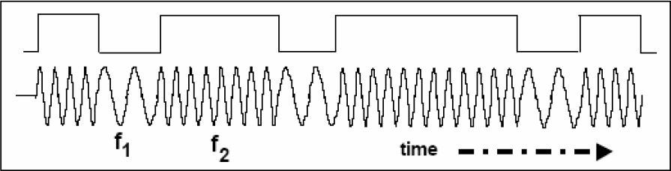
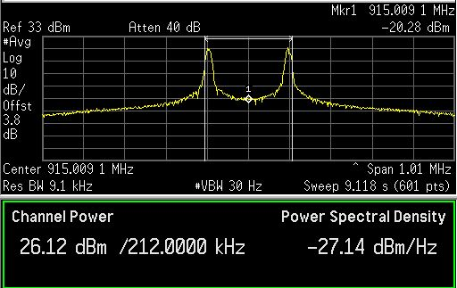
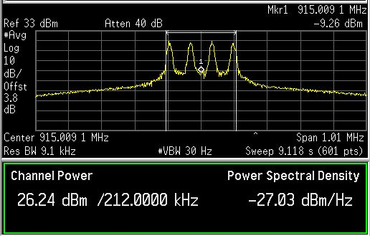
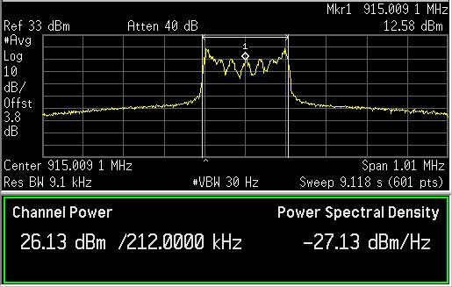
Digital Modulation - nFSK
Various types of Frequency Shift Keying modulation
FSK – Time Domain Waveform
2FSK
4FSK
GFSK
28

Slide 29
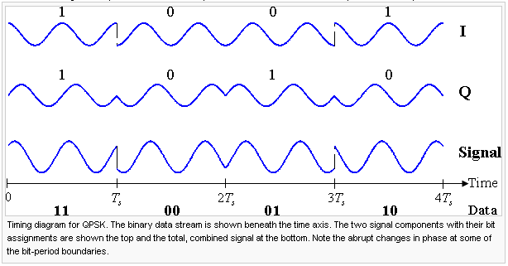
Digital Modulation – QPSK/OQPSK
Quadrature Phase Shift Keying
  Pros: Symbol represents two bits of data
  Cons: Phase in the signal can jump as much as 180^{O} causing out of band noise
  Offset Quadrature Phase Shift Keying
  Pros: Offsetting the signal limits the phase jump to no more than 90^{O}
  Example: IEEE 802.15.4 / ZigBee
10
01
11
00
http://en.wikipedia.org/wiki/Phase-shift_keying
Notes:
Quadrature Phase Shift Keying
The modulated signal is shown below for a short segment of a random binary data-stream. The two carrier waves are a cosine wave and a sine wave, as indicated by the signal-space analysis above. Here, the odd-numbered bits have been assigned to the in-phase component and the even-numbered bits to the quadrature component (taking the first bit as number 1). The total signal is shown at the bottom.
Offest Quadrature Phase Shift Keying
Taking four values of the phase (two bits) at a time to construct a QPSK symbol can allow the phase of the signal to jump by as much as 180° at a time. When the signal is low-pass filtered (as is typical in a transmitter), these phase-shifts result in large amplitude fluctuations, an undesirable quality in communication systems. By offsetting the timing of the odd and even bits by one bit-period, or half a symbol-period, the in-phase and quadrature components will never change at the same time. In the constellation diagram shown on the left, it can be seen that this will limit the phase-shift to no more than 90° at a time. This yields much lower amplitude fluctuations than non-offset QPSK and is sometimes preferred in practice.

Slide 30
OQPSK modulator
250kbps OQPSK modulation
  99% OCBW = 4720kHz
  90% OCBW = 3072kHz
  Average TX current = 100%
  ACI = ~30dBc (5MHz off)
Notes:
Matlab code to make the graphs
clear; %% Clear all variable in memory
%% close all %% Close and delete all figures open
%% Setup the basic modulation parameters
r_b = 2000000; %% The symbol rate of the modulator (symbol rate = bit rate for 2FSK/BPSK systems)
freq_dev = 93750; %% For FM modulation this specifies the maximum frequency deviation
channel_spacing = 5000000; %% Defines the channel spacing for ploting adajacent channels
nbits = 250; %% number of bits to be used in each burst of data (for QPSK nbits becomes number of symbols to transmit )
nbursts = 25; %% number of bursts to use for averaging (above 10 starts getting slow)
detail_plots = 0; %% Detailed modulation plots for each burst (much slower operation)
discrete_filter = 0; %% uses discrete values filters for the Gaussian filtering
%% Specify the oversampling used for each bit and each IF cycle
OS_rb = 8; %% Specify the oversampling rate of each symbol (BFSK : Bit rate = Symbol rate)
OS_if = 16; %% Specify the oversampling rate of the IF frequency calculation
%% Select which type of modulation to use based on the selection above
%% 1 = 'OOK' %% 2 = 'ASK' %% 3 = '2FSK'
%% 4 = '4FSK' %% 5 = '8FSK' %% 6 = '16FSK'
%% 7 = 'BPSK' %% 8 = 'QPSK' %% 9 = '8PSK'
%% 10 = '16PSK' %% 11 = 'MSK' %% 12 = 'O-QPSK
%% 13 = 'O2-QPSK'
Modulation_Type = 13;
%% Select which type of IF filtering that is needed
%% 1 = 'None' %% 2 = 'Gaussian'
%% 3 = 'RaisedCosine' %% 4 = 'HalfSine'
%% 5 = 'HalfSine _ Halfwidth'
Transmit_Filter_Type = 5;
%% Select which type of data to be used
%% 1 = 'Random data' %% 2 = 'All ones'
%% 3 = 'All zeros' %% 4 = '1/2*nbits of 0's and 1/2*nbits of 1's'
%% 5 = 'alternating 1,0's of size nbits'
%% 6 = 'Standard GSM burst' %% 7 = 'Standard DECT burst'
%% 8 = 'Zigbee (CCSS 16 codes - O-QPSK)'
InputDataType = 1;
Add_Noise=0; %% 0 = 'No noise added'
%% > 0 = Specify the SNR of the AWGN noise
%% to add
FFT_Windowing = 2; %% 1 = 'None'
%% 2 = 'Hanning'
%% 3 = 'Blackman'
RX_Bandwidth = 0; %% 0 = 'No RX bandwidth limitations = if no noise this should be default'
%% >0 = 'RX Bandwidth in Hertz'
%% Calculate basic modulation paramters based on input given above
OS_G = OS_if*OS_rb; %% Calculates the required oversampling of the filter function
Tb = 1/r_b; %% Calculate the bit time (in seconds)
mi = freq_dev/r_b; %% Calculate the modulation index based on freq dev and bit rate
%% Select whether the IQ modulation scheme is used or just a basic FM transmitter
switch Modulation_Type
case 1
IQ_MOD = 0; %% 1 = 'OOK'
symbol_map = 2;
nsymbols = nbits;
case 2
IQ_MOD = 0; %% 2 = 'ASK'
symbol_map = 2;
nsymbols = nbits;
case 3
IQ_MOD = 0; %% 3 = '2FSK'
symbol_map = 2;
nsymbols = nbits;
case 4
IQ_MOD = 0; %% 4 = '4FSK'
symbol_map = 4;
nsymbols = nbits / 2;
case 5
IQ_MOD = 0; %% 5 = '8FSK'
symbol_map = 8;
nsymbols = nbits / 3;
case 6
IQ_MOD = 0; %% 6 = '16FSK'
symbol_map = 16;
nsymbols = nbits / 4;
case 7
IQ_MOD = 1; %% 7 = 'BPSK'
symbol_map = 2;
nsymbols = nbits;
case 8
IQ_MOD = 1; %% 8 = 'QPSK'
symbol_map = 4;
nsymbols = nbits / 2;
case 9
IQ_MOD = 1; %% 9 = '8PSK'
symbol_map = 8;
nsymbols = nbits / 3;
case 10
IQ_MOD = 1; %% 10 = '16PSK'
symbol_map = 16;
nsymbols = nbits / 4;
case 11
IQ_MOD = 1; %% 11 = 'MSK'
symbol_map = 2;
nsymbols = nbits;
case 12
IQ_MOD = 1; %% 12 = 'O-QPSK'
symbol_map = 4;
nsymbols = nbits / 2;
case 13
IQ_MOD = 1; %% 13 = 'O2-QPSK'
symbol_map = 4;
nsymbols = nbits / 2;
end
%% Initialize array to zeros. This speeds up data processing of large arrays of data
if_data = zeros(1,nsymbols*OS_if * OS_rb); %%
tt_data = zeros(1,nsymbols*OS_if * OS_rb); %% time array for if data array
ff_data = zeros(1,nsymbols*OS_if * OS_rb); %% fft array of if data
fm_data = zeros(1,nsymbols*OS_if * OS_rb); %% modulation data
mif_data = zeros(1,nsymbols*OS_if * OS_rb); %% modulation data
IntQfi = zeros(1,nsymbols*OS_if * OS_rb); %% Running integration of modulation data
IntIfi = zeros(1,nsymbols*OS_if * OS_rb); %% Running integration of modulation data
%% Precalculate the filter functions used by the modulation schemes (Gaussian, Box, RaisedCosine, HalfSine)
G_L = 5;
G = Gauss(0.5, Tb, OS_G, G_L); %% Calculate the Gaussian transfer function
G = (pi/2)*OS_rb*G; %% scale the pulse such that we get pi/2 delta for each symbol
RC = RaisedCosine(0.5, G_L, OS_G);
RC = (pi/2)*OS_rb*RC; %% scale the pulse such that we get pi/2 delta for each symbol
HS = HalfSine2(G_L, OS_G);
HS = (pi/2)*OS_rb*HS; %% scale the pulse such that we get pi/2 delta for each symbol
HS2 = HalfSine(G_L, OS_G);
HS2 = (pi/2)*OS_rb*HS2; %% scale the pulse such that we get pi/2 delta for each symbol
figure(1)
for n=1:length(G),
tt(n) = n/OS_G - length(G)/OS_G*0.5;
end
plot(tt,G,'bo-');
hold on
if(discrete_filter == 1)
for n=2:length(G)
if(floor(n/OS_if) ~= n/OS_if)
G(n) = G(n-1);
end
end
plot(tt,G,'mo-');
end
plot(tt,HS(1:length(G)),'g');
plot(tt,RC(1:length(G)),'r');
grid on
xlabel('time, t')
ylabel('amplitude, g(t)')
title('Time domain waveform of pulse shaping filters')
Trim_GL = G_L - 0.5;
box = [zeros(1,Trim_GL*OS_G) ones(1,OS_G) zeros(1,Trim_GL*OS_G)];
box = (pi/2)*OS_rb*box/sum(box); %% scale the pulse such that we get pi/2 delta for each symbol
%% Precalculate the FFT windowing functions to use
%% The final length of the array will be : nsymbols*OS_G
if (FFT_Windowing == 1)
FFT_Window = ones(1,nsymbols*OS_G);
end
if (FFT_Windowing == 2)
FFT_Window = hanning(nsymbols*OS_G)';
end
if (FFT_Windowing == 3)
FFT_Window = blackman(nsymbols*OS_G)';
end
%% For Each burst perform the task of modulating the data and store
%% averages for later analysis
for bb=1:nbursts
fprintf('Burst number : %d\n', bb);
if(InputDataType == 1) %% random data sequence
an = floor(symbol_map*rand(1,nsymbols))/(symbol_map-1);
end
if(InputDataType == 2) %% 1/2 sequence of 1's and 1/2 sequence of 0's
for i=1:nsymbols
an(i) = 1;
end
end
if(InputDataType == 3) %% 1/2 sequence of 1's and 1/2 sequence of 0's
for i=1:nsymbols
an(i) = 0;
end
end
if(InputDataType == 4) %% 1/2 sequence of 1's and 1/2 sequence of 0's
for i=1:nsymbols/2
an(i) = 1;
end
for i=nsymbols/2:nsymbols
an(i) = 0;
end
end
if(InputDataType == 5) %% Alternating 1,0,1,0 sequence of nsymbols
for i=1:2:nsymbols
an(i) = 0;
an(i+1) = 1;
end;
end
if(InputDataType == 6) %% GSM formatted data sequence
nsymbols = 144;
D_field1 = round(rand(1,58));
D_field2 = round(rand(1,58));
%% Definition of the 8 different training sequnces
%% (including control bits) used in the normal burst.
%% These training sequences are defined in GSM 05.02 on page 12.
%% {{0,0,0,1,0,0,1,0,1,1,1,0,0,0,0,1,0,0,0,1,0,0,1,0,1,1,1,0},
%% {0,0,0,1,0,1,1,0,1,1,1,0,1,1,1,1,0,0,0,1,0,1,1,0,1,1,1,0},
%% {0,0,1,0,0,0,0,1,1,1,0,1,1,1,0,1,0,0,1,0,0,0,0,1,1,1,0,0},
%% {0,0,1,0,0,0,1,1,1,1,0,1,1,0,1,0,0,0,1,0,0,0,1,1,1,1,0,0},
%% {0,0,0,0,1,1,0,1,0,1,1,1,0,0,1,0,0,0,0,0,1,1,0,1,0,1,1,0},
%% {0,0,1,0,0,1,1,1,0,1,0,1,1,0,0,0,0,0,1,0,0,1,1,1,0,1,0,0},
%% {0,1,0,1,0,0,1,1,1,1,1,0,1,1,0,0,0,1,0,1,0,0,1,1,1,1,1,0},
%% {0,1,1,1,0,1,1,1,1,0,0,0,1,0,0,1,0,1,1,1,0,1,1,1,1,0,0,0}};
%% we are only using the first sequence in the following demostration
SyncWord = [0 0 0 1 0 0 1 0 1 1 1 0 0 0 0 1 0 0 0 1 0 0 1 0 1 1 1 0];
an = [D_field1 SyncWord D_field2];
end
if(InputDataType == 7) %% DECT formatted data sequence
%% 2FSK modulator with 1152kb/s bit rate
%% 288kHz deviation and 0.5Tb Gaussian filter
%% The following setting have been tested
%% r_b = 1152000;
%% freq_dev = 288000;
%% channel_spacing = 2000000;
%% nbits = 434;
%% Modulation_Type = 3;
%% Transmit_Filter_Type = 2;
D_field = round(rand(1,388));
SyncWord = [0 1 0 0 0 1 0 1 0 1 1 0 1 1 1 1 1 1];
Preamble = [0 1 0 1 0 1 0 1 0 1 0 1 0 1 0 1 0 1 0 1 0 1 0 1 0 1 0 1];
an = [Preamble SyncWord D_field];
end
if(InputDataType == 8) %% Zigbee formatted data sequence
zigbee_bits = nsymbols/8;
n_nibble = ceil(zigbee_bits/4); %% we need to make sure that we have 4 bits aligned data
D_field = round(rand(1,4*n_nibble)); %% aligning to 4 bits
an = 0;
for jj=1:4:zigbee_bits
ss = 8*D_field(jj) + 4*D_field(jj+1) + 2*D_field(jj+2) + D_field(jj+3);
switch ss
case 0; an = [an 1 1 0 1 1 0 0 1 1 1 0 0 0 0 1 1 0 1 0 1 0 0 1 0 0 0 1 0 1 1 1 0 ];
case 1; an = [an 1 1 1 0 1 1 0 1 1 0 0 1 1 1 0 0 0 0 1 1 0 1 0 1 0 0 1 0 0 0 1 0 ];
case 2; an = [an 0 0 1 0 1 1 1 0 1 1 0 1 1 0 0 1 1 1 0 0 0 0 1 1 0 1 0 1 0 0 1 0 ];
case 3; an = [an 0 0 1 0 0 0 1 0 1 1 1 0 1 1 0 1 1 0 0 1 1 1 0 0 0 0 1 1 0 1 0 1 ];
case 4; an = [an 0 1 0 1 0 0 1 0 0 0 1 0 1 1 1 0 1 1 0 1 1 0 0 1 1 1 0 0 0 0 1 1 ];
case 5; an = [an 0 0 1 1 0 1 0 1 0 0 1 0 0 0 1 0 1 1 1 0 1 1 0 1 1 0 0 1 1 1 0 0 ];
case 6; an = [an 1 1 0 0 0 0 1 1 0 1 0 1 0 0 1 0 0 0 1 0 1 1 1 0 1 1 0 1 1 0 0 1 ];
case 7; an = [an 1 0 0 1 1 1 0 0 0 0 1 1 0 1 0 1 0 0 1 0 0 0 1 0 1 1 1 0 1 1 0 1 ];
case 8; an = [an 1 0 0 0 1 1 0 0 1 0 0 1 0 1 1 0 0 0 0 0 0 1 1 1 0 1 1 1 1 0 1 1 ];
case 9; an = [an 1 0 1 1 1 0 0 0 1 1 0 0 1 0 0 1 0 1 1 0 0 0 0 0 0 1 1 1 0 1 1 1 ];
case 10; an = [an 0 1 1 1 1 0 1 1 1 0 0 0 1 1 0 0 1 0 0 1 0 1 1 0 0 0 0 0 0 1 1 1 ];
case 11; an = [an 0 1 1 1 0 1 1 1 1 0 1 1 1 0 0 0 1 1 0 0 1 0 0 1 0 1 1 0 0 0 0 0 ];
case 12; an = [an 0 0 0 0 0 1 1 1 0 1 1 1 1 0 1 1 1 0 0 0 1 1 0 0 1 0 0 1 0 1 1 0 ];
case 13; an = [an 0 1 1 0 0 0 0 0 0 1 1 1 0 1 1 1 1 0 1 1 1 0 0 0 1 1 0 0 1 0 0 1 ];
case 14; an = [an 1 0 0 1 0 1 1 0 0 0 0 0 0 1 1 1 0 1 1 1 1 0 1 1 1 0 0 0 1 1 0 0 ];
case 15; an = [an 1 1 0 0 1 0 0 1 0 1 1 0 0 0 0 0 0 1 1 1 0 1 1 1 1 0 1 1 1 0 0 0 ];
end
end
an = an(2:length(an));
end
%%%%%%%%%% TX modulation using a complete IQ modulation scheme %%%%%%%%
%% 1 = 'OOK' %% 2 = 'ASK' %% 3 = '2FSK'
%% 4 = '4FSK' %% 5 = '8FSK' %% 6 = '16FSK'
%% 7 = 'BPSK' %% 8 = 'QPSK' %% 9 = '8PSK'
%% 10 = '16PSK' %% 11 = 'MSK' %% 12 = 'O-QPSK
%% 13 = 'O2-QPSK'
if(IQ_MOD == 1) %% TX modulation using a complete IQ modulation scheme
if (Modulation_Type == 7) %% BPSK symbol mapping
nul = zeros(1,OS_G-1);
Qdata = [round(100*cos(pi*an(1)))/100 nul]; %% incomming data array in 'an'
Idata = [round(100*sin(pi*an(1)))/100 nul];
for i=1:length(an)
Qdata = [Qdata round(100*cos(pi*an(i)))/100 nul]; %% incomming data array in 'an'
Idata = [Idata round(100*sin(pi*an(i)))/100 nul];
end
end
if (Modulation_Type == 8) %% QPSK symbol mapping
nul = zeros(1,OS_G-1);
Qdata = [round(100*cos(1.5*pi*an(1)))/100 nul]; %% incomming data array in 'an'
Idata = [round(100*sin(1.5*pi*an(1)))/100 nul];
for i=1:length(an)
Qdata = [Qdata round(100*cos(1.5*pi*an(i)))/100 nul]; %% incomming data array in 'an'
Idata = [Idata round(100*sin(1.5*pi*an(i)))/100 nul];
end
end
if (Modulation_Type == 9) %% 8PSK symbol mapping
nul = zeros(1,OS_G-1);
Qdata = [round(100*cos(1.75*pi*an(1)))/100 nul]; %% incomming data array in 'an'
Idata = [round(100*sin(1.75*pi*an(1)))/100 nul];
for i=1:length(an)
Qdata = [Qdata round(100*cos(1.75*pi*an(i)))/100 nul]; %% incomming data array in 'an'
Idata = [Idata round(100*sin(1.75*pi*an(i)))/100 nul];
end
end
if (Modulation_Type == 10) %% 16PSK symbol mapping
nul = zeros(1,OS_G-1);
Qdata = [round(100*cos(1.8750*pi*an(1)))/100 nul]; %% incomming data array in 'an'
Idata = [round(100*sin(1.8750*pi*an(1)))/100 nul];
for i=1:length(an)
Qdata = [Qdata round(100*cos(1.8750*pi*an(i)))/100 nul]; %% incomming data array in 'an'
Idata = [Idata round(100*sin(1.8750*pi*an(i)))/100 nul];
end
end
if (Modulation_Type == 11) %% MSK symbol mapping
nul = zeros(1,OS_G-1);
Qdata = [-2*an(1)+1 nul]; %% incomming data array in 'an'
Idata = [2*an(1)-1 nul];
for i=1:length(an)
Qdata = [Qdata -2*an(i)+1 nul];
Idata = [Idata 2*an(i)-1 nul];
end;
end
if(Modulation_Type == 12) %% pi/4 Offset QPSK symbol mapping
nul = zeros(1,OS_G-1);
Qdata = [0 nul]; %% incomming data array in 'an'
Idata = [-1.4142 nul]; %% incomming data array in 'an'
for k=1:length(an)
state = 3*an(k);
if (state == 0)
Qdata = [Qdata 0 nul];
Idata = [Idata -1.4142 nul];
end
if (state == 1)
Qdata = [Qdata 1.4142 nul];
Idata = [Idata 0 nul];
end
if (state == 2)
Qdata = [Qdata -1.4142 nul];
Idata = [Idata 0 nul];
end
if (state == 3)
Qdata = [Qdata 0 nul];
Idata = [Idata 1.4142 nul];
end
end
end
if (Modulation_Type == 13) %% Offset QPSK symbol mapping
nul = zeros(1,OS_G-1);
nul2 = zeros(1, OS_G/2-1);
Qdata = [round(100*cos(1.5*pi*an(1)+0.25*pi))/100 nul]; %% incomming data array in 'an'
Idata = [0 nul2 round(100*sin(1.5*pi*an(1)+0.25*pi))/100 nul2];
for i=1:length(an)
Qdata = [Qdata round(100*cos(1.5*pi*an(i)+0.25*pi))/100 nul]; %% incomming data array in 'an'
Idata = [Idata 0 nul2 round(100*sin(1.5*pi*an(i)+0.25*pi))/100 nul2];
end
end
if(detail_plots == 1)
figure(3); clf; subplot(2,1,1); stem(Qdata); subplot(2,1,2); stem(Idata);
end
if (Transmit_Filter_Type == 1 ) %% No prefilting of data sequence selected
Qfi = conv(Qdata, box);
Ifi = conv(Idata, box);
end
if (Transmit_Filter_Type == 2 ) %% Gaussian filtering of data sequence
Qfi = conv(Qdata,G);
Ifi = conv(Idata,G);
end
if (Transmit_Filter_Type == 3 ) %% Raised Cosine filtering of data sequence
Qfi = conv(Qdata,RC);
Ifi = conv(Idata,RC);
end
if (Transmit_Filter_Type == 4 ) %% Half Sine filtering of data sequence
Qfi = conv(Qdata,HS);
Ifi = conv(Idata,HS);
end
if (Transmit_Filter_Type == 5 ) %% Half Sine filtering of data sequence
Qfi = conv(Qdata,HS2);
Ifi = conv(Idata,HS2);
end
%% Trim the filtered data sequence to remove "extra" data from convolution operation
Qfi = Qfi(OS_G*Trim_GL:nsymbols*OS_G+OS_G*Trim_GL-1);
Ifi = Ifi(OS_G*Trim_GL:nsymbols*OS_G+OS_G*Trim_GL-1);
if(detail_plots == 1)
figure(4); clf; subplot(2,1,1); plot(Qfi); subplot(2,1,2); plot(Ifi);
end
%% Integrate the data sequence ( initialize data array )
IntQfi(1) = Qfi(1)/OS_rb;
IntIfi(1) = Ifi(1)/OS_rb;
for ii=2:length(Qfi) %% run an integrate on the dataset
IntQfi(ii) = IntQfi(ii-1) + Qfi(ii)/OS_rb;
IntIfi(ii) = IntIfi(ii-1) + Ifi(ii)/OS_rb;
end
if(detail_plots == 1)
figure(6); clf; subplot(2,1,1); plot(tt_data, IntQfi); subplot(2,1,2); plot(tt_data, IntIfi);
end
if((Modulation_Type == 11) && (Transmit_Filter_Type ~= 1)) %% trap for MSK
Qfi = sin(IntQfi);
Ifi = cos(IntIfi);
else
if(max(Qfi)~=0)
Qfi = Qfi/max(abs(Qfi));
end
if(max(Ifi)~=0)
Ifi = Ifi/max(abs(Ifi));
end
end
if(detail_plots == 1)
figure(5); clf; plot(Qfi,Ifi);
figure(7); clf; subplot(2,1,1); plot(Qfi); subplot(2,1,2); plot(Ifi);
end
for ii=1:length(Qfi) %
tt_data(ii) = 1000 * 2*ii/(r_b * OS_rb * OS_if); %% generate an array with time data
ff_data(ii) = ii * (r_b * OS_if * OS_rb)/length(Qfi); %% generate an array with frequency data (for plots later)
mif_data(ii) = Ifi(ii) * sin(2*pi*ii/OS_rb) + Qfi(ii) * cos(2*pi*ii/OS_rb); %% IQ modulation
end
else
%%%%%%%% TX modulation using a simple FM modulator engine %%%%%%%
%% 1 = 'OOK' %% 2 = 'ASK' %% 3 = '2FSK'
%% 4 = '4FSK' %% 5 = '8FSK' %% 6 = '16FSK'
%% 7 = 'BPSK' %% 8 = 'QPSK' %% 9 = '8PSK'
%% 10 = '16PSK' %% 11 = 'MSK' %% 12 = 'O-QPSK
%% 13 = 'O2-QPSK'
an = 2*an-1; %% Incomming array is 0,1 we need NRZ a sequence for the FM modulator
nul = zeros(1,OS_G-1); %% generate a IF data array with each data point inserted for every location based on oversampling
data = [an(1) nul];
for i=2:length(an)
data = [data an(i) nul];
end
if (detail_plots == 1)
%% figure(3); clf; stem(data); %% makes Octave very slow.
end
if (Transmit_Filter_Type == 1 ) %% No prefilting of data sequence selected
fi = conv(data, box);
end
if (Transmit_Filter_Type == 2 ) %% Gaussian filtering of data sequence
fi = conv(data,G);
end
if (Transmit_Filter_Type == 3 ) %% Raised Cosine filtering of data sequence
fi = conv(data,RC);
end
if (Transmit_Filter_Type == 4 ) %% Half Sine filtering of data sequence
fi = conv(data,HS);
end
if (Transmit_Filter_Type == 4 ) %% Half Sine filtering of data sequence
fi = conv(data,HS2);
end
fi = fi/max(abs(fi)); %% scale the filter data to +/- 1
fi = fi(OS_G*Trim_GL:nsymbols*OS_G+OS_G*Trim_GL-1); %% trim the filter data
if(detail_plots == 1)
figure(4); clf; plot(fi);
end
Intfi(1) = fi(1)/OS_G;
for ii=2:length(fi) %% run an integrate on the dataset
Intfi(ii) = Intfi(ii-1) + fi(ii)/OS_G;
end
%% 1 = 'OOK' %% 2 = 'ASK' %% 3 = '2FSK'
%% 4 = '4FSK' %% 5 = '8FSK' %% 6 = '16FSK'
%% 7 = 'BPSK' %% 8 = 'QPSK' %% 9 = '8PSK'
%% 10 = '16PSK' %% 11 = 'MSK' %% 12 = 'O-QPSK
%% 13 = 'O2-QPSK'
for ii=1:length(fi) %
tt_data(ii) = 1000 * ii/(r_b * OS_rb * OS_if);
ff_data(ii) = ii * (r_b * OS_if * OS_rb)/length(if_data);
if(Modulation_Type == 1)
mif_data(ii) = (0.5*fi(ii)+0.5) * sin(2*pi*ii/OS_rb); % OOK modulation
end
if(Modulation_Type == 2)
mif_data(ii) = (0.4*fi(ii)+0.6) * sin(2*pi*ii/OS_rb); % ASK modulation
end
if(Modulation_Type == 3)
mif_data(ii) = sin(2*pi*ii/OS_rb + mi*2*pi*Intfi(ii)); % 2FSK modulation
end
if(Modulation_Type == 4)
mif_data(ii) = sin(2*pi*ii/OS_rb + mi*2*pi*Intfi(ii)); % 4FSK modulation
end
if(Modulation_Type == 5)
mif_data(ii) = sin(2*pi*ii/OS_rb + mi*2*pi*Intfi(ii)); % 8FSK modulation
end
if(Modulation_Type == 6)
mif_data(ii) = sin(2*pi*ii/OS_rb + mi*2*pi*Intfi(ii)); % 16FSK modulation
end
end
end
if (Add_Noise > 0)
mif_data = awgn(mif_data, Add_Noise);
end
if bb==1
fft_mif_sum = 20*log10(abs(fft(FFT_Window.*mif_data)));
else
fft_mif_sum = fft_mif_sum + 20*log10(abs(fft(FFT_Window.*mif_data)));
end
end
%% fft_mif_sum = fft_mif_sum/bb; %% Find the maximum response and scale it to 0dB
fft_mif_sum = fft_mif_sum/bb - max(fft_mif_sum/bb); %% Find the maximum response and scale it to 0dB
if IQ_MOD == 1
figure(6);
clf;
%% subplot(2,1,1); plot(IntQfi); subplot(2,1,2); plot(IntIfi);
subplot(2,1,1); plot(tt_data, Qfi); subplot(2,1,2); plot(tt_data, Ifi);
xlabel('Time [ms]');
title('Time domain plot of data (Filtered)');
grid on;
figure(7);
clf;
plot(ff_data, 20*log10(abs(fft(Qfi))));
axis([0 3*r_b 30 80]);
title('Frequency domain plot of data (Filtered)');
grid on;
else
figure(6);
clf;
plot(tt_data,fi);
xlabel('Time [ms]');
title('Time domain plot of data (Filtered)');
grid on;
figure(7);
clf;
plot(ff_data, 20*log10(abs(fft(fi))));
axis([0 3*r_b 30 80]);
title('Frequency domain plot of data (Filtered)');
grid on;
end
figure(8);
clf;
plot(tt_data, mif_data);
title('Time plot of IF signal (RANDOM, BURST, PREAMPLE)');
xlabel('Time [ms]');
grid on;
figure(9);
clf;
plot(ff_data, 20*log10(abs(fft(mif_data))));
f2 = 0.1 * r_b * OS_if * OS_rb;
axis([0.75*r_b*OS_if 1.25*r_b*OS_if 10 70]);
xlabel('Frequency [Hz]');
title('Modulation bandwidth of 1 burst (RANDOM, BURST, PREAMPLE)');
grid on;
figure(10);
clf;
ff_step = ff_data(2)-ff_data(1);
if(RX_Bandwidth>0)
[fft_max fft_max_index] = max(fft_mif_sum(1:length(fft_mif_sum)/2));
RX_BDW_index = floor(0.5*RX_Bandwidth / ff_step);
fft_mif_sum = [-200*ones(1, fft_max_index-RX_BDW_index) fft_mif_sum(fft_max_index-RX_BDW_index:fft_max_index+RX_BDW_index) -200*ones(1, length(fft_mif_sum)-fft_max_index-RX_BDW_index-1)];
end
plot(ff_data,fft_mif_sum);
hold on;
f2 = 0.1 * r_b * OS_if * OS_rb;
axis([0.75*r_b*OS_if 1.25*r_b*OS_if -80 0]);
xlabel('Frequency [Hz]');
title('Average modulation bandwidth using specified signal (RANDOM, BURST, PREAMPLE)');
grid on;
%% Bandwidth calculations and presentations
real_fft_mif_sum = 10.^(fft_mif_sum/10);
fft_max_index = nsymbols*OS_if; %% point to the center of the signal
int_fft = zeros(1,nsymbols*OS_if);
int_fft(1) = real_fft_mif_sum(1);
for kk=2:2*fft_max_index %% start from maximum
int_fft(kk) = int_fft(kk-1) + real_fft_mif_sum(kk);
end
int_fft = int_fft / int_fft(2*nsymbols*OS_if); %% scale the integral to 1
index_5p = find(int_fft>0.05);
index_5p = index_5p(1);
index_95p = find(int_fft>0.95);
index_95p = index_95p(1);
index_0p5 = find(int_fft>0.005);
index_0p5 = index_0p5(1);
index_99p5 = find(int_fft>0.995);
index_99p5 = index_99p5(1);
power_p90_freq = (index_95p - index_5p) * ff_step;
power_p99_freq = (index_99p5 - index_0p5) * ff_step;
t_ss = sprintf('90 power bandwitdh = %5.0f [Hz]',power_p90_freq);
text(1.05*r_b*OS_if,-8,t_ss);
t_ss = sprintf('99 power bandwitdh = %5.0f [Hz]',power_p99_freq);
text(1.05*r_b*OS_if,-18,t_ss);
if((index_95p - index_5p)>0)
plot([ff_data(index_5p) ff_data(index_95p)], [-10 -10],'-bo','LineWidth',2)
end
if((index_99p5 - index_0p5)>0)
plot([ff_data(index_0p5) ff_data(index_99p5)], [-20 -20],'-ro','LineWidth',2)
end
figure(11);
clf;
nbins_ch_space = floor(channel_spacing / ((r_b * OS_if * OS_rb)/length(if_data)));
plot(ff_data(1:length(ff_data)-nbins_ch_space+1),fft_mif_sum(nbins_ch_space:length(fft_mif_sum)),'r');
hold on;
nn = [zeros(1,nbins_ch_space) fft_mif_sum(1:length(fft_mif_sum)-nbins_ch_space)];
plot(ff_data, nn,'g');
plot(ff_data,fft_mif_sum);
axis([0.75*r_b*OS_if 1.25*r_b*OS_if -80 0]);
xlabel('Frequency [Hz]');
title('Adjacent channel performance');
grid on;
figure(12);
clf;
nbins_ch_space = 2 * nbins_ch_space;
plot(ff_data(1:length(ff_data)- nbins_ch_space+1),fft_mif_sum(nbins_ch_space:length(fft_mif_sum)),'r');
hold on;
nn = [zeros(1,nbins_ch_space) fft_mif_sum(1:length(fft_mif_sum)-nbins_ch_space)];
plot(ff_data, nn,'g');
plot(ff_data,fft_mif_sum);
axis([0.75*r_b*OS_if 1.25*r_b*OS_if -80 0]);
xlabel('Frequency [Hz]');
title('Next to adjacent channel performance');
grid on;
%% plot eye diagram
if IQ_MOD == 0
figure(13);
clf;
plot(tt_data(1:1+4*OS_G),fi(1:1+4*OS_G));
hold on;
for ii=1:4*OS_G:length(fi)-4*OS_G
plot(tt_data(1:1+4*OS_G),fi(ii:ii+4*OS_G));
end
axis([tt_data(1) tt_data(4*OS_G) -1.1 1.1])
xlabel('Time [ms]');
title('Eye diagram of 4 symbols before upconversion to IF');
grid on;
else
figure(13);
clf;
for ii=1:4*OS_G:length(Qfi)-4*OS_G
subplot(2,1,1);plot(tt_data(1:1+4*OS_G),Qfi(ii:ii+4*OS_G)); hold on;
subplot(2,1,2);plot(tt_data(1:1+4*OS_G),Ifi(ii:ii+4*OS_G)); hold on;
end
grid on;
axis([tt_data(1) tt_data(4*OS_G) -1.1 1.1])
xlabel('Time [ms]');
subplot(2,1,1);
grid on;
axis([tt_data(1) tt_data(4*OS_G) -1.1 1.1])
xlabel('Time [ms]');
title('Eye diagram of 4 symbols before upconversion to IF');
end

Slide 31
Comparison of Simulation to real data
The modulation, bit rate, frequency deviation are exactly the same in simulation and on a CC1101 device
  4FSK on the left (limited by modulation accuracy)
  2FSK on the right (limited by noise floor in output)
Notes:
Comparison between real measurement of a CC1101 and Matlabs simulation
4FSK on the left
The modulation seems to be a little wider (maybe noise or modulation errors)
2FSK on the right
The noise floor of a real system limits how low in signals strength the plot goes.
Note that the very sharp peaks in the Matlab script becomes more of a bump,
but still a very large bump.

Slide 32
Summary of modulation analysis
If we compare the 99% OCBW to the achieved bit rate you get a measure of spectral efficiency.
  Zigbee OQPSK is worst because it uses a spreading of 8
  No surprising 4GFSK is best at almost “1”
Modulation | Bit rate (Symbol) | Duty cycle | 90% OCBW | 99% OCBW | Bits/Hz (99%)
ASK | 250K (250K) | 50% | 229K | 1754K | 0.143
FSK | 250K (250K) | 100% | 268K | 508K | 0.492
GFSK | 250K (250K) | 100% | 252K | 397K | 0.630
4FSK | 250K (125K) | 100% | 215K | 321K | 0.779
4GFSK | 250K (125K) | 100% | 180K | 252K | 0.992
OQPSK | 250K (2000K) | 100% | 3072K | 4720K | 0.053
Notes:
Summary of modulation analysis
Note how the spectral efficiency (measured in Bit/Hz) increases with more and more complex modulation scheme.
4GFSK has a spectral efficiency of almost 1 bit/hz

Slide 33
Demodulation Requirements
Signal Synchronization methods
  Bit synchronization
  Byte synchronization
Comparison of Signal to noise performance of different modulation methods.
Notes:
Demodulation requirements
It is required that you receiver somehow gains synchronization with the transmitter. There are two
Basic required syncs that have to be achieved for a system to work.
Bit synchronization, what is the exact time that the receiver transitions between bit number x to bit number x+1.
Byte synchronization, in the sequence of bits, where are the start and end of a byte boundaries.

Slide 34
Bit synchronization (Preamble)
The Preamble is a pattern of repeated 1’s and 0’s, which is a representation of the modulation
4 bytes / 8 bytes
Which can be used by Receiver to pull Received Signal Strength Information (RSSI)
  To trigger a Carrier Sense Flag
  To qualify Sync Word to protect from false triggers
For data rates less than 500kb/s, a minimum 4 byte Preamble is recommended, at 500kb/s, a minimum 8 byte Preamble is recommended

Slide 35
Byte synchronization (Sync Word)
Data is asynchronous, no clock signal is transmitted.
Clock is recovered (trained) with the Sync Word.
Received Data Train
1 1 1 1
0 0 0 0
1 1 1 1
0 0 0 0
1 1
0 0
1 1
0 0
1
0
1
0
Expected Sync Word
4 clocks
2 clocks
1 clock
Recovered Clock Bit Time
Sync Word is 2 Bytes Programmable & can be repeated
  default 0xD391: 1101001110010001
An 8 bit Sync Word can be accomplished by Extending the Preamble with the Sync MSB

Slide 36
WaveMatch; Advanced DSP Detector
There are numerous benefits to this technology
  Ultra high sensitivity, down to -127dBm at 1.2kbps
  Extremely quick settling: 0.5 byte preamble (only needed for gain settling – AGC) including AFC
  Immune to noise, will not give false sync from noise
  Can also be used as a highly reliable preamble detector
We have designed the next generation radios where sensitivty and robustness is not limited by the sync detector!
Using state-of-the-art digital signal processing we have designed a highly robust, extremely sensitive waveform detector; WaveMatch
WaveMatch detector
SYNC DETECTED
Bit Timing Found
Frequency Offset found
Data Demodulation Start

Slide 37
Compare sensitivity of 2FSK-4FSK
“Waterflow graph” of a 2FSK and a 4FSK system
Each “o” represent a
system simulation result
  100000 symbols each
  Versus Eb/No (dB)
Results are
  2FSK is between 2-3dB
  better sensitivity than
  4FSK
~3dB
~2dB
Notes:
Drawback with 4FSK over 2FSK
4FSK is 2-3 dB worse that 2FSK.

Slide 38
Agenda
Definitions
RF Systems
Introduction to digital communication
Radio Frequency: Spectrum
Tools
Notes:
38

Slide 39
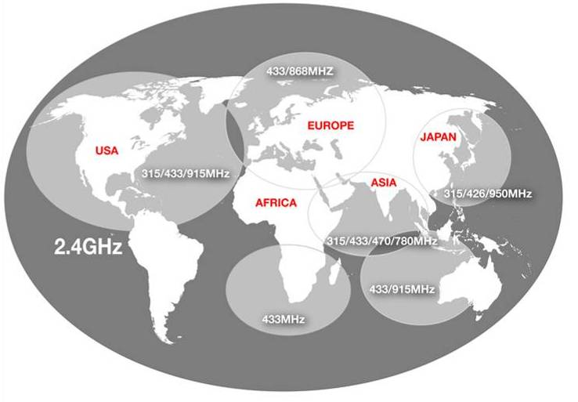
Regulations ISM/SRD Bands
Notes:
39
39

Slide 40
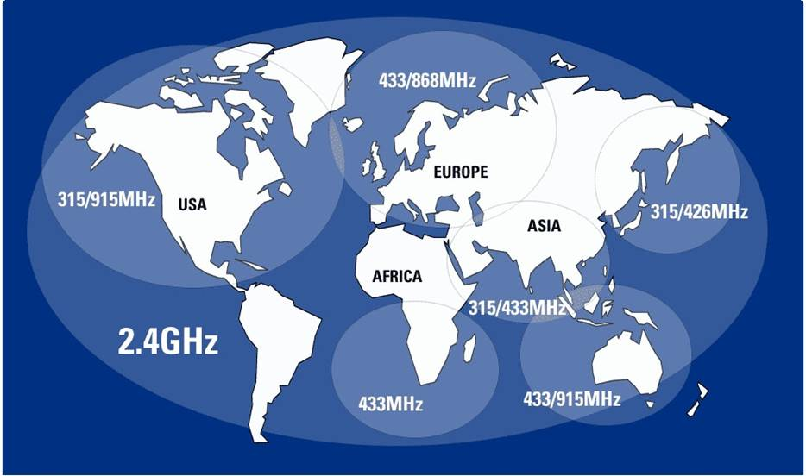



Regional Comparisons
United States
315/915MHz
2.4 GHz
Europe
433/868MHz
2.4 GHz
Japan
426MHz
2.4 GHz
Other National Requirements exist
Notes:
40
40

Slide 41
The “World-Wide” 2.4 GHz ISM Band
The 2400–2483.5 MHz band is available for license-free operation in most countries
2.4 GHz Pros
  Same solution for all markets without SW/HW alterations
  Large bandwidth (83.5MHz) available, allows many separate channels and high datarates
  100% duty cycle is possible
  More compact antenna solution than below 1 GHz
2.4 GHz Cons
  Shorter range than a sub 1 GHz solution (same output power)
  Many possible interferers are present in the band
Notes:
41
41

Slide 42
Frequency Spectrum Allocation
Unlicensed ISM/SRD bands:
USA/Canada:
  260 – 470 MHz (FCC Part 15.231; 15.205)
  902 – 928 MHz (FCC Part 15.247; 15.249)
  2400 – 2483.5 MHz (FCC Part 15.247; 15.249)
Europe:
  433.050 – 434.790 MHz (ETSI EN 300 220)
  863.0 – 870.0 MHz (ETSI EN 300 220)
  2400 – 2483.5 MHz (ETSI EN 300 440 or ETSI EN 300 328)
Japan:
  315 MHz (Ultra low power applications)
  426-430, 449, 469 MHz (ARIB STD-T67)
  2400 – 2483.5 MHz (ARIB STD-T66)
  2471 – 2497 MHz (ARIB RCR STD-33)
ISM = Industrial, Scientific and Medical
SRD = Short Range Devices
Notes:
42

Slide 43
Sub 1GHz ISM Bands
902-928 MHz is the main frequency band
  The 260-470 MHz range is also available, but with more limitations
The 902-928 MHz band is covered by FCC CFR 47, part 15
Sharing of the bandwidth is done in the same way as for 2.4 GHz:
  Higher output power is allowed if you spread your transmitted power and don’t occupy one channel all the timeFCC CFR 47 part 15.247 covers wideband modulation
  Frequency Hopping Spread Spectrum (FHSS) with ≥50 channels are allowed up to 1 W, FHSS with 25-49 channels up to 0.25 W
  Direct Sequence Spread Spectrum (DSSS) and other digital modulation formats with bandwidth above 500 kHz are allowed up to 1W
FCC CFR 47 part 15.249
  ”Single channel systems” can only transmit with ~0.75 mW output power
Notes:
43
43

Slide 44
Agenda
Definitions
RF Systems
Introduction to digital communication
Radio Frequency: Spectrum
Tools
Notes:
44

Slide 45
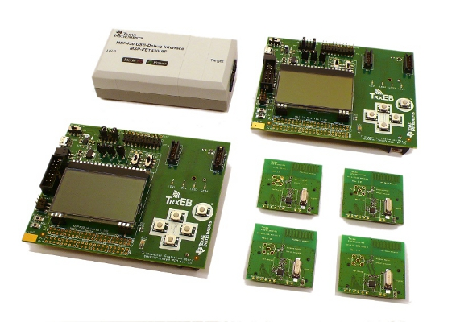
Development kits
Value Line CC110LDK-868-915 development kit contains
  2x TRXEB (new transceiver evaluation board)
  2x CC110L EM
  1x CC113L EM
  1x CC115L EM
  All EMs with PCB antennas
  Cables and docs
  Software needed for one way link & PER test
  Easy RF development with SmartRF Studio
Value Line 433MHz CC110LEMK-433 kit contains
  2x CC110L EM-433
  1x CC113L EM-433
  1x CC115L EM-433
  Based on existing CC1101 ref design
TRXEB with:
2x CC110L EM
1x CC113L EM
1x CC115L EM

Slide 46
SmartRF Studio version 7
SmartRF Studio is a PC application to be used together with TI’s development kits for ALL CCxxxx RF-ICs.
Converts user input to associated chip register values
  RF frequency, Data rate, Output power
Allows remote control/configuration of the RF device when connected to the PC via a SmartRF Evaluation Board
Supports quick and simple performance testing
  Packet RX/TX
  Packet Error Rate (PER)
Notes:
46
Download the tool here: www.ti.com/smartrfstudio
The tool is updated frequently – make sure you have the latest revision for the most up to date register settings and features.

Slide 47
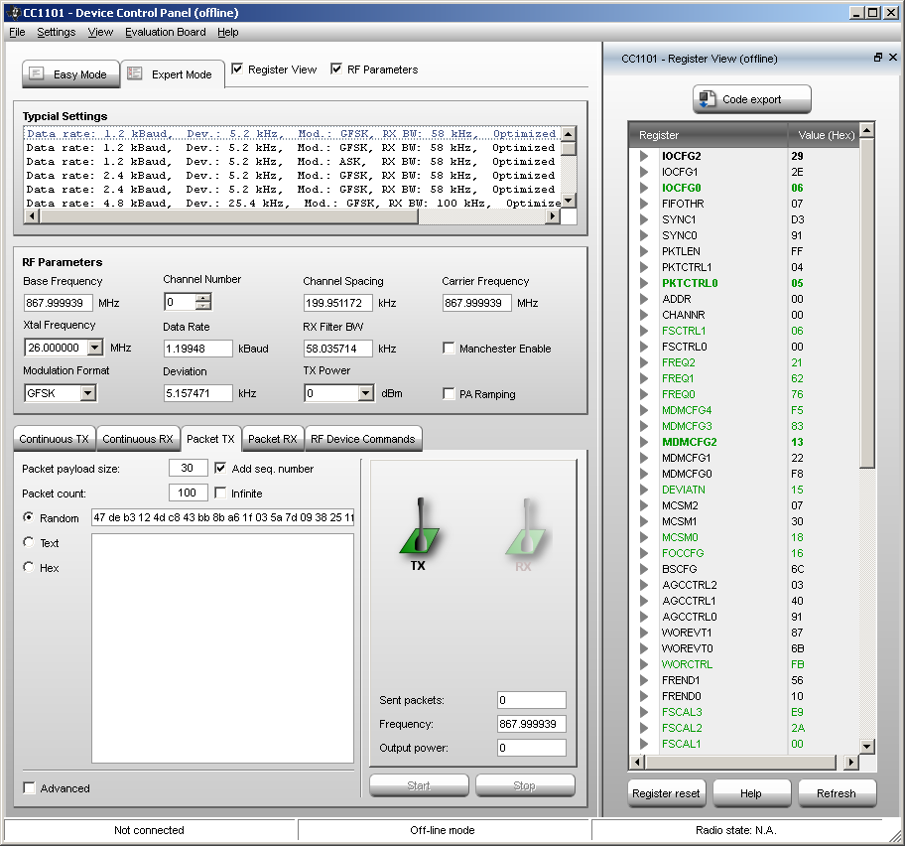
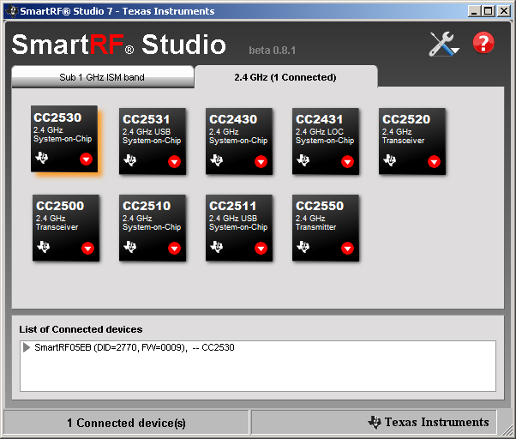
SmartRF Studio

Slide 48
Getting Started with TI LPRF
Questions?
Notes:
48

Slide 49
Backup
Notes:
49

Slide 50
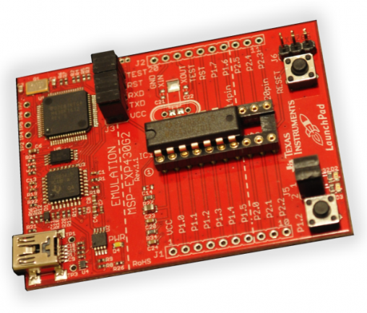
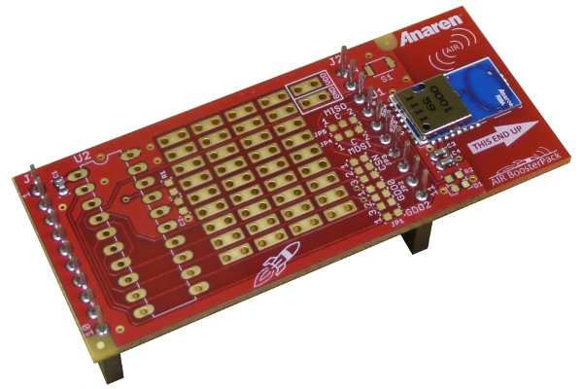
LPRF Value Line Tools Introduction
Booster pack EM for MSP430 launch pad
  Pair of compact CC110L-868-915 transceiver modules with PCB antenna mounted on PCB board for easy connection to MSP Launchpad
  Completely integrated module design
  Including RF certification for quickest time to market
  Module targeted to be used for development & volume production
  Module developed & certified by 3rd party

Slide 51
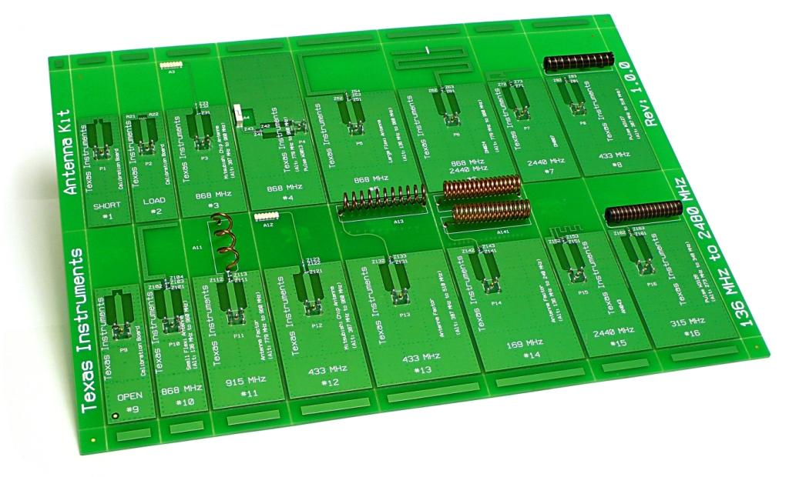
Antenna Evaluation Kit
Antenna reference designs (PCB, Chip and Wire antennas)
13 low cost antennas and 3 calibration boards.
Frequency ranges from 136 MHz to 2.48 GHz.
See also DN031
www.ti.com/lit/swra328
CC-ANTENNA-DK
Price $49
Notes:
51
The CC-Antenna-DK contains 13 low cost antennas and 3 calibration boards. The antennas cover the frequency range as low as 136 MHz to 2.48 GHz.
The main purpose of the CC-Antenna-DK is to ease the decision for which type of low cost antenna can be implemented as well as give an estimation of the performance that can be achieved.
All antennas are tuned for connecting to an EM board on the EB platform. A matching network is used on each antenna design so the antenna boards can matched for other GND sizes than the EB board.
Antennas are categorized under the operating frequency (169 MHz, 315 MHz, 433 MHz, 868 / 915 MHz or 2.44 GHz) and then the type of antenna (PCB Antennas, Chip Antennas, and Wire Antennas). The main focus is on PCB, Wire and Chip antennas, since these are mainly used in high volume products.
• 169 MHz (136 – 240 MHz) Antenna
• 315 MHz (273 – 348 MHz) Antenna
• 433 MHz (387 – 510 MHz) Antenna
• 868 MHz (779 – 960 MHz) Antenna
• 915 MHz (779 – 960 MHz) Antenna
• 2440 MHz Antenna

Slide 52
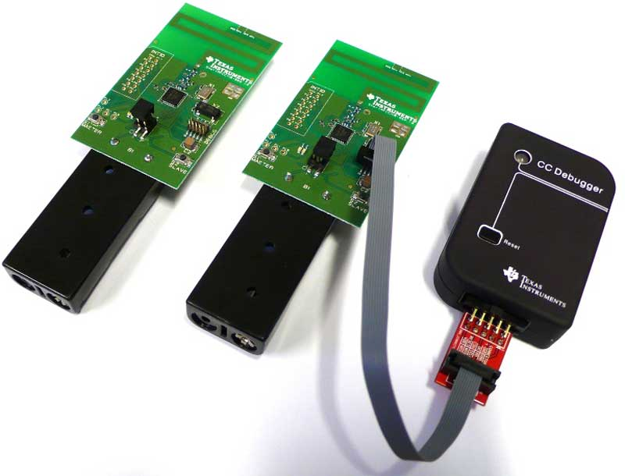
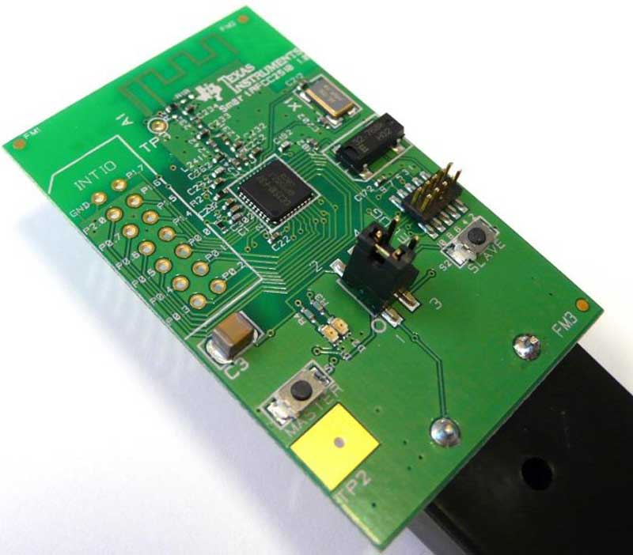
Mini-Development Kits
inexpensive flexible development platform for TI's CC2510Fx RF System-on-Chip solution.
CC2510Fx
- 26MHz single-cycle 8051 CC2500 RF transceiver
- FLASH, RAM, 5 DMA channels, ADC, PWM, UART, SPI, I2S, 4 timers, and 21 GPIO pins.
The target board in this kit is very close to a real product and features:
PCB antenna pre-tested for ETSI and FCC compliance
battery holders for 2x AAA or 1x CR2032 coincell operation
footprint for 2.54 mm connector connected to CC2510Fx GPIO pins
2 buttons & 2 LEDs for simple application development
pre-programmed with Link Test for RF range measurement

Slide 53
Antenna Evaluation Kit
Antenna reference designs (PCB, Chip and Wire antennas)
13 low cost antennas and 3 calibration boards.
Frequency ranges from 136 MHz to 2.48 GHz.
See also DN031
www.ti.com/lit/swra328
CC-ANTENNA-DK
Price $49
Notes:
53
The CC-Antenna-DK contains 13 low cost antennas and 3 calibration boards. The antennas cover the frequency range as low as 136 MHz to 2.48 GHz.
The main purpose of the CC-Antenna-DK is to ease the decision for which type of low cost antenna can be implemented as well as give an estimation of the performance that can be achieved.
All antennas are tuned for connecting to an EM board on the EB platform. A matching network is used on each antenna design so the antenna boards can matched for other GND sizes than the EB board.
Antennas are categorized under the operating frequency (169 MHz, 315 MHz, 433 MHz, 868 / 915 MHz or 2.44 GHz) and then the type of antenna (PCB Antennas, Chip Antennas, and Wire Antennas). The main focus is on PCB, Wire and Chip antennas, since these are mainly used in high volume products.
• 169 MHz (136 – 240 MHz) Antenna
• 315 MHz (273 – 348 MHz) Antenna
• 433 MHz (387 – 510 MHz) Antenna
• 868 MHz (779 – 960 MHz) Antenna
• 915 MHz (779 – 960 MHz) Antenna
• 2440 MHz Antenna

Slide 54
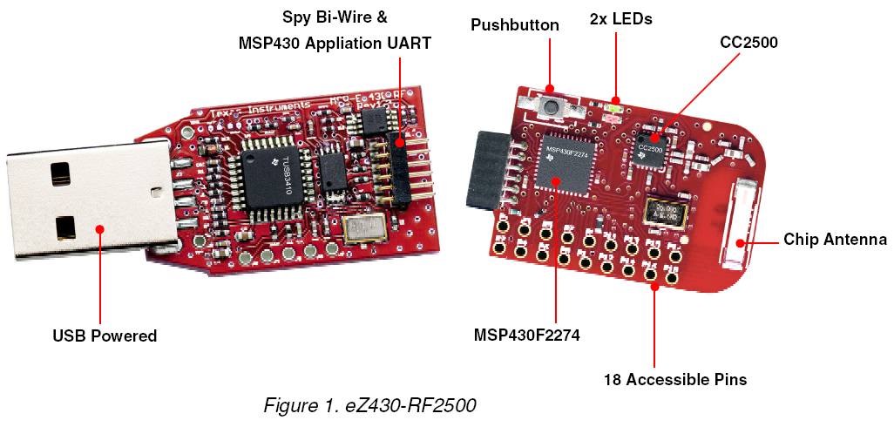
eZ430 – RF2500 Development Tool
MSP430F2274 Debug Chain via TUSBFET
MSP430F2274 UART to PC Virtual COM
Notes:
54

Slide 55
Software Stacks
Z-Stack - ZigBee Protocol Stack from TI
  One of the first ZigBee stacks to be certified for the ZigBee 2006 certification
  Supports multiple platforms such as CC2480, CC2431 and CC2520+MSP430 platform
  ZigBee 2007/PRO available on CC2530 and MSP430 platform
TIMAC
  A standardized wireless protocol for battery-powered and/or mains powered nodes
  Suitable for applications with low data-rate requirements
  Support for IEEE 802.15.4-2003/2006
SimpliciTI Network Protocol – RF Made Easy
  A simple low-power RF network protocol aimed at small RF networks
  Typical for networks with battery operated devices that require long battery life, low data
  rate and low duty cycle
RemoTI Remote control
  Compliant with RF4CE V1.0
  Built on mature 802.15.4 MAC and PHY technology
  Easy to use SW, development kits and tools
All software solutions can be downloaded free from the TI web
Notes:
55

Slide 56
Packet Sniffer
Captures and parses packets going over the air
Useful debugging tool for any protocol/SW designer
PC Tool available for FREE
Supported protocols
  SimpliciTI
  ZigBee RF4CE
  ZigBee 2007/PRO
  Generic protocol
Hardware required for packet sniffing
  CC2430DB
  CC1111, CC2511 and CC2531 USB Dongle
  SmartRF04EB + CC1110/CC2510/CC2430/CC2530
  SmartRF05EB + CC1110/CC2510/CC2430/CC2530/CC2520

Slide 57
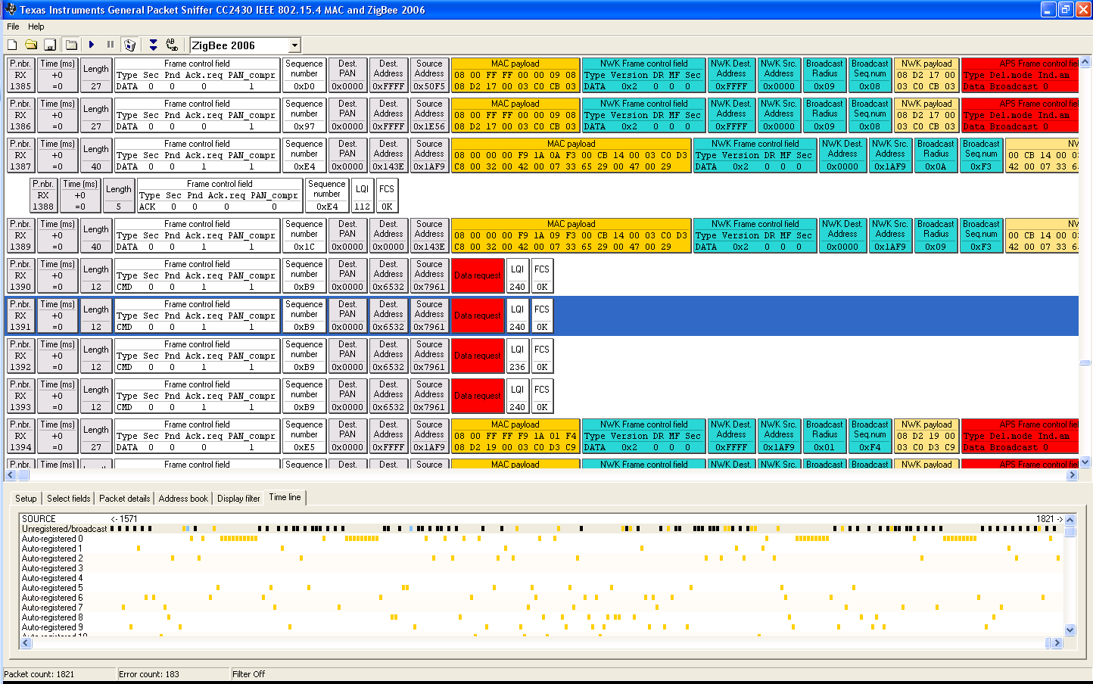
Packet Sniffer

Slide 58
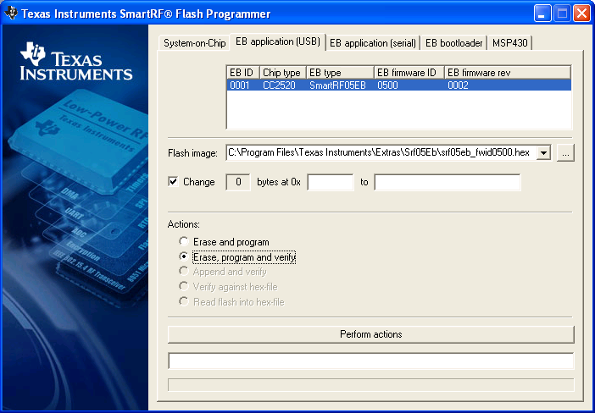
SmartRF Flash Programmer
Use this tool to program an application on a System-on-Chip
CC1110, CC1111, CC2510, CC2511, CC2430, CC2431, CC2530, CC2531
Program IEEE addresses on CC2430/CC2530
Can also be used to program MSP430s using either
MSP-FET430UIF or eZ430 Emulator Dongle
Firmware upgrades on the Evaluation Boards

Slide 59
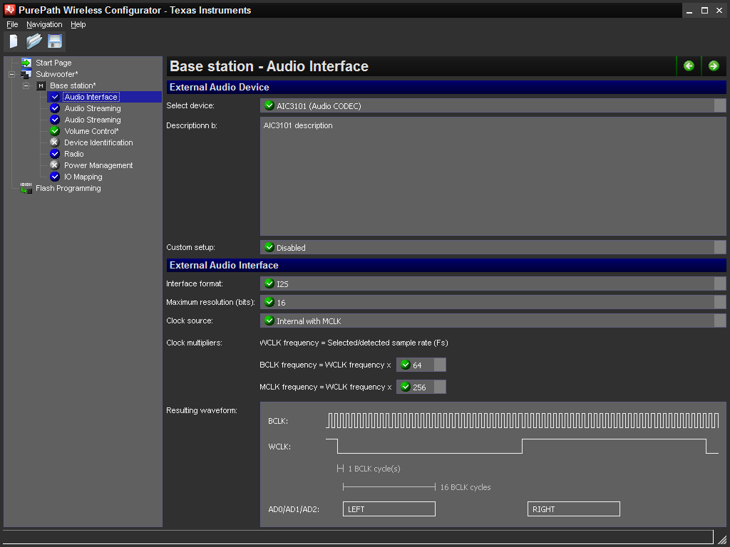
PurePath Wireless Configurator
Easy to use tool to configure the behavior of the CC8520 device
Configures e.g. audio interface, sample rate, I/O mapping
Customize the CODEC register settings
Generates a firmware image that can be programmed on the device

Slide 60
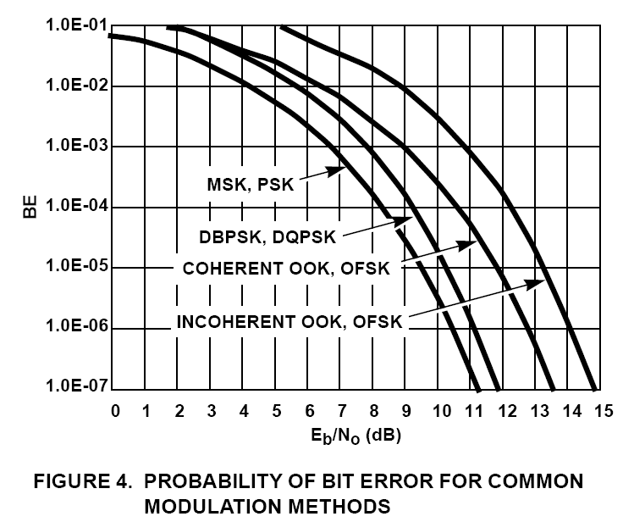
Probability of bit errors
Notes:
Note that QPSK is about 3dB better than FSK. Additionally, using FEC or the error correcting codes of the 802.15.4 specification improves the symbol error rate, but I haven’t included any of that here.

