Slide 1
CC112x Feedback to PLL
- Extending RX filter BW without increasing noise BW

Slide 2
Signal BW and RX Filter BW (1)
Assume 5 kbps and ±2.5 kHz frequency deviation and no frequency offset between RX and TX
  What is the signal bandwidth?
  What is the minimum required RX filter BW?
Receiver channel filter BW
IF = RF - LO
RF Frequency
0
Frequency offset
SBW = Symbol Rate + 2·freq dev
LO Frequency

Slide 3
Signal BW and RX Filter BW (2)
Assume 5 kbps, ±2.5 kHz frequency deviation, +/-10 ppm crystal tolerance in TX and RX, and 868 MHz operation
  What is the signal bandwidth?
  What is the minimum required RX filter BW?
  What is the theoretical degradation in sensitivity compared to using minimum RX filter BW (no frequency offset)?
Receiver channel filter BW
-X ppm
+X ppm
IF = RF - LO
RF Frequency
-2·X ppm
0
+2·X ppm
Frequency offset
-X ppm
+X ppm
RX BW > SBW + 4·Xppm·RF
LO Frequency
Notes:
Wider RX filter bandwidth:
Reduced sensitivity and close-in selectivity
Temperature compensation might not be neccessary
Allows cheaper (i.e. less accurate) crystal to be used
If the RX filter BW changes by a factor X, the theoretical sensitivity changes by 10log(X)

Slide 4
Measurement Results
5 kbps, ±2.5 kHz frequency deviation and 12.5 kHz RX filter BW
5 kbps, ±2.5 kHz frequency deviation and 50 kHz RX filter BW
If the RX filter BW changes by a factor X, the theoretical sensitivity changes by 10log(X)
  Theory matches measurements in this case!
12.5 kHz | 50 kHz
-118.5 dBm | -112.5 dBm

Slide 5
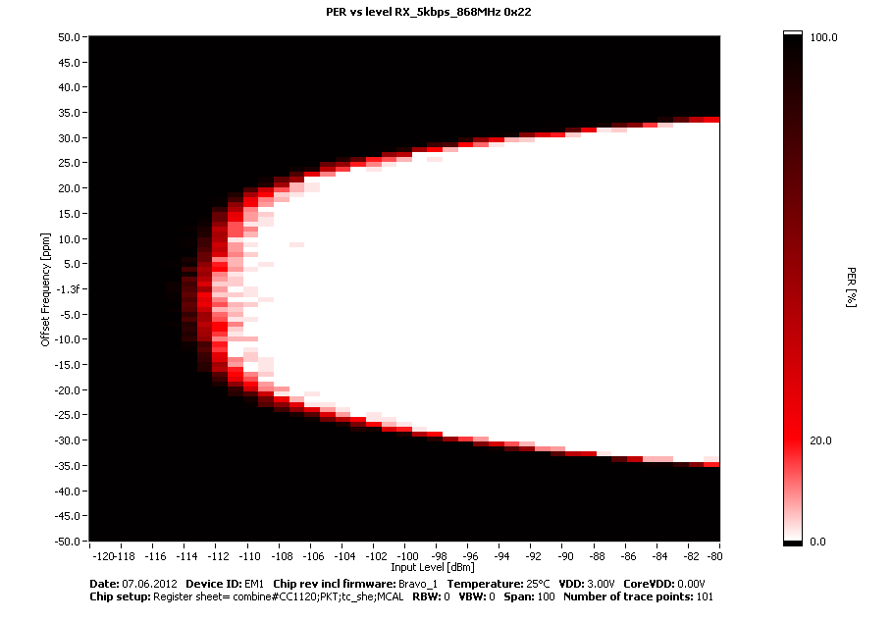
Crystal Accuracy

Slide 6
Feedback to PLL (1)
Extends RX filter BW without increasing noise bandwidth
FREQOFF_CFG = 0x30
  RX filter BW extended by ±BW/4
  Program 50 kHz Effective BW is 75 kHz
Programmed RX filter BW = noise BW
-X ppm
+X ppm
IF = RF - LO
RF Frequency
Negative Offset
No offset
Positive Offset
Extended RX filter
-X ppm
+X ppm
LO Frequency

Slide 7
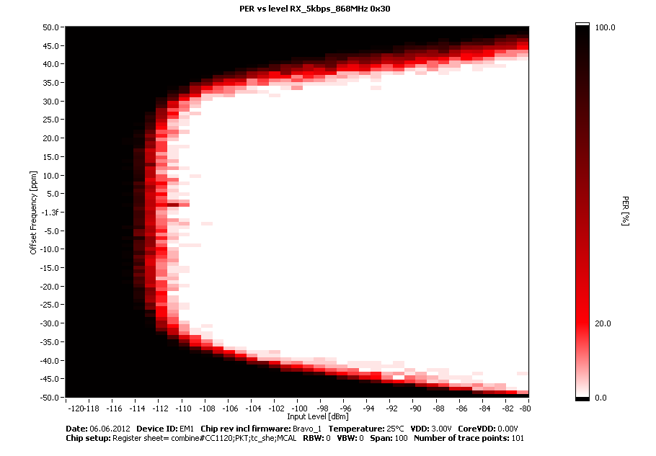
Crystal Accuracy

Slide 8
50 kHz
No feedback
to PLL
50 kHz and
feedback
to PLL

Slide 9
Feedback to PLL (2)
Assume 5 kbps, ±2.5 kHz frequency deviation, +/-10 ppm crystal tolerance,868 MHz operation, and using feedback to PLL
  What is the minimum required RX filter BW?
  What is the theoretical degradation in sensitivity compared to using 12.5 kHz RX filter BW (no offset case)?
  What is the theoretical improvement in sensitivity compared to using 50 kHz RX filter BW (no feedback to PLL case)?
12.5 kHz | 33.3 kHz | 50 kHz
-118.5 dBm | -114.5 dBm | -112.5 dBm

Slide 10
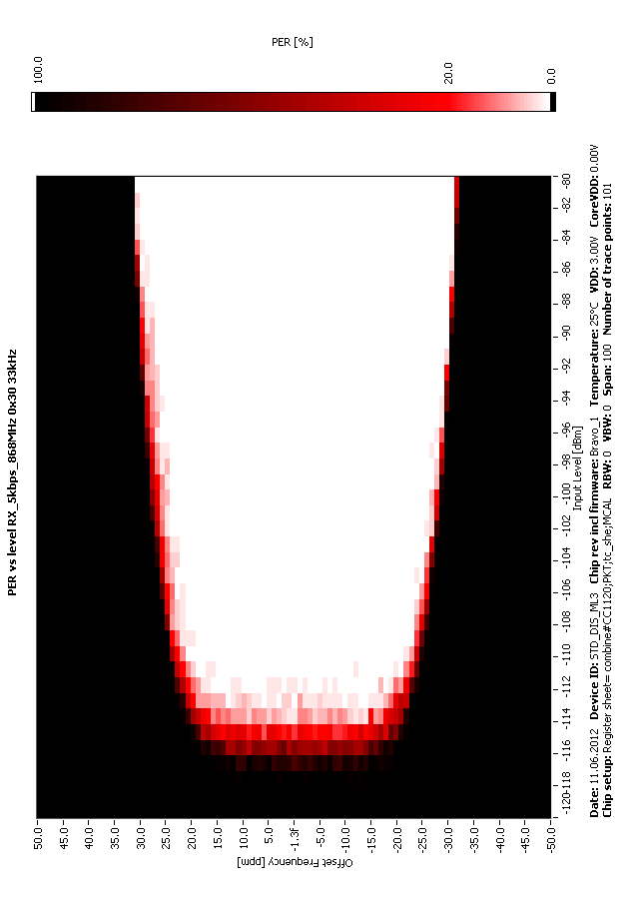
50 kHz
No feedback
to PLL
33.3 kHz and
feedback
to PLL

