Slide 1
Fundamental Rule
Auto correlation
  The sync word should not repeat itself as it will increase the likelihood of errors
Example
  Convert the sync word to a binary vector
  Run xcorr(2*sync_vector - 1)
  Plot the result
A good sync word has no side lobes

Slide 2
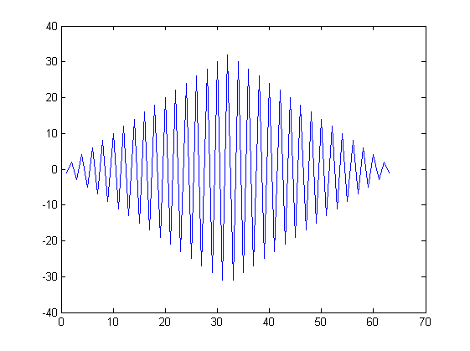
Example 1
Preamble as sync word
  0xAAAAAAAA

Slide 3
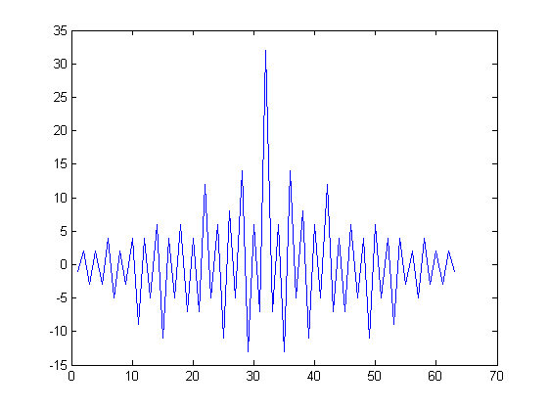
Example 2
A half random sync word
  0xBBA8E22A

Slide 4
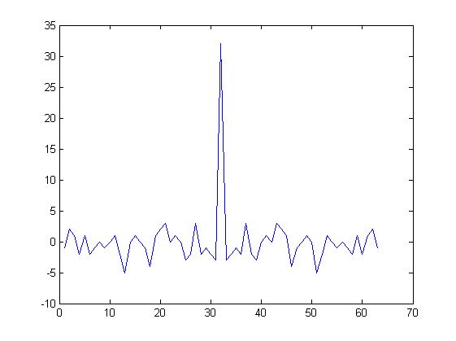
Example 3
Default CC1120 sync word
  0x930B51DE

