Slide 1
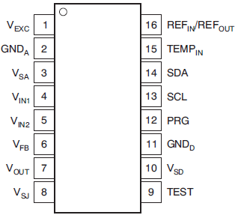
4
PGA309 Sensor board (without EEPROM)
PGA309
Sensor device
104
100Ω
100Ω
104
GND
10nF
V+(5V)
150pF
Sens_Out
Top side
Create the evaluation board
Install PGA309
Install sensor (P3->spec)
Force 5V to V+ and GND
Measure between Vexc and GND voltage, it was 0V.
Measure between Vsd and GND, Vsa and GND, there were 5V.
Measure between Out and GND was 0V.
Bottom seide
Via
Why is the voltage is not supplied to a sensor?
Unless it writes something in EEPROM, doesn't PGA309 work?

Slide 2
4
PGA309 Sensor Board (with EEPROM)
PGA309
Sensor device
104
EEPROM
100Ω
100Ω
104
GND
10nF
V+(5V)
150pF
Sens_Out
Top side
Create the evaluation board
Install PGA309
Install sensor (P3->spec)
Install blank EEPROM
Force 5V to V+ and GND
Measure between Vexc and GND voltage, it was 0V.
Measure between Vsd and GND, Vsa and GND, there were 5V.
Measure between Out and GND was 0V.
Bottom seide
Via
Why is the voltage is not supplied to a sensor?
Unless it writes something in EEPROM, doesn't PGA309 work?
Would you please teach to me the method of EEPROM programing and programing data.
Do you have any document?

Slide 3
4
I would like to do the following function by using PGA309.
Sensor output
Calculation of the approximate value of a sensor output
センサ素子出力の近似式
Differential output between Vin1 and Vin2 input(V)
Load
Load (full scale)
I would like to do the following function;
/ Linearization, Amplification, Offset compensation
/ Temperature drift compensation of output offset, Correction for temperature of sensitivity
Question:
/ Please let you know to me a flow to make PGA309 work.
/ When using PGA309 EVM-USB, which button and tab should be operated and
order?
/ When working EVM using our company's sensor, where should we just input for linearization and correction of temperature?
Please teach me concretely.

