Slide 1
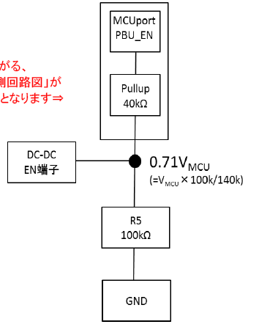
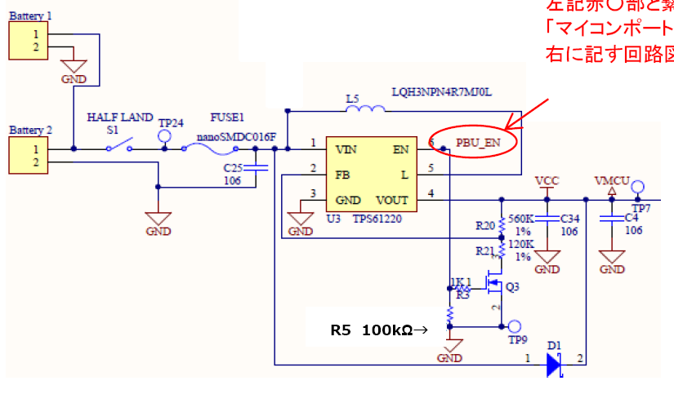
EN pin is controlled by MCU port.
Enable voltage is divided by pull-up resistor MCU inside 40kohm and 100kohm.
The connection between
MCU and EN pin
Application circuit
the voltage at shutdowm
Vin(V) | Vout(V)
3 | 2.13
2.9 | 2.06
2.8 | 1.99
2.7 | 1.99
2.6 | 1.99
2.5 | 1.99

Slide 2
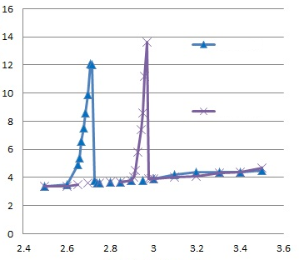
Input Voltage vs. quiescent current
Input current (uA)
sample1
sample2
Input Voltage (V)

