Slide 1
Non Isolated Power Supply Layout Design for EMI Mitigation
Yang Zhang
Denislav Petkov
Silicon Valley Analog
Notes:
1

Slide 2
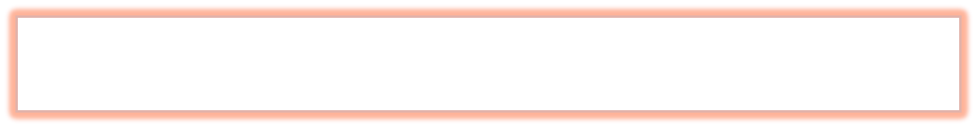

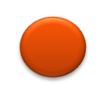

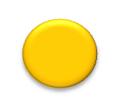

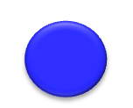
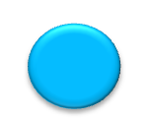
AGENDA
Introduction – EMI Overview
✓
Noise Sources Identification
✓
Minimize EMI Generation by Layout
✓
Protect Sensitive Circuits From Noise
✓
Conducted EMI and EMI Filters
✓
Summary
✓
© 2011 National Semiconductor Corporation.
2
Notes:
Transcript:
So, the agenda for this presentation, I'll start with an introduction of EMI problems in switch mode power supply, and then, how to identify the source of the noise in such topologies, then how to reduce the noise generation by PCB layout. And at the same time, how to protect the sensitive circuits on the same board from the noise, and then, I will cover briefly conducted EMI and the EMI filter. After this section, there will be an isolated and a high-power density PowerPoint design prepared by Youhao Xi.

Slide 3
AGENDA
Introduction – EMI Overview
✓
Noise Sources Identification
✓
Standard
EMI in SMPS
Definition
Minimize Noise Generation by Layout
✓
Protect Sensitive Circuits from Noise
✓
Conducted EMI and EMI Filters
✓
Summary
✓
Notes:
So, the first part of my presentation is an introduction. I will talk about the definition of the EMI, the standards, and the EMI problems in switch mode power supplies.

Slide 4
What is EMI & EMC?
EMI
(Electromagnetic Interference)
unwanted coupling of signals from one circuit to another, or to system
Conducted EMI:
coupling via conduction through parasitic impedances, power and ground connections
Radiated EMI: unwanted coupling of signals via radio transmission
EMC (Electromagnetic Compatibility)
An electrical systems ability to perform its specified functions in the presence of EMI generated either internally or externally by other systems
Notes:
EMI stands for electromagnetic interference. They are unwanted coupling of signals from one circuit to another or to the whole system. It has two major parts.
One is conducted EMI. One is radiated EMI.
Conducted EMI is coupled via conductions through the parasitic impedance, the power, and ground connections.
Radiated EMI are coupled through radio transmissions, and EMC stands for electromagnetic compatibility. It stands for electrical systems' ability to perform its specified functions in the presence of EMI generated by internally or externally by the other systems,

Slide 5
EMI/EMC Standards
EMC Standards vary by…
  Region
    US = FCC
    Europe = CISPR = EN
  Application usage
    Consumer
    Medical
    Automotive
  What standards do we use
    FCC part 15 B
    CISPR 22 = EN 55022
Notes:
5
The standards can vary by the region, by the application, so even two customers who are trying to use the same IC, they can apply totally different standards. So pay attention to special region and applications of a particular customer. And the standards we usually apply for our power supply is FCC part 15, sub-part B, and CISPR 22, which is the same as EN 55022,

Slide 6
EMI/EMC Standards Organizations
United States
Electrostatic Discharge Association (ESD)
Federal Communication Commission (FCC)
Institute of Electrical and Electronic Engineers (IEEE)
Institute of Interconnecting and Packaging Electronic Circuits (IPC)
National Institute of Standards and Technology (NIST)
International Society for Measurement and Control (ISA)
National Standards System Network (NSSN)
Society of Automotive Engineers (SAE) International
Telecommunication Industry Association (TIA)
Underwriters Laboratories, Inc (UL)
US Standard Developing Organizations (ANSI)
International
European Committee for Electrotechnical Standardization (CENELEC)
European Telecommunications Standards (ETSI)
Institute of Electrical and Electronic Engineers (IEEE)
International Electrotechnical Commission (IEC)
International Organization for Standardization (ISO)
International Special Committee on Radio Interference (CISPR)
International Telecommunication Union (ITU)

Slide 7
Links
EU EMC Directives: http://ec.europa.eu/enterprise/sectors/electrical/documents/emc/legislation/index_en.htm
EU EMC Standards List (24 Feb 2011):
http://eur-lex.europa.eu/LexUriServ/LexUriServ.do?uri=OJ:C:2011:059:0001:0019:EN:PDF
FCC Rules (Title 47 Telecommunications, Part 2): http://www.access.gpo.gov/nara/cfr/waisidx_10/47cfr2_10.html
FCC Rules (Title 47 Telecommunications, Part 15) Information Technology Equipment (ITE):
http://www.access.gpo.gov/nara/cfr/waisidx_10/47cfr15_10.html
FCC Rules (Title 47 Telecommunications, Part 18) Industrial, Scientific, & Medical Equipment (ISM):
http://www.access.gpo.gov/nara/cfr/waisidx_10/47cfr18_10.html
FDA Inspection and Compliance (Medical devices are exempt from FCC regulations):
http://www.fda.gov/ICECI/Inspections/InspectionGuides/ucm090621.htm

Slide 8
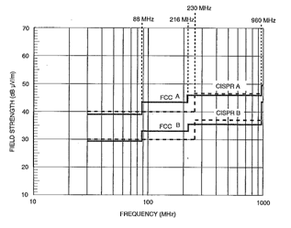
Conducted vs. Radiated Emission Limits
Conducted
Radiated
FCC/CISPR Conducted Emission Limits
FCC/CISPR Radiated Emission Limits
Measured at 10m
FCC and CISPR standards the same
FCC and CISPR standards somewhat different
FCC B (consumer) much more stringent than FCC A (commercial, industrial, and business)
Notes:
8
8
We showed the two most commonly used standards in our power supply design for both conducted and radiated in this slide. So, the CISPR and FCC standards are pretty close to each other, and CISPR is stricter than the FCC in the radiated specs.
Class B is even more restricted than Class A. So, we trying to design our power paths as Class B, so that it can be used by all the customers in different regions,
Conducted limits ends at 30Mhz
Radiated limits start at 30Mhz
If you fail conducted you will probably fail radiated.

Slide 9
How Does Noise Show Up in the System?
NOISE SOURCE
Emissions
ENERGY COUPLING MECHANISM
Conducted
Electric Fields
Magnetic Fields
Radiated
Low Frequency
Low, Mid Frequency, LC Resonance
High Frequency
SUSCEPTIBLE SYSTEM
Immunity

Slide 10
Engineering Approach To Mitigate EMI
NOISE SOURCE
Identify Significant EMI Sources
Unwanted Emissions
EMI Filters
Shielding
Figure Out EMI Coupling Paths
ENERGY COUPLING MECHANISM
Conducted
Electric Fields
Magnetic Fields
Radiated
Engineer Circuit Layout To Mitigate EMI
EMI Filters
Shielding
Add EMI Filter / Snubber / Shielding
SUSCEPTIBLE SYSTEM
Notes:
So, as power engineers, what should we do to reduce the problem? We shall start with identifying the source of the noise, and then, figure out the path of the noise transmission. Then, use the proper PCB layout to reduce the noise generation and the transmission. If these are not good enough, we can add some EMI filters, add some snubbers, and some additional shielding to add further protection to the susceptible systems.

Slide 11
SMPSs Are Big Generators Of Radiated And Conducted Emissions
Switch Mode Power Supply
Supply
LOAD
Due to
  High power
  High di/dt on the switches and diodes
  Fast transients (voltage and current)
  Not generally enclosed (not shielded)
  Parasitic inductance and capacitance in current paths
Causing
  Noise Conducted to Supply and / or Load
  Interfere with circuits in the same system
  Interfere with other systems
Notes:
11
Switch mode power supplies are generally big generators of radiated and conducted emissions. Due to its high-power, high di/dt on the power switches, fast transitions, and the fact that they are not generally enclosed. This is exacerbated by the parasitic inductance and capacitance in the current paths.
Switch mode power supplies can also generate large conducted emissions that might make it back to the supply or the load, and compromise their operation.

Slide 12
Electrically Small Loop Antennas
Electro Magnetic Field Energy is *:
  f: frequency of interest (Hz)
  A: loop area of the current path (meters squared)
  I : Current magnitude at the frequency of interest (A)
  R is measured distance between source and receiver (meters)
*Henry Ott’s classic Noise Reduction Techniques in Electronic Systems
Notes:
This comes from Henry Ott's EMI reduction techniques. It claims that the electromagnetic field energy is proportional to the square of the frequency. And also, it's proportional to the loop area enclosed by the current paths and proportional to the current magnitude at the frequency of interest and the inverse proportional to the measured distance from the source of the noise. So, it comes to a conclusion from here that to reduce the noise generation, we could reduce the switching frequency. We could reduce the high-frequency component in the di/dt current transition or we can reduce the high-frequency current loop area.

Slide 13
Theory Behind EMI Mitigation by PCB Layout
Any Current must go from a source of energy and they must RETURN to the same source
Self Inductance
Voltage Spike
Reduce loop area reduces L
B fields cancel each other if current return path is close to current path
13
Notes:
First of all, a current. A current always has to come from a source of energy, and they must go back to the same source. So, there will always be a current loop, and the self-inductance of the current loop is proportional to the area enclosed by the current loop. If there is di/dt current transition exists in the current loop-- a voltage spikes is going to be generated, and the voltage spikes is proportional to its self-inductance and proportional to the di/dt.
If we can reduce the loop area similar to the picture shown at the bottom, you can see that the loop area is largely reduced. So, the self-inductance can be smaller, and the voltage spikes can be reduced. Also, if the current return paths can be very close to the current paths, the B field generated by the two opposite direction current can be almost canceled.

Slide 14
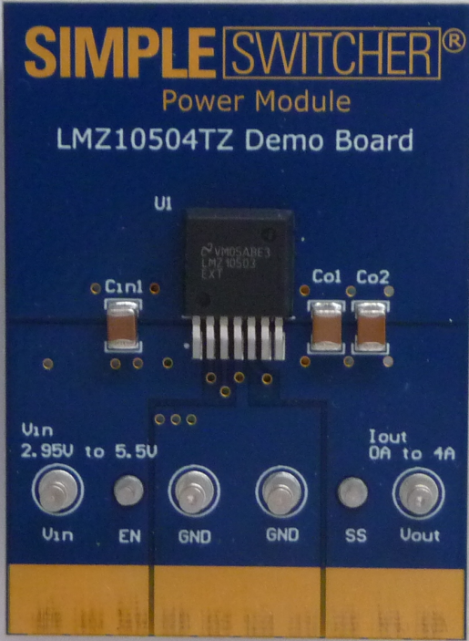
Theory Behind EMI Mitigation by PCB Layout
Which PATH is the current going to take?
Current Takes the Path of Least IMPEDANCE, NOT the Path of Least RESISTANCE!
Z = R + jX
  High freq components contained by high di/dt current can go through different path than their low freq counterpart
Thus, the loop area enclosed by high freq components can be completely different
HF Current Path
DC Current Path
Notes:
How can we identify the paths that the current is going to take?
It comes from the characteristic of the current. It always takes the path of the least impedance, but not the path of the least resistance. And the impedance is a combination of the resistance, the inductance, and the capacitance on the path. So, the high current components contained by the high di/dt current can go through different paths than their low-frequency counterpart, and the loop area enclosed by the high-frequency component can be completely different as well. An example is shown on the right by a Simple Switcher Power Module board. So, the right arrow shows the DC current paths defined by the PCB layout design when you do the board. You have input current go in from Vin and go out to ground, and the output current go out to Vout and go back to ground. But the high current component in the input and output current is going to see the capacitors as smaller impedance paths at high frequency. So, the paths they are going to go is shown by the current loops on the picture, and is completely different than the DC current path.

Slide 15
Theory Behind EMI Mitigation by PCB Layout
ElectroMagnetic Field Energy is Proportional To*:
  f²: frequency of the harmonic of interest
    From switching frequency and di/dt
  A: loop area of the current path
  I_{f}: current magnitude at the frequency of interest
  1/r: measured distance r
Reduce Noise Generation
  Reduce fsw and high freq component in di/dt
  Reduce high freq loop area
*Henry Ott’s classic Noise Reduction Techniques in Electronic Systems

Slide 16
EMI Mitigation
Choice of Switching Frequency
Not just for efficiency/space trade-offs
Beware of EMI “keep out” zones
  Automotive = 500kHz < AM Band > 2MHz
  ADSL = >1.24MHz to avoid channel interference
  Harmonics
Choose switching frequency that keeps beat frequency and harmonics out of the EMI range
Spread-Spectrum Switching
LM5088 dithers frequency
and shows up to 20dB
decrease in EMI
Fundamental switching frequency spike reduction and sidebands using spread spectrum switching in the LM5088
Notes:
16
16
16
We discussed briefly the choice of switching frequency in terms of meeting conducted emissions, but also it could be application specific. For example, there may be keep out zones that the customer's trying to meet. He has a range of frequency where it needs to be particularly quiet at because he's sampling at that rate, for example. For automotive applications, we know that it has an AM receiver; And typically in the old cars you'll put it on the AM band and you're twiddling with the knob, and you press on the accelerator, you can actually hear the engine, the revs per minute. You can hear the (inaudible) on the radio. That's typically an EMI problem. That band is between 500KHz and 2MHz, so automotive applications are particularly sensitive to noise in that range.
Another technique, if you like, for minimizing EMI noise is spread-spectrum switching. As you can on the graph on the right hand side, you can see where you're not dithering the frequency, you can see a huge energy pulse at the switching frequency. However, for example, by using the LM5088, this dithers the frequency in a controlled fashion by plus or minus 5%, thereby spreading the energy that's seen in the frequency domain over a wider range, bringing its peak to a lower level. And thereby it could be the difference between passing and failing EMI certification.

Slide 17
Steps To Mitigate EMI In PCB
Where is high di/dt?
Where is the Critical PATH?
How to reduce di/dt and LOOP area?
Switching components generate high di/dt current ➔ where is the return path?
Loop Contains high di/dt current is CRITICAL PATH.
Slow down switching action
Reduce high freq path enclosed area
Notes:
And so, in switch mode power supply PCB design, we should first identify the location of the high di/dt noise, and then, identify the return paths of the high di/dt current, which we call the Critical Paths of the board design, and then, we can reduce the di/dt and reduce the loop area, to reduce the noise generation.

Slide 18
AGENDA
✓
EMI Overview – definition and standards
✓
Noise Sources Identification
Minimize EMI Generation by Layout
✓
Boost
Buck Boost
Buck
Protect Sensitive Circuits from Noise
✓
Conducted EMI and EMI Filters
✓
Summary
✓
Isolated and High Power Density Power Supply Board
✓
Notes:
So, the first step is to identify the source of the noises in switch mode power supplies. So, in my section of the presentation, I'm going to cover the non-isolated DC-DC converter topologies, which is Buck converter, Boost converter, and Buck-Boost converter, and in the coming session, we'll cover the isolated converter topologies.

Slide 19
Identify Critical Path
Buck Converter
Switching Current exist in the input side
Boost Converter
Buck-Boost Converter
Critical path
Notes:
19
19
19
In a Buck converter, it is obvious that the power switches is going to be part of the high di/dt loop, but which ground connection is more critical than the others? How we find out is by identifying the current path of the two sub-sections in switching period of this converter.
When the high-set FET is on, the current is going to go through the blue trace, and when the low-set FET is on, the current is going to through the pink trace, shown in this slide. And if a branch contains both of the two colored lines, that means 100% of the time of the switching period, there is current going through this branch, and we consider that a DC current path. If a branch only contains one of the colored lines, that means only a part of the switching period has a current going through this branch, and the current is going to be discontinuous.
So, we consider those to be high di/dt paths and the critical paths of the PCB layout. So, in Buck converter, this is shown as the shaded loop, which contains the high-side switch, the low-side switch, and the input capacitor.

Slide 20
Identify Critical Path
Buck Converter
Boost Converter
Buck-Boost Converter
Critical path
Notes:
20
20
20
We can do the same thing in the Boost converter, and the critical path is contained by the two switching components and the output capacitor.

Slide 21
Identify Critical Path
Non-Inverting
Buck Converter
Boost Converter
Inverting
Critical path
Buck-Boost Converter
Notes:
21
21
21
Now, inverting Buck boost is shown here, and the Buck boost. In both the input and output current are discontinuous.

Slide 22
What Can We Do In PCB Layout?
--Buck example
Buck Converter
Boost Converter
Buck-Boost Converter
Minimize critical path area
Separate noisy ground path from quiet ground
Notes:
22
22
22
Layout the pcb with the small loops. Sometimes extra capacitors are
Needed to bypass the noise.

Slide 23
What Can We Do In PCB Layout?
--Buck-Boost example
Non-Inverting
Buck Converter
Boost Converter
Buck-Boost Converter
Notes:
23
23
23

Slide 24
AGENDA
EMI Overview – definition and standards
✓
Noise Sources Identification
✓
Minimize EMI Generation by Layout
✓
Protect Sensitive Circuits from Noise
✓
Grounding
Critical Path Area Reduction
EMI Filters
✓
Summary
✓
Isolated and High Power Density Power Supply Board
✓
Notes:
So, now, we are going to talk about PCB layout. How do we minimize the EMI generation, and we are going to talk about it in two-folds. One is, how to reduce the path's loop area. The other is, how proper grounding can help in EMI reduction?

Slide 25
EMI Mitigation by PCB Layout
Critical Path Area Reduction
Grounding
BUCK Example
Bypass Caps in High di/dt loop should be placed as close as possible to the switching components
Low side FET SOURCE should be connected as close as possible to the input capacitor
Apply to critical paths in other SMPS topologies
High di/dt Caps
SW Node
FETs & Driver
Notes:
So, we go back to the Buck example. As we said before, the goal is to put the Bypass Caps in the high di/dt loops as close as possible to the switching components. And the low-set FET source should be connected as close as possible to the Bypass Caps ground, and the same thing applied to all the other topologies.

Slide 26
Lower EMI can be achieved by…
Place capacitors on
same side of board
as component being
decoupled
Locate as close to
pin as possible
Keep trace
width thick
Connecting to decoupling capacitors
Connecting to output capacitors
Notes:
26
26
26

Slide 27
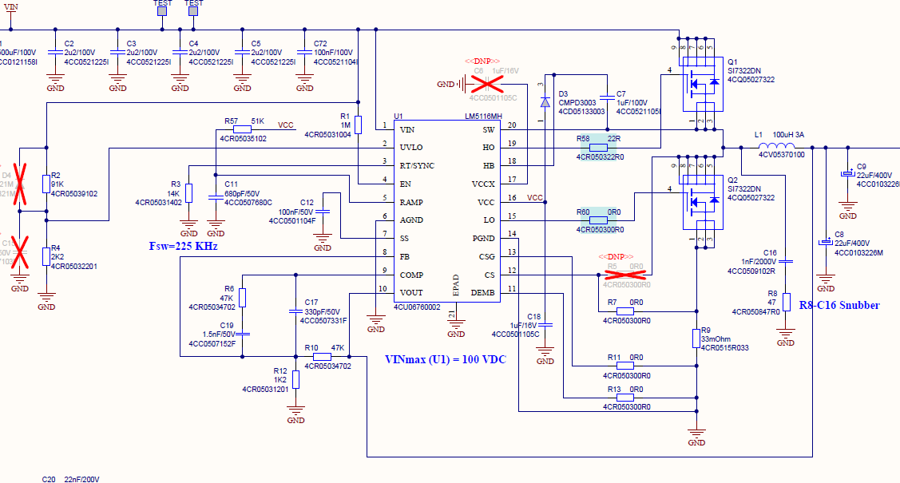
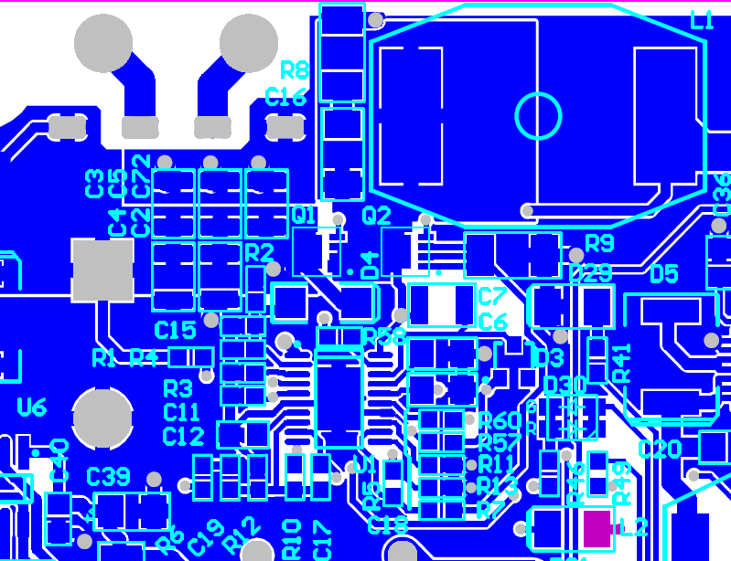
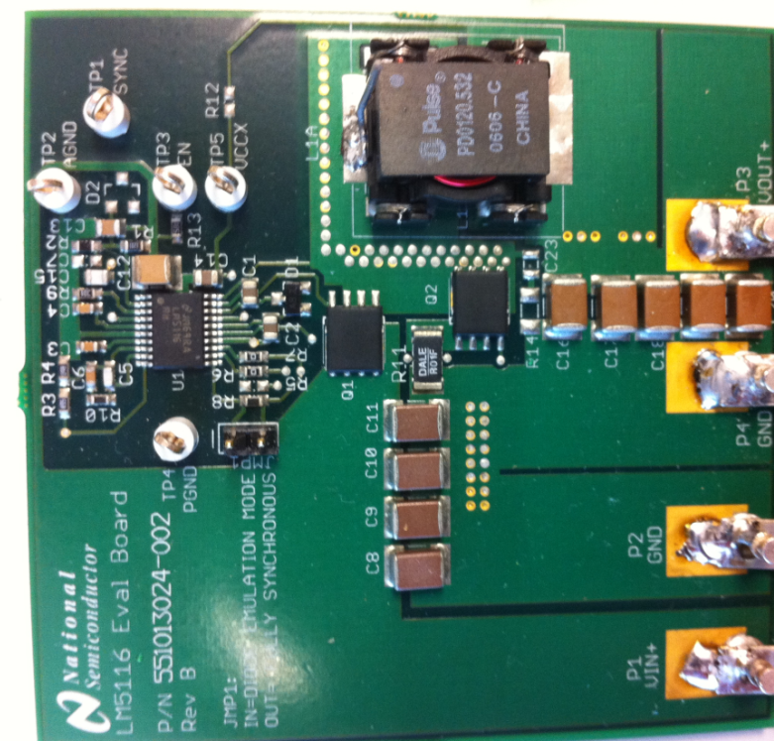
Customer Layout Example
BUCK controller Input Cap GND connection
Input Cap GND
LS FET GND
Customer Board
Eval Board
Input Cap GND
LS FET GND
LS FET GND
Input Cap GND

Slide 28
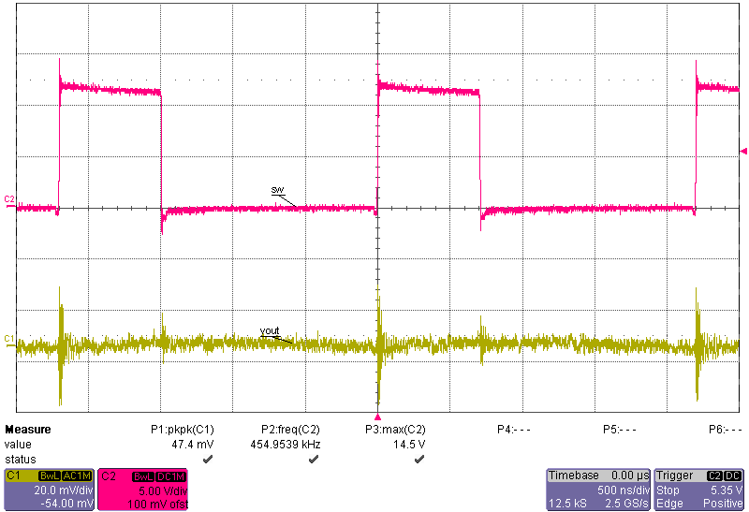
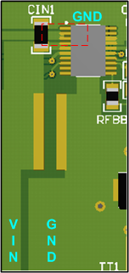
EMI Mitigation by PCB Layout
Critical Path Area Reduction
Grounding
Buck Regulator Comparison with Cin location (single Cin, smaller loop area)
High di/dt Caps
SW Node
SW 14.5V max
41dBµV/m
VOUT 47mVpp
FETs & Driver
VOUT
VIN
28
Notes:
Also, to show the effect of the high di/dt paths, bypass capacitors, we did an experiment here. We have only one -- this board is a Buck regulator switch amp load, and we only use one input capacitor for this comparison. And in the first case, the capacitor is put as close as possible to the IC pins, which contains the switching components inside. So, we measure the switch node at the peak current, the Vout peak-to-peak ripple, and the radiated EMI data.

Slide 29
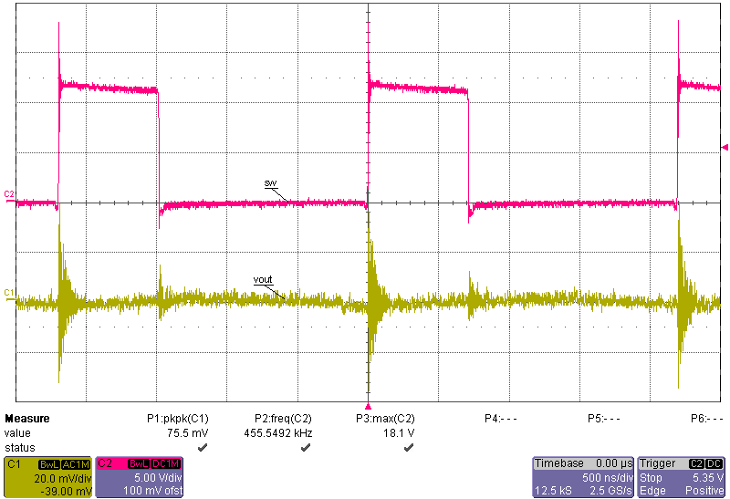
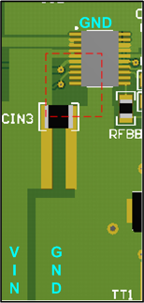
EMI Mitigation by PCB Layout
Critical Path Area Reduction
Grounding
Buck Regulator comparison with Cin location (single Cin, 2.5 times larger area)
High di/dt Caps
SW 18.1V max
SW Node
44dBµV/m
FETs & Driver
VOUT 75mVpp
Comparison | SW max (V) | Vout p2p (mV) | EMI peak (dBµV/m)
Smaller Area | 14.5 | 47 | 41
Larger Area | 18.1 | 75 | 44
29
Notes:
And as a comparison, the input capacitor is moved to be a little bit further away from the pins, and the loop area is about 2.5 times bigger comparing to the first case. And the measurement we did, we see that the switch node maximum voltage is about 3.6 volts more, and the Vout peak-to-peak ripple is about 50% more, and the EMI peak also shows 3 dB micro volt per meter more. And all the other parts of the board -- all the other part of the BOM are identical in this comparison.

Slide 30
EMI Mitigation by PCB Layout
Critical Path Area Reduction
Grounding
Minimize loop area enclosed by high-side FETs, low-side FETs, and bypass caps
Connect the low-side FET’s source to the input- cap ground directly on the same layer, then connect to the ground plane
Use copper pours for drain and source connections to power FETs
Minimize stray inductance in the power path
High di/dt Caps
SW Node
FETs & Driver

Slide 31
EMI Mitigation by PCB Layout
Critical Path Area Reduction
Grounding
Swings from V_{IN} or V_{OUT} to ground at Fsw. Very high dv/dt node! Electrostatic radiator
Requires a contradiction:
  As large as possible for current handling,
  yet as small as possible for electrical noise reasons
Solutions:
  Keep inductor very close to FETs, sw-node short & wide
  Minimum Copper Width Requirement:
High di/dt Caps
SW Node
FETs & Driver
Where T = Trace width in mils, A is current in Amps, and CuWt is copper weight in Ounces. Formula works over a range of 1A to 20A.
Or roughly 30mils per amp for 1 Oz Cu and 60 mils per amp for ½ Oz Cu
Notes:
After talking about the bypass capacitors, there is a node in this high di/dt loop we normally call the switch node because the voltage swings from Vin or Vout to ground at the switching frequency, and it is a very high dv/dt node. It can be a radiator of EMI, but the layout of this node has a contradiction.
It should be as big as possible for the current handling and thermal handling, and yet, as small as possible to reduce the noise radiation. So, the solution should be that we should keep the inductor as close as possible to the FETs and keep the switch node trace to be short and only as wide as necessary to carry the current.
To make matters worse the SW is also often a heat-sink for the low side switch.

Slide 32
EMI Mitigation by PCB Layout
Critical Path Area Reduction
Grounding
Gate drives are also high di/dt paths, lower current level
Place drivers close to MOSFETs
Keep C_{BOOT} and V_{DD} bypass caps very close to driver and FETs
Minimize loop area between gate drive and its return path: from source of FET to bypass cap ground
Minimize stray inductance in the power path
  Avoid vias in di/dt path
  Short trace and width >0.5mm for C_{BOOT}, C_{VDD-bypass}, and Gate drive
High di/dt Caps
SW Node
FETs & Driver
Notes:
Gate drive signals are also high di/dt signals. They just have smaller power level comparing to the power track current.
So, the drivers should also be placed as close as possible to the MOSFETs, and the Boot capacitors and the VDD bypass capacitors should be placed as close as possible to the drivers and the FETs. And the loop area between the gate drive and its return paths should be as small as possible, the paths being from the source of the FET to the bypass caps ground. To minimize the stray inductance in the gate drive paths, vias should be avoided in the gate drive signal, and also the traces for the Boot cap, the Bypass caps, and the gate drive would be best to be short and wide.

Slide 33
EMI Mitigation by PCB Layout
Critical Path Loop Reduction
Grounding
Contradiction on SW node transition rate:
  Faster Rising and Falling Times
  = Less sw losses
  = higher EMI generated
Options to Slow Down Rise / Fall Time
  Use gate resistor to soften gate ringing
  Keep between 1 to 10ohms
  Low capacitance schottky diode to improve turn off time
High di/dt Caps
SW Node
FETs & Driver
Resistor in Series with Cboot to Slow Down HS FET Rising Rate
Resistor in Series w/ Gate to Slow Down both Rising and Falling Rates; Diode to Reduce Falling Time
Notes:
Here is another contradiction in the switch node transition rate design. If you have a faster rising and falling time on the switching current, which is controlled by the gate drive of the MOSFET, then you will have smaller switch losses, but at the same time, the EMI generated by the di/dt is going to be higher.
So, here, I showed two options of how to slow down the rise and fall time of the power MOSFET if it is needed. The idea is to add gate resistors to slow down the Pin and Pout time. The resistor should be kept to about 1 to 10 ohms, and if in a controller case, you have access to the gate, then a schottky diode can be added in parallel to the gate resistors to increase the falling time, and also to pull on the gate harder to reduce the likelihood of shoot-through problems.

Slide 34
EMI Mitigation by PCB Layout
Critical Path Loop Reduction
Grounding
Ground Plane
  Return Current Takes The Least IMPEDANCE Path
  Unbroken Ground Plane Provides Shortest Return Path – Image current return path
Trace or Cut on the ground plane
Ground Plane
Current flow in top layer trace
Ground Plane
Return current path in unbroken ground plane directly under path
Area minimized
B field minimized
Return current path enclose much larger area if the direct path is blocked
Notes:
So, after talking about the critical paths loop reduction, I want to also cover how to design the ground plane and shielding and how that is going to help with the EMI problem. So, an unbroken ground plane could provide the best -- the least impedance paths for a counter trace on the top or on the bottom to return to the current source. And if the current is right on top of each other, the loop area is minimized, and the EMI generated by the loop is small as possible, and the B-field can be canceled as well. The case shown on the right that if you have a cut in the ground plane, then, the return current has to find a longer path to go around the cut, to return to the current source. Then, the area enclosed by the current is much bigger and the EMI problem is going to be worse.

Slide 35
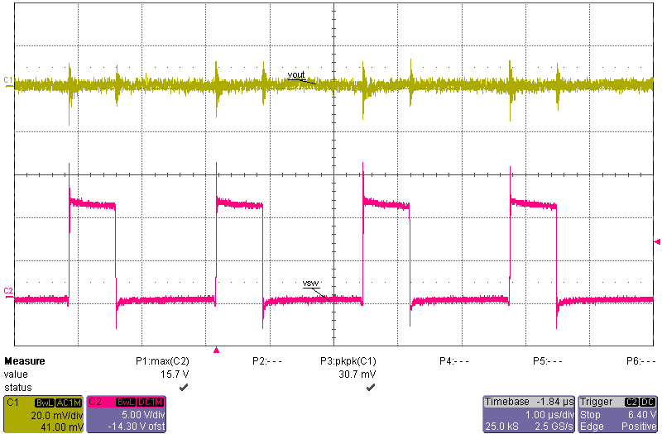
EMI Mitigation by PCB Layout
Critical Path Area Reduction
Grounding
Ground Shielding Example – Two Layer Board
VOUT 30mVpp
SW 15.7V max
32.5dBμV/m
Notes:
In the first case, we have a two-layer board, which is also a Buck regulator 3 amp load level, and we also married the Vout peak-to-peak ripple, the switch node maximum voltage spike, and also, the radiated EMI number.

Slide 36
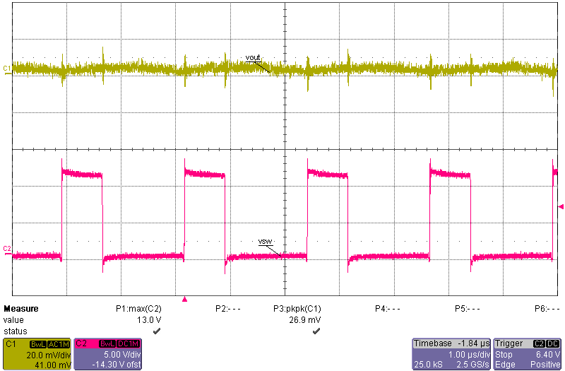
EMI Mitigation by PCB Layout
Critical Path Area Reduction
Grounding
Ground Shielding Example – Four Layer Board w/ Identical Layout / BOM – Two GND Planes in between
VOUT 23mVpp
SW 13V max
27.5dBμV/m
Comparison | SW max (V) | Vout p2p (mV) | EMI peak (dBµV/m)
Two Layer | 15.7 | 30 | 32.5
Four Layer | 13.0 | 23 | 27.5
Notes:
It's the same board. It's the same layout and it's the same BOM and it's the same part as built up in a four-layer board with two ground planes in the middle, and to compare the things we care about. We can see that at the switch node, peak ripple is reduced by 2.7 volts. The peak-to-peak on the Vout is 7 millivolt smaller, and also, the peak of the radiated EMI is 5 dB microvolt per meter smaller.

Slide 37
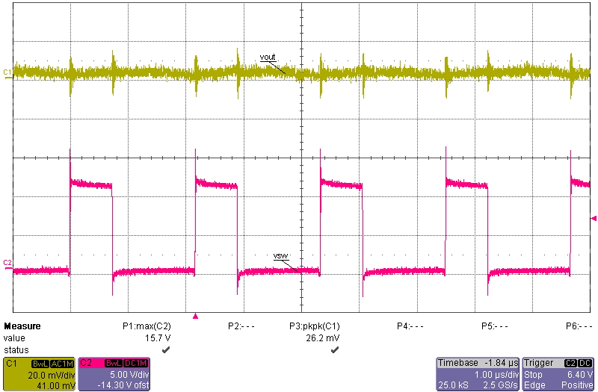
EMI Mitigation by PCB Layout
Critical Path Area Reduction
Grounding
Ground Shielding Example – Four Layer Board w/ Identical Layout / BOM – w/ CUT under SW node
VOUT 26mVpp
SW 15.7V max
32.5dBμV/m
Comparison | SW max (V) | Vout p2p (mV) | EMI peak (dBµV/m)
Two Layer | 15.7 | 30 | 32.5
Four Layer | 13.0 | 23 | 27.5
Four Layer w/ GND cut | 15.7 | 26 | 32.5
Notes:
A third case we did is, all the same thing as before, but we have a cut on the ground plane right underneath the switch node. And then, from the table here, we can see that shielding is not as good as a solid ground plane. The switch node ripple, the Vout peak2peak and the EMI are all higher than the second case, which has two solid ground planes in between.

Slide 38
EMI Mitigation by PCB Layout
Critical Path Area Reduction
Grounding
Ground Plane
  Unbroken Ground Plane provides shortest return path to EMI and Best Shielding
  Don’t cut ground plane
  Keep high power, high di/dt current away from ground plane, run separate paths on the top layer to contain it
  Ground plane is for DC distribution and signal reference only, ideally, there should be no current flow on ground plane
  Bypass to ground PINs, not the plane
Notes:
General rules for the ground plane. An unbroken ground plane provides the shortest return path to EMI and best shielding. So, don't cut the ground plane, and we should keep the high power high di/dt current away from the ground plane. Run separate paths on the top layer to contain the high di/dt current. The ground plane is only for the DC distribution and signal reference. Ideally, there should be no current flow through the ground plane.

Slide 39
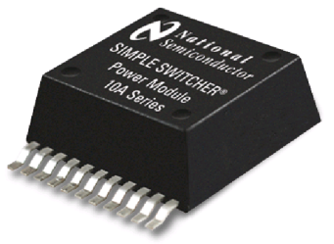
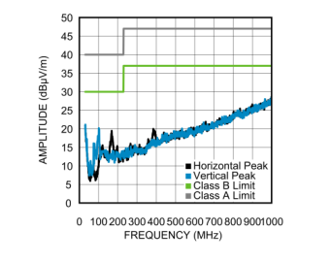
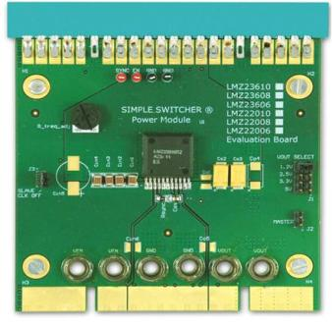
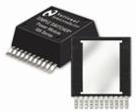
Switcher Power Modules
(LMZ23610)
15 mm
5.9 mm
Ease of Use
  Webench, Ease to mount & rework
  Internal Comp
Dual Lead frame
Built in Vin Capacitors to solve EMI issue, & shielded inductor
15 mm
2.8 mm
10 Amp Current Sharing Eval board
CISPR 22 Measurements
EMI Configuration
39
Notes:
9/13/2012
39

Slide 40
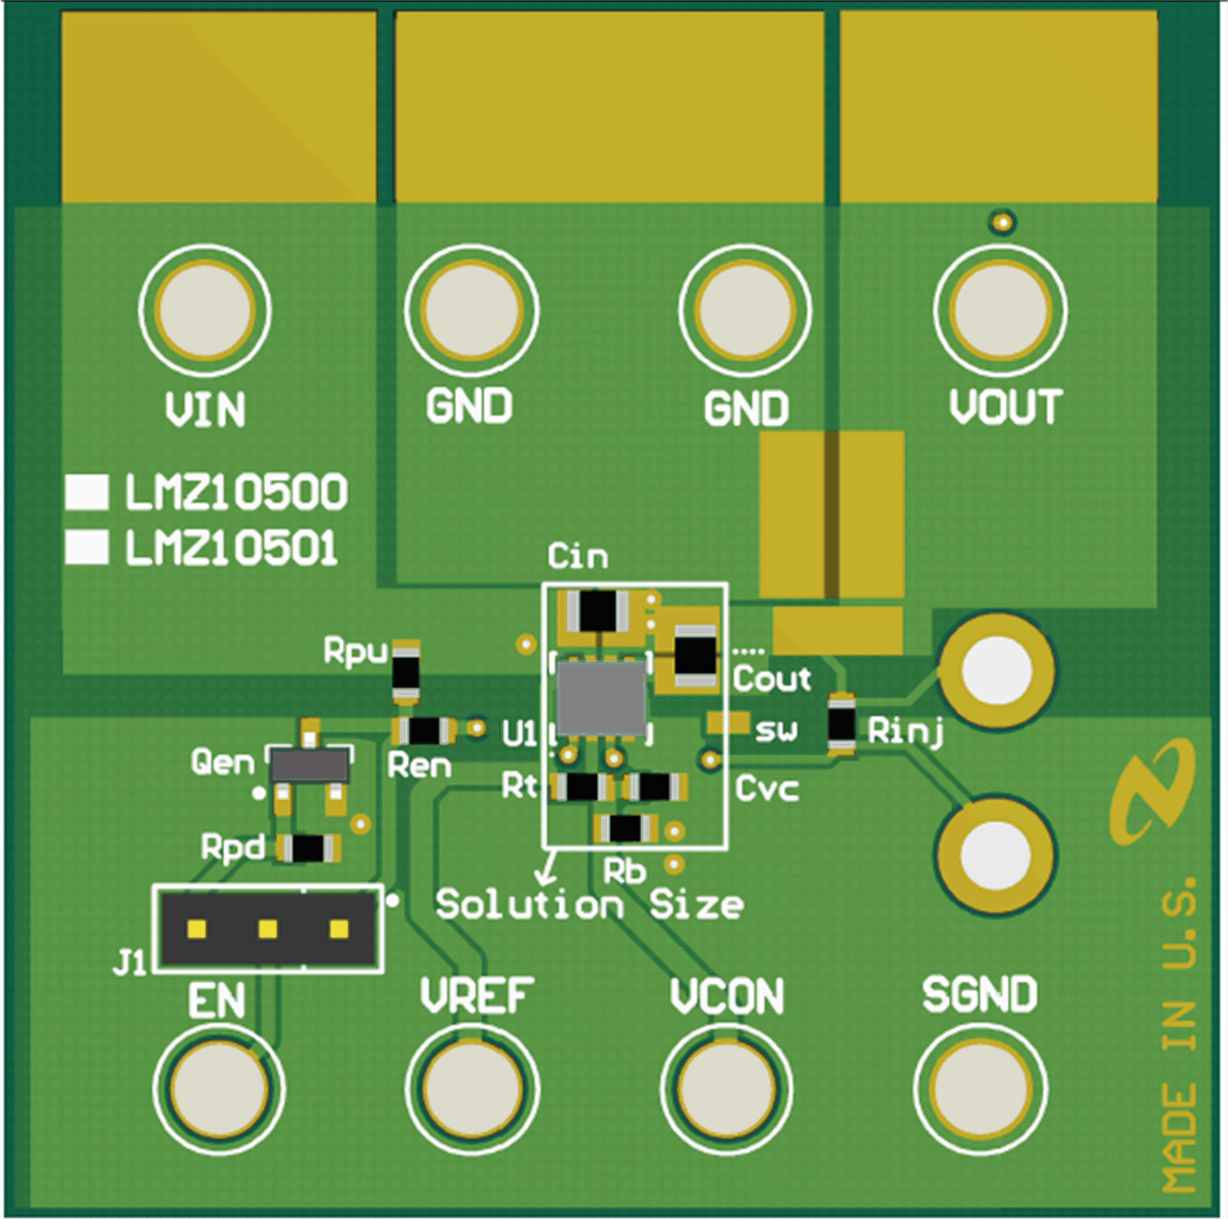
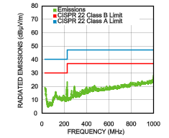
Passing CISPR22 Class B Radiated EMI
The evaluation board with the default components complies with the CISPR 22 Class B radiated emissions standard.
5Vin, 1.8Vout, 1A load
10uF input capacitor
10uF output capacitor
1nF VCON capacitor
40
Notes:
See AN-2168

Slide 41
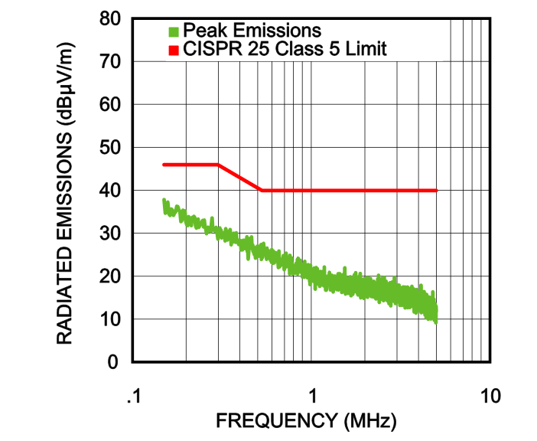
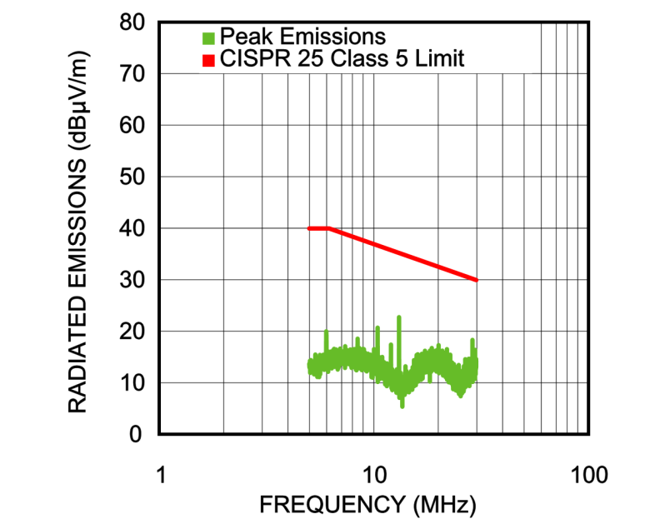
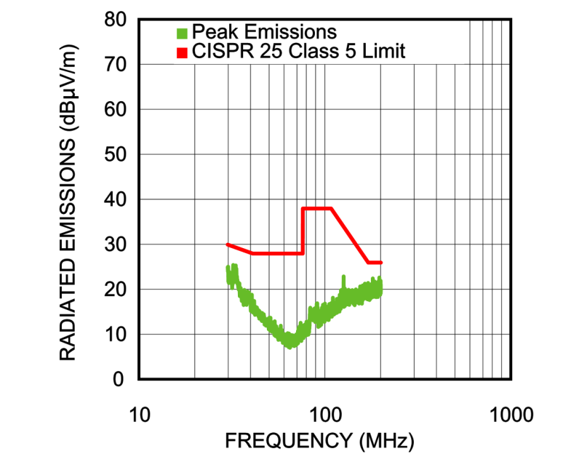
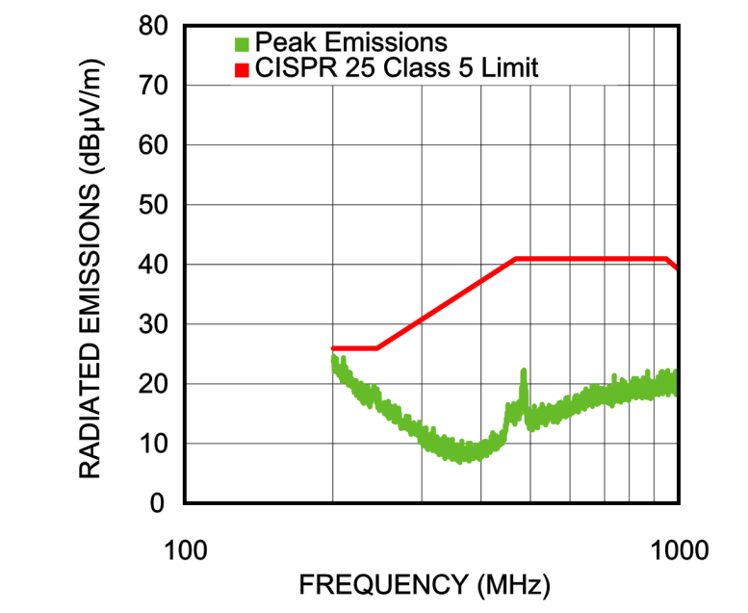
Passing CISPR 25 Class 5 Radiated EMI
Adding two small 0.1μF 0805 input capacitors results in CISPR 25 Class 5 radiated emissions standard compliance
41

Slide 42
AGENDA
EMI Overview – definition and standards
✓
Noise Sources Identification
✓
Minimize EMI Generation by Layout
✓
Protect Sensitive Circuits from Noise
✓
Conducted EMI and EMI Filters
✓
Summary
✓

Slide 43
Protect EMI Sensitive Nodes from Noise
Sensitive Nodes: Control and Sensing Circuits
Noisy Nodes: Any Nodes in High di/dt Loop
  Vout sensing path and feedback node
  Compensation network
  Current sensing path
  Frequency setting
  Monitoring and Protecting Circuits
  … …
  SW node
  Inductor
  High di/dt bypass caps
  MOSFETs
  Power Diodes
  … …
  Shielded by Ground / Power Planes
  Away from EMI source
Notes:
On a switch mode power supply, we have all these noisy nodes in the high di/dt loop, and we also have some sensitive nodes including the control and sensing circuits, including the Vout sensing paths and the feedback node, the compensation network, the current-sensing paths, the frequency setting network, and the monitoring or protecting circuits, and more if you have more functions. Well, I think there are two ways to protect these sensitive nodes. One is to shield them by the ground or power planes, put them on the other side of the shielding. The other way, if you cannot -- if it is not possible to put them on the other side, then put them further away from the source of noise.

Slide 44
Good Practice to Protect EMI Sensitive Nodes
Use Layers – four layer board stack-up plan
  Top: All high power parts and high di/dt paths, signals that can be routed away from high di/dt paths
  Mid1: Ground Plane
  Mid2: Ground Plane / Power Plane / Signal & low power traces
  Bottom: low power and signal traces
  Alternatively, swap the Mid2 layer and Bottom so a GND plane is on the bottom for better heatsinking
  Flood unused area with copper for improved thermal performance and shielding
Place and Route
  Keep all bypass caps close to pins
  The higher the impedance and/or gain, the smaller the node should be, especially inputs to op-amps: FB pin, comp pin, etc
  Low impedance nodes can be wide, such as VIN and VOUT
Notes:
It is good practice to protect the sensitive nodes. One is to use the layers, and here, I have a commonly used four-layer board stack-up plan. We have the majority of the power components on the top layer. So, we keep the high-power high di/dt paths also on the top layer. And also, we can have some signals that can be routed away from the high di/dt paths on the top layer. And the middle layer one should be a solid, unbroken ground plane. The middle layer 2 can be a ground plane, can be a power plane, and can be a low-power and signal trace plane based on the complexity of the board you are designing. And the bottom is purely for the more sensitive nodes and traces and the components, so that we can put it on the other side of the shielding. And also, we should flood the unused areas with copper to improve the thermal performance and to have better shielding.
For place and route, general rule is to put all bypass capacitors as close as possible to the pins. The higher the impedance or gain of a node, the smaller the size of the node should be, especially the input to the op-amps. For example, the feedback node and the compensation, and the low impedance node can be wide, such as the Vin and Vout traces.

Slide 45
Protect EMI Sensitive Nodes – Cont.
Make long runs to low impedance nodes, short runs to high impedance nodes. Apply to
  Place output voltage divider close to the FB node (high impedance), farther from Vout (low impedance), if have to choose
√
×
Route Sense+/Sense- traces parallel to one another – minimize differential-mode noise pickup. Apply to
  Current sensing traces
  Voltage remote sense lines
Keep sensitive small signal traces thin and further away from surrounding signals – lower capacitance coupling
Notes:
Another thing we need to pay attention to is that, if you choose to run a long trace for the Vout feedback, you should run it from the Vout to the top of the resistor divider.
We know that the feedback node is a high impedance node. If any noise is coupled in it, voltage spikes are going to be generated, and in the contrary, the Vout is low impedance node. Any noises coupled can be conducted out. So, the best way is to put the resistor divider closer to the feedback node, and to run a longer trace to Vout if you have to choose.
For sensing traces, if you have differential sensing, for example, for the current sensing or Vout remote sensing, the two traces should be run in parallel to each other to minimize the differential mode noise pickup.

Slide 46
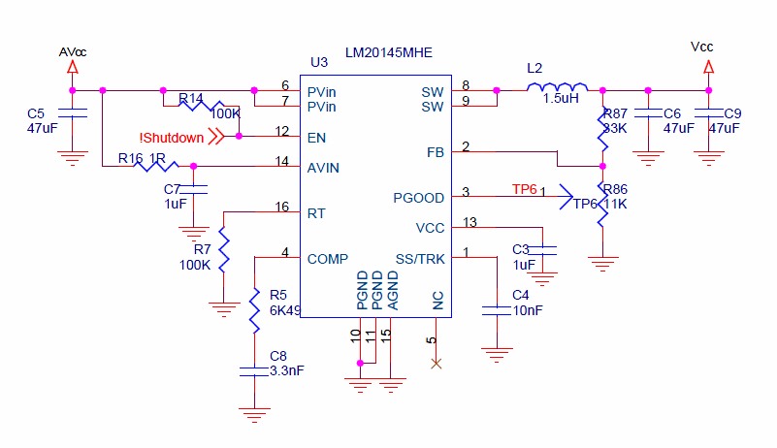
Customer Layout Example
LM20k 5A Buck regulator
SW
FB trace
Identified layout problems
Vout sensing point is right under the inductor – noise pick up
FB trace route very close to SW node and di/dt loop – noise coupling
L
Res Divider
46

Slide 47
Customer Layout Example
More problems in this layout
COMP RC
GND
CIN
PGND pins
CIN GND to LS source path (high di/dt) undefined, through gnd plane
AVIN bypass cap gnd return path very long
Comp network close to high di/dt loop
AVIN
GND

Slide 48

Check List
If your board can not pass Radiated EMI
  Check high di/dt loop layout, especially CIN gnd to LS FET source connection
  Check GND shielding
  Suggest Shielded L
  Use twisted pair at input / output (where switching current exists)
  Suggest to reduce f_{sw} or switch transition rate
  Consider adding conducted EMI filter (also alleviate Radiated EMI)
If your board is not working properly (no schematic reason) or too much volt spikes, check
  High di/dt loop layout
  GND shielding
  Sensitive nodes layout, especially FB divider and routing
  Sensitive node grounding
  Bypass caps
  Add small bypass caps (e.g. 47nF) to Vin and Vout as close as possible
  Add snubber to SW node
Notes:
If a board cannot pass radiated EMI, what can you check?

Slide 49
AGENDA
EMI Overview – definition and standards
✓
Noise Sources Identification
✓
Minimize Noise Generation by Layout
✓
Protect Sensitive Circuits from Noise
✓
Conducted EMI and EMI Filters
✓
Summary
✓

Slide 50

DM Conducted EMI
I
Switch Mode Power Supply
Supply
LOAD
Differential Mode Conducted EMI
  In DC-DC converter topology, only Hot and Neutral lines, no CM EMI involved
  Involves the Normal Operation of the Circuit
  Does not involve Parasitics, except input / output CAP ESR and ESL
  Only Related to CURRENT, not voltage
  For example, with the same power level Buck converter, lower input voltage means higher input current, thus worse conducted EMI
Why we care?
  Excessive Input and/or Output Voltage Ripples can compromise operation of Supply and/or Load
Notes:
Conducted EMI in the switch mode power supplies -- the switch mode power supplies always have two wires to connect it to the supply and to the load. So, any current goes in has to go out through the other wire, so the sum of the two currents is always zero. There is no common mode conducted EMI involved in the non-isolated switch mode power supply design. So, we only consider differential mode conducted EMI here.
For a differential mode, conducted EMI in switch mode power supplies, it involves the normal operation of the circuit. PCB layout cannot quite help to reduce the problem. It does not involve other parasitic except the ESR and ESL of the capacitor in the part with discontinuous current, and it is only related to the current of the discontinuous port, but not the voltage.
So, for example, in fixed power level Buck converter, if the input voltage is reduced, then the input current is going to be higher, and the differential mode conducted EMI problem is going to be worse. So, why do we care? The conducted EMI can go back to the power supply or go to the load, and could compromise their operation.

Slide 51
DM Conducted EMI Mitigation
EMI filter design
  Add filter to prevent noise conducted to Supply or Load
  Must be designed so it does not affect SMPS stability
  See Application Note for practical EMI filter design (AN-2162)
Switch Mode Power Supply
Supply
LOAD
(Buck)
51
Notes:
That’s why we should reduce them, and the effective way to do it is to add an EMI filter to prevent the high-frequency noise from going back to the supply or the load, but the filter added could affect the switch mode power supply stability.

Slide 52
Input Filter Design for Conducted EMI
There are two basic requirements for the conducted EMI filter:
Must meet noise attenuation requirement to meet regulations (i.e. CISPR 22)
Must not interfere with the normal operation of the SMPS converter
  If filter impedance exceeds the negative impedance of the input supply, it will cause interaction and stability issues.
Example of a Buck regulator
No input filter
Fails CISPR 22 regulation limits
This regulator needs an input filter to meet regulations.
But how do we estimate how much filter attenuation to add?
52
Notes:
Moving onto the next slide, we're going to discuss input filters for, let's just say, a DC to DC buck converter.
Let's say you just have an input in your buck converter, you want to minimize the amount of noise seen on the input for another switching supply.
Now one of the careful things we need to adhere to is the input filter will interact with our control loop of our buck converter. We're going to make sure that the output impedance of our input filter is much lower than the input resistance of our buck converter. The input resistance of our buck converter is negative. Now why do we say that? Input resistance is negative because as the voltage goes up on a buck converter, its current comes down. So we call it negative resistance. As I mentioned, the output impedance of our input filter needs to be much lower than the Rin.

Slide 53
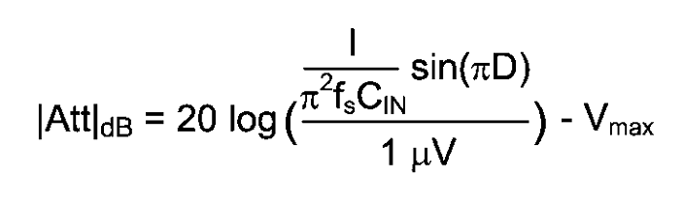
Necessary Input Filter Attenuation
Methods of estimating the filter attenuation without LISN and Spectrum Analyzer
Method 1 – estimation using oscilloscope measurement
  Measure the input ripple voltage using a wide bandwidth scope and calculate the attenuation.
  VMAX is the allowed dBμV noise level for the particular EMI standard.
Method 2 – Estimation using the first harmonic of input current
  Assume the input current is a square wave (small ripple approximation)
  VMAX is the allowed dBμV noise level for the particular EMI standard.
  CIN is the existing input capacitor of the Buck converter.
  D is the duty cycle , I is the output current, Fs is the switching frequency

Slide 54
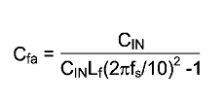


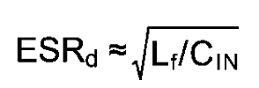
Typical Conducted EMI Filter
Follow the design steps described in AN-2162.
Calculate the required attenuation using Method 1 or Method 2.
Capacitor CIN represents the existing capacitor at the input of the switching converter.
Inductor Lf is usually between 1μH and 10μH, but can be smaller to reduce losses if this is a high current design.
Calculate capacitor Cf. Use the larger of the two values (Cfa and Cfb) below:
Capacitor Cd and its ESR provides damping so that the Lf Cf filter does not affect the stability of the switching converter.

Slide 55
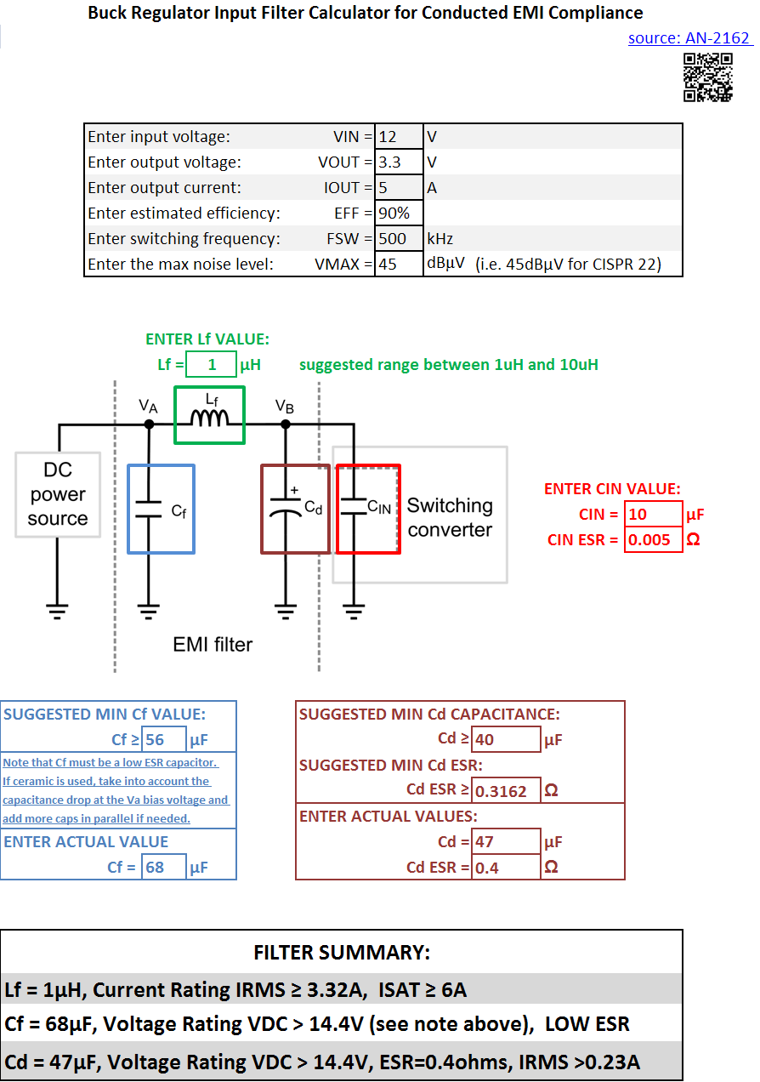
Conducted EMI Filter Design Tool
Excel based tool is available to help design the conducted EMI filter.
The tool is based on the steps described in
AN-2162.
The filter design can be printed on one page.
double click to open calculator

Slide 56
Conducted EMI Before and After Filter
VIN = 30V, VOUT=3.3V,
IOUT = 1.6A, CIN = 10μF + 1μF,
Fs = 370kHz
Results before installing filter:
Results with the following filter:
Lf = 3.9 μH, Cf = 10 μF, Cd = 100 μF
56
Notes:
This picture just shows a before and after of the conducted EMI environment before and after EMI filter. So, on the left is before the filter, and the first highest spike happens at the switching frequency of this converter, and the following spikes are sub-harmonics, and some frequency components could come from the di/dt of the switching action.
On the right is after the filter, and we can see that the sub-harmonic spikes are pretty much all filtered out, and the switching frequency is also greatly reduced, and the data we captured is peak noise values. So, it should be compared to the pink lines on the top. So, after the filter, this converter actually passes the EMI limits.

Slide 57
AGENDA
EMI Overview – definition and standards
✓
Noise Sources Identification
✓
Minimize EMI Generation by Layout
✓
Protect Sensitive Circuits from Noise
✓
Conducted EMI and EMI Filters
✓
Summary
✓

Slide 58
SUMMARY
EMI is Electromagnetic Interference. There are many EMC standards, based on regions and applications
SMPSs are big source of radiated and conducted EMI
EMI comes from high power switching action
EMI problems can be mitigated by identifying high di/dt loop and reducing loop area by careful board layout
Sensitive circuits should be protected with careful layout and shielding
Filters can be designed to attenuate conducted EMI to protect supply / Load
Filters also help reduce radiated EMI

Slide 59
AGENDA
EMI Overview – definition and standards
✓
Noise Sources Identification
✓
Minimize EMI Generation by Layout
✓
Protect Sensitive Circuits from Noise
✓
Conducted EMI and EMI Filters
✓
Summary
✓
Questions
✓

