Slide 1
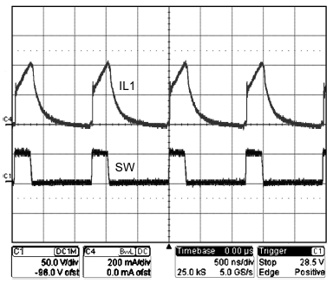
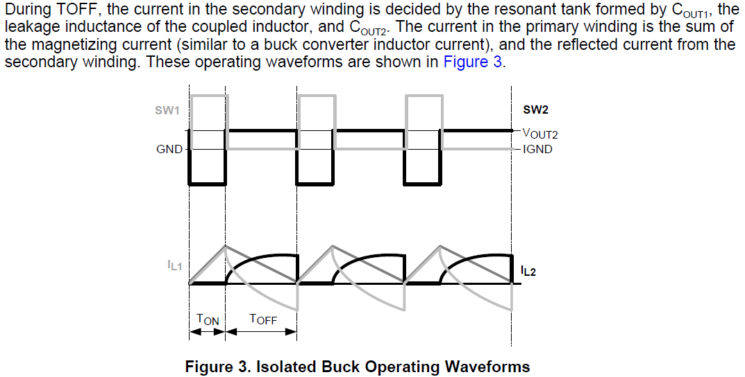
Q1. Why is the current wave form curve? Could you tell me more detail?
Q2. When low input voltage operation, the current wave form is straight. Why is the current wave form straight?
Q3. Which is better, curve or straight?

