Slide 1
Power Tip #6: Accurately Measuring Power Supply Ripple

Slide 2
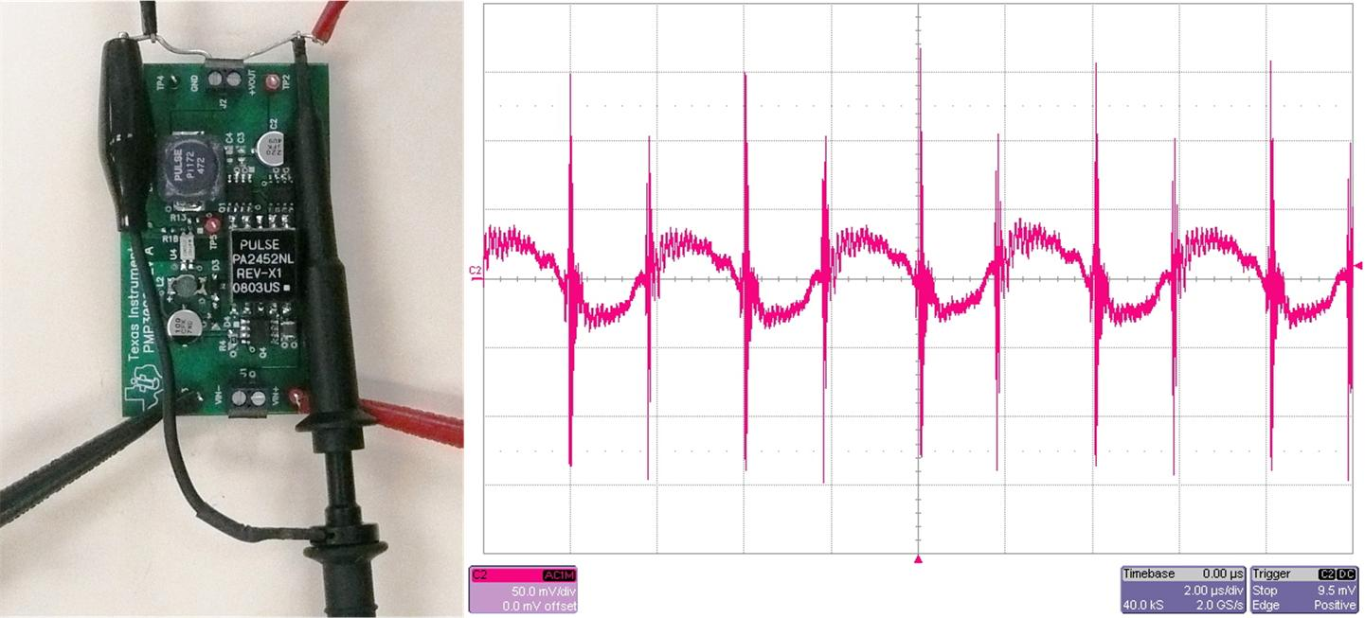
Improper Ripple Measurement Yield Poor Results
Full Scope Bandwidth
Long Probe Lead
Common Mode Pick-up
Notes:
2

Slide 3
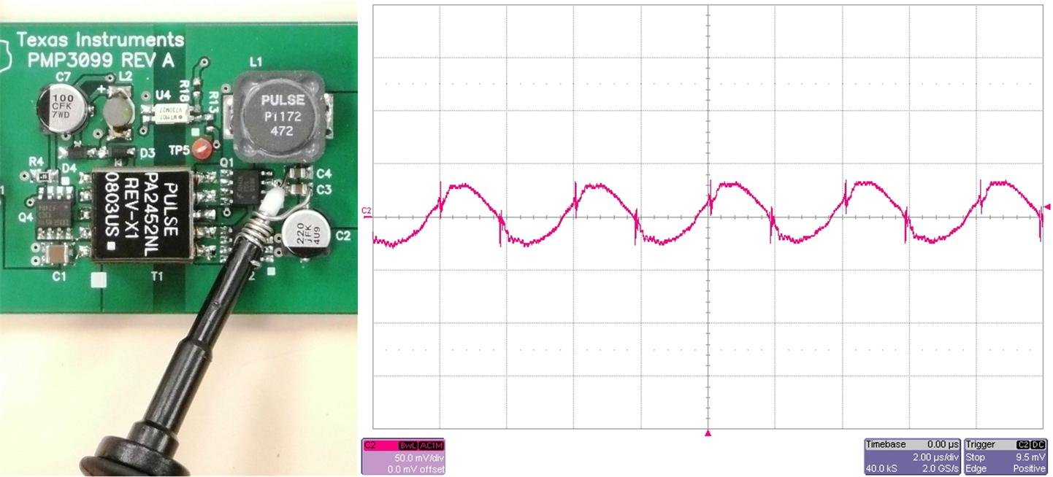
Four Simple Changes Drastically Improve Measurement
20 MHz Scope Bandwidth
Shortened Probe Lead
Measure on Caps
Common Mode Filter on Probe Lead
Notes:
3

Slide 4
Ripple Usually Gets Better in the System
Interconnect Inductance
  Wiring
  Board Etch
Additional Load Capacitance
Effect Particular Apparent on Spikes
  15 nH & 10 uF Resonate at 400 kHz!
Notes:
4

Slide 5
For more Power Tips:
Visit Power Management DesignLine and search: Power Tips
http://www.eetimes.com/design/power-management-design
Or click on the link to all articles in the description section of this video.

