Slide 1
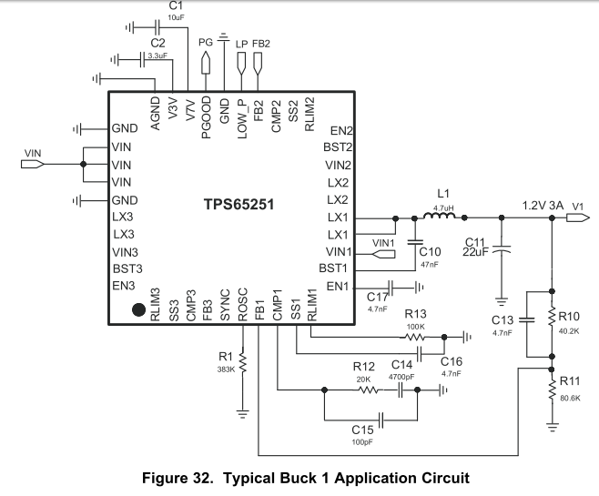
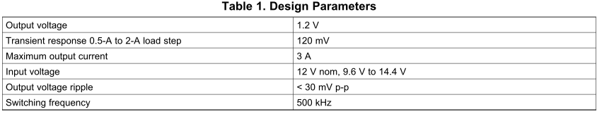
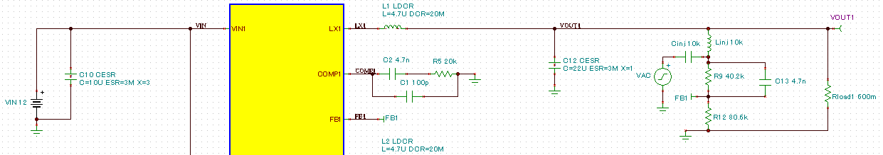
Datasheet “Design Guide - Step-By-Step Design Procedure”
Fc=60kHz

Slide 2
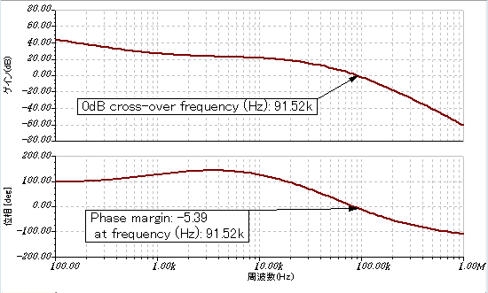
TINA-TI simulation result
Comparison “Step-By-Step Design Procedure target” and TINA-TI result
 | fc | Phase margin
Datasheet | 60kHz (target) | >45 (target)
TINA-TI | 91kHz | -5.39

