Slide 1
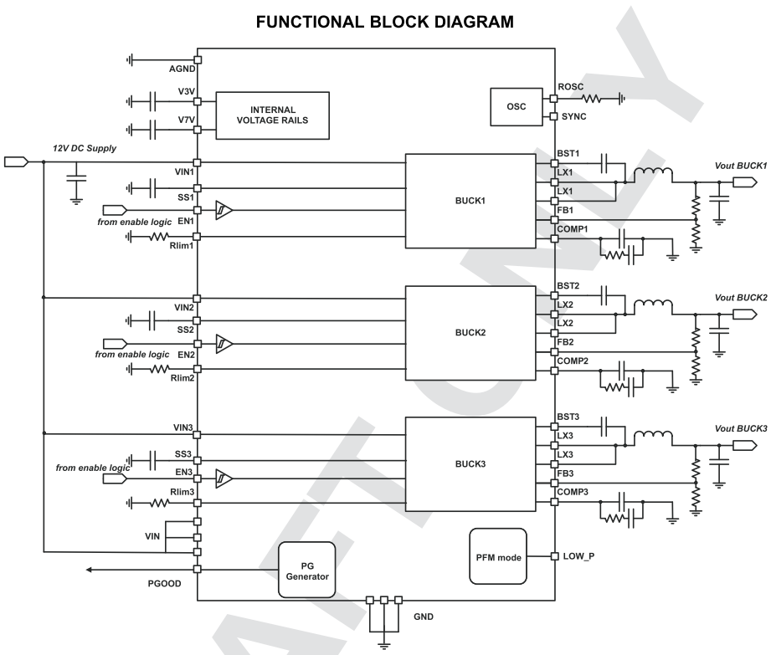
TPS65251-Q1
1
2
3
4
Feedback
and
Control
Gate Drive
and
Synchronous FET

Slide 2
TPS65251-Q1
No | Functional Block | Block Area /Total Chip Area
1 | Internal Voltage rail | %
2 | OSC | %
3 | BUCK1: Feedback and control | %
4 | BUCK1: Gate Drive and Synchronous FET | %
3 | BUCK2: Feedback and control | %
4 | BUCK2: Gate Drive and Synchronous FET | %
3 | BUCK3: Feedback and control | %
4 | BUCK3: Gate Drive and Synchronous FET
5 | Others | %

