Slide 1
Improve Accuracy with Software:
S₀ Calibration

Slide 2
Calibrating the System
Plot
Draw the best straight line fit for the above function
  You can find the line with a minimum of two points
    Run a conversion at two different object temperatures.
    Try to run the system at the two extreme points of operation and measure the object’s temperature with a accurate temperature measurement
    Example: the sensor is at 25°C and the object is at 0°C and 60°C.
  The more points measured the better the calibration
S₀ (calibrated sensitivity) is equal to the slope
of this line

Slide 3
Calibration – Solving for S₀

Slide 4
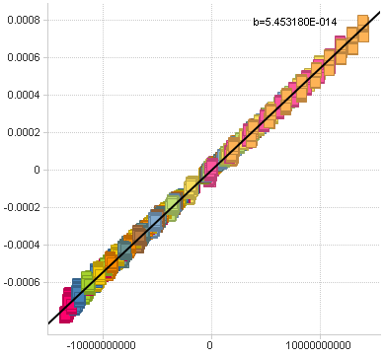
Calibrating the System: Example
The slope of the line S₀ =
(x₂, y₂)
Calibration Function
This is the best straight line fit for these points
(x₁, y₁)
T_{die}⁴ – T_{obj}⁴

