Slide 1
Silicon Based Temp Sensor Primer

Slide 2
How does a Si temp sensor work?
A silicon temperature sensor measures the changes in base-emitter voltage due to temperature with a known pair of fixed precision currents. The currents through a p-n junction are given by the following equations:
The change in base-emitter voltage produces Proportional-to-Absolute (PTAT) voltage which is immune to most variations in process. The temperature is calculated from this PTAT voltage:
I_{F} Forward current
I_{s} Saturation current
V_{BE} Base Emitter Voltage
η Process non-ideality factor
k Boltzmann’s constant (1.38 x 10⁻²³ J/K)
T Absolute Temperature in K
q Electron charge constant (1.6 x 10⁻¹⁹ C)

Slide 3
Remote vs. Local Temperature Sensing
 | Local | Remote
Advantages | Inexpensive Easy to use Good noise immunity No external transistor required Excellent accuracy and temperature range Extremely Linear | Multi-channel available; allows temperatures to be monitored for more than 1 location Measure direct die temp of CPUs/GPUs Not required to be close to temperature source Good accuracy and temperature range Extremely Linear
Disadvantages | Must be proximal to source Only 1 temperature reading from 1 location | Remote Diode or transistor required Higher Noise sensitivity Not as accurate as local temp sensor N-factor calibration required

Slide 4
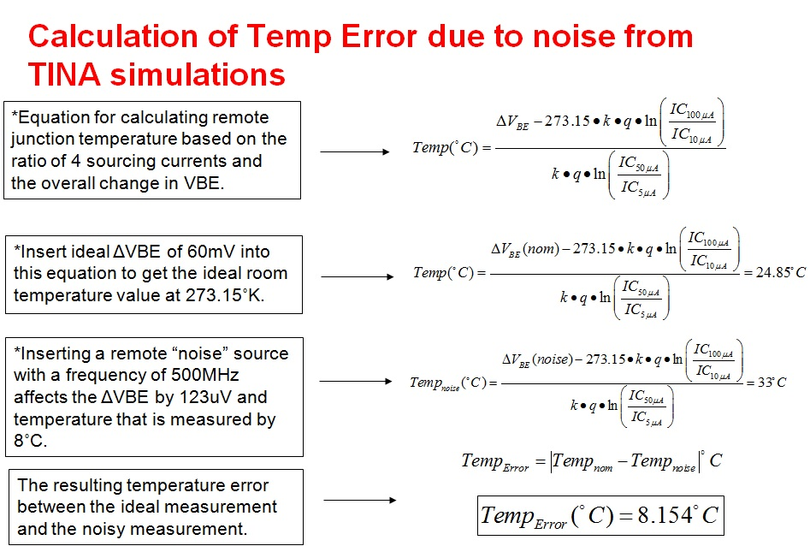
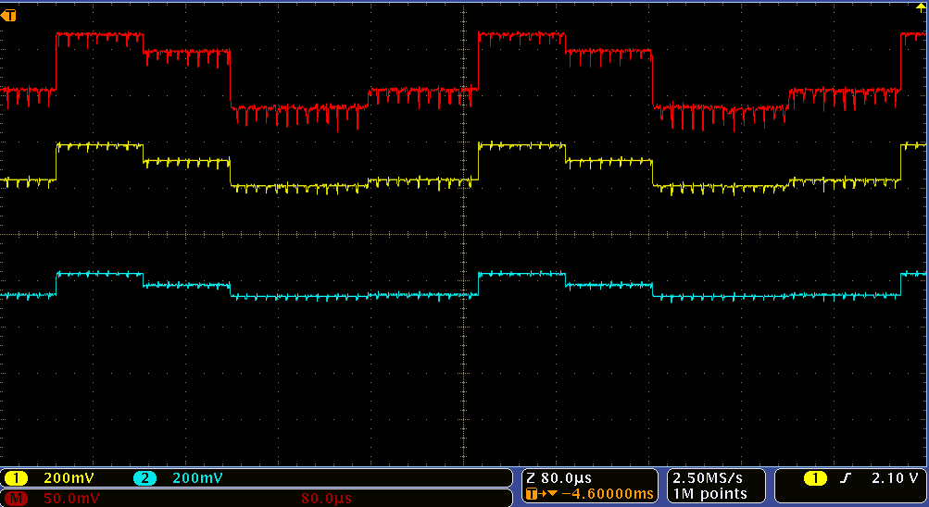
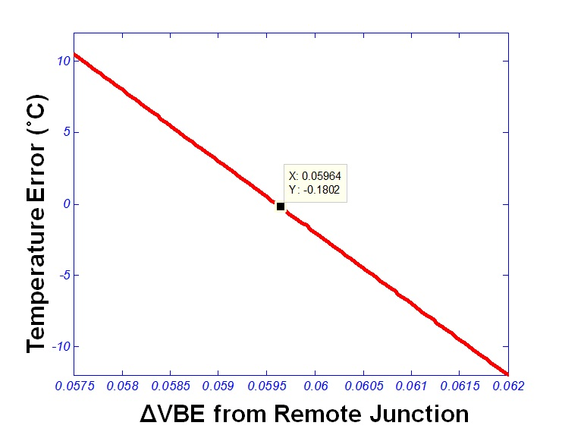
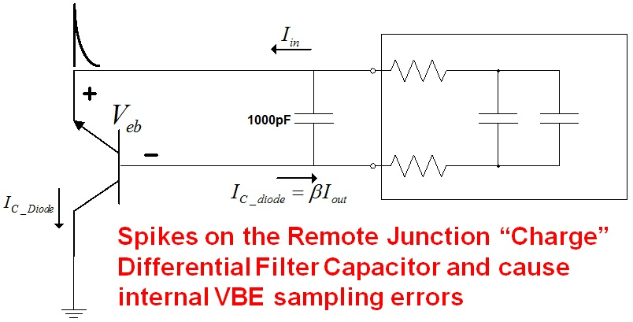
Error Effect of Noise in a Remote Diode Junction
Example of Noise in a remote diode junction

Slide 5
What is the fix for EMI/RFI from a noisy remote junction?
Add series resistance to attenuate capacitor “sampling” effect
Remove the Differential “Filter” capacitor
Add Ferrite Beads with a cutoff of 200MHz
If possible, use twisted pairs from the remote source to the temperature sensor
Use good bypassing at the supply pins

Slide 6
Thermal Management Solutions
Local Analog
Voltage output proportional to temperature
Smallest: LM20 LM94023
Highest Accuracy LM57
Lowest Power: LM94022 TMP20
Highest Temp: LM34
Most Popular: LM50
Local Digital
Reports temperature at location of the sensor
Smallest: TMP112 TMP103
Lowest Power: TMP102 TMP103
Highest Temp: LM95172
Highest Accuracy: TMP275 TMP112
Ind. Standard: LM 75 TMP75
Remote Digital
Measure any Diode, Transistor, or CPU/GPU/FPGA
Highest # of Ch: LM95234 LM95214
Int. Power Monitor TMP512 TMP513
Beta Correction: TMP44x LM95245
Most Popular: TMP411 LM96163
Contactless IR
Measures passive IR to determine object temperature without making contact
World’s First: TMP006
Switches/Thermostat
Simple hardware over temperature protection
Dual Alerts: LM56 LM57
Resistor Prog. TMP708 LM57
Pin Programmable: TMP302
Factory Preset: TMP303 LM27
Fan Control /HW Monitors
2 Wire Interface: LM96080 AMC80
Fan Control: LM96163 AMC6821
Monitor & Control: LMP92001
6-ch Comparators: LMV7231

