Slide 1
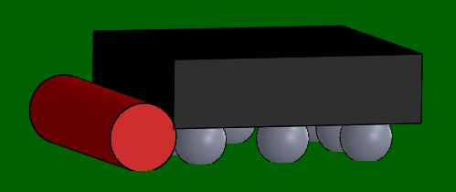
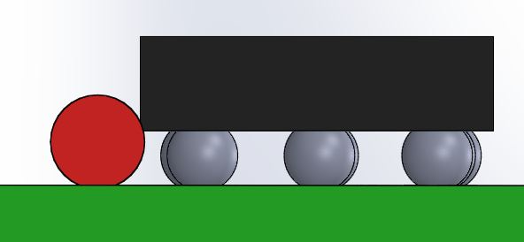
We have used a syringe and normal red RTV to deposit a barrier around the bottom
Of TMP006 and TMP007 to keep this area clear, of not only flux but any compound that
will thermally short the sensor. Only one side shown in these pictures but would need
The bead all the way around. Then you could coat the device with conformal coat but
Would need to keep the top side of the die open. I’m sure the Conformal coats out there
are not IR transparent .

