Slide 1
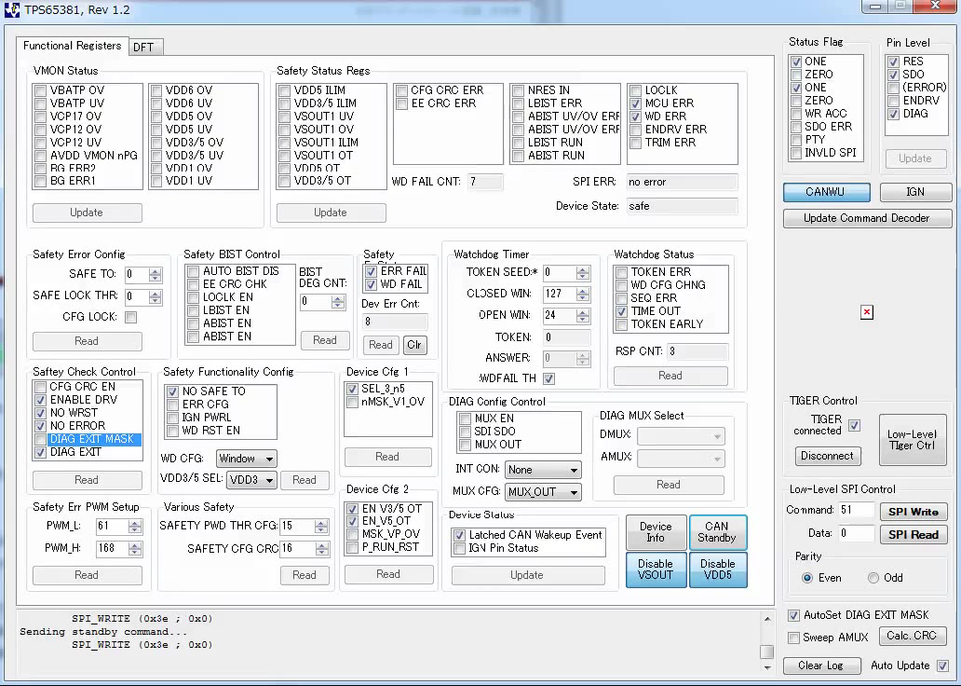
Figure-1. Send WR_CAN_STBY with VSOUT1_EN=0
Movie-1. Device State behavior of Figure-1 and Figure-2
RES
VSOUT1
VDD3/5
Figure-2. VSOUT1_EN=0 and No additional Load
RES
VSOUT1
VDD3/5

Slide 2
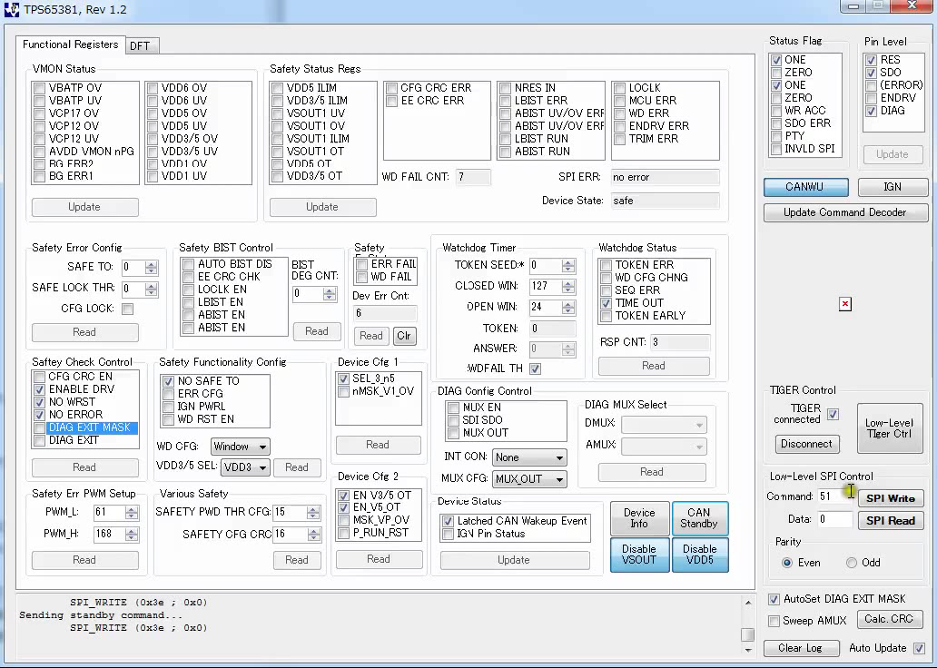
Figure-3. Send WR_CAN_STBY with VSOUT1_EN=0 and 100ohm/100uF Load
RES
VSOUT1
VDD3/5
1ms
Movie-2. Device State behavior of Figure-3

