Slide 1
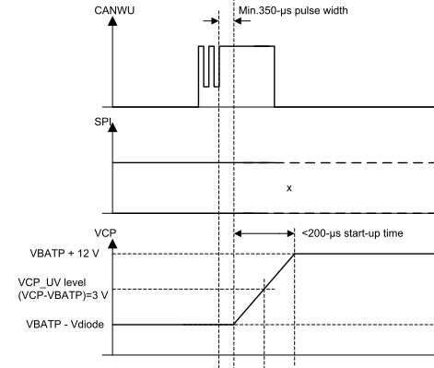
CANWU deglitch time test - 1
From CANWU rising edge to VCP start should be same with CAN deglitch filter time(100us to 350us).
CANWU
1.21ms
VCP
Figure-1
Figure-2
Datasheet P23

Slide 2
Signal on CANWU > deglitch time starts the power up sequence
Short pulses <= deglitch time on CANWU ignored
Total start up time from CANWU held > deglitch time to externally measuring VCP high
-> typical time => CANWU deglitch + 200us start up time
Figure-3

Slide 3
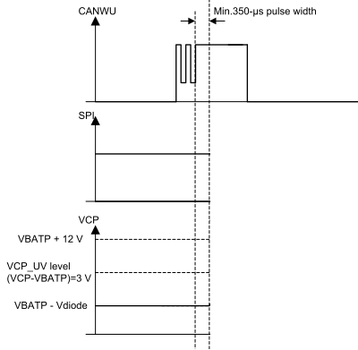
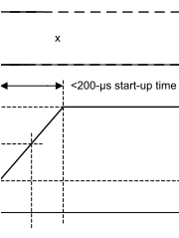
CANWU deglitch time test - 2
CANWU
VCP
Figure-4
Figure 5-2. Power-Up / Power-Down Behavior
Chang Time Scale
CANWU
Deglitch is 228us
976us (Some delay)
Deglitch time
VCP
<200-us start-up time
Some delay
Figure-5
Figure-6

