Slide 1
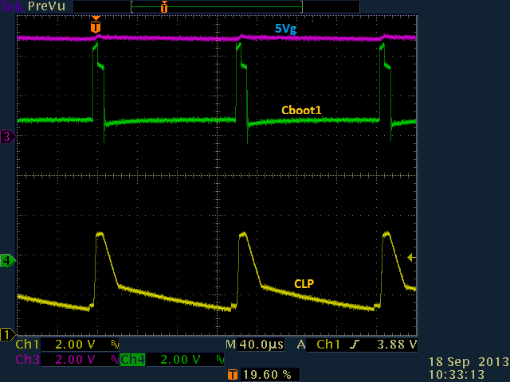
Vbat = 12V, load current = 25mA
Voltage on CLP increasing with load current if it is floating

Slide 2
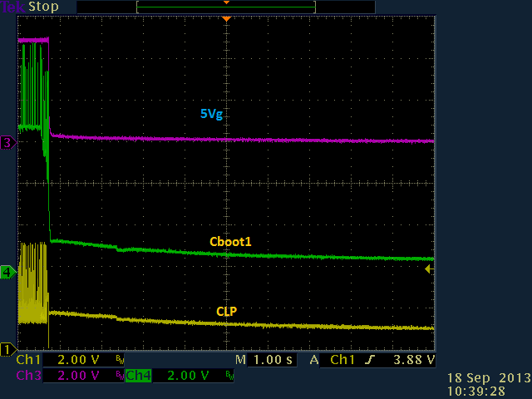
Power off behavior
During power off residual voltage on CLP and Cboot1. All other pins have no residual voltage

Slide 3
Bench test conclusion
CLP has internal pull up circuit so device can operate in low power mode and PWM mode depends on load current
Floating CLP voltage is not because of crosstalk
CLP voltage can increase to 5V steady in PWM mode
During power down and before device turning off boost circuit is active
When device is off so Q3 transistor Cboot1 keeps residual voltage (see scope picture)
It seems the same amount of residual voltage in on CLP

