Slide 1
LMK04828 MultiMode Driver Termination
1

Slide 2
Introduction
CLKout driver termination network impacts CLKout output swing, phase noise and power dissipation.
Recommended AC coupled termination network for PECL drivers (LVPECL 1.6V, LVPECL 2V, LCPECL) are shown in slide #3.
Recommended termination network for HSDS drivers (HSDS-10mA/8mA/6mA) and LVDS are shown in slide #4, #5.
Recommended low Vcm DC coupled termination network for LCPECL drivers are shown in slide #6~9.
Default EVK termination network:
  CLKout0,1,2,3: PECL drivers
  CLKout4,~13: HSDS / LVDS driver

Slide 3
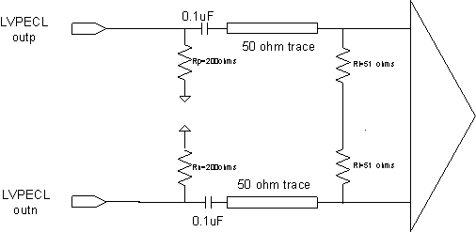
PECL Driver Termination (200 ohms to GND provides DC bias; 100 ohms at receiver end provide trace termination)

Slide 4
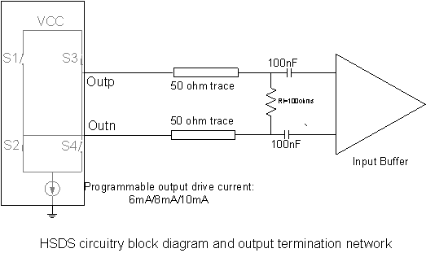
HSDS/LVDS Driver Termination: 100 ohm provide DC bias as well as trace termination.

Slide 5
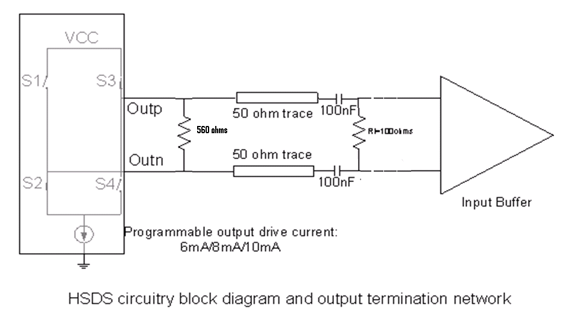
HSDS/LVDS Driver Termination for Bench Test: 560ohm provides DC bias; 50 /100 ohm from test equipment/termination resistors provide trace termination)

Slide 6
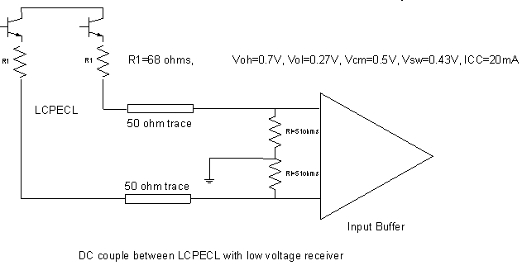
Low Vcm DC Coupling Using LCPECL
Vcm=0.5V

Slide 7
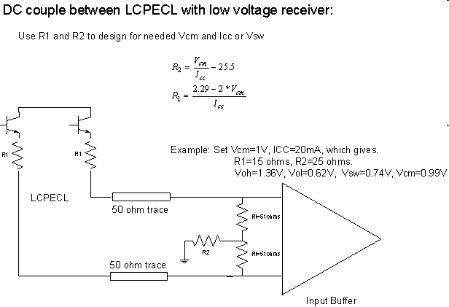
Low Vcm DC Coupling Using LCPECL
Vcm= 1V

