Slide 1
Thermal Design for Power Stages

Slide 2
Thermal Design Consideratons
Understand test conditions
Power test
Natural convection or forced air flow
Heat sink requirements
Thermal mass
Thermal resistance
Thermal interface requirements
Thickness
Thermal conductivity

Slide 3
Device power density
2x300W output power @ η=90% → 60W dissipation
Power pad area = 0.64mm² (<0.1sq inch)
Thermal interface material between device and heat sink is very important!
Thin interface layer required
High thermal conductivity required

Slide 4
Heatsink mounting

Slide 5
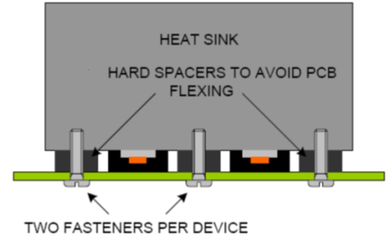
Heatsink mounting

