Slide 1
Class D Output Power Estimation
Audio Group
Applications

Slide 2
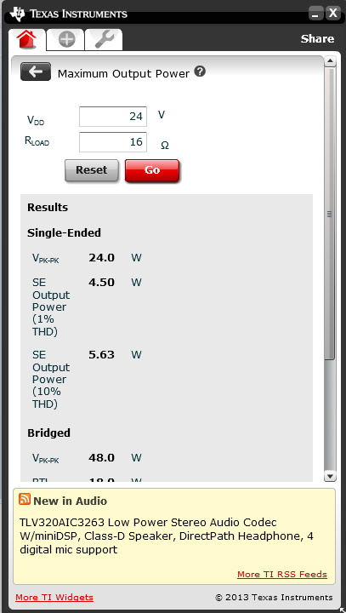
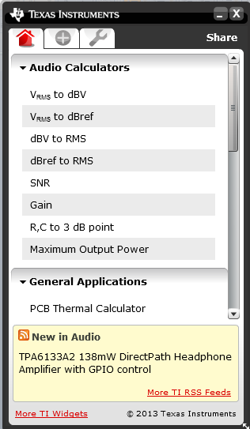
TI Widgets -
http://www.ti.com/general/docs/gencontent.tsp?contentId=45777&DCMP=TI_Gadgets&HQS=Other+OT+widgets

Slide 3
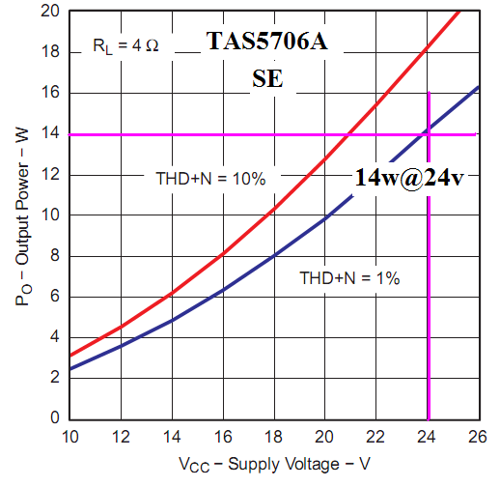
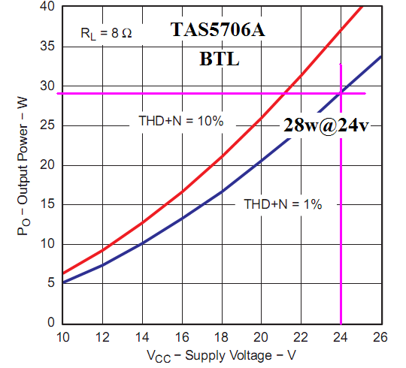
Output Power Estimation of Class D Amplifier
Simple Calculation:

Slide 4
APA Circuit Impedances
Audio power amplifier circuits includes many other impedances than load (Speaker). The voltage on the load is reduced due to these impedances.
Power supply internal impedance, trance impedance, MOSFET turn on resistance and inductor DC resistance must be small compared to load impedance to maintain efficiency and output power.

Slide 5
Output Power Estimation of Class D Amplifier
Simple Calculation:
Accurate Calculation:

