Slide 1
TAS57xx DAP Workshop
January 2014
Home Audio Group
TAS57xx

Slide 2
Agenda
TAS57xx Products Overview
  TAS57xx Features
  TAS57xx Products Comparison
TAS57xx Audio Process Flow
  Audio Input
  Digital Audio Processing
  Audio Output
TAS57xx Layout Recommendations
  Components
  Placement
  Routing
  Concerns

Slide 3
TAS57xx Products Overview
Home Audio Group


Slide 4
TAS57xx
Black-Box View
Digital Supply
(3.3V)
Analog Supply
(4.5V to 24V) *
TAS57xx
DIGITAL AUDIO IN
(I2S Format)
Audio Output
(PWM FORMAT)
Magic Inside!!
I2C Protocol
Register R/W
Terminal Controls
(PDN, RESET etc.)
* Typical Range
4
Notes:
4

Slide 5
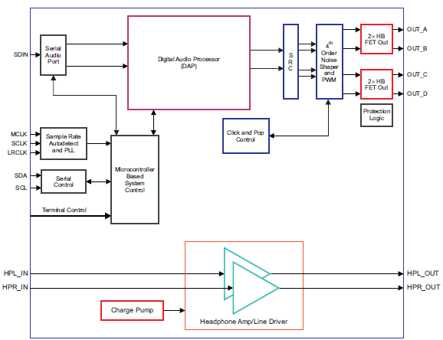
TAS5719 Functional Block Diagram
5
Notes:
5

Slide 6
TAS57xx Flavors!
TAS57xx Dictionary Definition:
  A Texas Instrument’s digital-input, medium-power (10W to 25W) class of efficient Class-D audio amplifiers, which have a wide-range of digital audio processing capability. These are commonly found in TV’s, Laptop’s & other cool gadgets!!
DAP Variations:
Fs Rate
  Fs Min Supported 8KHz - 32KHz
  Fs Max Supported 48KHz - 192KHz
SE Mode (2.1) support.
DRC Implementation (1-Band or 2-Band etc..)
No. of EQ’s available per channel.
Ternary Modulation support.
Multiple I2C Slave Address support.
Sub-Woofer Channel.
Output-Stage Variations:
Architecture :Open-Loop or Closed-Loop
RDs-ON
Supply Range
  Min 4.5V - 12V
  Max 18V - 26V
Output-Power rating.
Pinout (48-Pin to 64-pin)
Package type (QFP, TSSOP)
Integrated Head-Phone.
Minimum Load Impedance.
6
Notes:
6

Slide 7
TAS57xx Products Comparison
Feature | TAS5721MD | TAS5729MD | TAS5727 | TAS5733M | TAS5739MD | TAS5760MD
Output Power @ 10% THD+N | 2x10W (8Ω BTL) @ 24V | 2x15W (8Ω BTL) @ 24V | 2x25W (8Ω BTL) @ 20V | 2x20W (8Ω BTL) @ 24V | 2x25W (8Ω BTL) @ 24V | 2x25W (8Ω BTL) @ 24V
Supply Range | 4.5 to 24V | 4.5 to 24V | 8 to 26V | 8 to 26V | 8 to 26V | 4.5 to 24V
Minimum Load | 4Ω | 4Ω | 4Ω | 4Ω | 4Ω | 4Ω
Closed-Loop | No | No | No | No | No | Yes
Output Configuration | 2.1, BTL Stereo, SE Stereo , PBTL Mono | BTL Stereo, PBTL Mono | BTL Stereo, PBTL Mono | BTL Stereo, PBTL Mono | BTL Stereo, PBTL Mono | BTL Stereo, PBTL Mono
Digital Audio Processing | Yes | Yes | Yes | Yes | Yes | No
DirectPath Headphone/Line Driver | Yes | No | No | No | Yes | Yes
Package Size | 48-Pin HTSSOP | 48-Pin HTSSOP | 48-Pin HTQFP | 48-Pin HTQFP | 48-Pin HTQFP | 48-Pin HTSSOP
7
Notes:
7

Slide 8
TAS57xx Digital Audio Processing Intro
TAS57xx are I2C slave devices.
  Several TAS57xx devices have the option of multi-slave address, where the device address is set by a ASEL pin.
  Standard (100KHz) & Fast (400KHz) I2C rates are supported.
TAS57xx devices have a fixed I2C register map.
  Registers are used to set the device in different configurations and configure the DAP flow.
  Error-Register can be polled to check for any error conditions such as clock-error’s, Over Temperature, Over-Current, Under-Voltage etc..
TAS57xx devices mostly have a DAP
  Input Mixer, Bi-Quads, DRC, Output Mixer, THD Manager, etc..
8
Notes:
8

Slide 9
TAS57xx Audio Processing Flow
Home Audio Group


Slide 10
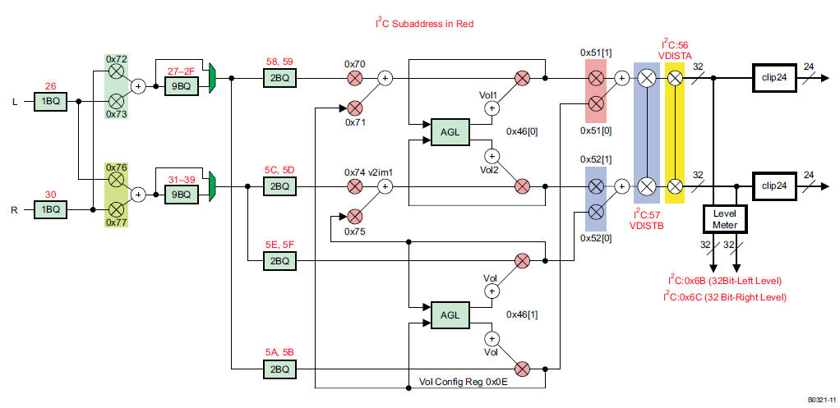
TAS57xx Example DAP flow
Bi-Quads (EQ)
THD-Manager
Left Channel
Right Channel
DRC (AGL)
Mixer-Node(s)
Level
Monitor

Slide 11
DAP Block Details…
Input Mixer nodes can be used to combine the different channels (in desired ratios) before audio processing, to create 3D effect’s etc. Typical use-case however is no input-mixing.
The TAS57xx DAP, provides several dedicated “Bi-Quads” which can be used to implement the digital filtering (EQ..more On this later…)
The DRC/AGL blocks are used to implement Dynamic Range Compression. i.e. DRC is used to limit the output at an arbitrary level. It is mainly used to prevent over-driving the speakers.
The Output Mixer nodes are used to combine the post-processed audio (i.e. after EQ & DRC). One common use is in multi-band DRC (more on this later..)
Other Blocks like level-meter and scaler nodes are also available on some TAS57xx devices.
11
Notes:
11

Slide 12
More on DRC/AGL…
What is Dynamic Range?
  Difference between Max Signal & Min Signal. (i.e. Peak – Noise).
  DRC is then simply the process of compressing this range.
Why compress the range?
  Prevent Clipping & Distortion.
  Protection of speaker, from damage due to large transients.
What is multi-band DRC?
  Audio band is 20Hz to 20KHz. Simplest form of DRC is single-band DRC.
  However, in 1-band DRC, compression is applied over the entire audio band (Bass, Mid & High frequency regions).
    For example, if an explosion sound (bass freq) is compressed, then mid-band (dialogue) also gets compressed.
  For better control, multi –band DRC can be implemented, where the audio is split into different bands. Each band has its dedicated DRC block.
  The different bands are therefore are decoupled from compression processing of the other.
12
Notes:
12

Slide 13
EQ – Concept(s), Formulae etc..
Digital Processing can be used to modify signal properties.
Transformation is applied through digital filters. (Can be of two types, IIR & FIR).
Transformation in digital domain is very attractive, since equivalent analog filter implementation would need several components (also subject to component tolerances)
Very simply, the input x(n) is applied to a digital filter to yield output y(n). The Digital filter’s transfer function determines the output y(n).
A 2nd order IIR filter is referred to as a “Bi-Quad”- (short for Bi-Quadratic), which refers to the fact that the transfer function of 2nd order IIR filter is a polynomial of 2nd order.

Slide 14
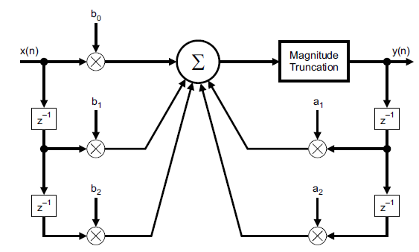
EQ – Concept(s), Formulae etc..
y[n] = bo * x[n] + b1 * x[n-1] + b2 * x[n-2] - a1 * y[n-1] – a2 * y[n-2]
Y(z) = b0 * x(z) + b1 * X(z)*Z⁻¹ + b2 * X(Z) Z⁻² –a1* Y(Z) *Z⁻¹ – a2 *Y(Z) * Z⁻²
Y(z)/X(z) = H(z) = [ (bo + b1*Z⁻¹ + b2*Z⁻²) ] / [ (1 + a1*z⁻¹ + a2*z⁻² ) ]

Slide 15
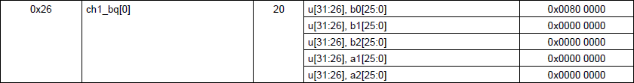
EQ – Register Mapping
TAS5717 has dedicated registers to perform EQ-function for each Bi-Quad (14 Bi-Quads for each channel)
Previously we saw that the transfer function of the digital filter determines the type of filtering applied.
Basically, all we are looking to do is program the five co-efficients ao, a1, bo, b1 & b2 to specify the type of filtering we require.
An extract from the data-sheet for register 0x26 (corresponding to the 1st Bi-Quad on left-channel) is shown below. We notice that the length of the register is 20-bytes, spilt into 5-chunks (one for each coefficient).
Further, note that the default value is a0=1 & all other coefficients = 0, which implies output y(n) = input x(n). (Note: Fixed Point Arithmetic)

Slide 16
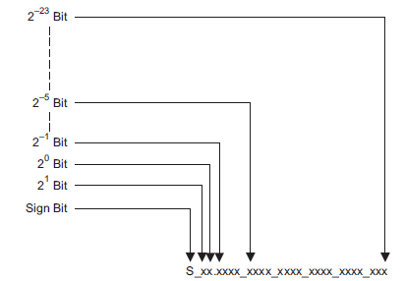

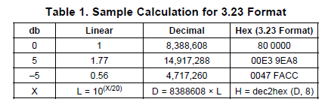
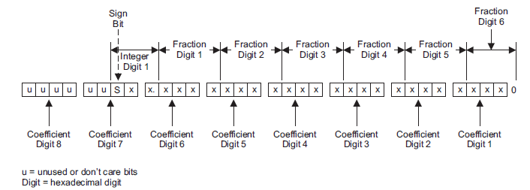
EQ – Coefficient Format Conversion

Slide 17
EQ-Use Case Examples
Some EQ-Use cases:
  Compensate speaker frequency response variations, and achieve a flat response.
  Bass/Treble Boost or attenuation using shelving filter.
  Notch filter to reject power-supply related hum noise (50Hz/60Hz) .
  High-Pass (DC-block) and Low-Pass filtering.
    This property is used in 2-band DRC to spilt the audio band into two bands (using high-pass & low-pass)

Slide 18
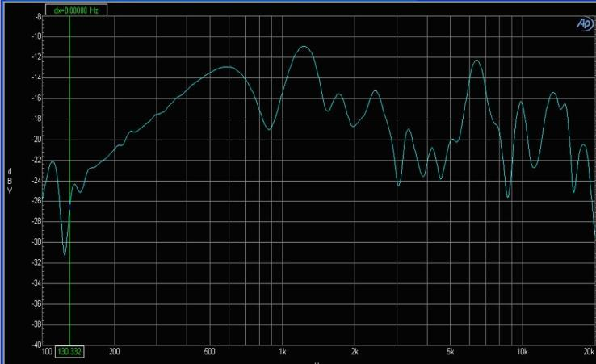
Example – frequency response of an LCD-TV speaker.
→ Choice of TV speakers is driven by cost & space considerations.
→ As seen in this plot, speaker response typically varies a lot across audible frequency range.
This can significantly impact the perceived audio-quality,. (High-end , good quality speakers are typically ones with a maximally flat-response.)
Using Auto-Eq, tool the inverse response & corresponding register coefficients can be generated.
Image-Source: http://i.cmpnet.com/audiodesignline/2008/03/qft_fig1.jpg

Slide 19
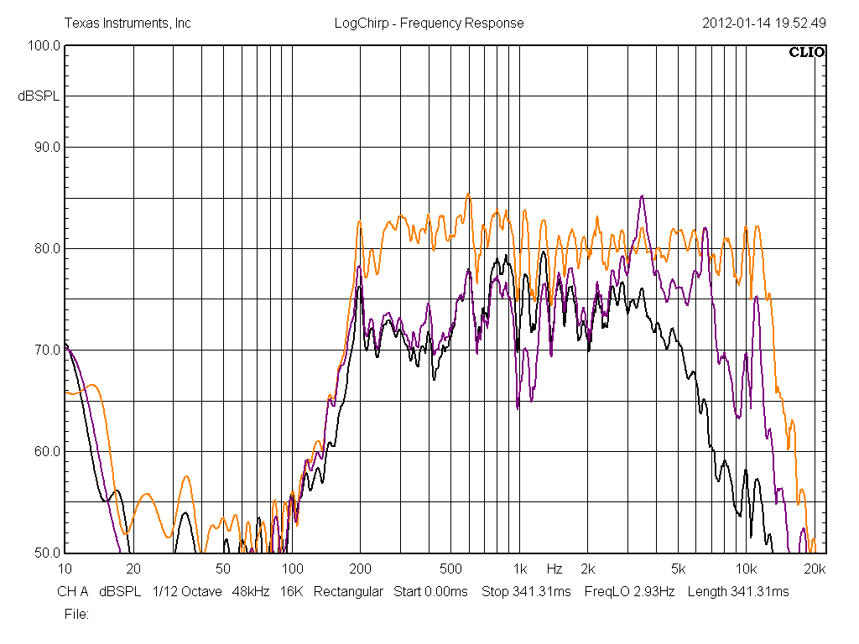
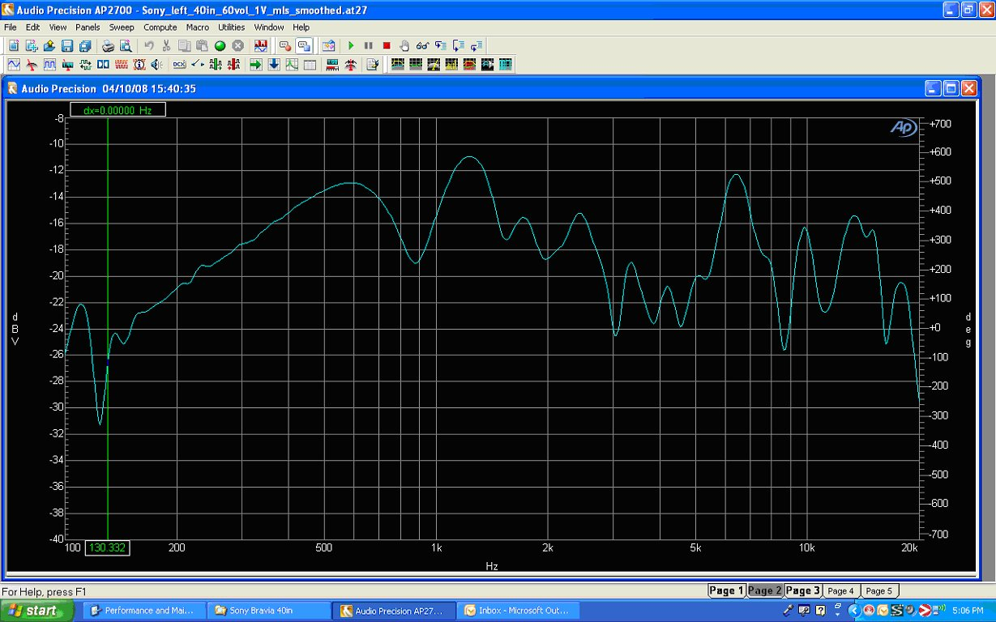
More on Bi-Quads / EQ…
19
The Ideal frequency response of a speaker is a flat line from 20Hz to 20KHz.
  However, real-world speakers have a widely varying frequency response.
  The audio output from these speakers without any audio processing is usually not of the highest perceived quality, as many frequencies can be attenuated.
The process of compensating the speaker-response to make it close to a desired response is called “Equilization” or “EQ”. Some use-cases
  Compensate speaker frequency response variations, and achieve a flat response.
  Bass/Treble Boost or attenuation using shelving filter.
  Notch filter to reject power-supply related hum noise (50Hz/60Hz) .
  High-Pass (DC-block) Low-Pass filtering.
Notes:
19

Slide 20
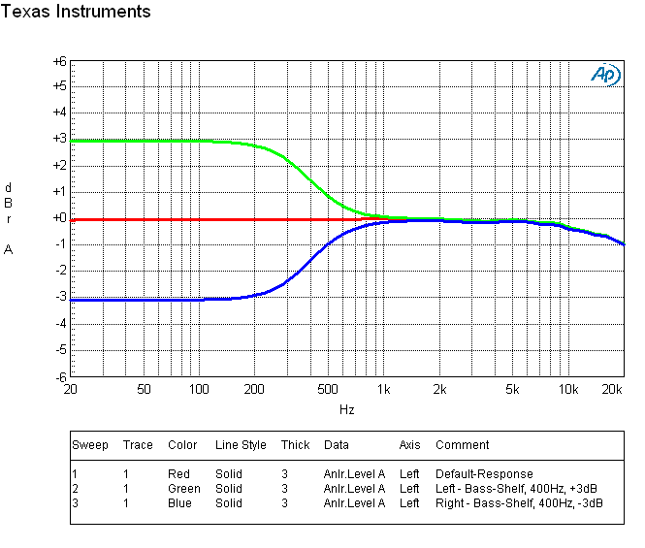
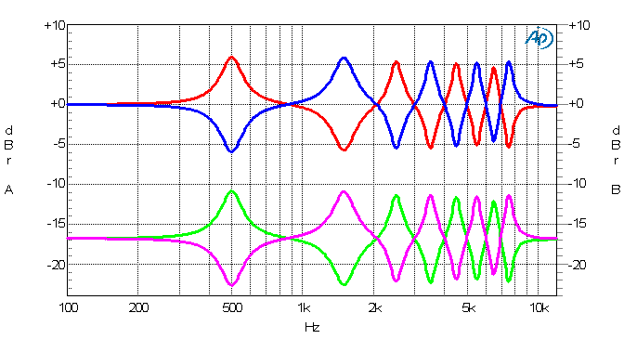
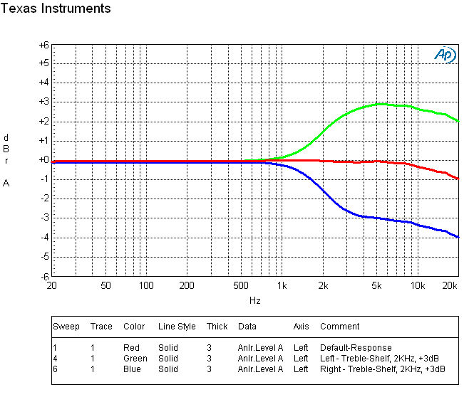
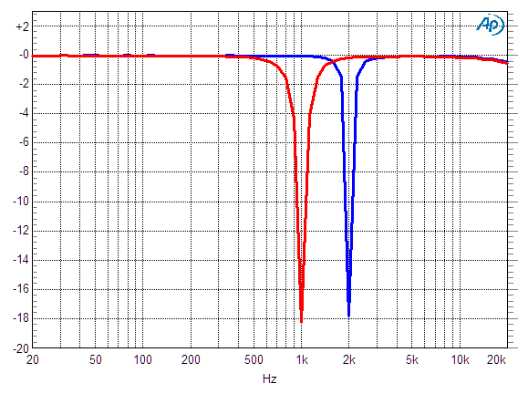
EQ - Example Plots
Bass Shelf
Multiple EQ (alternating)
Boost
Speaker – EQ
Default
Attenuate
Head-Phone – EQ
Boost
Treble Shelf
Default
Notch
Attenuate
Note the roll-off at high-frequency (due to LC filter).
We will try to compensate this using EQ next.

Slide 21
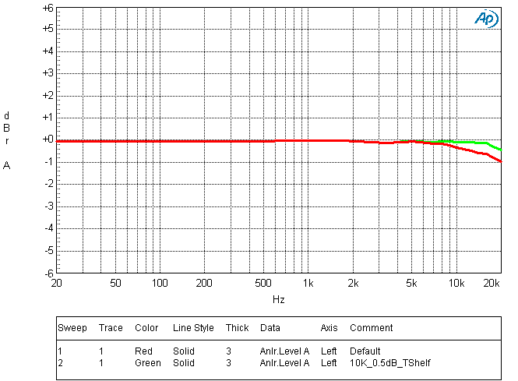
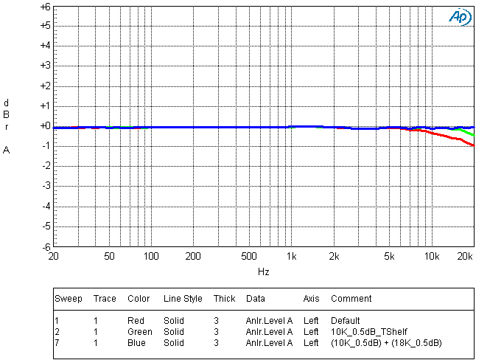
EQ Example - Compensating roll-off
Treble Shelf gain –Applied at 10K(GREEN)
(roll-off is now compensated (almost..)
Treble Shelf gain –Applied at 10K &18K (BLUE)
(roll-off is now completely compensated
Default response (RED)
(roll-off due to LC filter)

Slide 22
DRC AND AGL COMPARISON
DRC
Feed-forward
Adjustable compression ratio
Settings:
  Threshold
  Compression ratio
  Energy filter
  Attack time
  Release time
AGL
Feed-back
Fixed compression ratio
Settings:
  Threshold
  Softening filter
  Attack time
  Release time

Slide 23
COMPRESSION WITH AGL
DRC: TAS5706-TAS5711
AGL: TAS5713-TAS5727

Slide 24
AGL FORMULA
SOFTENING FILTER ALPHA (AEA)
  DRC1 (lower-band) AEA is 3B. Upper 4 bytes are AEA. Lower 4 bytes are AEO.
  DRC2 (upper-band) AEA is 3E. Upper 4 bytes are AEA. Lower 4 bytes are AEO.
  AEA = 1 – e^(-1000/(fs* User_AE)) --- 3.23 format
  e ~ 2.718281828
  Fs = sampling frequency
  User_AE = duration in mS – user input
SOFTENING FILTER OMEGA (AEO)
  AEO = 1 – AEA --- 3.23 format
ATTACK RATE
  Attack and release rates are programmed in 3C for lower-band DRC1 and 3F for upper-band DRC2. Upper 4 bytes are AA.
  Attack rate = 2*(AA + Release rate) --- 9.17 format
  AA = 1000*User_Ad/Fs
  User_Ad = attack duration in mS – user input
RELEASE RATE
  Attack and release rates are programmed in 3C for lower-band DRC1 and 3F for upper-band DRC2. Lower 4 bytes are Release Rate.
  Release rate = 1000*User_Rd/Fs --- 9.17 format
  User_Rd = release duration in mS – user input
  NOTE: The release duration (User_Rd) should be longer that attack duration (User_Ad)
ATTACK THRESHOLD
  Attack threshold is programmed in 40 for lower-band DRC1 and 43 for upper-band DRC2.
  When the signal is below the threshold, ALG is not applied. When the signal is above the threshold AGL is applied.
  Attack Threshold = dB level – user input --- 9.23 format

Slide 25
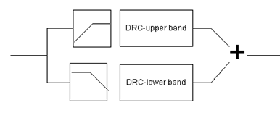
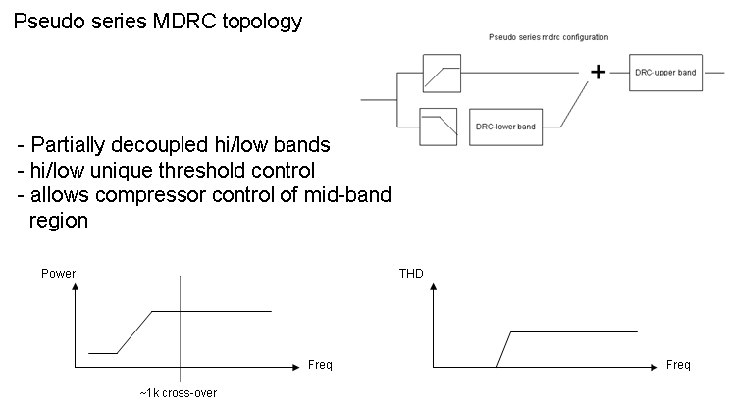
Two-Band DRC
By using a high-pass filter, audio signals above a “cut-off” value can be passed – lets call it band-1. By using a low-pass filter at the same cut-off frequency, the other band (band-2) can be passed.
This cut-off frequency is called crossover-frequency, and the two bands can now be processed separately with independent DRC settings (The high-pass & low-pass filters are implemented by using dedicated Bi-Quads.)
The 2-band DRC on TAS5717/19 can be configured under two different settings (Parallel or Series)
Parallel 2-band
Series 2-band

Slide 26
2-Band DRC (Series vs. Parallel flow)
Red+Green = Series
Red+Blue = Parallel
Parallel
Series
Input-Ch1
Band-1
Band-2
Band-2

Slide 27
PARALLEL AGL PROCESS FLOW
LEFT-UPPER
RIGHT-UPPER
RIGHT
LOWER
LEFT-LOWER

Slide 28
SERIES AGL PROCESS FLOW
LEFT-UPPER
RIGHT-UPPER
RIGHT
LOWER
LEFT-LOWER

Slide 29
PARALLEL VS SERIES
By design parallel AGL has louder sound in mid-band with higher gain
By design series AGL has flatter frequency response

Slide 30
WHY DECOUPLE VOLUME – SERIES

Slide 31
2-Band DRC : Combined Response
→ Parallel AGL has louder sound in mid-band with higher gain
→ Series AGL has flatter frequency response

Slide 32
PROCEDURES – 2 BANDS
Determine crossover
Check THD+N at operating set points: PVDD, load, 0dBFS, 0dB gain – record power and THD+N
Choose parallel or series
Change to maximum system gain
Either small attack time (little steps) and large softening time (long integration time) or large attack time (many steps) and small softening time (short integration time)

Slide 33
PARALLEL AND SERIES SETTINGS
Parallel
  1st order LPF and 1st order HPF at crossover frequency
  Turn on lower bytes of x51 and x52
  Pre-scale address is x57 with 9.17 format
    Headroom is 48dB for preserving volume information during calculations – avoid clipping in certain cases
  Post-scale address is x56 with 5.23 format
    Only 24dB so clipping can occur with post-scale setting
Series
  1st order LPF and 1st order HPF at crossover frequency
  Turn on x71 and x75
  Pre-scale: same as parallel
  Post-scale: same as parallel

Slide 34
ADJUSTING HIGHER BAND
Set input to 1kHz
Turn on compression – AGL
Turn off Softening filter – oscillation
  00 08 00 00 00 00 00 00 (α = 1 and ω = 1 – α)
Adjust the attack time
Adjust the release time
Adjust the pre and/or post scales if necessary
Add softening filter
Tuning AGL is similar to tuning EQ – it will take time

Slide 35
ADJUSTING LOWER BAND
Set input to 100 Hz
Turn on compression – AGL
Turn off Softening filter – oscillation
  00 08 00 00 00 00 00 00 (α = 1 and ω = 1 – α)
Adjust the attack time
Adjust the release time
Adjust the pre and/or post scales if necessary
Add softening filter
Tuning AGL is similar to tuning EQ – it will take time

Slide 36
Elements of DRC
TAS57xx implementation of DRC in the form of AGL, (Automatic Gain Limiter).
The different settings of DRC control are:
  Threshold (Value beyond which audio is compressed/limited)
  Attack time (Step-Size, i.e. time DRC takes to reach threshold)
  Release time (Step-Size, i.e. time DRC takes to reach threshold )
  Softening filter (Sharpness of the compression-knee)

Slide 37
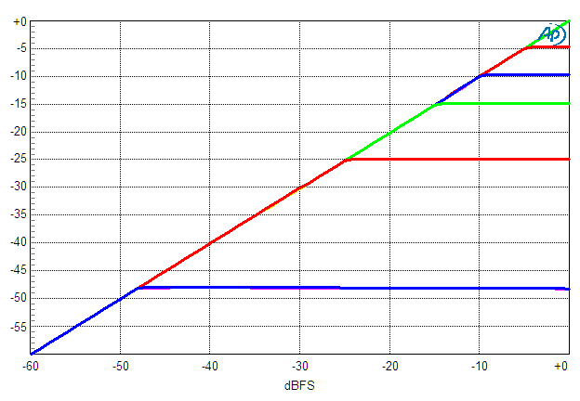
DRC - Threshold
Plot shows the output level (y-axis) vs. input level (x-axis).
With no DRC, the line is a 1:1 ratio, all the way upto full-scale input.
Different threshold settings are plotted, at each threshold level, the output can be seen to be limited.

Slide 38
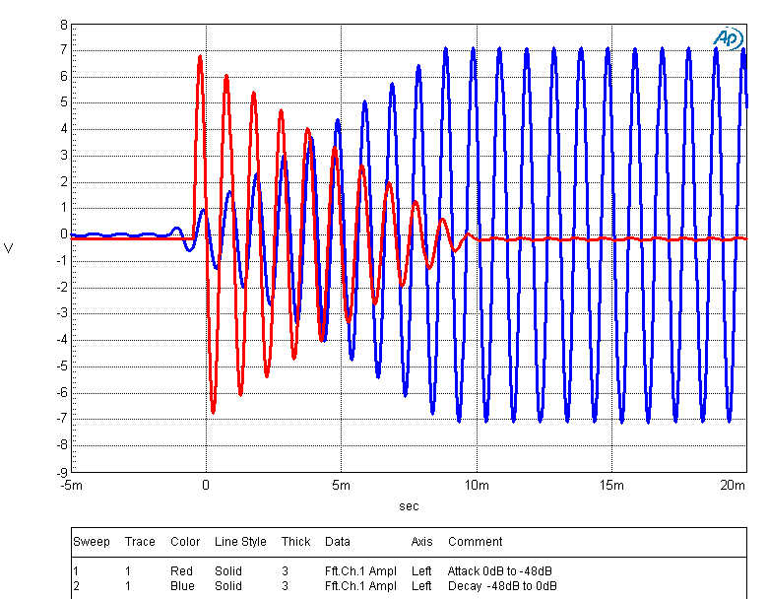
DRC - Attack & Decay time
Plot below shows DRC attack (RED) & decay (BLUE).
For attack case, a very low threshold was set (-40dB or lower??), and then a large audio signal was provided. The DRC compresses the audio to threshold level in ~10ms.
After audio was in this compression range, threshold was instantaneously raised to 0dB. The DRC immediately starts releasing (BLUE) and audio reaches full level in ~10ms

Slide 39
FINAL ADJUSTMENTS
Listening test
Fine tune – small changes to:
  Scales
  Attack time
  Softening time
  Release time

Slide 40
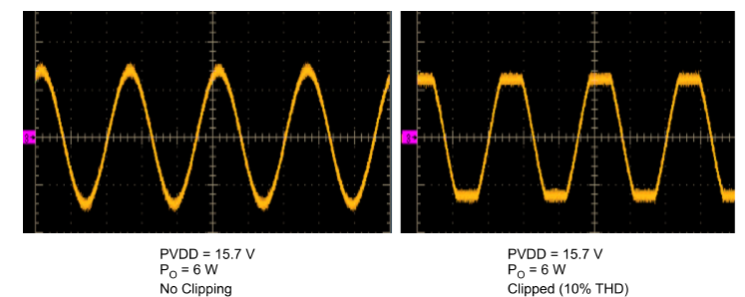
Other DAP Blocks: THD Manager
Reg 0x57 is used to achieve clipping.
Reg 0x56 is used to scale power-level at desired clipping.
THD-Manager (Pre-Scale, Post-Scale)
The THD manager can be used to achieve digitally the specified THD levels without voltage clipping.
This allows user to achieve the same THD (for example, 10% THD) for different power levels (15 W/10 W/5W) with same PVCC level.

Slide 41
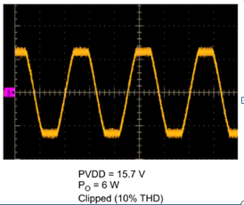
THD Manager: Output Peak Power Limit
Reduce input signal to reduce output power to safe level (typical -12dBFs from max input signal volume of system)
Disable AGL/DRC
Set Post Scale register to around -20dB attenuation
Set Pre Scale register to around 20dB gain
Increase input signal until clipping (10% THD+N) shown here
If no clipping in observed lower input signal to -12dBFs and set post scale to -26dB and pre scale to 26dB and check for (10% THD+N) shown here, while ramping input signal
Decrease post scale gain and increase pre scale gain at the same rate until clipping is achieved
When clipping is achieved set input to 0dBFs (max input signal volume of system) and increase or decrease post scale gain set desire power for clipping to occur. It recommended have most of the gain before AGL/DRC block (use post AGL/DRC block including pre and post scale gains as last resort). If there’s available channel gain or gain before AGL/DRC block remove gain from pre scale and add the gain removed from pre scale to block before AGL/DRC (e.g. use channel gain, mixer gain, etc). Utilize the maximum gain available before the AGL/DRC block.
This will cut-off signals above this level limit the output power and creating a lower virtual power rail, which will protect the speakers and power supply from high peak signals that escapes the DRC/AGL
After setting clip level DRC/AGL must be re-tuned for correct DRC/AGL thresholds

Slide 42
THD Manager: AGL/DRC Re-tuning
At 0dBFs (max input signal volume of system) enable AGL/DRC
Check if AGL/DRC is engaged
If not engaged increase the channel gain (before AGL/DRC block) until AGL/DRC becomes engaged (it most likely would be engaged)
Once engaged adjust AGL/DRC threshold until desire level is achieved

Slide 43
Other DAP blocks: PWM Level Meter
  Provide an estimate of the output signal level (through I2C register read-back), one register for per channel.
  By using an external uC to monitor the signal levels, dynamic-DRC can be performed, or perhaps a LED brightness could be controlled etc…
Two’s complement
0111 1111
32bit
Ex.) Large input = 0x4E403228
ADDR = 0x6B/6C
RMS estimator
16bit
Ex.) Low input = 0x00006215
0000 0000
:
Post-DAP processing
1000 0000
Time window
= generally, greater than 5-10 times of input freq.
Otherwise, not good estimation for RMS value.
If muted in DAP, code will be zero.
43

Slide 44
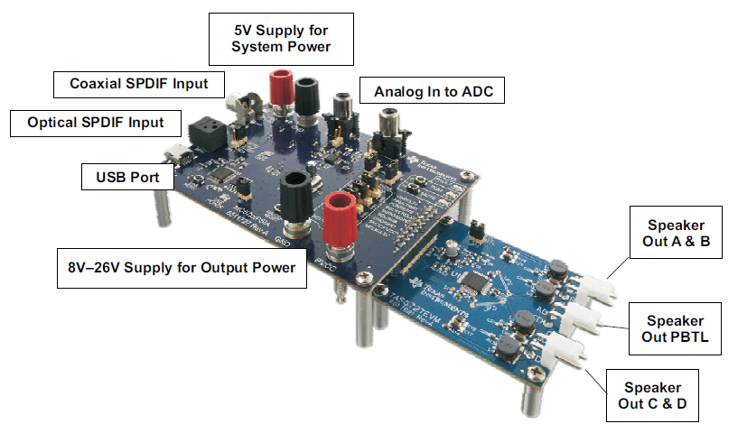
Typical TAS57xx EVM
44
Notes:
44

Slide 45
Layout Guidelines
Reliability
  High Frequency Decoupling should be very close to device pin.
    Good quality Cap’s (X7R)
    Voltage rating >> max system PVDD
  RC-Snubber should be as close as possible to the output pin.
  BST cap path should be kept small.
Thermal
  Recommended Via Pattern (in datasheet) should be followed.
  Have thermal via’s around the IC GND pins.
  Good connection between Thermal PAD & PCB.
  Open spacing around the device, esp close to GND pins.
Other
  GND isolation between adjacent traces.
  Thick & short traces for output.
  Shielded Inductors for good cross-talk performance.
  Sufficient Bulk Decoupling. Voltage rating >>max system PVDD
45
Notes:
45

