Slide 1
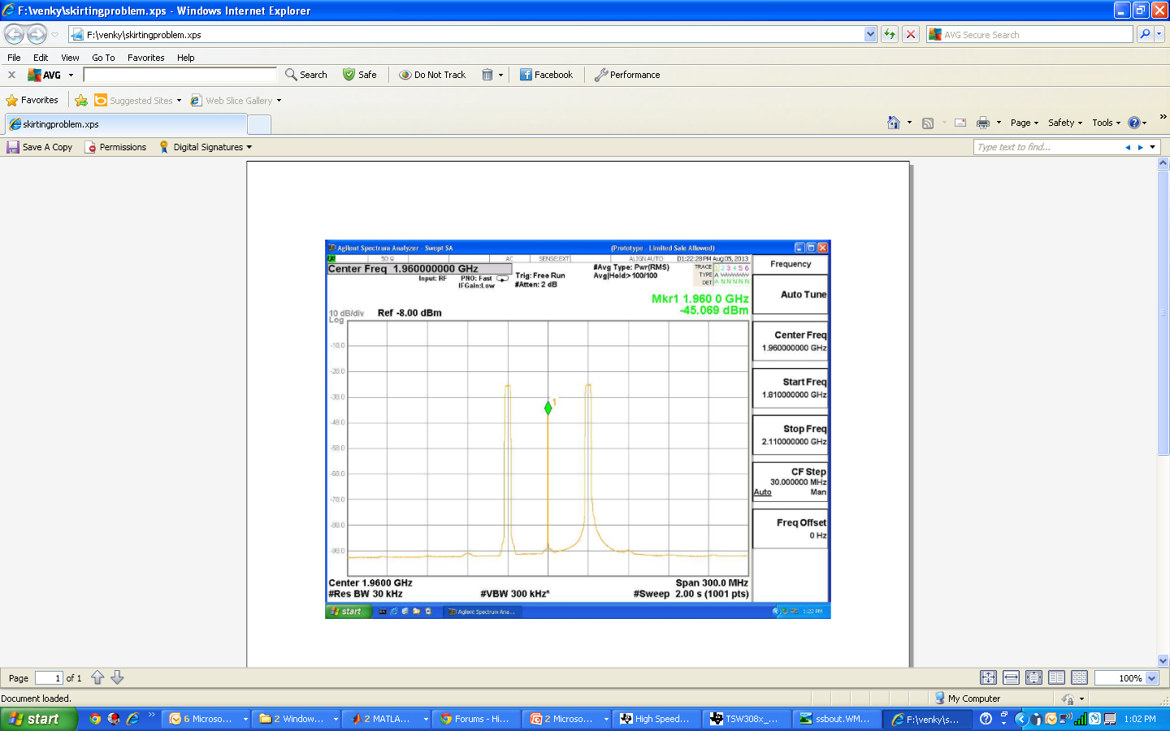
Why is the spectrum broad here ?

