Slide 1
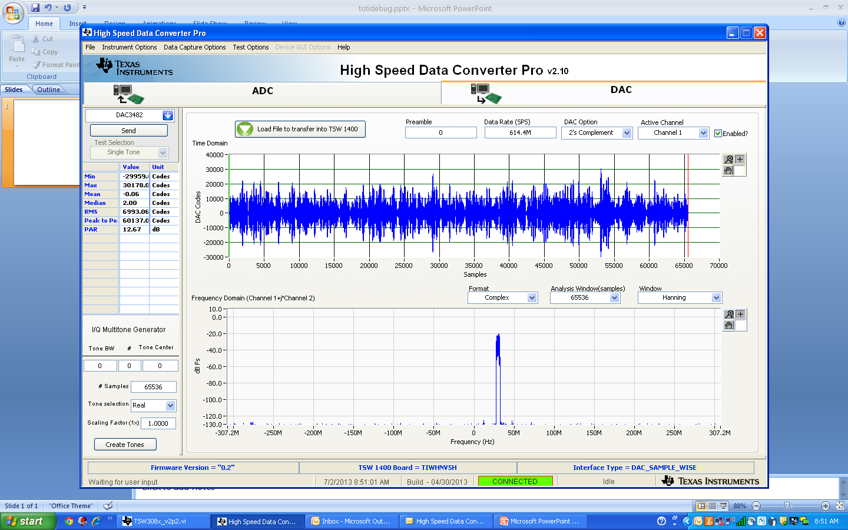

Slide 2
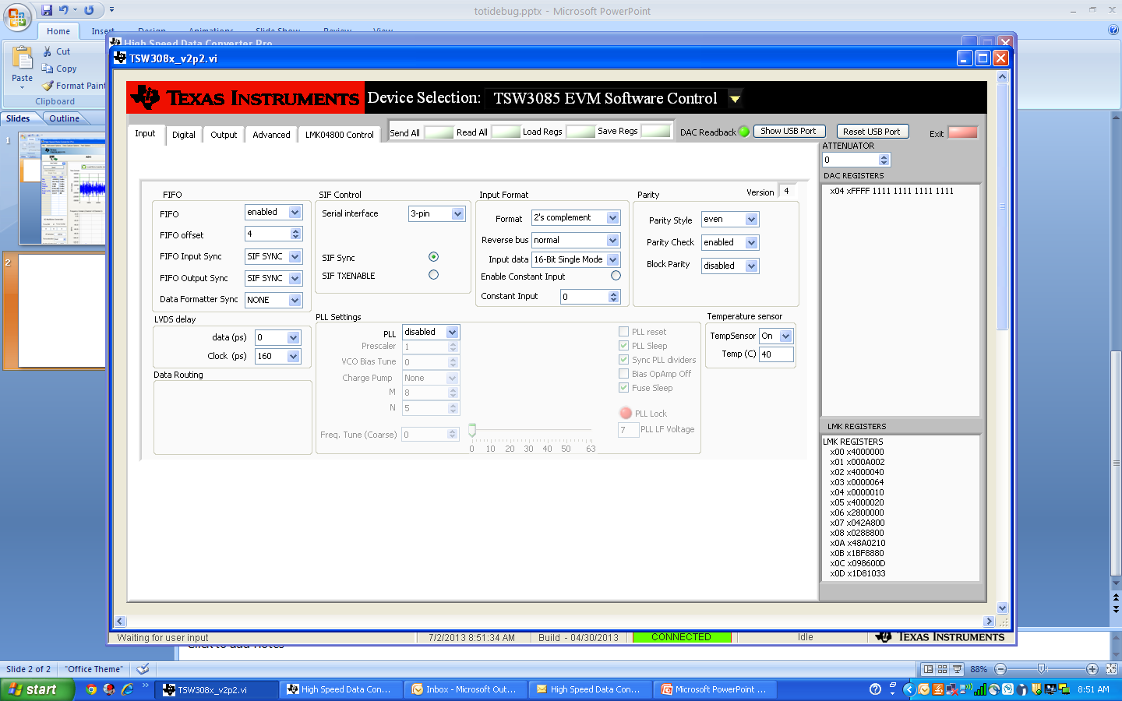

Slide 4
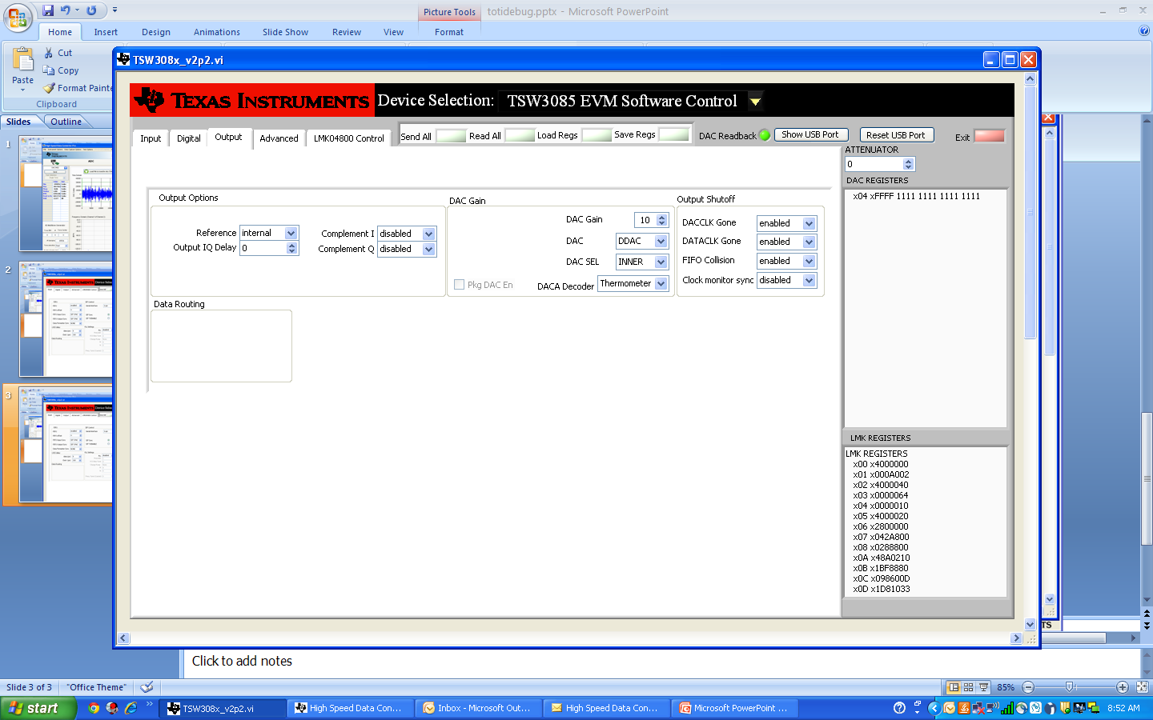

Slide 6
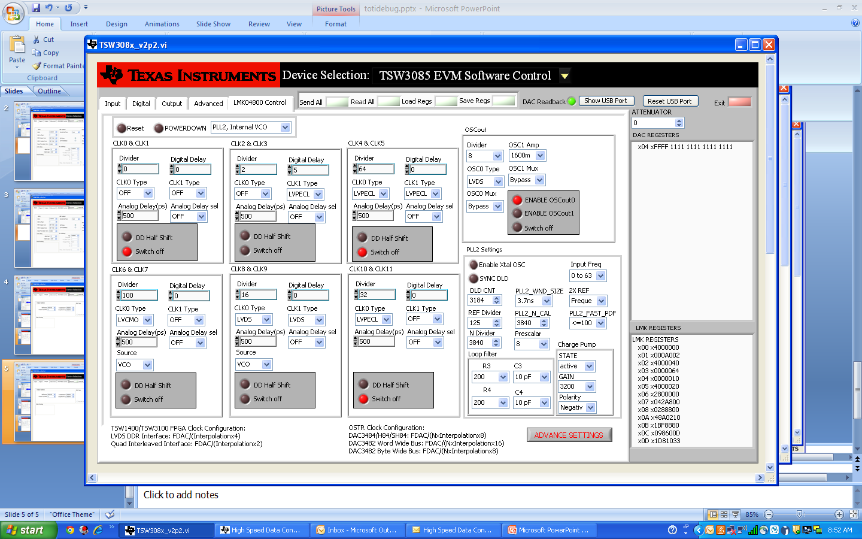

Slide 7
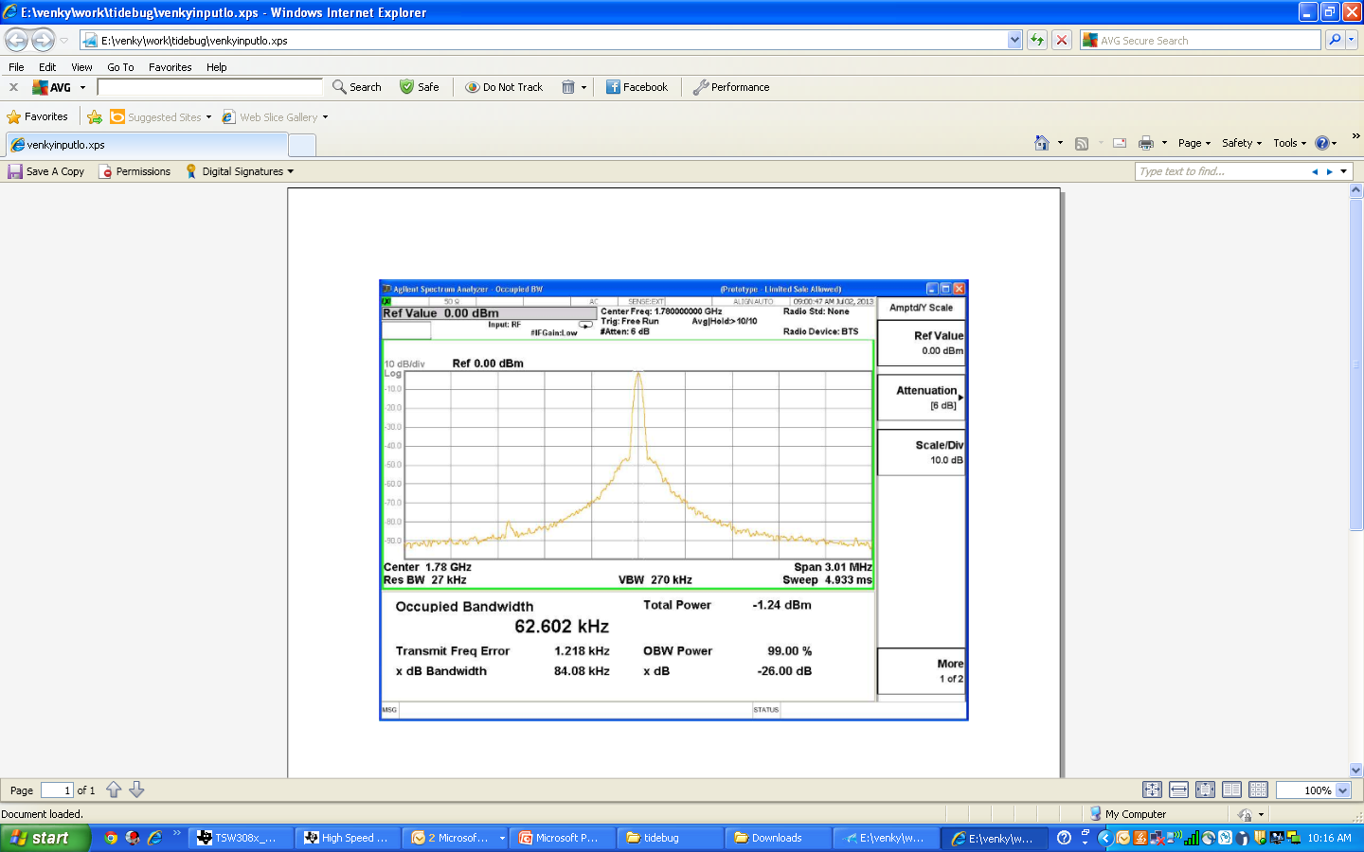
Input RF IN
0dBm @ 1.78Ghz

Slide 8
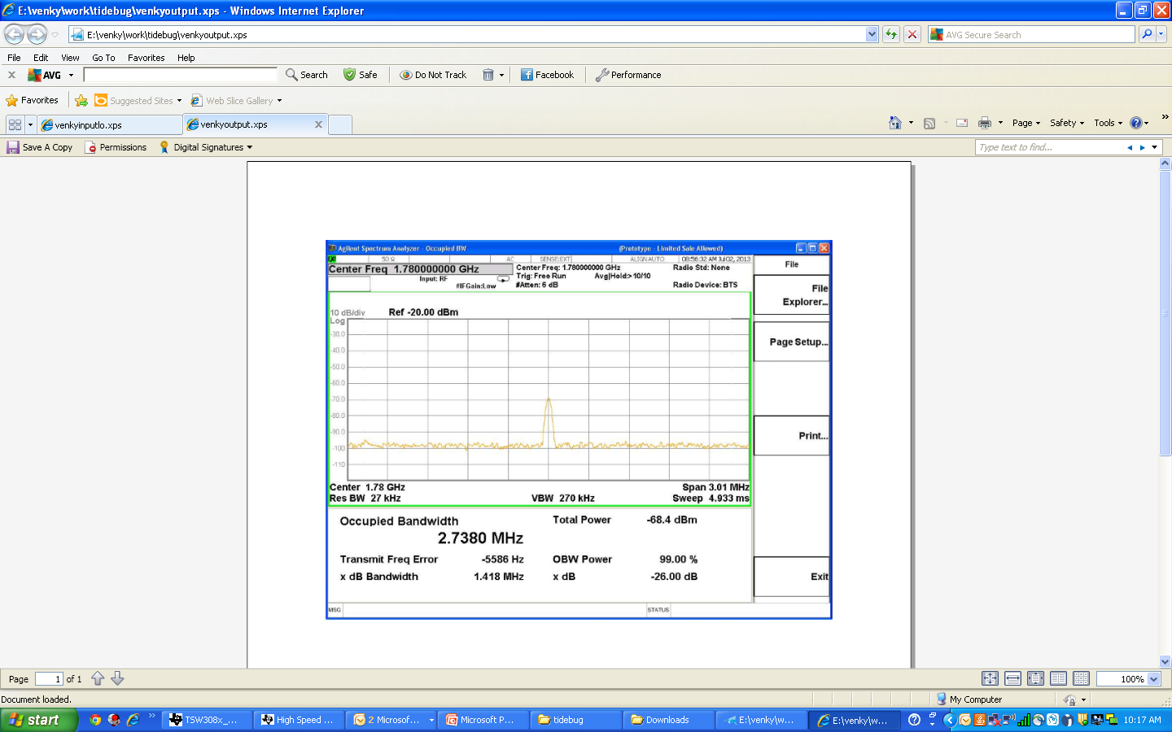
Output RF
@ 1.78Ghz
Do not see the modulated waveform @1.78Ghz / 1.84 Ghz

