Slide 1
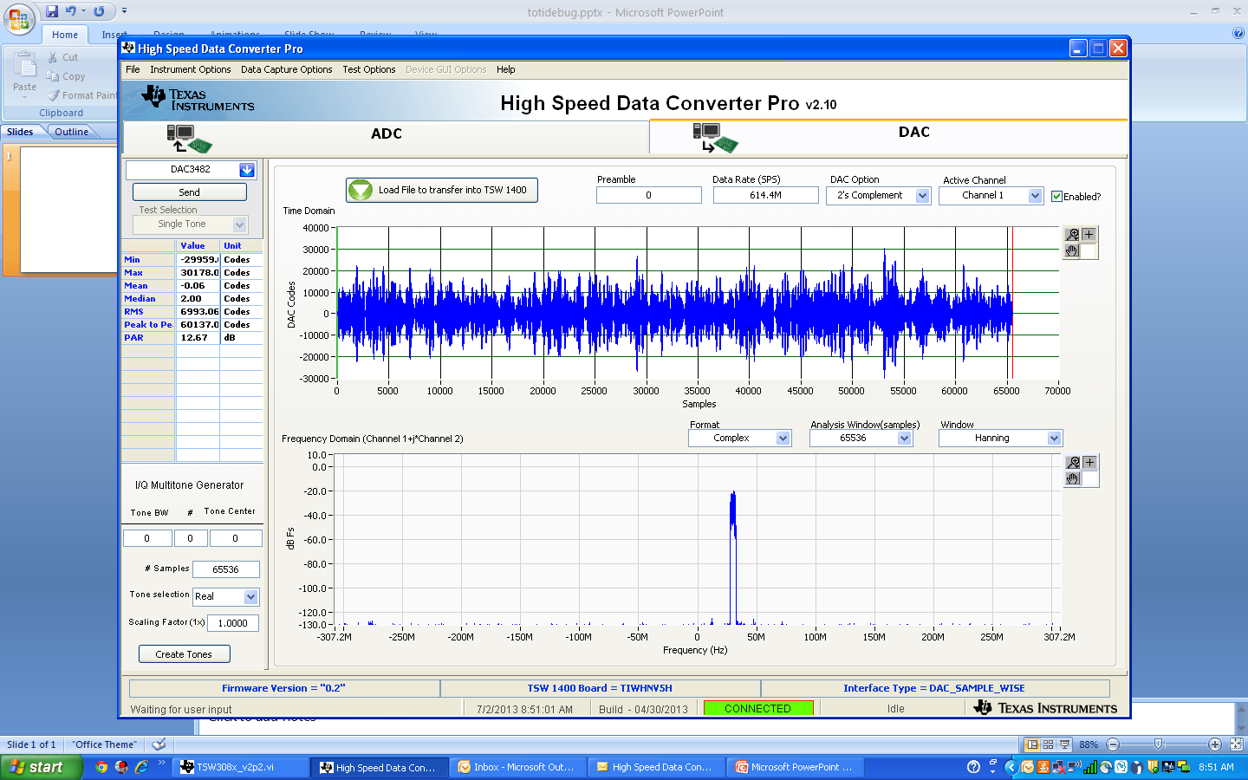

Slide 2
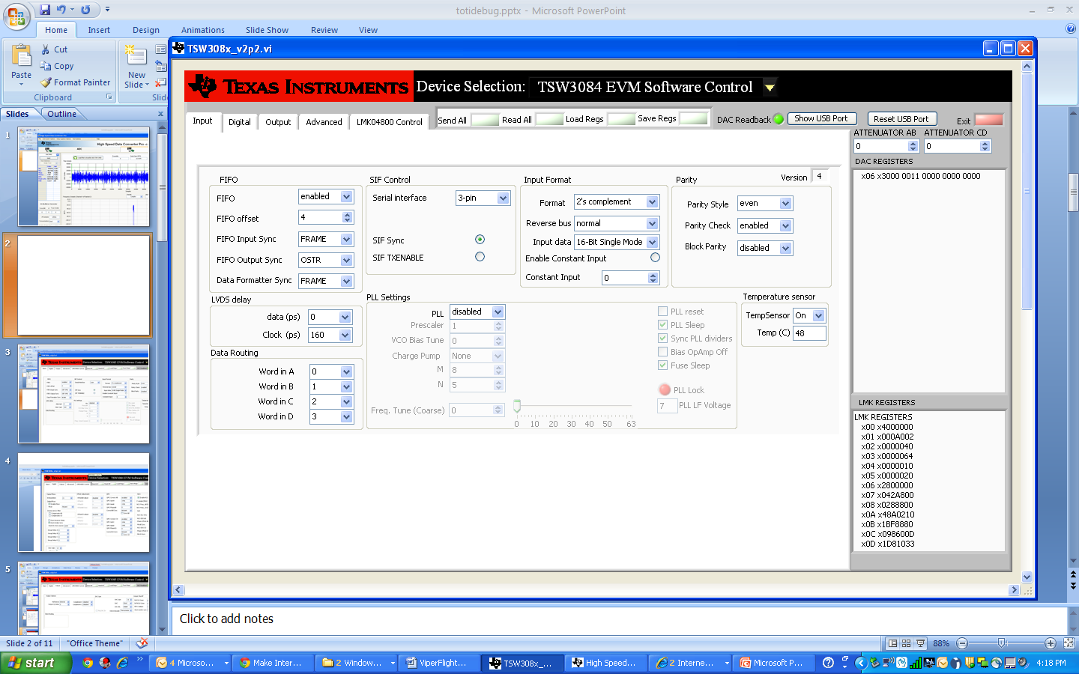

Slide 3
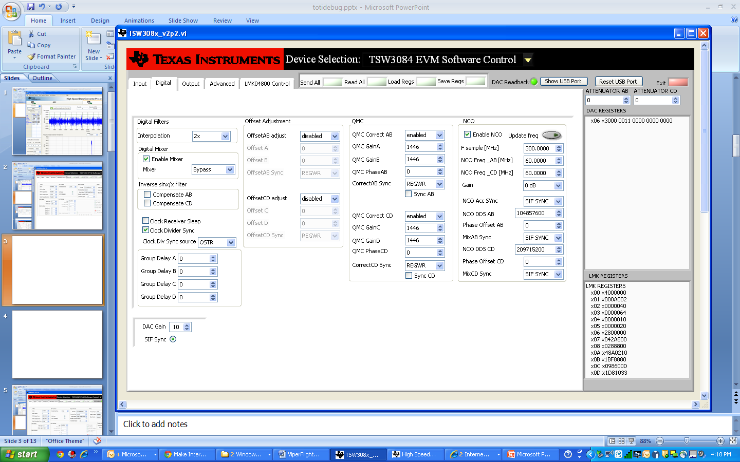

Slide 4
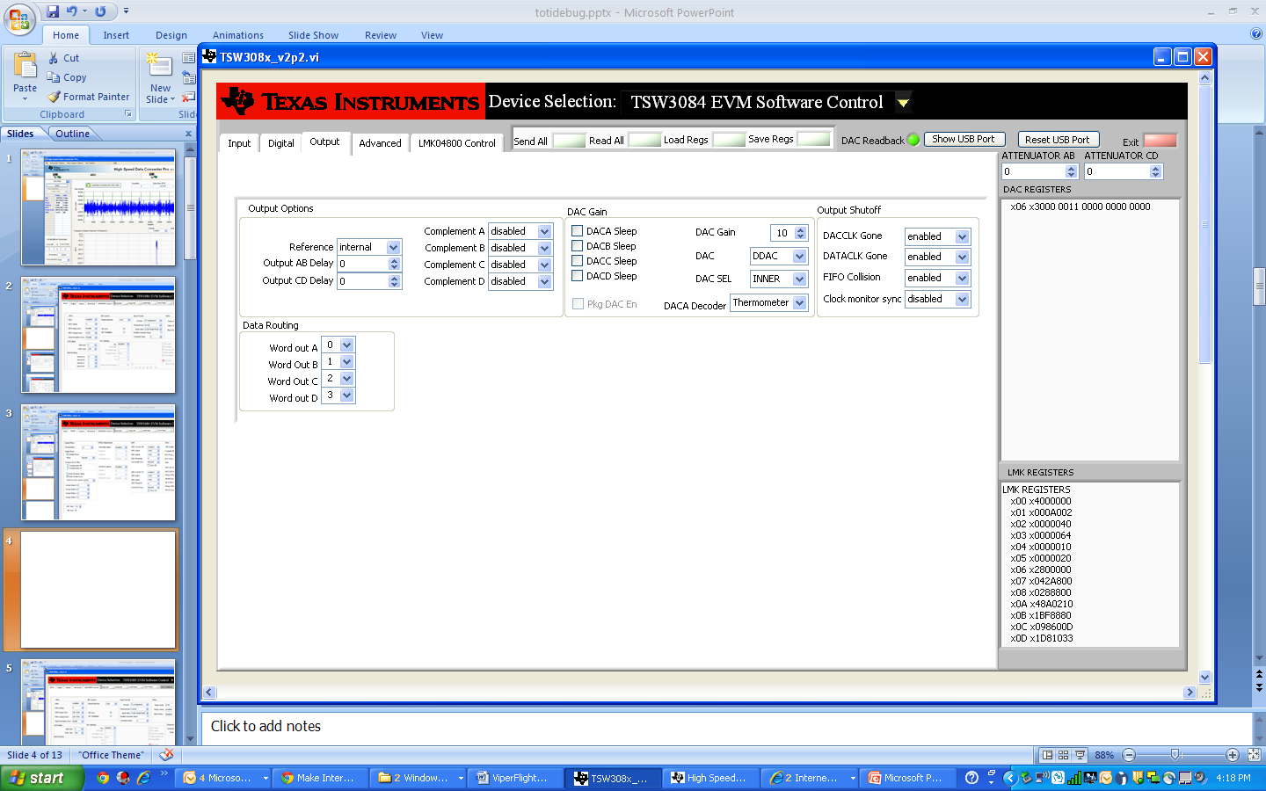

Slide 5
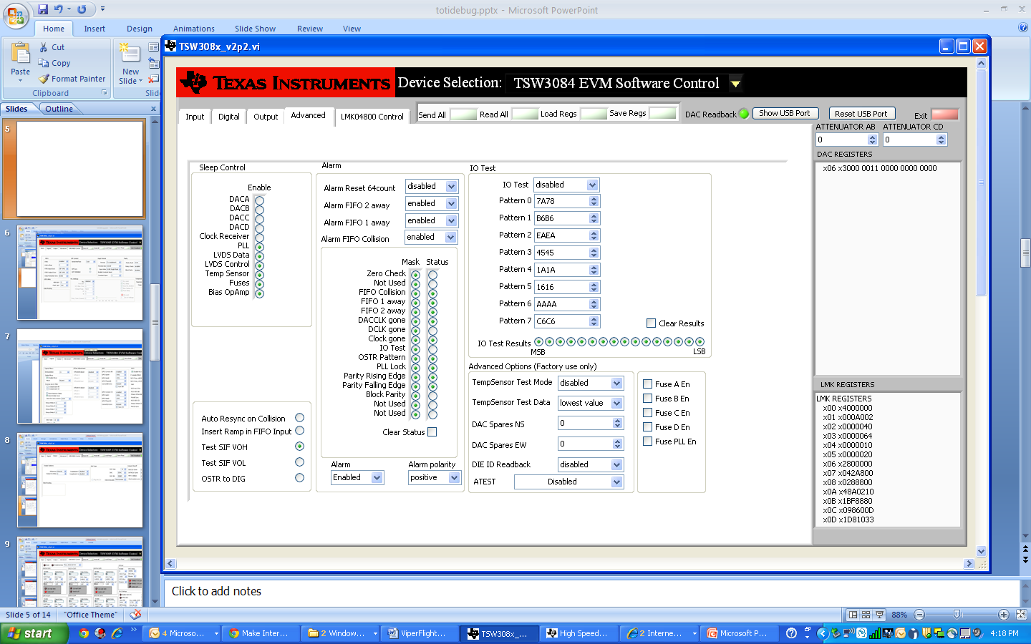

Slide 6
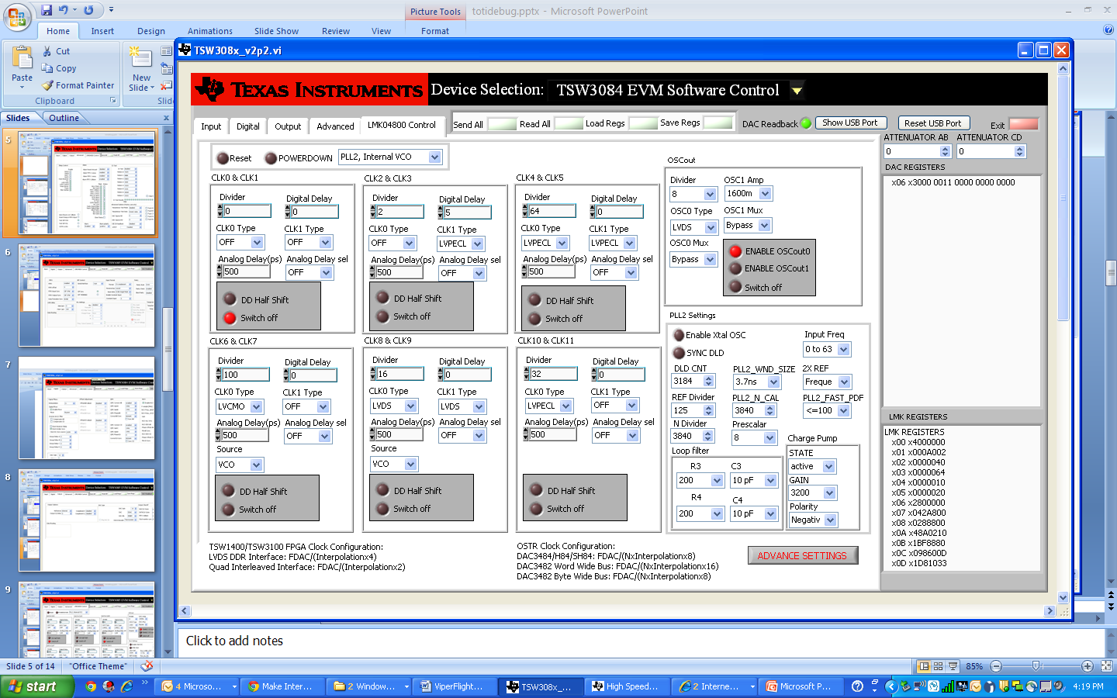

Slide 7
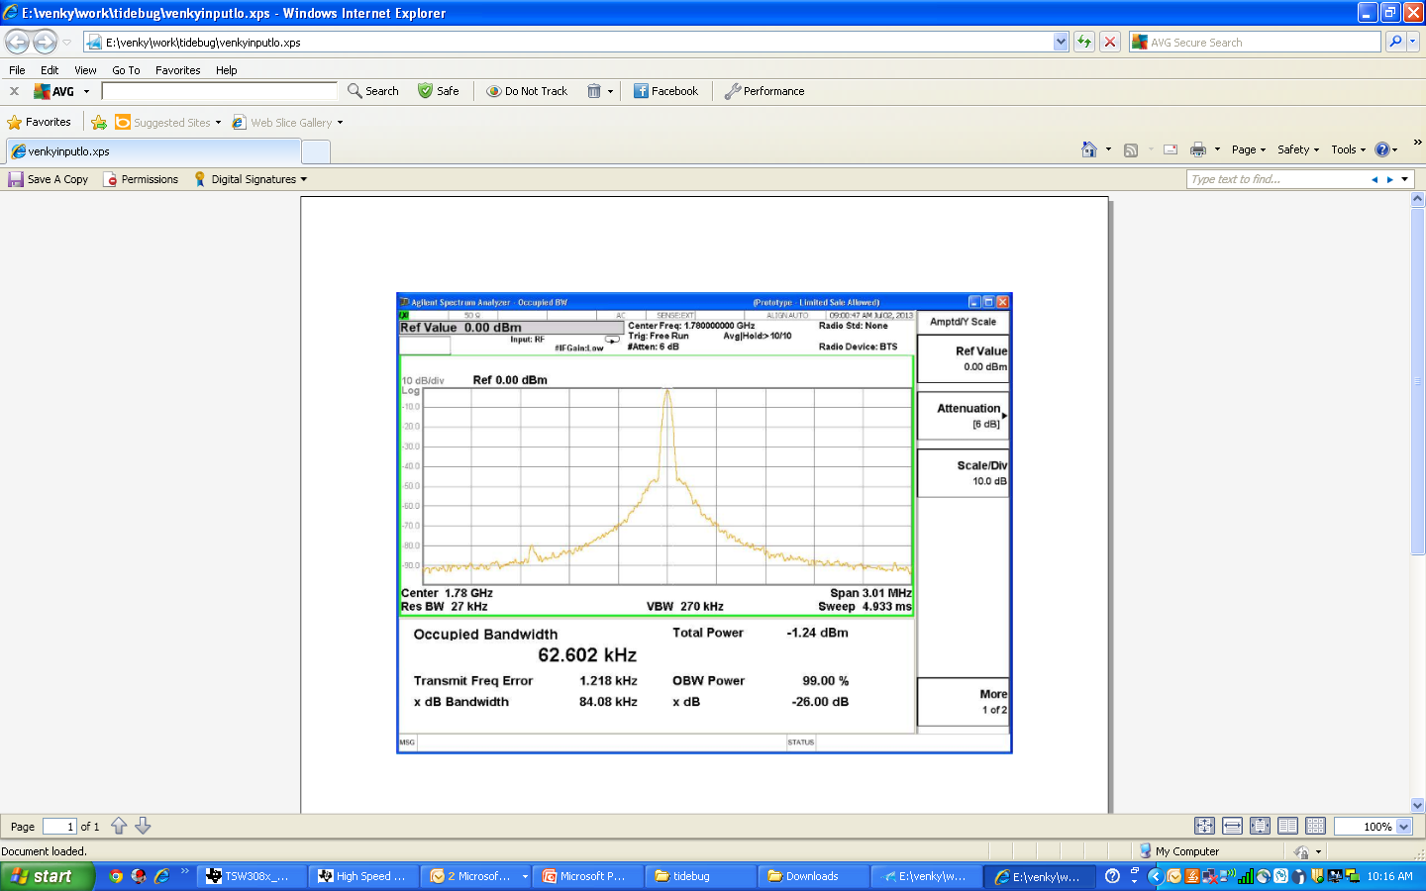
Input RF IN
0dBm @ 1.78Ghz

Slide 8
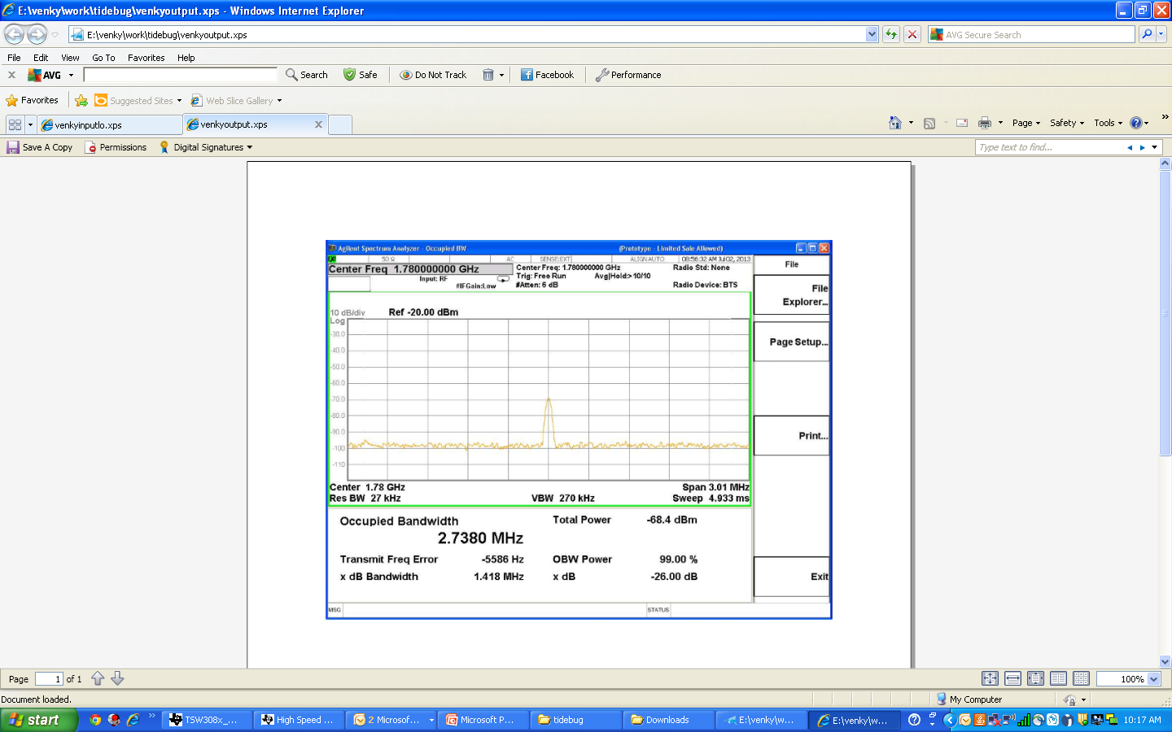
Output RF
@ 1.78Ghz
Do not see the modulated waveform @1.78Ghz / 1.84 Ghz

Slide 9
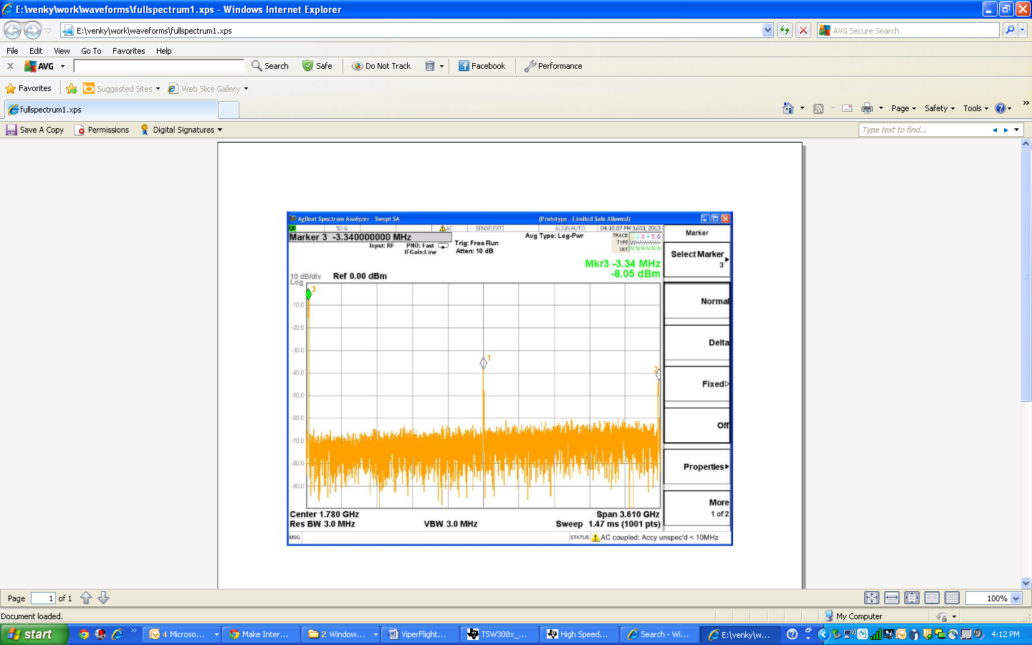
Marker 1 @ 1.78Ghz
Marker 2 @ 3.56 Ghz
Marker 3 @ -3.3Mhz
There is no signal @ 1.84 Ghz

