Slide 1
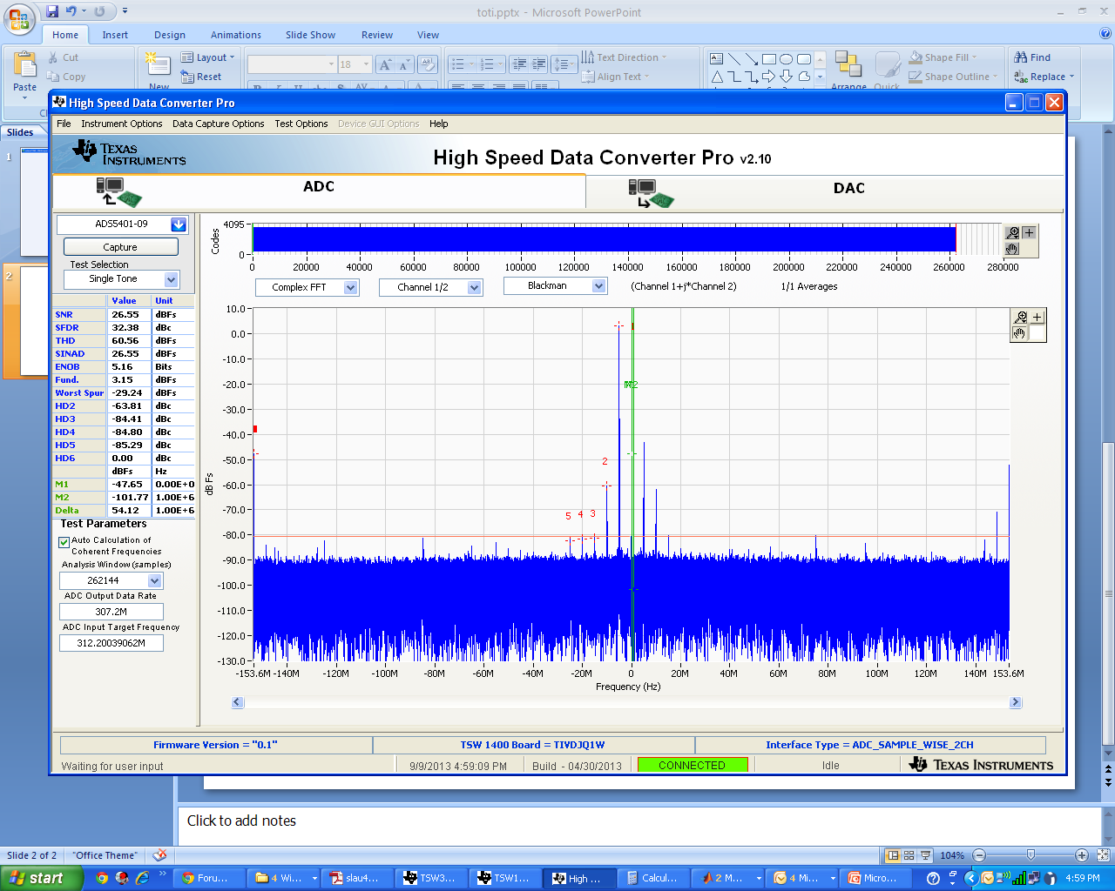
Needed signal @ 1955Mhz or center
Spurious/Unwanted
Spurious/Unwanted

