Slide 1
Nano Module SMT Guideline
David Chin
July-26-2013

Slide 2
Nano Modules SMT Guideline - Summary
 | LMZ10501 | LMZ10501SIL | LMZ21701
Package Outline (mm) | 2.5 X 3.0 | 2.6 X 3 | 3.5 X 3.5
Dimension of area for pick up (mm) | 1.69 X 1.84 | 1.6 X 2 | 2 X 2.5
SMT Nozzle Size (Diameter in mm) | <1 | <1 | <1.3
Nozzle with Soft Tip | Mandatory | Prefer | Prefer
Placement by Force (N) | <3
Placement by part thickness (mm) | Actual +0.05
PCB Land Pattern and Stencil | Refer to individual Package Outline Drawing
Suggested Reflow Profile | Similar to QFN (See Back Up)
Suggested Manual Placement | Refer to Nano 1SIL Datasheet

Slide 3
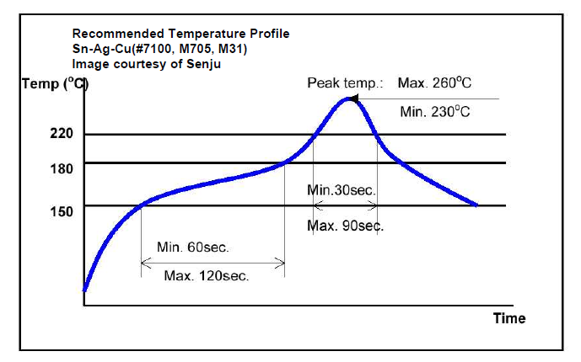
Nano Modules SMT Guideline – Lead Free No Clean Solder Paste

Slide 4
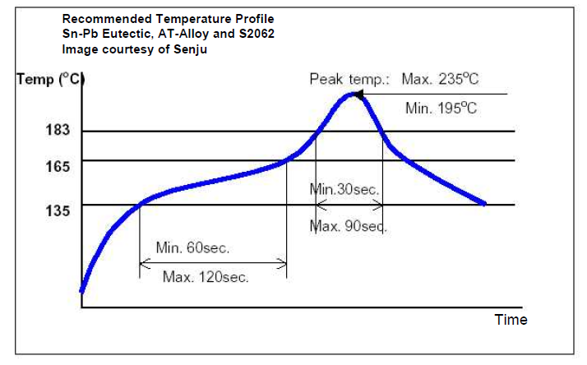
Nano Modules SMT Guideline – Eutectic Solder Paste

Slide 5
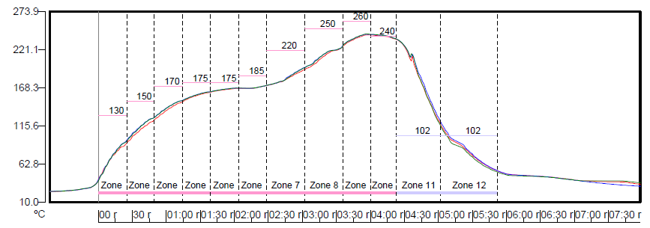
Nano Modules SMT Guideline – Water Soluble Solder Paste

