Slide 1
PPCMB External I2S
MPAA
PPCMB (AIP006G)

Slide 2
External I2S
External I2S may be provided through connector J4.
Connect respective ground of each signal to ensure clean clocks and data.

Slide 3
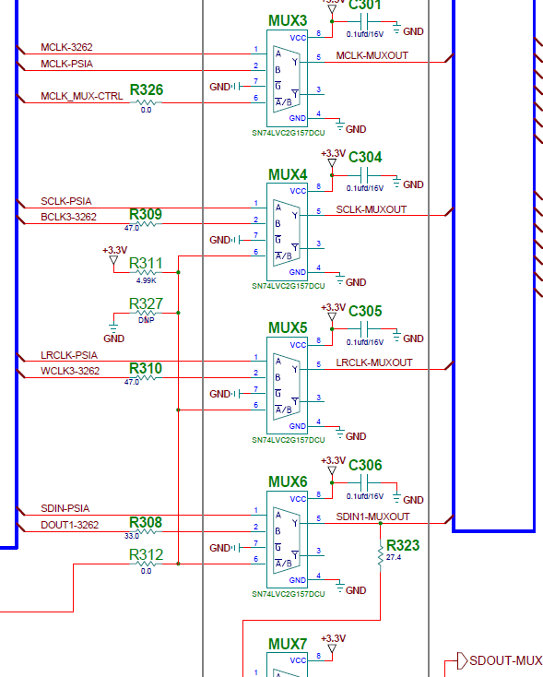
Hardware Modification
Remove R311 and populate R327 with a 5k resistor.
This will select external I2S for MUX4/5/6.

Slide 4
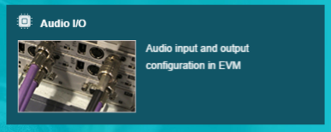
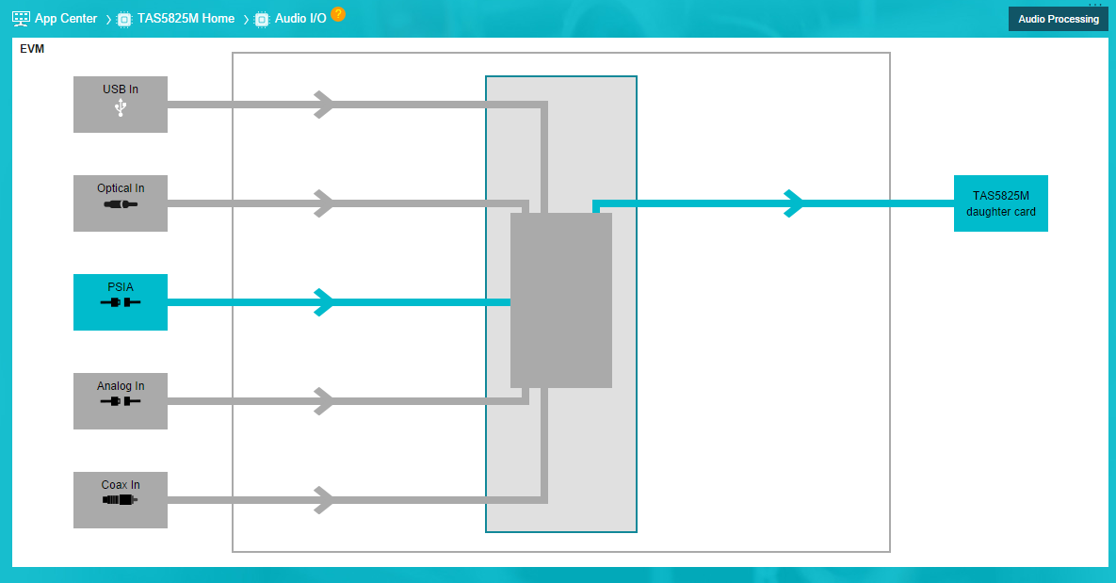
Software Selection
Select “Audio I/O” from PPC3 GUI within TAS5825M Application
Select “PSIA” for external I2S connection

