Slide 1
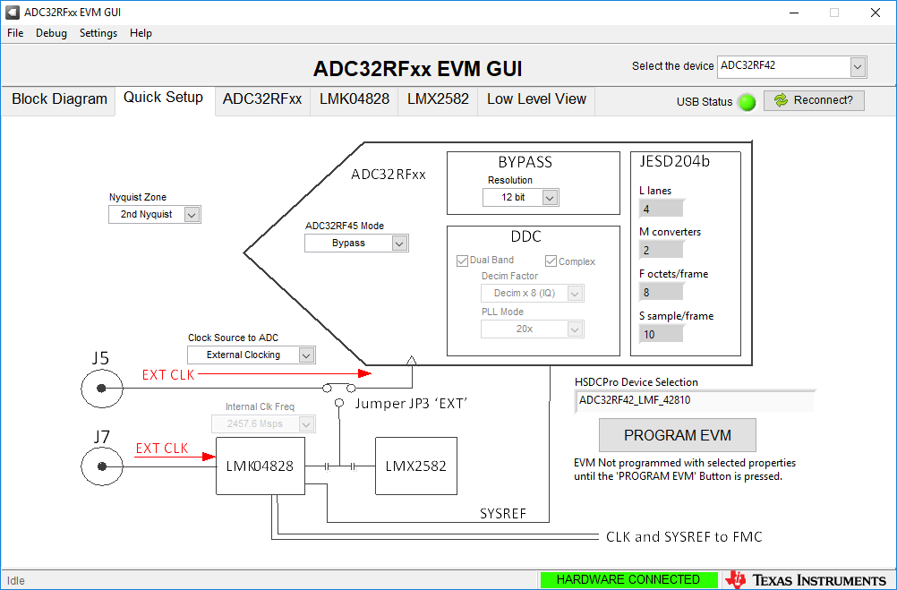
Quick Setup settings

Slide 2
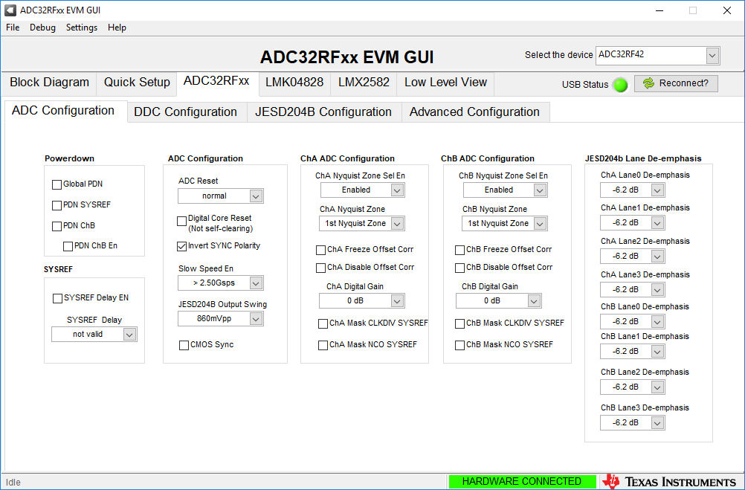
Set slow speed En

Slide 3
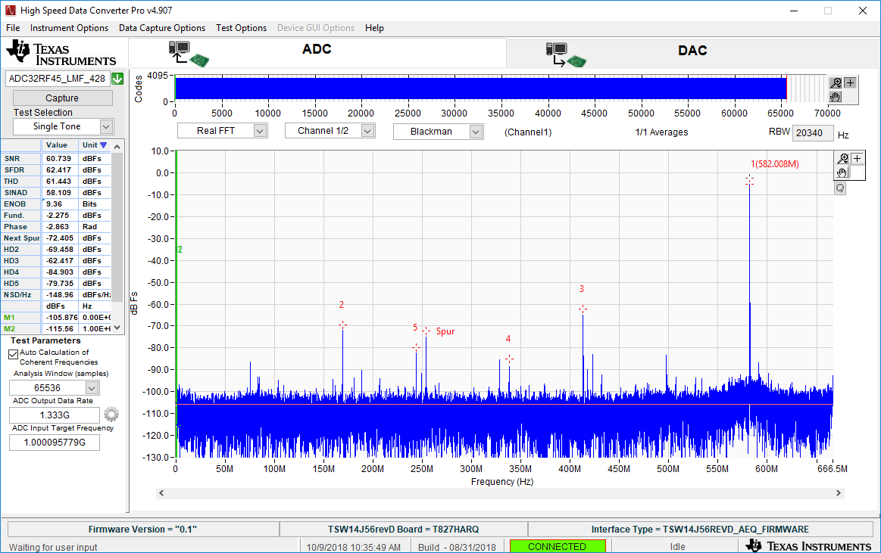
Fs =1.33G fin = 751M

Slide 4
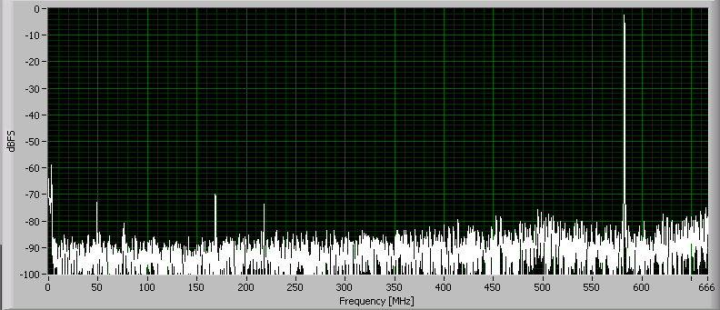
Fs =1.33G fin = 751M
751M | TI data | iRF-1 | iRF-2
Fund | -2.28 | -2.17 | -2.17
2nd | -69.46 | -69.33 | -70.15
3rd | -62.42 | -78.75 | -76.74
8192-point FFT
Blackman Window

Slide 5
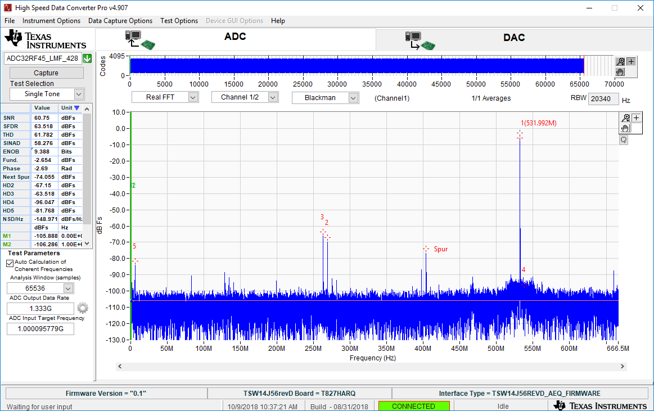
Fs =1.33G fin = 801M

Slide 6
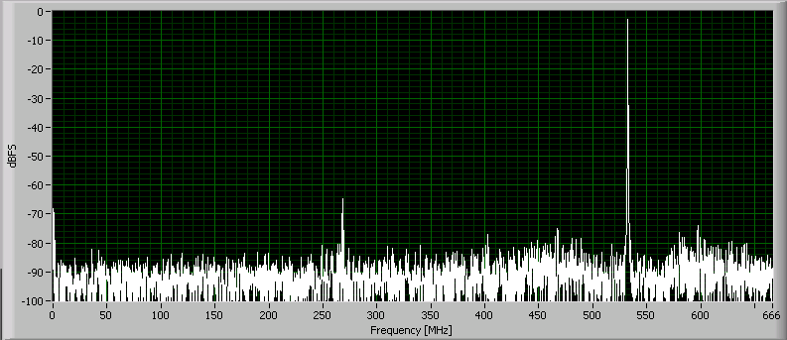
Fs =1.33G fin = 801M
801M | TI data | iRF-1 | iRF-2
Fund | -2.65 | -2.16 | -2.17
2nd | -67.15 | -64.95 | -64.45
3rd | -63.52 | -81.73 | -80.18
8192-point FFT
Blackman Window

Slide 7
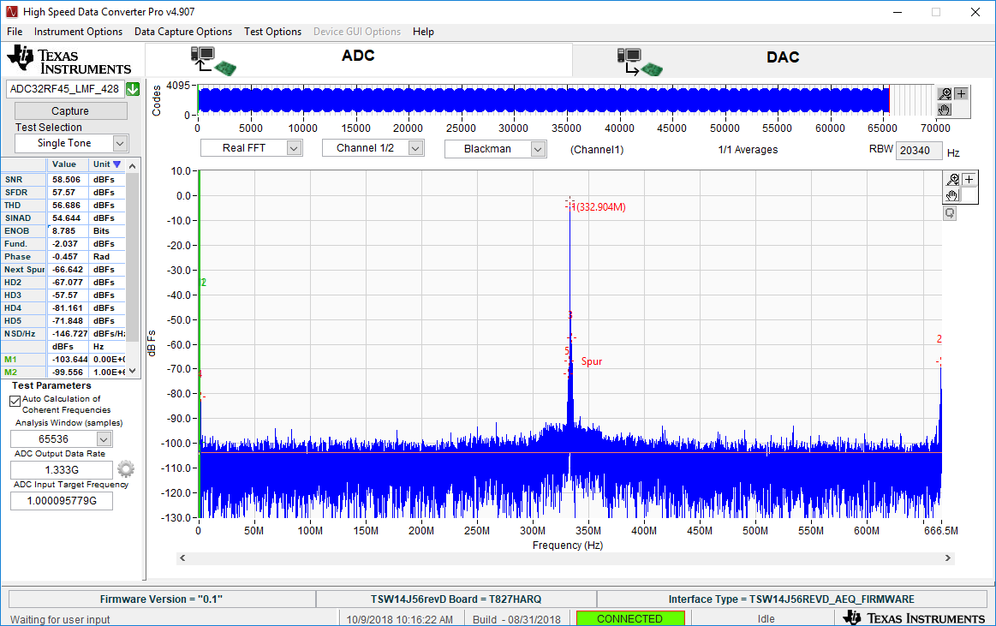
Fs =1.33G fin = 1000M

Slide 8
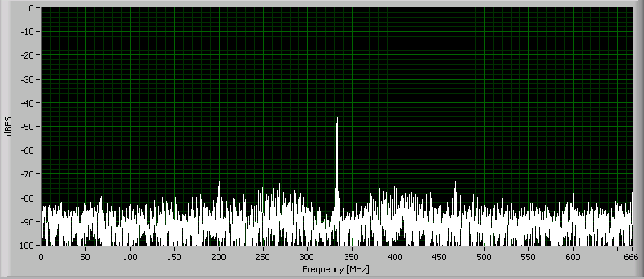
Fs =1.33G fin = 1000M
Note: ADC appears to attenuate signal at 1000M.
Is Offset Corrector Block enabled?
8192-point FFT
Blackman Window

Slide 9
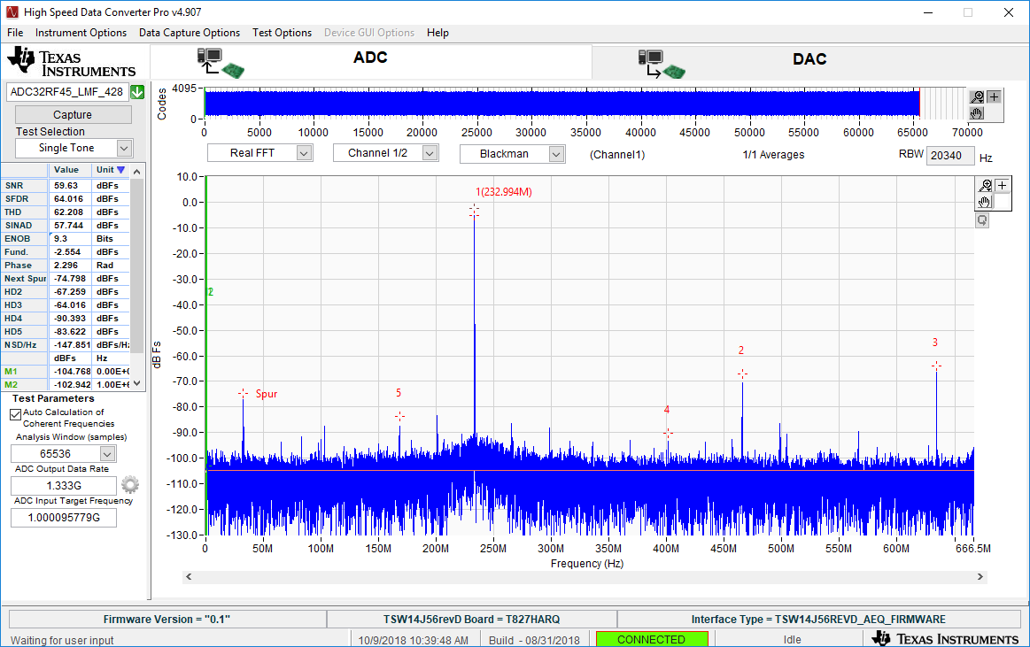
Fs =1.33G fin = 1100M

Slide 10
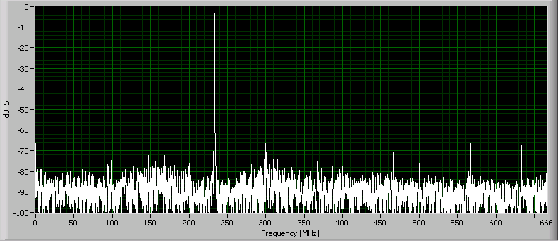
Fs =1.33G fin = 1100M
 | TI data | iRF-1 | iRF-2 | iRF-3 | iRF-4 | iRF-5
Fund | -2.55 | -2.28 | -2.27 | -2.26 | -2.26 | -2.26
2nd | -67.26 | -65.57 | -66.73 | -68.17 | -65.97 | -66.56
3rd | -64.02 | -66.88 | -67.24 | -66.24 | -66.73 | -67.31
566.666M | -90 | -72 | -66 | -68 | -71 | -67
300M | -88 |  | -66 | -67 | -69 | -65
8192-point FFT
Blackman Window

Slide 11
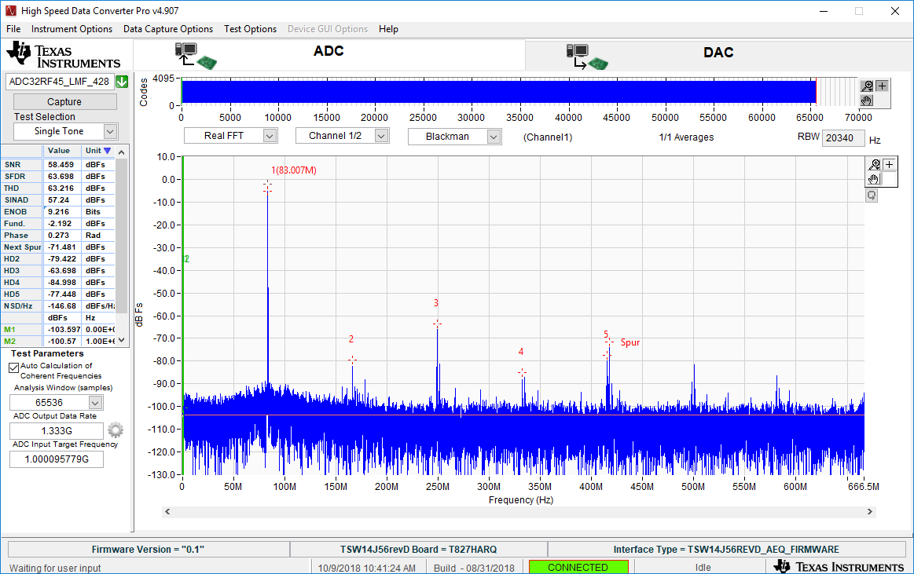
Fs =1.33G fin = 1250M

Slide 12
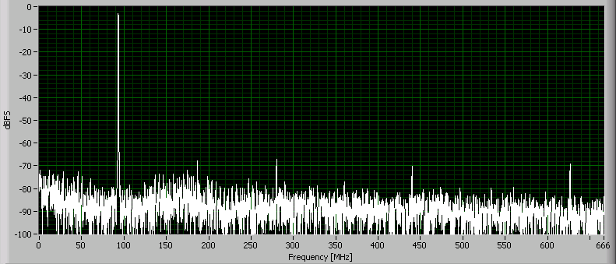
Fs =1.33G fin = 1240M
1240M | TI data* | iRF-1 | iRF-2
Fund | -2.19 | -2.36 | -2.36
2nd | -79.42 | -71.00 | -67.83
3rd | -63.69 | -67.88 | -66.95
Note: TI data is for 1250MHz.
iRF anti-alias filter for testing has higher IL at 1250MHz.
8192-point FFT
Blackman Window

