Slide 1
Tackling EMI and RFI at the Board and System Level
By Thomas Kuehl – Senior Applications Engineer

Slide 2
EMI – RFI
EMI – Electromagnetic Interference
RFI – Radio frequency Interference
Why are EMI and RFI a concern?
RF Spectrum pollution
Compatibility within circuits
System disturbance or malfunction
Damage and liability
Regulation conformance
EMI/RFI → Unintended Radiators and Receptors
Notes:
Why do we even have concerns about EMI and RFI? Basically, it comes down to the proliferation of unintentional EMI/RFI radiators and receptors and the interference and havoc that arises when attention is not given to this matter. Emitted EMI/RFI amounts to frequency spectrum pollution that if not kept in check would render intended radio frequency services partially or completely ineffective.
However, that is only the start of the issue. EMI and RFI, because of their radio frequency energy, can affect circuits that have no intended radio frequency respond, do so in in an unexpected, negative fashion. This may take place on a single circuit board completely enclosed and isolated from other circuits. Or it may be on larger scale from one system to another located a distance away.
The unexpected negative response may be small measurement error or something as significant as a system malfunction shutdown, or even circuit damage. This is why EMI is such an issue with life support systems and air transportation.
Then there are the EMI conformance regulations mandated by government agencies around the world such as the FCC (USA), VDE (Europe), VCCI (Japan) and CISPR (Europe). These are the result of international treaties. Additionally, the military has mandatory EMI regulations of its own in place for electronics. While the automotive industry has had voluntary standards in place for many years.

Slide 3
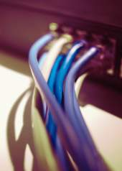
EMI or RFI?
Both are sources of radio frequency (RF) disturbance
EMI – electromagnetic interference
  Often a broadband RF source
RFI – radio frequency interference
  Often a narrowband RF source
Terms are often used interchangeably
Notes:
Electromagnetic Interference (EMI) and Radio Frequency Interference (RFI) are both electromagnetic interference. EMI is a more general term applicable to any electrical system interference but tends to be used to describe RF disturbances that are broadband in characteristic. While RFI is often associated with narrowband, radio transmission or reception based interference.
EMI is an undesirable byproduct of electrical systems and if it can be confined to the source or generator – all the better. But because EMI can produce a wide range of frequency spectra, it can affect otherwise properly operating circuits if they are sensitive to the particular frequencies generated by the source.
Even though an EMI source may be present in the vicinity of analog circuits their bandwidth or circuit design may be that they have little or no response to it. However, some analog circuits having surprisingly low bandwidth will respond to EMI in an undesirable manner. That is because individual components or subcircuits within them can have much higher bandwidths that see and respond to the EMI frequencies.

Slide 4
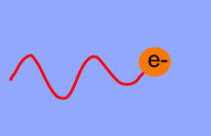
Fields – EMI can propagate by one or more types
Electric Field (E) – Force created by uneven charge distribution
Magnetic Induction Field (H) – Force created by moving charges
Electromagnetic Field – Created whenever charges are accelerated
i.e. Capacitive Coupling
i.e. DC Current in a Wire
i.e. AC Current in a Wire
Source http://www.w8ji.com/radiation_and_fields.htm
Fields fall of rapidly with distance → proportional to 1/d
Notes:
A discussion of EMI requires a mention of fields. Fields are the medium by which the EMI propagates into the surrounding environment; either through conduction directly into circuit connecting wires, or radiation into the surrounding environment.
A field is a mathematical description of the forces between charges. There are three simple conditions that create physical forces between charges; electric, magnetic and electromagnetic (radiation) forces.
An electric field describes a force created by uneven charge distribution between two physical points. The force between charges is caused by nature trying to balance or even out the charge distribution. The electric field has a measure of volts/distance, which falls off rapidly with distance.
A magnetic field is created when charges move. When charges move they exert force on all other charges around them. Current flow in a wire is the movement of charge which results in the generation of a magnetic field. This field (or force) too falls off rapidly with distance.
Note that the electric and magnetic fields are interrelated and a change in one results in a simultaneous change in the other.
The electromagnetic field is created whenever an electron is accelerated. This occurs whenever a charge changes direction or is accelerated. Visualize the movement of an electron through a sine wave cycle.

Slide 5
The necessary elements for EMI
2
Coupling medium
Receptor
of
Electromagnetic
Energy
3
1
0
+
_
1
Source of electromagnetic energy
Notes:
Three elements must be present for an EMI response from an analog circuit. First, there must be a source of EMI. Second, there must be a medium present that couples the electromagnetic energy to the circuit. And third, a sensitive receptor of the energy must be present. That may be the analog circuit or any other circuit.
All 3 elements must be simultaneously present for EMI to have an affect. The source must generate sufficient RF power at frequencies that the receptor is sensitive to. A coupling source or sources must be present to couple the RF to the receptor. And the receptor has to be sufficiently sensitive to that particular RF condition such that it produces an unintended response.
Even though EMI may start its life as radiated energy it is eventually converted to conducted EMI where it may be freely conducted into other circuits.
As often as EMI occurs in practice it doesn’t seem like it is all too difficult to create the right conditions.

Slide 6
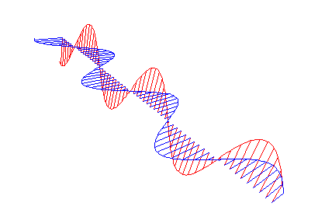
Source of Electromagnetic Energy
RF generating sources
Intentional radiators
cell phones
transmitters & transceivers
wireless routers, peripherals
Unintentional radiators
System clocks & oscillators
Processors & logic circuits
Switching power supplies
Switching amplifiers (class D)
Electromechanical devices
Electrical power line services
Electromagnetic wave
representation
E
f = 1/ t (per cycle)
H
t
Notes:
The source of electromagnetic energy may be a local, intended RF generator, but more likely it is a device in close proximity operating normally that produces RF energy as a byproduct.
Some sources may be more intuitive like clock circuits, oscillators and switching power supplies. Less obvious may be a normal operating, high-speed, digital IC. Or it may simply be an electromechanical device switching current and only produces EMI during make or break operations.
High-voltage electrical power system components can degrade and break down with time and provide a current path to ground. Arching connections often lead to corona discharge that interferes with sensitive radio receiving equipment.

Slide 7
How radio frequency energy comes about in circuitry
sin x
x
T₀
1/T₀ 2/T₀ 3/T₀ 4/T₀
Complex frequency domain in
Polar form
Edge rates of logic signals produce range of RF frequencies
Notes:
This is an extreme example that illustrates the time and frequency domain characteristics of a pulse. A single 20ns pulse is shown with its corresponding frequency spectrum. The pulse edges are extremely fast for this example.
This is the classic “sin x / x” amplitude response across frequency. Note that the amplitude minimums occur at frequencies that relate to the reciprocal of T₀. The plot gives the amplitude per a 1Hz bandwidth at a given frequency.
A 20ns pulse corresponds to a fundamental frequency of 50MHz – nothing out of the ordinary from a frequency standpoint. A system clock often produces a symmetrical square wave output with limited rise and fall times. Its frequency content will appear quite different than the pulse example consisting primarily of tightly clustered spectra at odd multiples of the fundamental frequency.
A point to keep in mind is even though a system’s operating frequencies may be much lower than this, is that the edge rates of logic signals can produce a wide range of radio frequencies. Some of these frequencies may have sufficient power to cause an unintended response from surrounding analog and digital circuits.

Slide 8
It’s all about edge rates
f_{max} = frequency extent of harmonics
A rule of thumb for
digital signals and
transients
f = 10MHz
square wave
Harmonics →
significant to
≈ 300MHz
10MHz Square Wave Spectrums
Notes:
The likelihood of a signal being a potential source of EMI is related to its spectral content and the intensity of that content. The system clock may establish a time reference for the circuit, but it is the edge rates of the clock and digital circuits that create the harmonics.
The example shows the spectral content of a 10MHz square-wave; one with a 10ns edge rate, while the other has a 1ns edge rate. It can be seen that increased harmonics content accompanies the square wave with the faster edges.
A good rule of thumb regarding the frequency extent of harmonics accompanying a particular rate is given by:
f_{max} = (π ∙ t_{rise})⁻¹
This equates to about 31.8MHz for the 10ns edge rate. The above plot shows that the last significant harmonic occurs at 30MHz. Meanwhile, the 1ns edge rate example equates to a maximum frequency of 318MHz. If the frequency scale had been extended beyond 300MHz, it then shows that the harmonics are significant to, but diminish rapidly above that frequency.

Slide 9
Coupling Medium: Conducted Emissions
Notes:
Common mediums by which EMI enters a circuit are by electrostatic (capacitive) and/or magnetic (inductive) coupling and by direct conduction. When the EMI source is in close physical proximity of another circuit, connection wires, PC board traces exhibit parasitic capacitance and mutual inductances. These capacitances and inductances may be small relative to the use frequency, but may be significant at a much higher EMI frequency. When that is the case they can directly couple the EMI signal into unintended circuits.
Switching power supplies often operate with a switching frequency between 100kHz and 1MHz. Power Mosfets most often perform the switching task, because of their ability to carry large currents, speed and very low “on” resistance. Filtering is employed to attenuate high frequency switching transients and other “hash” (RF energy). However, these supplies are directly connected to the circuits via the power supply buss lines. Should any remaining RF energy reach the active devices, it may initiate a unintended response from the device.

Slide 10
Coupling Medium: Radiated Emissions
proportional to 1/f
Antenna element coupling optimal at multiples of 1/4λ
Notes:
The second medium by which the high frequency EMI energy enters circuits is by radiation. This is a direct application of radio technology in which there is an RF source, a radiating antenna, and a receptor antenna that is connected to the active circuitry.
The antennas in this case may simply be wires, PC board traces, component and IC leads, board planes and even metal enclosures. The medium is simply the dielectric that exists between the source and receptor antennas. It is the medium through which the electromagnetic radiation propagates.
An important factor in the successful transfer of RF energy via radiation is efficient antennas. Wavelength is inversely proportional to frequency. Therefore, as the frequency is increased the wavelength decreases. For the energy to be efficiently radiated, any conductor serving as an antenna must represent a significant portion of a wavelength. Otherwise, the antenna “element” will exhibit very high reactance and will not effectively couple the electromagnetic energy.
The element lengths that most effectively couple RF energy are those which are multiples of ¼-wavelength. Such lengths represent resonant circuits with little to no reactive components. Since the element lengths in circuits are relatively short, they are most effective at VHF and UHF. Note however, if the EMI source produces sufficient power enough energy may be radiated by a grossly non-resonant element to produce field intensities sufficient to cause EMI.

Slide 11
Analog receptors: electromagnetic energy
Op-amps
Low-speed: offset shift, RF noise
High-speed: linear and non-linear
amplification
Converters
EMI aliased into passband
offset shift
Regulators
offset shift in output voltage
Notes:
Receptors of EMI signals may be the sensors or transducers, the connecting wires or the analog circuits or the analog integrated circuits themselves. It depends on the their location relative to the EMI source and their susceptibility.
The most common response of analog circuits to EMI is signal rectification. Often the overall bandwidth of the analog circuit may be far less than that of the EMI source, but individual stages within the devices can respond due to their much higher bandwidth.
Op-amps usually exhibit a different slewing rate for positive and negative going signal transitions. When the EMI is rectified a voltage offset results at the output that is a function of the difference between the positive and negative slewing rates. This response is most often exhibited by low-speed op-amps.
High-speed op-amps may have sufficient bandwidth to amplify the frequency components of the EMI and sum them with the intended signal. If the EMI signal level is excessive non-linear amplification can result adding noise and distortion to the intended signal.
Depending on the converter architecture and speed, the response to EMI can range from an output offset shift, to the EMI being aliased into the signal pass-band. When aliasing occurs these unintended signals result in distortion products and increased noise.
Regulators, both linear and switching, may produce an EMI-related voltage offset resulting in an incorrect regulator voltage.

Slide 12
Conducted EMI and its effect on an op-amp’s voltage offset
TLE2071
GBW = 10MHz
Av = +1000V/V
0.022Vrms
0.071Vrms
0.224Vrms
Tested with RF Generator – Direct injection into Op Amp inputs
Notes:
A TLE2071 wideband, low-noise JFET operational-amplifier is tested to determine its susceptibility to conducted EMI. The amplifier is connected for a high gain of +1000V/V such that any shift in input voltage-offset can be readily observed when RF is applied to its input.
A properly terminated, wide range RF generator is applied to the TLE2071 non-inverting input. The generator is swept from 1MHz to 500MHz, while the input amplitude is stepped in 3 increments fro -20dBm to +0dBm. A sensitive DVM connected at the output monitors the output-referred voltage-offset as the frequency is swept. The input voltage-offset change is derived from the circuit gain and output-offset voltage change, then plotted over frequency. Note that TLE2071 gain-bandwidth (GBW) to about 10MHz and at the lower frequencies exhibits some gain.
The offset-voltage change is the result of rectification by internal PN junctions encountered as the RF makes its way through the amplifier. As expected the voltage-offset shift is most pronounced at the highest input voltage level (0dBm), and least when it is at the lowest level (-20dBm). 0dBm, -10dBm, and -20dBm represent input voltage levels of 0.224V, 0.071V and 0.022V, respectively, across a 50Ω input termination resistor.

Slide 13
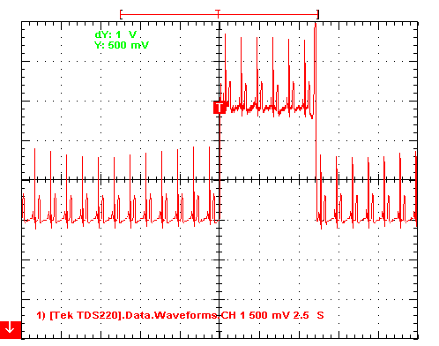
Radiated RFI and its effect on an ECG simulator
(V_{in} ≈ 1mV_{p-p} G = 2500V/V)
Transmitter
470MHz
P_{out} 0.5W
d ≈1.5 ft (46cm)
Significant DC Offset
when RF present
+4.0V offset RF present
RF noise
On ECG
Single Supply
CMOS
INA326
OPA335(s)
Δ1.5V
Due to RFI
Transmitter
keyed 6 sec.
+2.5V offset normal
Fly wire Proto board
ECG Full Scale 1Vp-p 0.5V/div
EMI slide
Information
by John Brown
0.5W UHF Transceiver keyed with antenna 1.5 feet away
Notes:
This oscilloscope diagram depicts the affect of a strong EMI source in close proximity to a sensitive analog circuit. A 0.5W output, UHF transceiver is keyed with the antenna approximately 1.5 feet (45.7cm) from the ECG simulator. An ECG signal is very small, about 1mVp-p in amplitude, and requires a very high signal chain gain to bring the signal to usable observation levels.
When the transceiver is keyed, 2 effects are observed. The DC offset increases about 1.5mV and RF-related noise is evident on the ECG waveform. The basic ECG repetition rate stays the same, but the offset shift would be evident to both the human eye and any digital processing.

Slide 14
Electric-Field Strength, Power Density
EMI - electric-field strength units Communications - power density units
Isotropic sources
E (V/m) = 61.4 [P(mW) / cm² ]^{1/2}
For free space Z =377Ω
P_{d} = P_{t} / 4π∙r² (W/m² or mW/cm²)
100V/m = 2.65mW/cm² | 10mW/cm² = 194V/m
10V/m = 26uW/cm² | 1mW/cm² = 61V/m
1V/m = 0.26uW/cm² | 0.1mW/cm² =1.9V/m
Notes:
EMI uses electric-field strength (volts/meter, uV/m) as the measurement parameter for electromagnetic fields. While power density (watts/ sq. meter, mW/cm²) is used as the parameter for communications applications. The units can be cross calculated to equivalent values.
When measured in volts/meter the susceptibility of a system to EMI can be expressed. An exposure level of 10V/m or similar can be specified and the system tested accordingly.

Slide 15
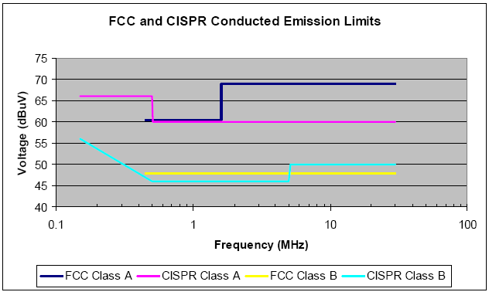
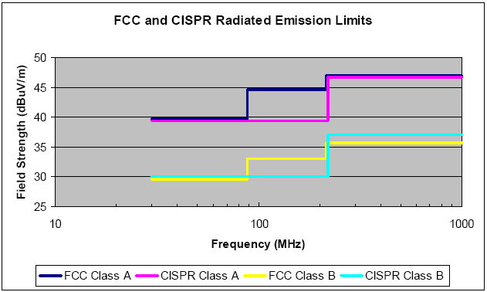
Emission Source Limits
FCC Regulates USA, CISPRA regulates Europe
Conducted Emissions - 10kHz to 30MHz
Radiated Emissions - 30MHz to 1GHz
measurement distance 10m
Freq (MHz) | Class A dBuV | Class B dBuV
0.45 - 1.6 | 60 | 48
1.6 - 30 | 69.5 | 48
Freq (MHz) | Class A dBuV/m | Class B dBuV/m
30 - 80 | 39 | 29.5
88 - 216 | 43.5 | 33
216 - 960 | 46.4 | 35.6
960 - 1000 | 49.5 | 43.5
Sources: SynQor app. note 00-08-02 Rev. 04
& www.cclab.com/engnotes/eng290.htm
FCC Class A – Commercial, Industrial, Business
FCC Class B – Residential Environment (close to TV, Radio Receivers)
Notes:
EMI emission levels from digital sources are limited in the US by the FCC under part 15, and in Europe by the standards found in Publication 22 of the International Special Committee on Radio Interference (CISPRA). In 1993, the FCC moved to harmonize the US standards for radio frequency emissions from digital devices with the international emissions standards.
It is important to note that both the conducted and radiated emission levels are regulated by the FCC and CISPRA. Since conducted EMI exists on a conductor cable, wire or PCB trace, it is specified in uV, or dBuV. While radiated EMI is specified by field strength in uV/m, or dBuV/m. Conducted EMI limits are from 10kHz to 30MHz, and radiated EMI limits from 30MHz to 1GHz. Note that the levels listed are for a distance of 10m, and the levels will be considerably higher closer to the source.
The FCC divides both conducted and radiated EMI into 2 classes related to the intended use of the product containing the radiating devices. Class A is for electronic equipment intended for use in commercial, industrial or business environments. Class B is for electronic equipment intended for use in the residential environment, but may also be subjected to the Class A environment as well. Class B limits are more restrictive because of the likelihood of such devices being placed in close proximity to TV and radio receivers. Compliance is the responsibility of the end-product manufacturer.

Slide 16
Typical RF field levels
EMI electric field strength
Automotive
Medical
Military
Industrial
Commercial
0.1 1.0 10 100 1000 log V/m
Unprotected
sensitive analog circuits
Less sensitive analog circuits
Circuit Sensitivity
Digital circuits
Notes:
The EMI field strength in an environment can be roughly associated to the electronics application type. Typical field strength levels by application:
Commercial 1 to 10V/m
Industrial 1 to 10V/m
Military 1 to 200V/m
Medical 3 to 400V/m
Automotive 20 to 200V/m
Note that this tells nothing about the frequencies involved, only field strengths. Even though the field strength may be high there may be no receptors of the particular EMI frequency.
On the other end, some unprotected analog circuits may respond to very low signal strength EMI. They may rectify low level RF signals and amplify the resulting audio in subsequent stages.
Digital circuits which may act as sources of EMI usually have a high EMI threshold making most an unlikely receptor. Their “rail-to-rail” operation affords a high amount of EMI immunity.

Slide 17

Differential and Common-mode EMI
Common-mode interference is most frequently encountered
Differential-mode
EMI dominates
f < 1MHz
Often results
through conduction
I_{DM}
-
V_{DM}
_{emi}
I_{DM}
+
Differential-mode EMI produces a voltage difference between the inputs
I_{CM}/2
-
Common-mode
EMI dominates
f > 1MHz
Often originates
as radiation
V_{CM}
_{emi}
I_{CM}/2
V_{CM}
_{emi}
+
I_{CM}
Common-mode EMI produces the same voltage on each input with respect to ground
Notes:
EMI, originating as conducted or radiated, can appear at the inputs of an analog circuit as a differential signal, a common-mode signal, or a combination of both. Differential-mode EMI dominates at frequencies below 1MHz, while common-mode dominates above 1MHz. But keep in mind that either mode may originate from either a radiated or conducted source.
Radiated differential-mode EMI often originates from small, unintentional loop antennas within the circuits. These loop antennas are defined by the area enclosed by a loop and are formed by conductors carrying the EMI current. The radiated field strength is a function of the current magnitude, the area enclosed by the loop, and is proportional to the square of the EMI frequency. Differential-mode EMI radiation can be reduced by minimizing the area enclosed by the loop antenna. Unexpected loop antennas in receptor circuits can couple the radiated EMI into the analog circuit.
Radiated common-mode EMI is often transmitted and received by input and output cables. The conductors serve as electric dipoles where the electric field dominates. Wires and form open loops often behaving as monopole antennas. As a cable length is made longer, it becomes a more appreciable fraction of a wavelength and is able to more effectively radiate or receive EMI energy.
Common-mode EMI is most frequently encountered. Very low levels of common-mode EMI current (uA) can result in a system failing radiated emissions levels. On the hand differential-mode EMI levels must be much higher (A) before it results in a system failing radiated emission levels.

Slide 18
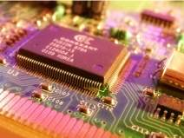
Taming the EMI environment
Minimize EMI radiation at source
Minimize coupling medium’s effectiveness
Minimize receptor susceptibility to EMI
Notes:
It was mentioned that three elements are necessary for EMI to occur; an EMI source, a coupling medium and a sensitive receptor. Minimizing or limiting EMI from all sources is a good start. But once within compliance limits further reductions may become excessively difficult or costly to achieve. Designing a circuit and employing techniques that minimize EMI right from the start can prove to be the lower cost option. Having to revisit a non-compliant EMI source and applying remedies can prove difficult and expensive.
Reducing the effectiveness of the coupling medium is often addressed by careful layout, shielding and decoupling techniques. Depending on whether the EMI is common-mode or differential-mode the solution for reducing the coupling medium’s effectiveness will be quite different. This is a because of the difference in frequencies involved in the EMI.
Since sensitive analog circuits can be placed in almost any environment there is usually little way of knowing what EMI sources the circuit may encounter. A circuit might respond to a particular EMI source in one application and not to a different source in another. Therefore, one of the safest ways to avoid responding to EMI is to build effective EMI immunity into the circuit. That may be more easily said than done. But again, taking steps to reduce a circuits response susceptibility during the design phase is often the most prudent approach.

Slide 19
An AC line filter for conducted EMI
Common-mode inductor
Mode | 150kHz | 500kHz | 1MHz | 5MHz | 10MHz | 20MHz | 30MHz
Common | 6 | 20 | 28 | 42 | 45 | 45 | 48 | dB
Differential | 10 | 13 | 30 | 50 | 50 | 40 | 40 | dB
Attenuation characteristics for AC line filter (SAE GA1B-10)
Notes:
Filters are one of the most common elements employed in restricting EMI from entering a circuit or leaving a circuit. Most often this takes the form of a low-pass filter designed such that the filter cut-off is well below the EMI frequencies.
For AC applications common-mode interference is most frequently encountered. EMI filters are designed to attenuate the common-mode EMI signals and may also be designed to effectively attenuate differential-mode EMI signals.
The AC line filter shown in the slide is designed for both common-mode and differential-mode filtering. A key element effective in the common-mode attenuation is the common-mode transformer. The common-mode signals are in phase and the fields do not cancel within the transformer core. Each CM signal encounters the winding impedance which provides inductive reactance and restricts the CM current flow.
The transformer (L₁ and L₂) exhibits inductance which is selected in conjunction with the common mode capacitors (C₁ and C₂) to form a low-pass pi filter. The table shows that the common-mode attenuation does not begin to come into play until the frequency exceeds about 100kHz.
Differential-mode EMI attenuation is facilitated by an inherent pi filter. The common-mode transformer exhibits significant leakage inductance. This can be upwards of 2% of the common-mode inductance. The pi filter is formed by this leakage inductance and the 2 differential capacitors (C₃ and C₄). Again, like the common-mode filter, the differential-mode doesn’t become effective until the frequency exceeds 100kHz.

Slide 20
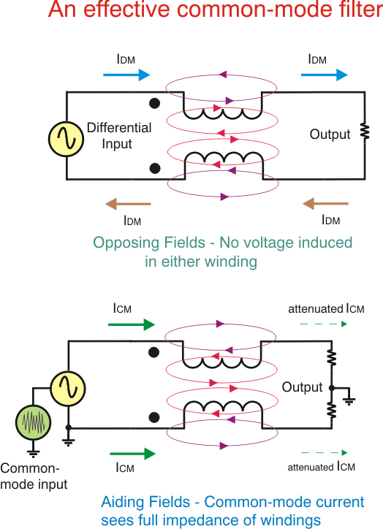



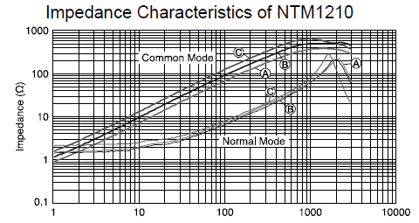
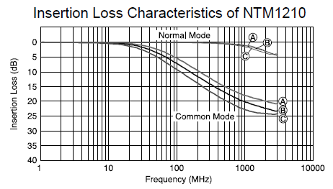
The common-mode transformer
Differential Mode → Flux Cancellation → Low Impedance from mismatch windings
Common Mode → Flux Addition → Full Impedance of both windings
Notes:
A common-mode transformer can be an effective filter to common-mode EMI and noise, while offering little opposition to differential-mode signals.
The effectiveness of the common-mode filter lies in the way the transformer’s magnetic fields behave with common-mode and differential-mode signals. The dot convention indicates how the windings lie relative to each. Probably the easiest way to think about it is the two windings being wound adjacent to each other and wound in the same direction – even though the physical form of the transformer may be different.
When a signal is applied in a differential manner the currents flow through each winding in opposing directions. They produce opposing magnetic fluxes in the core and cancel each other. Little to no voltage is induced in the other winding. The differential signal passes through the transformer with little attenuation. Note that the totality of the flux cancellation depends on the matching, or “balance” of the two windings.
When a common-mode signal enters the two windings the flux build up from each aids the other. Therefore, the common-mode signal encounters the full impedance (inductive reactance) of both windings. This impedance restricts the flow of common-mode current effectively blocking it from flowing to the load.

Slide 21
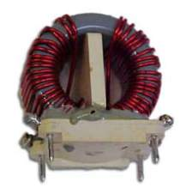
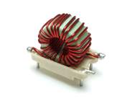
An AC line filter for conducted EMI
Common mode inductor
Torroid coil for DM inductor
Examples from CWS - Coil Winding Services
CM Filter uses 2 windings in phase + CM Cap + CM Res
Diff Filter uses CM leakage Inductance + Diff Caps + Diff Res
Notes:
This slide shows typical inductors used in AC line filter applications. The common-mode coil or transformer has two windings separated with sufficient spacing between coils windings to prevent high voltage breakdown. The windings follow the dot convention such that their magnetic fields are in phase internal to the core.
The differential filter can be made to have greater attenuation by reducing the filter’s cut-off frequency. The leakage inductance on it’s own is sufficient to be used for a lower frequency filter, but a differential-mode inductor can be added in series with each input to the common-mode coils to lower the cutoff frequency.
Although the inductors shown are suitable for AC line filters, properly specified common-mode and differential-mode inductors may be utilized in EMI filter from DC to RF.

Slide 22
Input RC filtering as applied to an instrumentation amplifier
Set CB=CC for symmetrical Common Mode Filter
Set CA = 10*CB so any common mode mismatch filtering that results in differential mode noise will be attenuated
Differential Mode
f_{-3dB} = [2π(R_{A}+ R_{B})(C_{A}+ C_{B}/2)]⁻¹
let R_{B} = R_{A} and C_{C} = C_{B}
f_{-3dB} = 343Hz
Common Mode
f_{-3dB} = [2π∙R_{A}∙ C_{B})]⁻¹
let R_{B} = R_{A} and C_{C} = C_{B}
f_{-3dB} = 7.2kHz
Notes:
Similar to the AC line filter is the EMI/noise filter commonly employed at the input of an instrumentation amplifier. Like the line filter this filter provides attenuation to both differential and common-mode EMI signals.
This is a passive RC filter exhibiting a first-order roll-off characteristic. However, the -3dB cutoff frequency is quite different for the two modes. The differential bandwidth of the filter must be set such that the desired signals from the source are not attenuated. From this requirement the differential filter -3dB bandwidth can be set.
Let’s use an example where the maximum differential signal frequency is less than 100Hz. A cutoff of about 350Hz will be used. In order to keep resistor noise contribution low their value should be kept under 10kΩ, and preferably less. The smaller the resistors are made the larger the filter capacitor values will be for a given cutoff frequency. So a compromise is called for. In this case, RA and RB are set 4.7kΩ, which results in as standard capacitance value of 47nF for CA.
The standard practice for the common-mode capacitors is set their value to 1/10th that of the differential-mode capacitor; 4.7nF each, in this case. The common-mode filter cutoff frequency is then a function of this capacitance and RA or RB. The resulting common-mode cutoff frequency is about 21 times higher than that of the differential-mode filter.

Slide 23
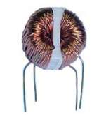
Adding a common-mode transformer at low frequencies
CM Transformer added to lower CM cut-off frequency
Notes:
The previous slide indicated that the common-mode cutoff frequency was about 20 times higher than the differential-mode cutoff frequency. What can be done to realize high common-mode rejection when the differential-mode cutoff frequency must be increased, or just higher EMI common-mode rejection is needed?
A common-mode transformer can be added in front of the passive RC to lower the lower the common-mode filter’s cutoff frequency.

Slide 24
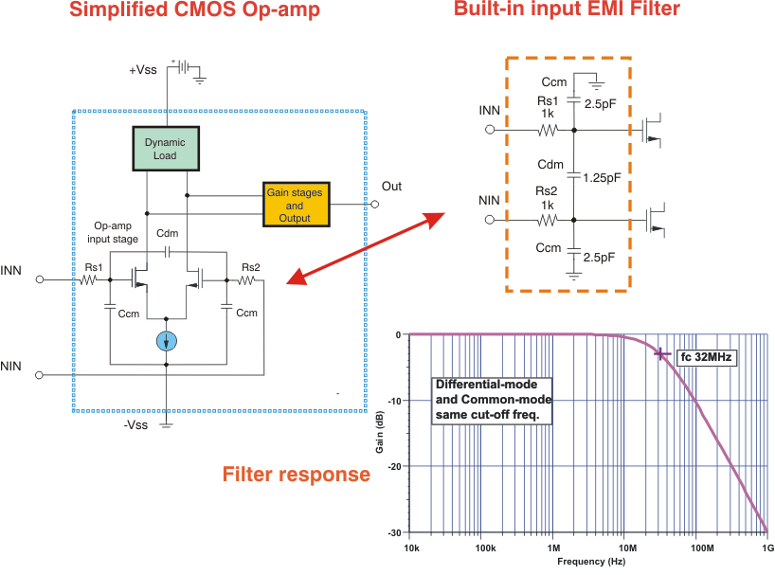
Newer Op-amps have EMI filtering
Notes:
Reducing an operational-amplifier’s EMI susceptibility now may include an integrated input filter. A low-pass filter is created by using the input differential pair junction capacitances, and a small series resistances in the input paths. Since the differential pair exhibits both differential and common-mode capacitances the filter is effective for filtering both types of EMI.
An equivalent filter is shown having total differential and common-mode capacitances of 2.5pF and 5.0pF, respectively, and 1kΩ series input resistors. The filter response plot reveals a first-order, low-pass response, and a -3dB cutoff frequency of 32MHz. Both differential and common-mode cutoff frequencies are the same for the capacitance and resistance values used.
The actual unity-gain bandwidth of the operational-amplifier is commonly be a few Megahertz, so the low-pass filter cutoff frequency is well above it. That prevents the EMI filter from becoming a factor in the operational-amplifier’s normal AC response. However, the cutoff frequency is low enough to be effective in filtering of 100MHz and higher.
The series resistances are selected to set the filter’s cutoff frequency, yet must be keep low in value so as not to degrade the amplifier’s low noise performance.

Slide 25
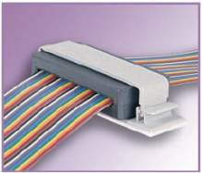
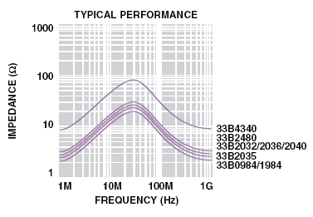
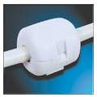


Ferrites for EMI suppression
Ferrite surrounding the cable actually forms a common-mode transformer
30MHz
Impedance of wire passing through
FerriShield® ribbon cable ferrite
Clamp-On Ferrites concentrate magnetic field in wire
to multiply wire’s self inductance at high frequencies
Notes:
Ferrites are comprised of a homogenous mixture of ceramic, iron oxide(s) or carbonates and one or more additional metals such as zinc, manganese, nickel or magnesium. The ferrite composition is pressed into the required size and shape and then fired in a kiln at 2000ºF (1093ºC). Specific combination have been developed for different applications such as EMI suppressors (chokes), switching supply inductors, RF transformers, etc.
When employed as RF chokes ferrites are useful for EMI suppression. All wires exhibit self inductance which amounts to a few nanohenries per centimeter; 6nH/cm (1mm dia.) and 2.2nH/cm (10mm dia.). The reactance associated with short straight wires is usually negligible at frequencies less than 100MHz or so, and offers little reactance to EMI on the wires. Increasing the inductive reactance at the EMI frequencies helps choke off their current and prevents them from entering, or leaving, a circuit.
Placing a wire or cable in close physical proximity to a ferrite causes the magnetic field surrounding the wire to concentrate in the ferrite core. This has the net effect of multiplying the wire’s self inductance by the core’s permeability.
Ferrites have a permeability ranging from 10’s to 10,000’s so dramatic increases in the inductance and associated inductive reactance can be had by their inclusion in the EMI path. Note that the correct ferrite core material must be selected for the particular application. Different mixtures are optimized for specific frequency ranges. The curves shown in the slide are for the ribbon cable ferrite product which is optimized for applications of 60MHz or less. Other ferrite materials are optimized for applications from 1KHz to 1GHz.

Slide 26
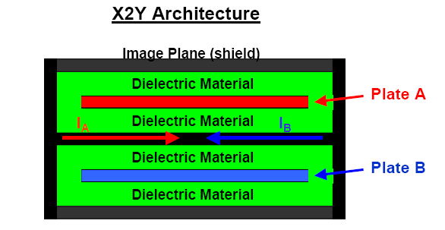
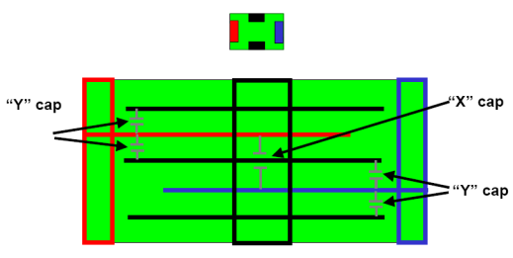
X2Y Capacitor Architecture
The X2Y capacitor:
1 “X” capacitor, 2 “Y” capacitors
Simultaneous common-mode and
differential-mode filtering
G1
A
B
G2
Cx = ½ Cy
From Yageo.com
website
terminations
Notes:
The X2Y capacitor is a fairly recent capacitor structure development that by itself offers significant signal attenuation at EMI frequencies. It is effective in attenuating both common-mode and differential-mode EMI which stems from the fact that it is the equivalent of both differential and common-mode filter capacitors
Its construction is such that it is a truly balanced structure comprised of alternate capacitor and ground plates. The result is a matched and balanced, dual capacitor that provides both E and H field cancellation. The X2Y appears as a low-pass filter with a particular cutoff frequency. The larger capacitance values have lower cutoff frequencies. It exhibits a broader band reject bandwidth characteristic than a conventional series-resonant, ceramic capacitor, attributable its low internal inductance and field cancellation properties.
Quoting a Yeago products presentation, X2Y Technology – Technology in balance, “The X2Y architecture uses images planes – shields, which create rectangular current loops that share a common image plane. The X2Y plates A& B charge the image plane with opposing skin currents. When the currents are common on the image plane and 180º out-of-phase or oppositely charged, they will cancel.”

Slide 27
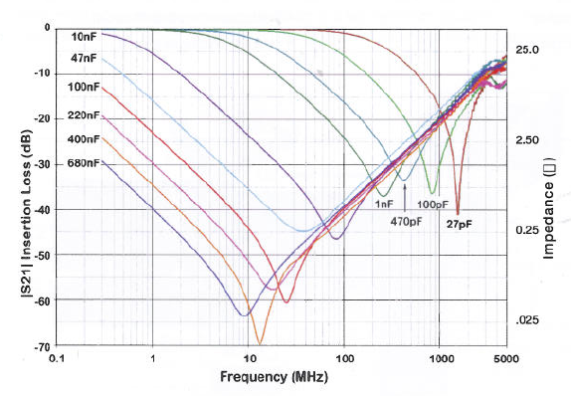
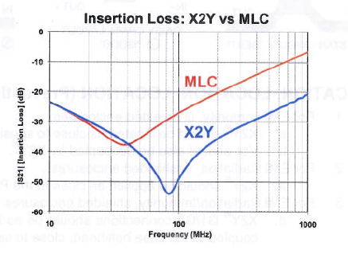
The X2Y® Capacitor
X2Y® Filter & Decoupling Capacitors
Input filtering s21
Signal-to-Ground
Ceramic Cap vs X2Y
10nF
X2Y provides CM + Diff Filter, CM & Diff cutoff Freq about same
Notes:
This application of the X2Y® capacitor shows two different uses; one used as the input EMI filter and the other as the power supply decoupling capacitor. The advantage in decoupling applications is from the reduced series inductance compared to standard decoupling capacitors. It has proven to be a much more effective decoupling element than the equivalent value, conventional ceramic capacitor.
The plot shows the insertion loss presented to frequencies above the X2Y® cutoff frequency. Like a series resonant capacitor there is a resonant point where a impedance minimum is attained. However, the X2Y has a broader, and lower series impedance characteristic at the minimum, than that had by a conventional ceramic capacitor. The series impedance, increases at a rate of 20dB/dec on both sides of the resonant point. It increases without bound on the low frequency end, but eventually achieves a maximum at the anti-resonant (parallel resonant) frequency on the high end.
A not so obvious advantage of the X2Y® filter approach is that the differential-mode and common cutoff frequencies will be close. Thus, the differential bandwidth can be much closer to the common-mode bandwidth. Which can be an issue with the standard RC filter approach.
The OPA326 application circuit shown has resistances added to the X2Y® capacitor to lower the cutoff frequency. This should only be necessary when the application requires a cutoff frequency below what can be attained by the largest value X2Y® capacitor.

Slide 28
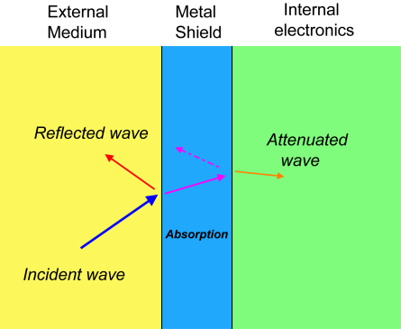
Shielding & Screening
Minimizing the medium’s effectiveness
Shielding Effectiveness (S.E.)
of enclosed material
Emission Suppression
S.E_{dB (Em. Supp.)} ≈ A_{dB}
Susceptibility
S.E_{dB (Sus.)} ≈ A_{dB} + R_{dB (appropriate)}
where: A: absorption loss in dB
R: reflection loss in dB
From: COTS Journal, January 2004 – “Design Considerations
In Building Shielded Enclosures.”
Derived from: EDN – The Designer’s Guide
to Electromagnetic Compatibility
Notes:
Metal shielding can be applied between a source and receptor to reduce the effectiveness of the coupling medium. This reduction can be described in terms of an insertion loss, or alternately shielding effectiveness. The EMI energy received from, or transmitted into the external medium, will decrease as the insertion loss increases. Thus, the greater the insertion loss the better the shielding effectiveness will be.
The overall shielding effectiveness is different whether it is being applied to emission suppression or susceptibility of an enclosed circuit. For the emission suppression of an EMI source the effectiveness is approximately equal to the absorption loss. While the effectiveness relative to an enclosed susceptible circuit is approximately equal to the sum of the absorption, plus reflection loss associated with the type of incident wave.¹
1. From: COTS Journal, January 2004 – “Design Considerations
In Building Shielded Enclosures.”

Slide 29
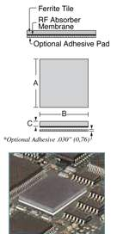
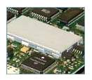

Shielding & Screening
Minimizing medium’s effectiveness
Magnetic Fields→ Low Impedance Source & Magnetic Energy creates Eddy currents in ferrous materials
RF Fields → High Impedance Source & Continuity of Shielding is critical (slot antenna)
Metal Shielding
Magnetic field f < 20kHz
Ferrous metals
steel
Mu-metal – nickel, iron
RF fields 10kHz < f < 1GHz
Non-ferrous metals
Al foil I_{Loss} > 90dB
Cu, Ni I_{Loss} 40-60dB
Vacuum plating
I_{Loss} > 80dB
Electroless deposition
I_{Loss} > 80dB
From: EDN EMI/EMC guide
Ferrite shield
RF absorber
shield
Notes:
Magnetic fields are induced by a low impedance source; while an electric field is induced by a high impedance source. Therefore, the method by which one or the other is contained or reduced differs.
As previously mentioned, the electromagnetic wave is comprised of the magnetic and electric fields. Close in, in the near field, the magnetic field or induction field may be a source of EMI. This is especially at frequencies below 20kHz. Some examples of possible magnetic EMI sources are transformers and CRT deflection coils.
Ferrous based, high permeability metals, such as steel, nickel-steel and Mu-metal (77% Ni, 15% Fe, +Cu, annealed in hydrogen) are effective in shielding circuits from inductively induced EMI. Magnetic energy induced into such materials result in eddy currents. When eddy currents flow through ferrous metal, which exhibits electrical resistance, the energy is converted to heat.
Electric fields emanating from high impedance sources such as IC pins, components leads and PC board traces are shielded with non-ferrous metals such as aluminum, copper and nickel. The thickness of the shield is not particularly critical and thin deposited metal films on non-conductive materials is effective in shielding EMI.
More important than the RF shield thickness is the continuous nature of the shielding. Ideally, the shield would completely surround the EMI source with no openings or seams. Since that is not practical the opening sizes should be minimized and sufficient for wiring and cooling. Critical applications should incorporate EMI gaskets and seals.
Shielding materials are not limited to solid sheets of metal. Ferrite plates and EMI absorbing materials can be employed on a local level, such as over a PC board or even a specific integrated circuit.

Slide 30
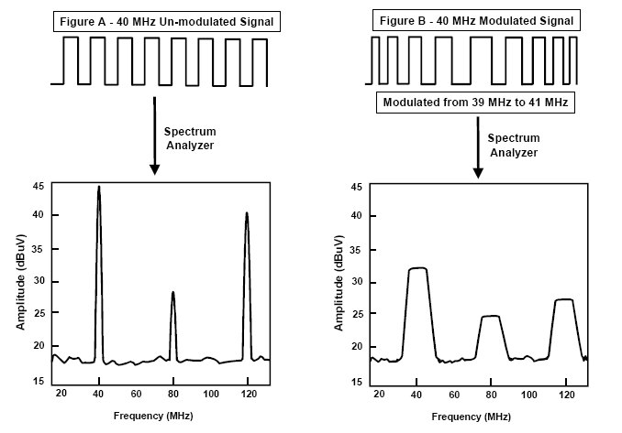
Frequency spreading of the system clock
FCC peak EMI limit
Class B digital devices
with d = 10meters
dBuV/m
From: PulseCore, Reliance Semiconductor
Lowers Peak EMI but creates lower amplitude, broader spectrum EMI
Notes:
In 2001 PulseCore announced a DDS based IC that was slated to reduce EMI generated by the system clock. It used a spread spectrum techniques to smear the clock frequency. A stand alone DDS can also serve in this function.
Frequency spectrum plot A illustrates the radiated clock amplitude of a conventional system clock at a distance of 10m. The amplitudes of the 1st and 3rd harmonic exceeds the FCC, class B limits in their respective frequency range.
The Pulsecore IC triggers off the clock edge and the DDS frequency modulates the incoming pulses resulting in a clock that varies from 39MHz to 41MHz. The results of the frequency smearing are shown in figure B. The 1st and 3rd harmonic amplitude has now decreased by about 15dB. Additional EMI reduction techniques would be required to bring the circuit into compliance.
One concern with this technique is whether the system being clocked, and those that interface with it, can withstand a constantly varying clock. This is an idea worth considering when the system is being designed. An EMI concern with this solution is that a broader range of frequencies with higher power levels may now affect a previously undetected receptor.

Slide 31
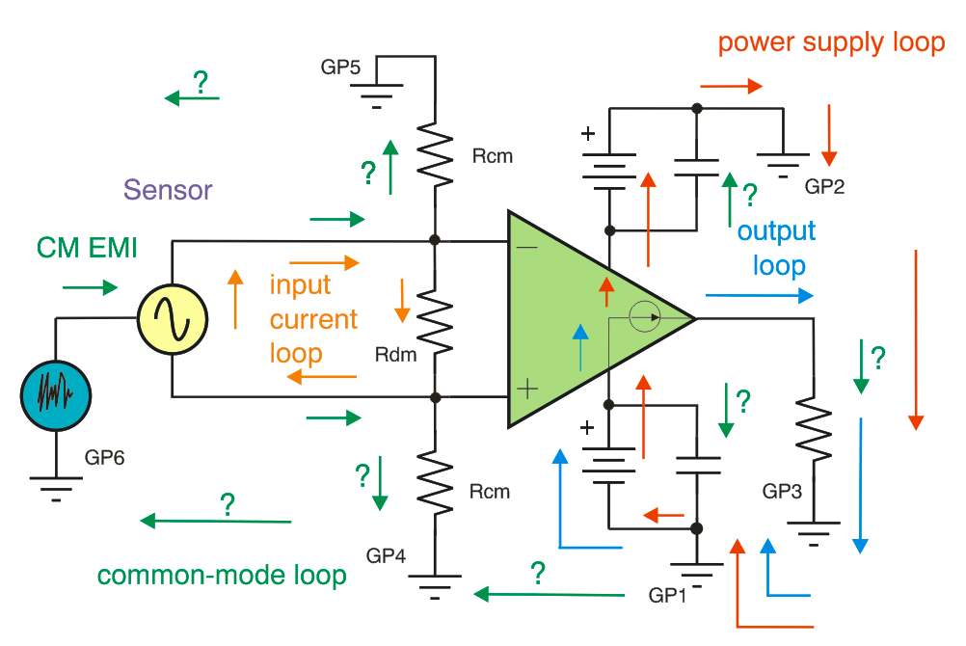
a Loop – the path current follows
Loops
Introduces unintended inductance in the current path where:
V_{L} = L di/dt
May result in multiple AC signals sharing a current path
May become a loop antenna that couples EMI/RFI
The common-mode return loop
may be difficult to predict
Notes:
This illustrates the concept of current loops in an analog circuit. The instrumentation amplifier has several current loops shown; an input current loop associated with the signal source and the amplifier input, the power supply loop, an output current loop, and multiple common-mode EMI loops. Note how these various current lops share a common path through ground.
EMI introduced by direct connection, or radiated and converted to a conducted current, returns to its source through the ground return paths. As it makes it way through the circuits it has the potential to disturb and corrupt the intended signals.
Physically, PCB traces and wiring associated with the loops may act as antennas. These antennas may effectively couple EMI/RFI in or out of circuits.

Slide 32
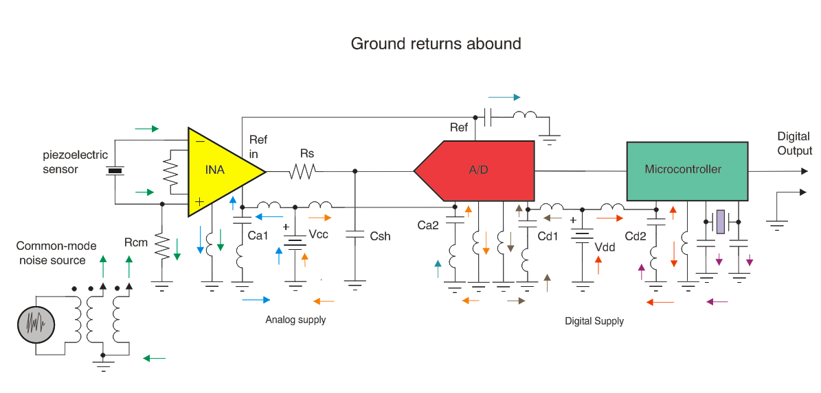
The ground return environment may be very complex
Current paths must be carefully considered to avoid long loops
Notes:
A potential EMI situation exists when digital return currents flow through the same wiring as analog return currents. The wiring, which is likely a PC board trace, exhibits inductance which will develop a time variant voltage that modulates the various ground connections on the ICs.
This voltage is related to the inductance and the instantaneous current:
V_{L} = L• di /dt
The circuit diagram illustrates the complexity of return currents through the system ground. Forethought applied before the circuit is laid out can minimize potential problems created when sensitive analog signals share paths with larger digital signals. As a rule the analog circuits should be partitioned from the digital circuits. Less field coupling is likely to occur by placing each circuit type physically apart from the other
PC board trace inductances can abound but if kept small their magnetic fields will be weak and less likely to be coupled. This requires short, wide traces. When possible keep the trace length-to-width ratio to 3 or less for high-current processor and digital circuits. A continuous ground plane, without any slots, provides the best prospect of eliminating ground loops.

Slide 33

Non-ideal passive components in the RF and EMI realms
Other passives at RF
Conductors
  skin effect
  inductance
  capacitance
Inductors
  resonance at f_{r}
  X_{C} above f_{r}
PC board traces
  ground loops
  traces and planes become monopole or loop antennas
Non-ideal
Capacitor
model
Ideal
10nF
capacitive
inductive
Notes:
A circuit schematic as drawn provides the intended interconnection of passive and active components. But in reality the drawn schematic is usually only a first order representation of the circuit. The physical circuit may be transformed into a much more complex model as the frequencies used are increased.
Here for example is the model for a non-ideal 1nF capacitor. It consists of the capacitor and an equivalent series resistance (ESR) and two equivalent inductances (ESL). These inductors represent the lead inductances.
An ideal capacitor would exhibit ever decreasing capacitive reactance or impedance as the frequency is increased. The non-ideal capacitor behaves as a series resonant circuit having minimum reactance at resonance. As the frequency is further increased the reactance increases, but now as an inductive reactance. The capacitor is less able to couple increasingly higher frequencies. When this occurs bypass and decoupling capacitors may become less effective in shunting signals to ground or isolating circuits, respectively.
Capacitors are not the only passive element who’s characteristics become more complex with increasing frequency. Inductors attain a resonant point and begin to exhibit capacitive reactance beyond resonance. Inductance in conjunction with wiring or PC board traces may act as resonant antennas.
PC board traces and planes can become a complex network of stray capacitances, series inductances and even antennas. In combination they can couple EMI in or out of active components.

Slide 34
Use the correct capacitor to help minimize EMI
Capacitors
Decoupling capacitors serve as charge reservoirs supplying transient current demands
Decoupling capacitors must have low self-inductance and have low inductance circuit paths
Distribute decoupling capacitors among pins having the same function; +Vdd, etc
Use the correct capacitor type for the frequency range
Capacitor type | Maximum useable frequency*
aluminum | 100kHz
tantalum | 1MHz
plastic film | 10MHz
silvered mica | 500MHz
leaded ceramic | > 500MHz
surface mount ceramic | > 1GHz
surface mount glass, porcelain | >1GHz
PCB embedded ceramic | 1GHz +
*much dependent on total inductance
Notes:
Capacitors should be selected relative to the frequency range where they must provide effective bypassing, decoupling and coupling. As was seen earlier, the lead inductance limits the useful high frequency operating range. Note that not only the lead inductance, but the PC trace inductance as well can combine to lower the resonant frequency. PC board layouts must be designed to minimize the inductance in the bypass capacitor connection path.
Although a high upper limit is listed for the ceramic capacitor this only applies to those using the higher quality dielectrics such as C0G (NPO) and X7U.

Slide 35
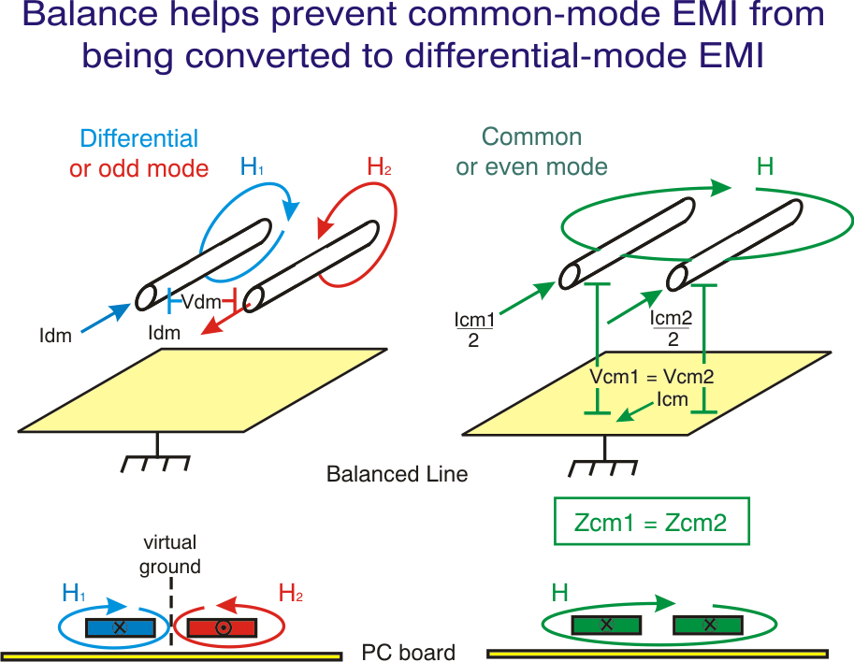
Balance helps limit CM EMI response
Prevent induced CM signals from becoming Diff signals
Notes:
Cables can receive and transmit EMI. And on a smaller scale PC board traces can do the same. Since common-mode EMI often propagates by way of these “lines” measures should be taken to reduce the likelihood of such occurrences. The key is to prevent common-mode currents from becoming differential currents which the active circuits connected to these lines may respond to in an unintended way.
Balanced lines and traces are constructed of two identical conductors separated equidistant from each other and having consistent dielectric characteristics. Twisting the wires within a cable such as done with telephone and CAT-5 cable helps assure close matching relative to their environment. When exposed to a common-mode field, or when a common-mode voltage is applied, each conductor exhibits identical electrical characteristics. The conductor currents are the same, the voltage with respect to ground is the same, and their impedance is the same. Therefore, the common-mode signals or EMI remains in their common-mode form and aren’t converted to differential-mode signals or EMI.
Conversely, in an unbalanced line each non-identical conductor sees a different electrical environment when exposed to common-mode EMI. The impedance to ground for each conductor is different and the voltage developed between them is different. Therefore, when the EMI reaches the active device inputs it sees the EMI as a differential voltage and responds to it in a differential manner.

Slide 36
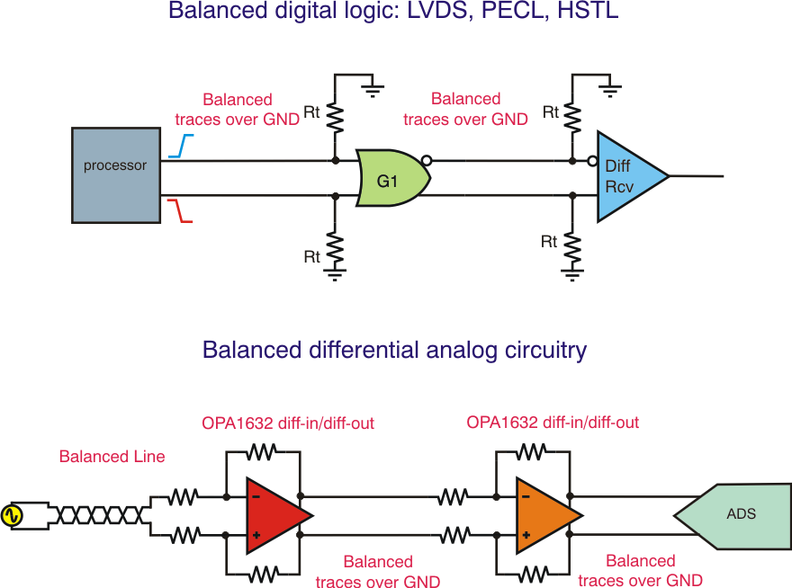
Balanced analog and digital circuit
(common-mode signals not welcome!)
Low voltage digital protocols use less current to charge parasitic caps
Less current implies lower EMI.
Notes:
Applying balance to digital and analog circuits reduces a circuit’s likelihood of generating or responding to common-mode EMI.
Digital circuits that use low-voltage signal protocols dramatically reduce EMI simply because the signal amplitudes are smaller and less current is needed to charge the parasitic and load capacitances. Using a low-voltage, differential signaling protocol such as Low-Voltage Differential Signaling (LVDS) greatly reduces EMI generation.*
Similarly, balance may be applied to analog circuits to help reduce their response to common-mode EMI. The analog circuits exhibit common-mode rejection and this is optimized in a balanced circuit. Here too balanced input cables and PCB traces help keep common-mode EMI from converting to a differential EMI signal.
* Falcon, Carl, “Curbing the Power of Radiated EMI in ASICS Designs,” EE – Evaluation Engineering, June 2004

Slide 37
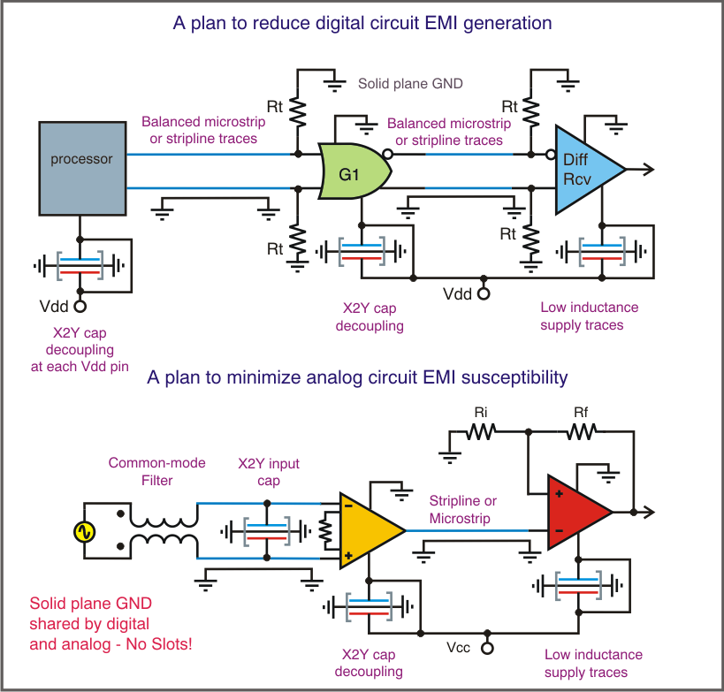
Circuit techniques to minimize EMI
Strive for a zero impedance ground
Design for a differential signal environment, both logic and analog
Minimize PCB loops that act as EMI antennas
Use X2Y capacitors for filtering and decoupling
Make use of common-mode transformers
Use balanced lines and traces
Notes:
Here are some techniques to help control in-circuit EMI. Establish a near-perfect, zero impedance ground plane and if possible use a shielded enclosure. A perfect ground’s potential remains constant and is independent of currents into and out of it. In a system with a perfect ground only differential currents flow.
In a system with an imperfect ground, common-mode currents can develop. Unlike differential-mode currents, where there is no net charge transfer at any point in time, common-mode currents results in a charge imbalance and charge transfer. This charge transfer creates the fields that propagate EMI. Note that differential-mode currents can be transformed to common-mode currents in a poorly executed ground environment.
High-frequency currents sometimes encounter a high impedance path as they complete the return loop. Such an impedance is usually associated with an inductive reactance. When this occurs the lowest impedance path may then be capacitive coupling back to its source. An electric field is created and EMI can propagate away from that circuit and be received by another circuit.

Slide 38
PCB layout tips to minimize EMI
Minimize path inductance - especially ground
Use a continuous ground plane - without slots!
Partition potential EMI sources on one end of board, receptors on the other end
Utilize true differential signals and paths when possible
Use microstrip and stripline traces between circuits
Use terminated transmission lines for high-speed and wide-band signals
Fill open areas on signal plane with ground

Slide 39
Electronic Control Box w/o Proper EMI/RFI Filtering
Undefined EMI Current Paths
EMI Current
Through ICs → Upset
Large Loop Areas
Notes:
An example Electronic Control Box is shown above. It consists of an instrumentation amplifier front end, with inputs from an external bridge sensor, an ADC, Microcontroller, DAC and buffer amplifier output to the real world.
Note that for most EMI signals they can be viewed as referenced to chassis ground. In this example an EMI signal couples into the input instrumentation amplifier and the Output buffer amplifier. The EMI currents seek a path of least impedance back to chassis ground. This path is undefined and could be through ICs in our control box since we have unknown parasitic coupling through stray capacitances to chassis ground. EMI currents routing through our control box in large loop areas and/or through our signal conditioning ICs can result in EMI upset in the ICs manifesting itself as DC offset shifts, increased noise, and/or decreased signal acquisition accuracy.

Slide 40
Electronic Control Box w/ Proper EMI/RFI Filtering
Defined EMI
Current Paths
NO EMI Current
Through ICs →
NO Upset
Small
Loop Areas
EMI Currents seek path of least impedance.
Analyze EMI path relative to chassis ground.
Notes:
We re-visit our Electronic Control Box and add proper EMI/RFI Filtering. One way to do this is to add CX1-CX4 which are coupling capacitors between our
Analog and Digital Ground and Chassis Ground. Schematically we show these capacitors located at the four corners of our box. Physically on our PCB board we will place them at each corner of the board with the idea being that however and wherever the EMI current gets into our system we will create the smallest loop area to get the EMI currents out of our box so they cannot circulate through our signal conditioning circuitry. Industry standard practice is for CX1-CX4 to be rated at 1kV or higher to handle transients between chassis ground and signal/power ground. In addition we add RX, a 1MΩ, 1kV, resistor to keep our signal/power ground from floating high above chassis which would create dangerous voltage potentials should one encounter signal/power ground while referenced to chassis ground!
With this proper EMI/RFI Filtering we have defined the path for EMI currents to circulate if they do find their way into our box. In addition we have minimized the loop area to force EMI circulating currents back out of our box instead of allowing them to move freely through our ICs or on our signal traces and/or power and ground planes.

Slide 41
Electronic Control Box w/ Proper EMI/RFI Filtering
Recommended PCB Connections
Notes:
From our recommended EMI/RFI Filtering schematic in the previous slide we show a recommended PCB implementation of the key additional EMI/RFI Filter components (CX1-CX4 and RX). A chassis “ground ring” is created around the outside edge of our PCB and CX1-CX4 are located between this chassis ground ring and signal/power ground. CX1-CX4 are placed respectively in the four corners of the PCB to keep the loop area small for circulating EMI currents no matter where they get induced into our box. The chassis ground ring is connected mechanically and electrically directly to the box enclosure ensuring this connection provides a low impedance path at the EMI/RFI frequency ranges.

Slide 42
Easy Check for “Relative” EMI/RFI Susceptibility
FRS (Family Radio Service) Radio
(0.5 Watt Transmit Power)
Channel Frequencies:
Channel 1: 462.5625MHz
Channel 2: 462.5875MHz
Channel 3: 462.6125MHz
Channel 4: 462.6375MHz
Channel 5: 462.6635MHz
Channel 6: 462.6875MHz
Channel 7: 462.7152MHz
Channel 8: 467.5625MHz
Channel 9: 467.5875MHz
Channel 10: 467.6125MHz
Channel 11: 467.6375MHz
Channel 12: 467.6625MHz
Channel 13: 467.6875MHz
Channel 14: 467.7125MHz
Use FRS Radio to check “relative” susceptibility
of circuits by keying transmitter and moving antenna towards PCB traces, wires, etc.
Typical distance 0.5 Meter to 1 Meter.
Compare effects of circuitry output before and after modifications to minimize circuit susceptibility.
Lower cost than repeated CE Compliance Testing!
Notes:
The Family Radio Service (FRS) is one of the Citizens Band Radio Services. FRS operates at 1/2 watt with 14 channels of unlicensed communication. You are able to communicate up to 2 unobstructed miles. All FRS Radios are 0.5 Watt Transmit Power. You can use an FRS Radio as a “relative” test method for electronic circuitry susceptibility to EMI/RFI. You can quickly compare results of circuitry changes by repeating the same test before and after the circuit modifications and note the changes in the circuitry output to keying the transmitter to within 0.5 to 1 meter of PCB traces, input wires, etc. This is a low cost alternative to repeated CE Compliance Testing.

Slide 43
In Conclusion EMI/RFI
May constitute an operational, liability or regulatory concern
Is best confronted at the onset of a design
Requires a source, medium and receptor
Propagates by conduction and/or radiation
May require one or more reduction techniques
  striving for a near-zero impedance ground
  effective decoupling
  minimizing circuit loops and loop areas
  shielding > cables and metal cabinets
  filtering > RC, LC and CM/DM transformers
  balanced logic and/or analog circuits
A Happy IC - EMI Free!

