Slide 1
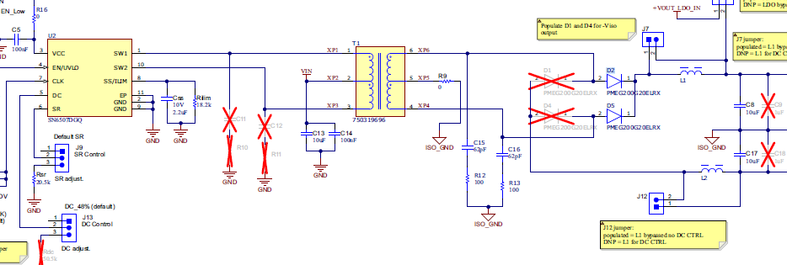
SN6507EVM
Test Conditions:
Vin=12V，523KHz，Rilim: 18.2kohm(assume output current is 1.6A)
Without Snubber, and Output Filter Inductor

Slide 2
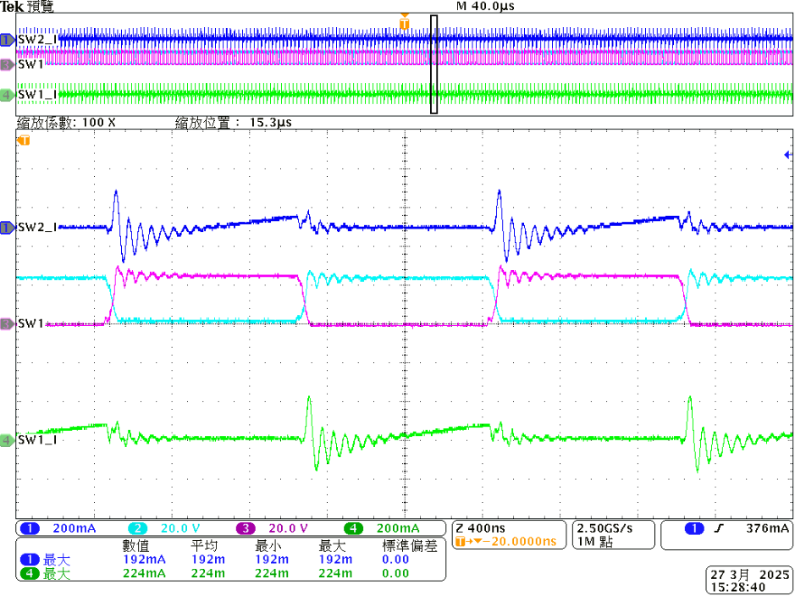
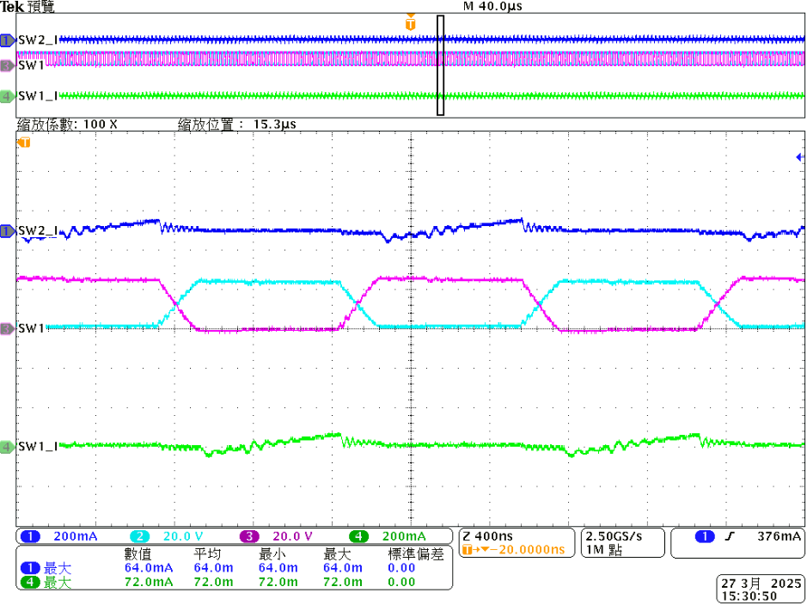
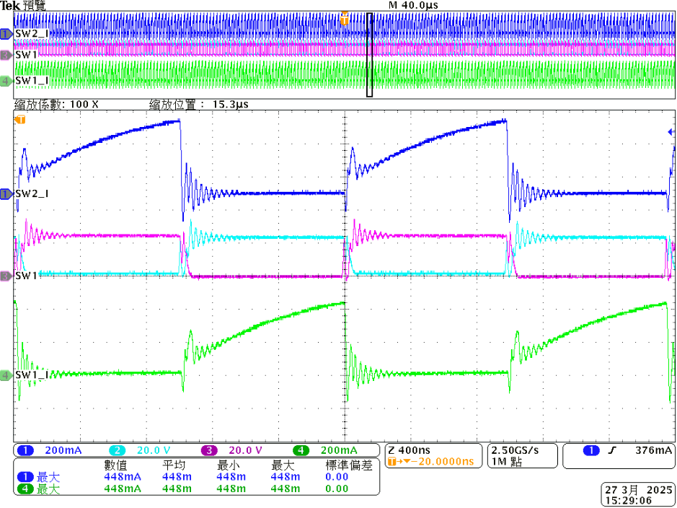
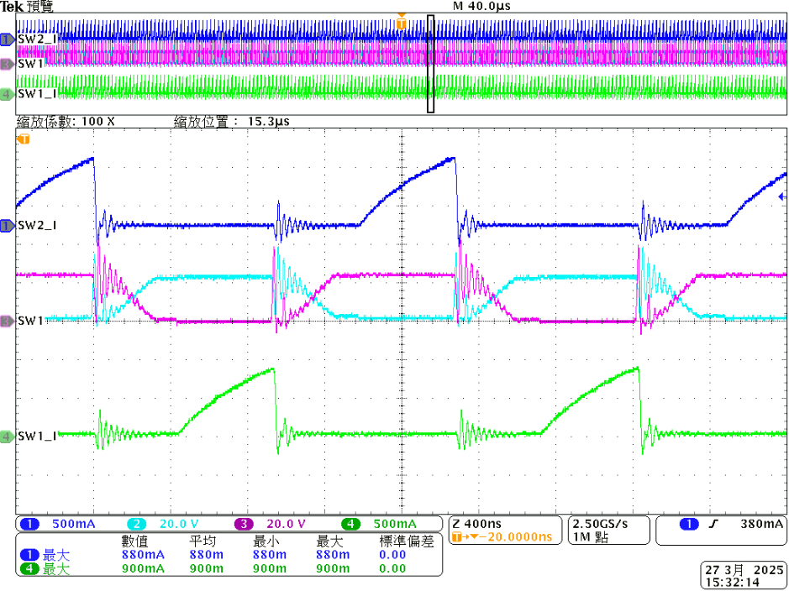
Probe Setting
CH2:SW2_V
CH1:SW2_I
CH3:SW1_V
CH4:SW1_I
Vin = 12V
Vo = 18.1V
No-Load
(RDC=51k Duty Control)
Vin = 12V
Vo = 22.8V
No-Load
(No RDC)
Deadtime is different?
Vin = 12V/0.29A
Vo = 14.57V
Load = 0.2A
(RDC=51k Duty Control)
Vin = 12V
Vo = 15.7V
Load = 0.2A
No RDC
Peak=448mA
Peak=900mA
200mA
500mA
Peak current is different?

Slide 3
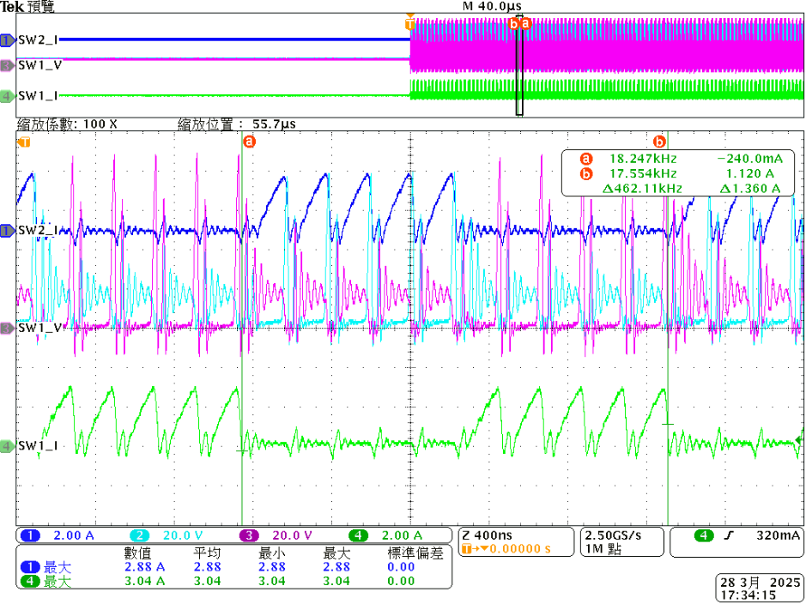

Vin=12V，523KHz，Rilim=18.2kohm(1.6A)，Electronics Load = 0.2A
Without Snubber and inductor filter
CH2:SW2_V
CH1:SW2_I
CH3:SW1_V
CH4:SW1_I
Vin = 12V
Vo = 15.8V
Load = Short circuit
58無Duty _No Load_VO=22.8
59無Duty _Load=0.2A_VO=15.7
CC01 15V 60mA
CC02 15V 80mA
RS485、CAN=80mA
60Duty _No Load_VO=18.1V
61無Duty _Load=0.2A_VO=14.57V，Vin=12V 0.29A
RB168MM150TR

Slide 4

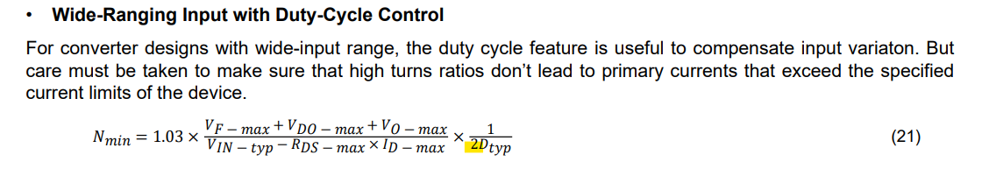
Questions:
Why is there a different on equation between DC and non-DC control mode?
2. On the page 2 waveform, we found the deadtime is difference between DC and non-DC mode. How come?
And also, the current is 2 times difference in between? Could you help to explain from energy’s point of view?
3. On the page 3 waveform, when output rail is shorted to ground, there’re always 4 PWM cycles shutting off
and then turn on With 4 PWM cycles. In the d/s, it says when short event is happened, PWM will be cycle-by-cycle
protection. Is this waveform behavior correct?
58無Duty _No Load_VO=22.8
59無Duty _Load=0.2A_VO=15.7
CC01 15V 60mA
CC02 15V 80mA
RS485、CAN=80mA
60Duty _No Load_VO=18.1V
61無Duty _Load=0.2A_VO=14.57V，Vin=12V 0.29A
RB168MM150TR

Slide 5
Answers:
Why is there a different on equation between DC and non-DC control mode?
For converter designs with wide-input range but no duty cycle control, the turns ratio needs to take the minimum input voltage into consideration. When Duty Cycle control is enabled, the requirement of turns-ratio doubles as duty cycle is halved from 48% to 25%.
CC01 15V 60mA
CC02 15V 80mA
RS485、CAN=80mA
RB168MM150TR

Slide 6
2. On the page 2 waveform, we found the deadtime is difference between DC and non-DC mode. How come?
And also, the current is 2 times difference in between? Could you help to explain from energy’s point of view?
The peak current is due to primary inductance of the transformer and the change in on-time duration.
Is this deadtime difference observed with same transformer?
RB168MM150TR

Slide 7
3. On the page 3 waveform, when output rail is shorted to ground, there’re always 4 PWM cycles shutting off
and then turn on With 4 PWM cycles. In the d/s, it says when short event is happened, PWM will be cycle-by-cycle
protection. Is this waveform behavior correct?
This depends on type of short, hard short or soft short. In soft-short the converter goes into hiccup mode
on hitting the programmed OCP threshold, the driver will be shut-off for 100 ns (typical), and then retry driving.
If the OCP trips again, the cycle continues.
RB168MM150TR

