Slide 1
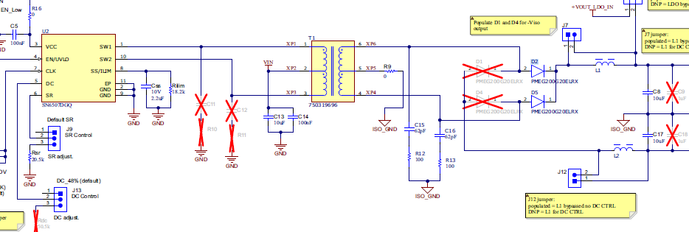
SN6507EVM
Test Conditions:
Vin=12V，523KHz，Rilim: 18.2kohm(assume output current is 1.6A)
Without Snubber, and Output Filter Inductor

Slide 2
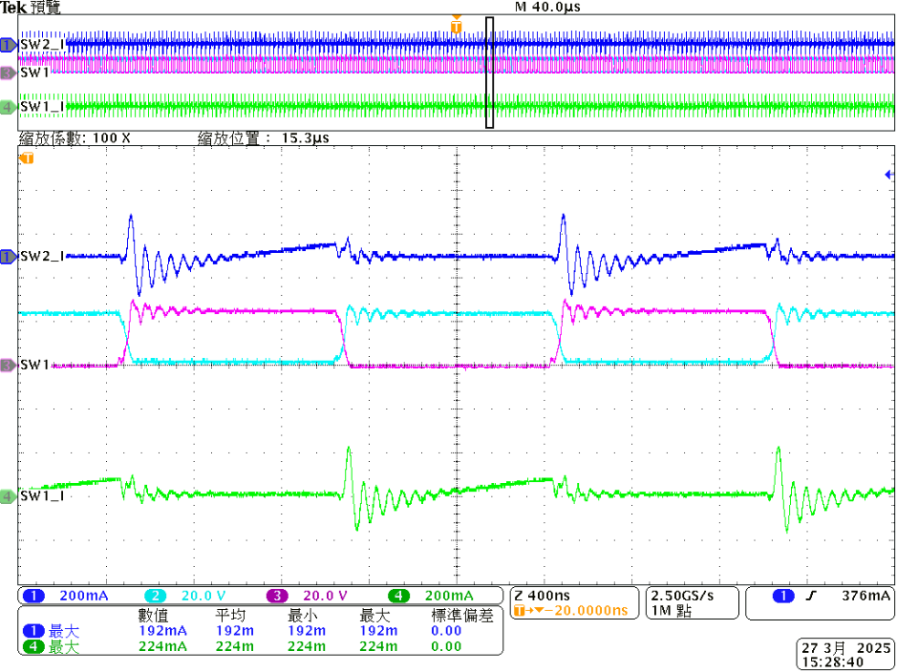
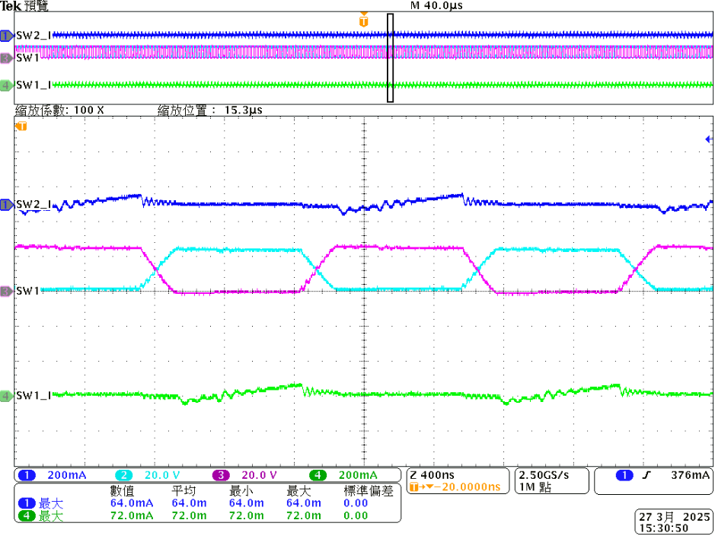
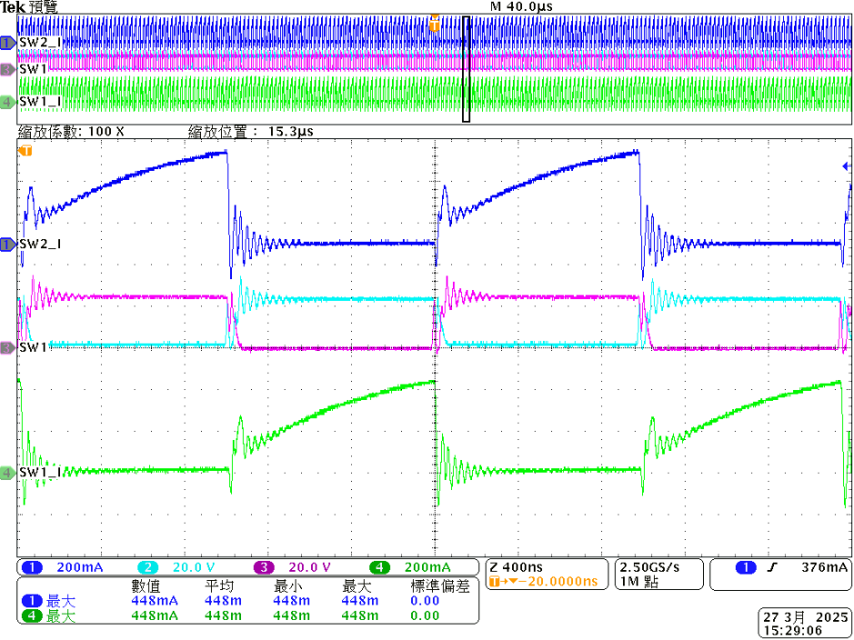
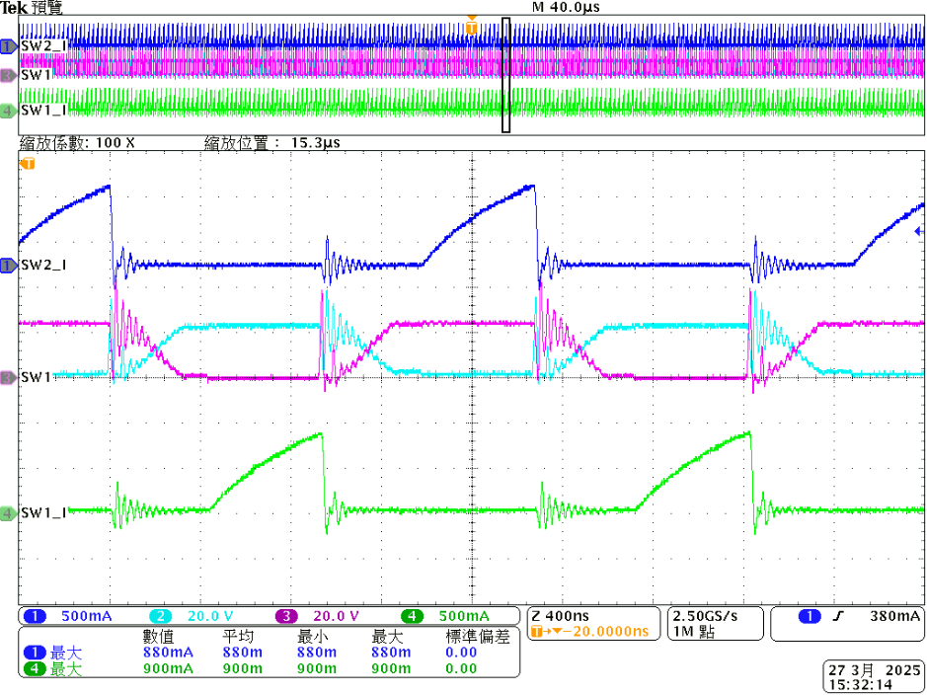
Probe Setting
CH2:SW2_V
CH1:SW2_I
CH3:SW1_V
CH4:SW1_I
Vin = 12V
Vo = 18.1V
No-Load
(RDC=51k Duty Control)
Vin = 12V
Vo = 22.8V
No-Load
(No RDC)
Deadtime is different?
Vin = 12V/0.29A
Vo = 14.57V
Load = 0.2A
(RDC=51k Duty Control)
Vin = 12V
Vo = 15.7V
Load = 0.2A
No RDC
Peak=448mA
Peak=900mA
200mA
500mA
Peak current is different?

Slide 3
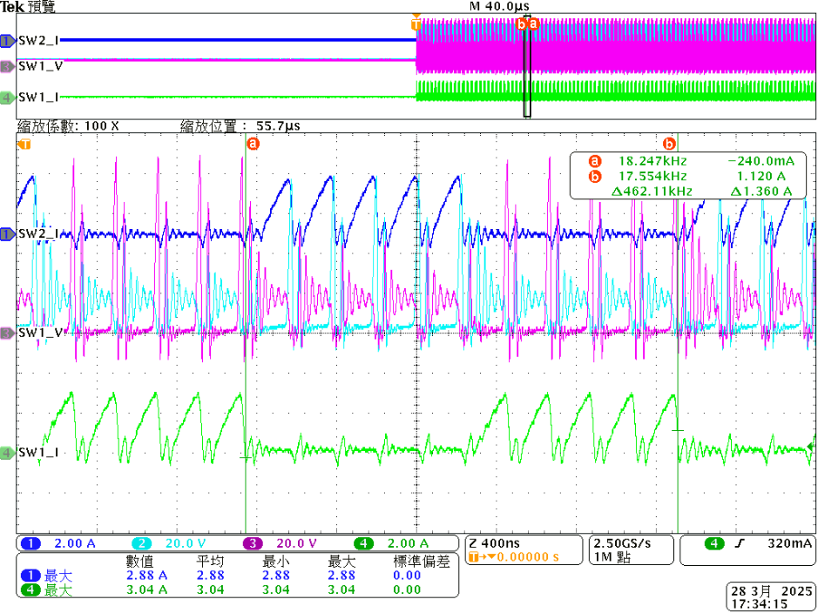

Vin=12V，523KHz，Rilim=18.2kohm(1.6A)，Electronics Load = 0.2A
Without Snubber and inductor filter
CH2:SW2_V
CH1:SW2_I
CH3:SW1_V
CH4:SW1_I
Vin = 12V
Vo = 15.8V
Load = Short circuit
58無Duty _No Load_VO=22.8
59無Duty _Load=0.2A_VO=15.7
CC01 15V 60mA
CC02 15V 80mA
RS485、CAN=80mA
60Duty _No Load_VO=18.1V
61無Duty _Load=0.2A_VO=14.57V，Vin=12V 0.29A
RB168MM150TR

Slide 4

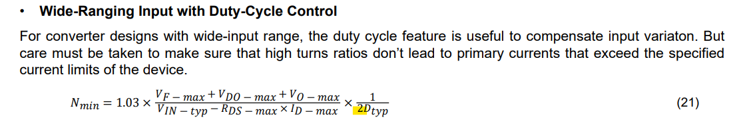
Questions:
Why is there a different on equation between DC and non-DC control mode?
2. On the page 2 waveform, we found the deadtime is difference between DC and non-DC mode. How come?
And also, the current is 2 times difference in between? Could you help to explain from energy’s point of view?
3. On the page 3 waveform, when output rail is shorted to ground, there’re always 4 PWM cycles shutting off
and then turn on With 4 PWM cycles. In the d/s, it says when short event is happened, PWM will be cycle-by-cycle
protection. Is this waveform behavior correct?
58無Duty _No Load_VO=22.8
59無Duty _Load=0.2A_VO=15.7
CC01 15V 60mA
CC02 15V 80mA
RS485、CAN=80mA
60Duty _No Load_VO=18.1V
61無Duty _Load=0.2A_VO=14.57V，Vin=12V 0.29A
RB168MM150TR

Slide 5
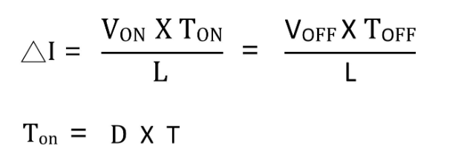
Answers:
Why is there a different on equation between DC and non-DC control mode?
For converter designs with wide-input range but no duty cycle control, the turns ratio needs to take the minimum input voltage into consideration. When Duty Cycle control is enabled, the requirement of turns-ratio doubles as duty cycle is halved from 48% to 25%.
CC01 15V 60mA
CC02 15V 80mA
RS485、CAN=80mA
RB168MM150TR

Slide 6
Here is a general formula for the inductor current. We still don’t figure out why peak current doesn’t match
this formula from physics perspective as the waveform shown on the page 2. (448mA vs. 900mA)
2. In the formula (21), how device implement it?
3. The reason why customer would like to look into this current is because the
Current rating of the Schottky diode needs to be selected correctly when DC is enabled.
In page 2, four different waveforms are given 1> Vin = 12V, Vo = 22.8V, No-Load, (No RDC)
2> Vin = 12V, Vo = 18.1V, No-Load, (RDC=51k Duty Control)
3> Vin = 12V, Vo = 15.7V, Load = 0.2A, No RDC
4> Vin = 12V/0.29A, Vo = 14.57V, Load = 0.2A, (RDC=51k Duty Control)
Do all this these test are done with a single transformer? Is this a custom build transformer or the same EVM transformer?
At which point output voltage are monitored J1 or J8. Is it possible to measure the onload input current with and without RDC.
2. The duty cycle feature is be enabled by connecting a resistor RDC on DC pin, and an inductor at the output side.
The duty cycle feature is not needed for fixed input designs. The default (pin floating) maximum duty is 48% typical, when DC
is enabled based on resistor value it adjust within 48% to 25%. By making the DC pin voltage a function of the input, the
duty cycle will adjust with VIN, so that VOUT can be kept constant. The transformer turns ratio needs take this duty cycle into
calculation to ensure the expected output voltage level. But care must be taken to make sure that high turns ratios don’t lead
to primary currents that exceed the specified current limits of the device.
3. Can you please clarify this point. The output rectifier diode current is selected based on output load current. The monitored
peak current are reflecting on device switches and not able to find any diode on input side.

Slide 7
2. On the page 2 waveform, we found the deadtime is difference between DC and non-DC mode. How come?
And also, the current is 2 times difference in between? Could you help to explain from energy’s point of view?
The peak current is due to primary inductance of the transformer and the change in on-time duration.
Is this deadtime difference observed with same transformer?
Yes, it’s the same transformer (From DELTA)
Can you please reconfirm once, EVM uses Wurth transformer. Or the testing is done with a custom transformer?
The change in duty cycle will affect the dead time, the minimum duty cycle is determined by the charge and discharge
time of the gate capacitance of Power FETs and the maximum duty cycle is limited by the dead time 70 ns (typical).
RB168MM150TR

Slide 8

3. On the page 3 waveform, when output rail is shorted to ground, there’re always 4 PWM cycles shutting off
and then turn on With 4 PWM cycles. In the d/s, it says when short event is happened, PWM will be cycle-by-cycle
protection. Is this waveform behavior correct?
This depends on type of short, hard short or soft short. In soft-short the converter goes into hiccup mode
on hitting the programmed OCP threshold, the driver will be shut-off for 100 ns (typical), and then retry driving.
If the OCP trips again, the cycle continues.
It could be a “ Hard short ” as it’s shorted by Electronics load.
Why there’re five pulses observed during short circuit?
It’s about 5MHz/pulse. And in between the pulses, there is a
100ns shut-off time.
Is this short-circuit behavior a hiccup mode or cycle by cycle?
Could you explain more details!
The internal switches are protected with cycle-by-cycle current limit in case of
over current. During OCP the device enters in to hiccup mode and shut-off for
100 ns and then retry driving and this cycle continues.
RB168MM150TR

