Slide 1
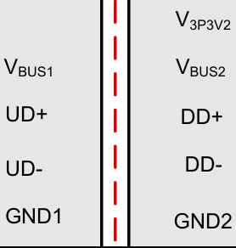
USB and One-Wire Interface
USB 2.0 Isolator
(ISOUSB211DPR)
ISO_3V3
ISO_5V_USB
ISO_3V3
1:4 USB 2.0 Hub
(USB2514B-I/M2)
#3
USB Downstream Type A Connector
(292303-1)
Port 1
ESD Protection (ESDS302DBVR)
Pad USB
#1
USB Upstream Type A Connector
(292303-1)
Port 2
Device2_USB
Host PC
Port 3
Device3_USB
Isolator
(ISOUSB211DPR)
One_wire_3V3
ISO_3V3
Port 4
ISO_GND
GND_FIELD
GND_FIELD
Galvanic Isolation
ISO_GND
ISO_GND
ISO_GND
ISO2_GND
ISO_5V
USB to UART Converter
(FT232RNQ-REEL)
ISO2_GND
ISO_5V
UART to one-wire Converter
(DS2480B+)
ISO2_GND
Header
(SFH11-PBPC-D05-ST-BK)
One-Wire Signal

Slide 2
12V,272.9mA
-12V,107.5mA
12V,165.4mA
#2
Relay Driver
(TPS4H000AQPWPRQ1)

