Slide 1
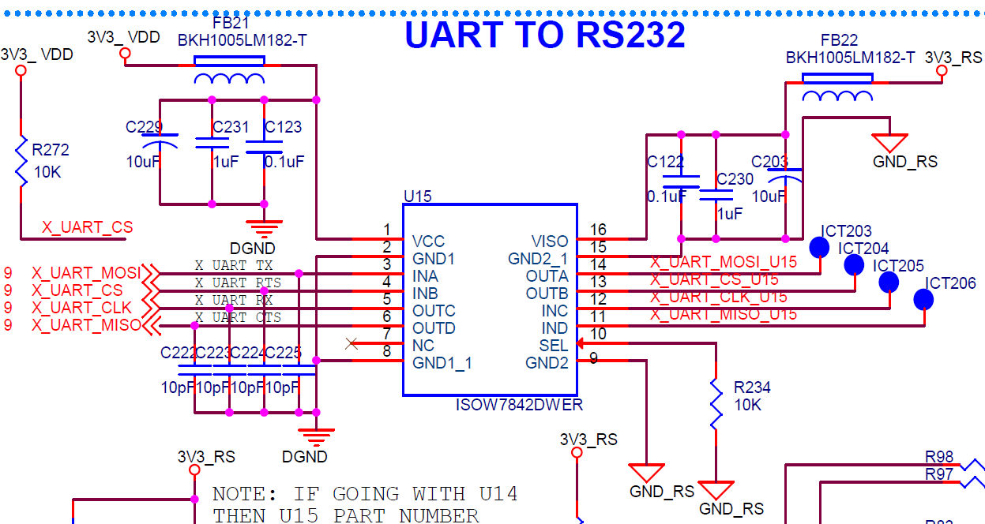
Schematics

Slide 2
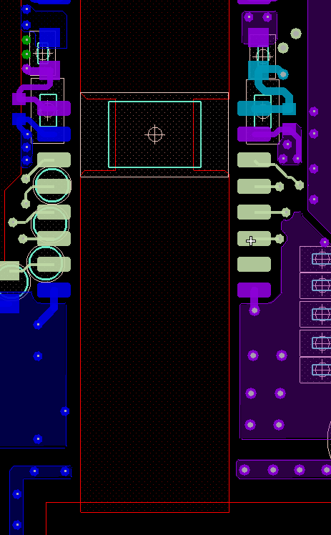
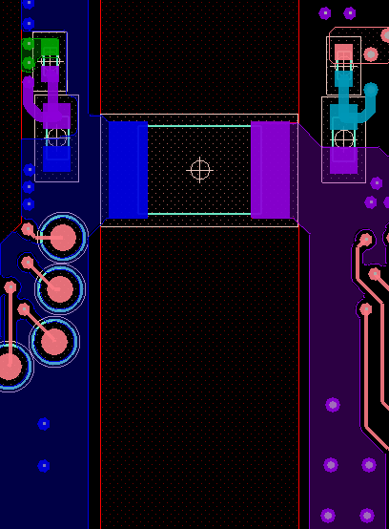
Layout
Ferrite bead
Input caps
Stitching cap External
Bottom layer
Top layer

Slide 3
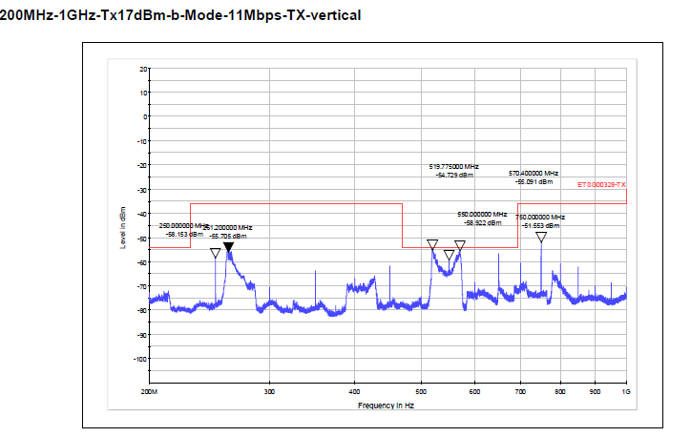
RSE test plot

Slide 4
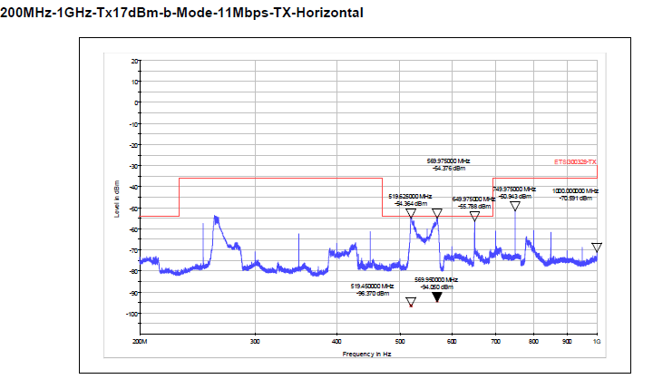
RSE test plot

