Slide 1
CAN Failure Issue
24/01/22

Slide 2
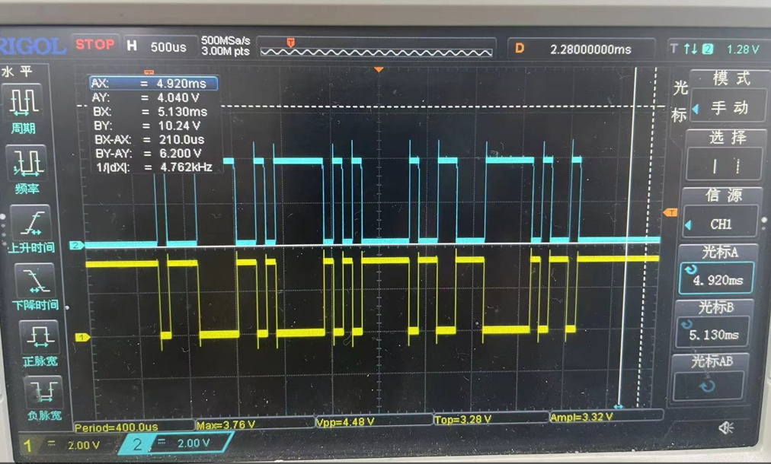
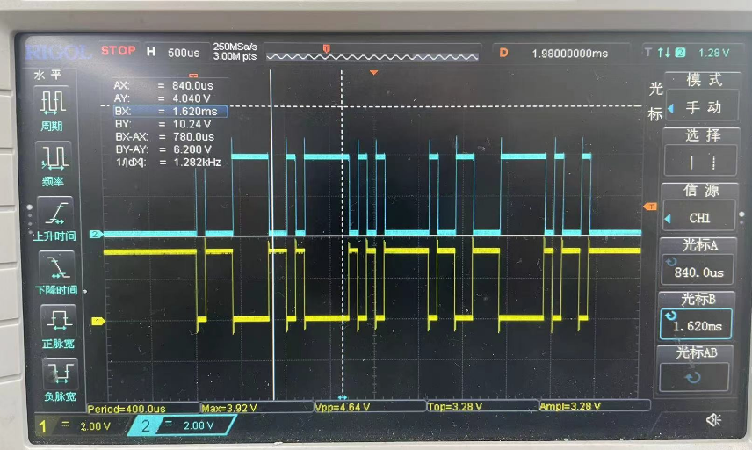
Diagnosis-Normal PCBA
Yellow Channel : CAN_TX
Blue Channel：CAN BUS
Yellow Channel : CAN_RX
Blue Channel： CAN BUS
CAN_TX & CAN BUS match
CAN BUS & CAN_RX match

Slide 3
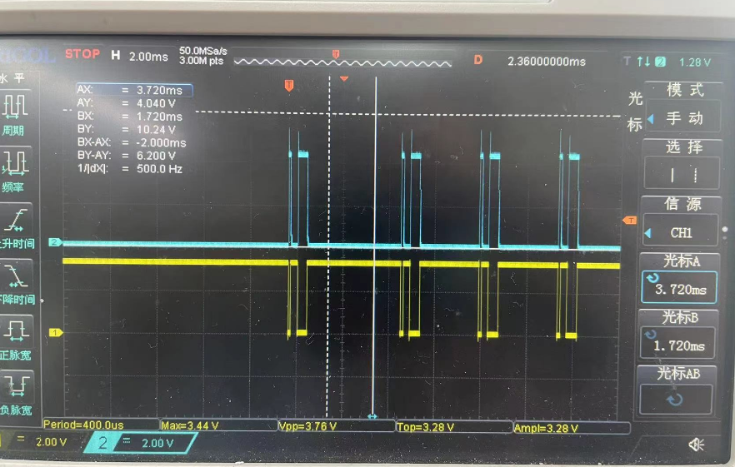
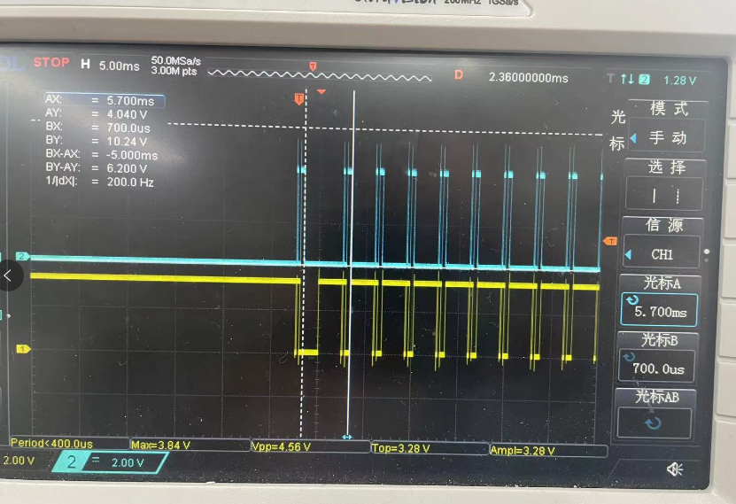
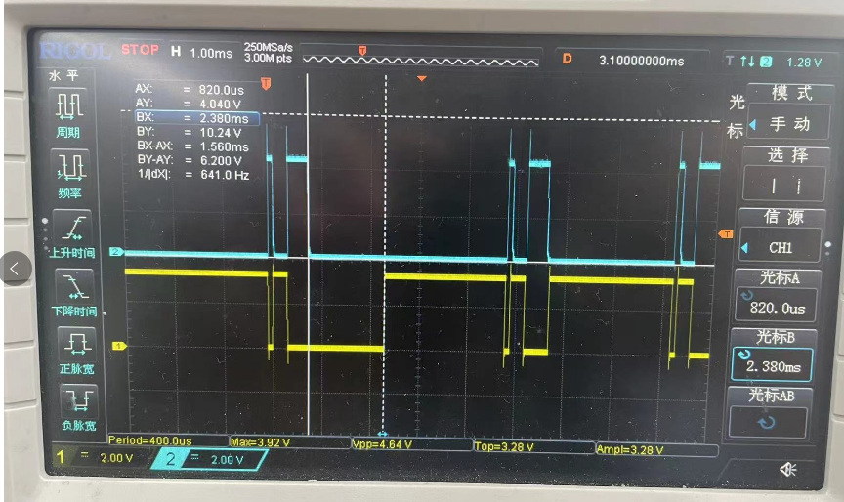
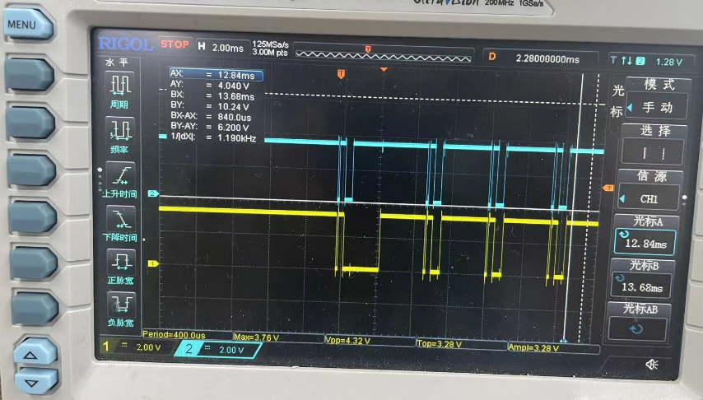
Diagnosis-Failure PCBA
Yellow Channel : CAN_TX
Blue Channel：CAN BUS
Yellow Channel : CAN_RX
Blue Channel： CAN BUS
CAN RX & CAN BUS match
Yellow Channel : CAN_TX
Blue Channel： CAN_RX
1.56ms mismatch between
CAN_TX & CAN_RX
1.56ms mismatch between CAN_TX & CAN BUS

Slide 4
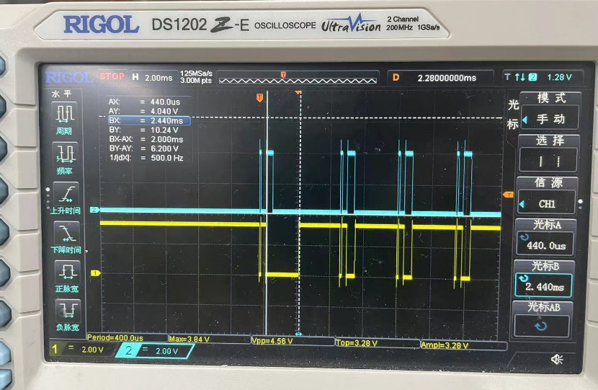
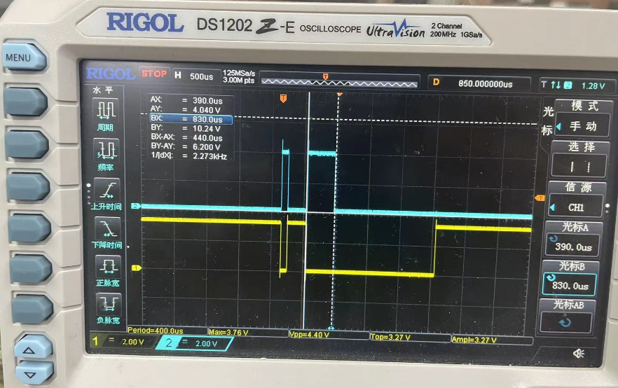
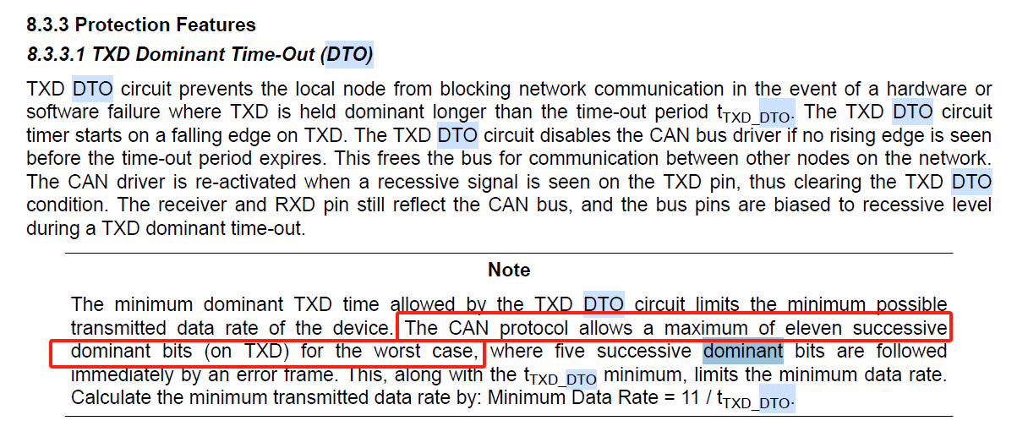
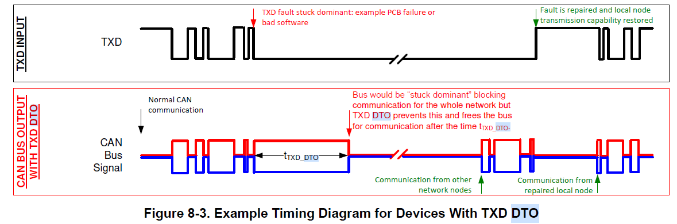
Diagnosis-Failure PCBA
Yellow Channel : CAN_TX Blue Channel：CAN BUS
1.56ms mismatch between
CAN_TX & CAN BUS
CAN_TX keep 2ms
CAN BUS dominant hold 440us

Slide 5
Diagnosis-Failure PCBA
Yellow Channel : CAN_TX Blue Channel：CAN BUS
It seems 1050 goes into Dominant Time-Out mode ， but my question here ，why
Dominant can only last 440us？ Our BAUD rate is 10Kbps，so only 5bit dominant will kick-off DTO mode？
CAN_TX keep 2ms
CAN BUS dominant hold 440us

Slide 6
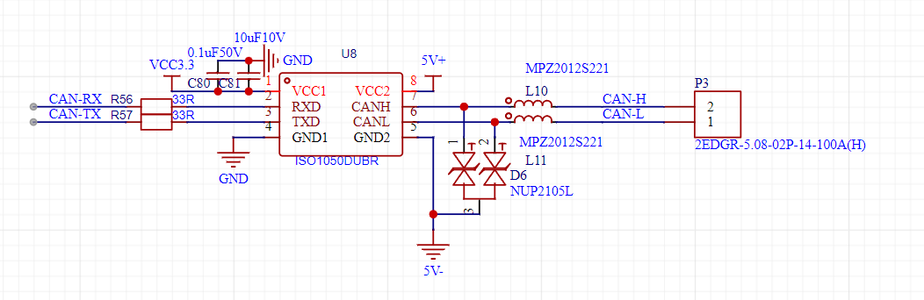
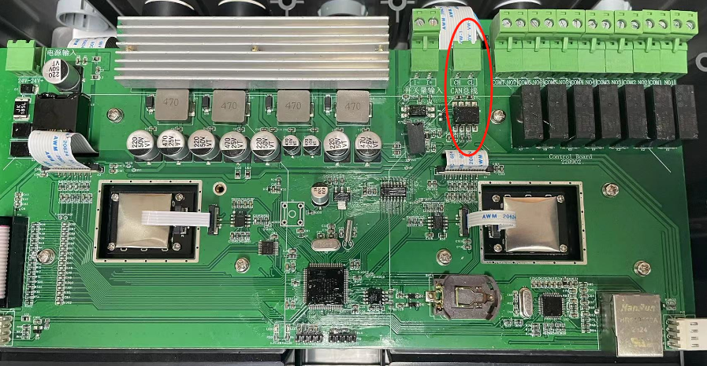
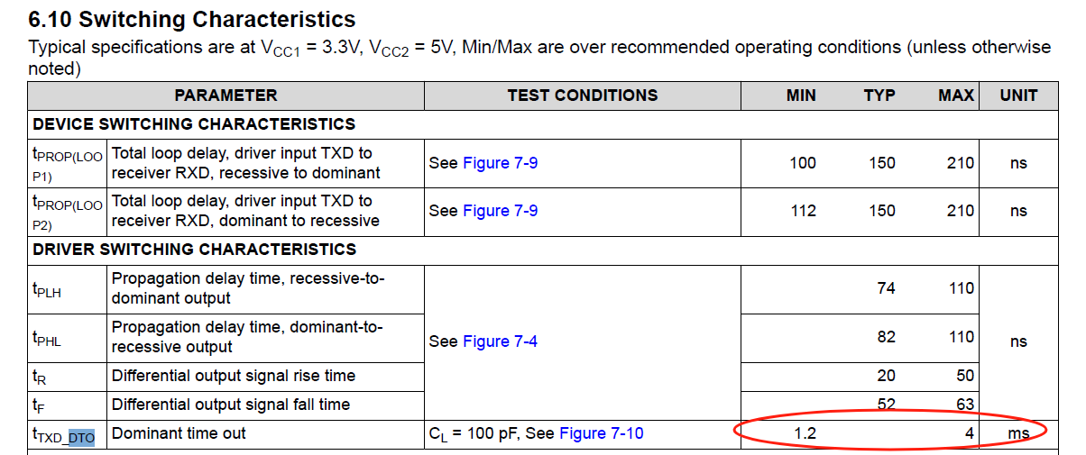
Diagnosis
Failure follow ISO1050 after A-B-A swap test
Maybe Dominant Time-Out issue which lead to the PCBA（include software）select particular 1050 ？

