Slide 1
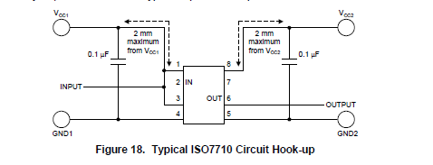
CORRECTI9NG A GRAPHICAL TYPO
IS
WAS

