Slide 1
Data Summary
Data taken with two RF-DSP Cascade board units side-by-side
RF1 is a good board, RF2 appears to be a bad board
Data was taken outside with a retro-reflector 10.3m away from the units
Both units were configured the same: 25m max range, 9 Tx in TDM mode
To compute the FFTs we padded the 256 samples per chirp with zeros to yield 512 range bins in the FFTs
The retro is at range bin 208 in the following graphs
The first graph shows the range solution for both boards at 0 velocity
Note that the signal for RF2 is at least 12 dB lower than the signal for RF1
The next 16 graphs are range plots for RF1 for each Rx, with all Tx’s shown
Rx1-4 are chip1, Rx5-8 are chip 2, Rx9-12 are chip 3, Rx13-16 are chip 4
The next 16 after those are the plots for RF2
Note that chip4 (Rx13-16) of RF2 has a problem

Slide 2
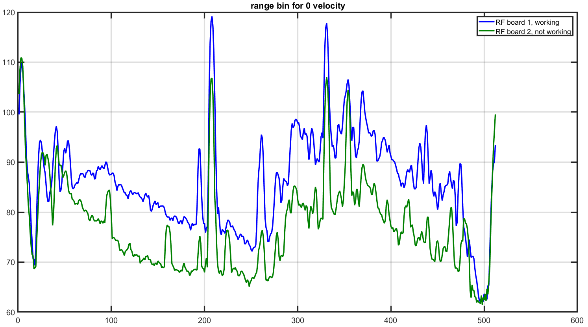
FFT Solutions for Both Boards, RF2 is much Weaker

Slide 3
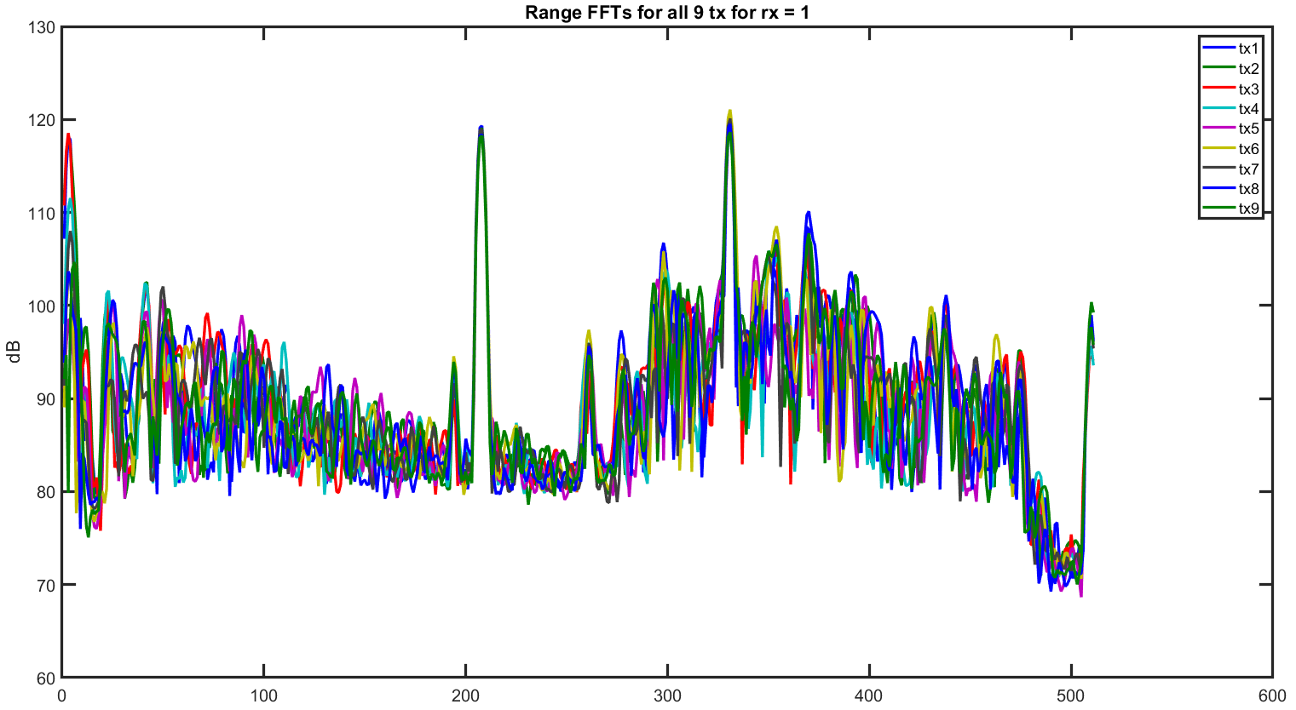
RF Board 1 (good) Range FFTs for Rx = 1

Slide 4
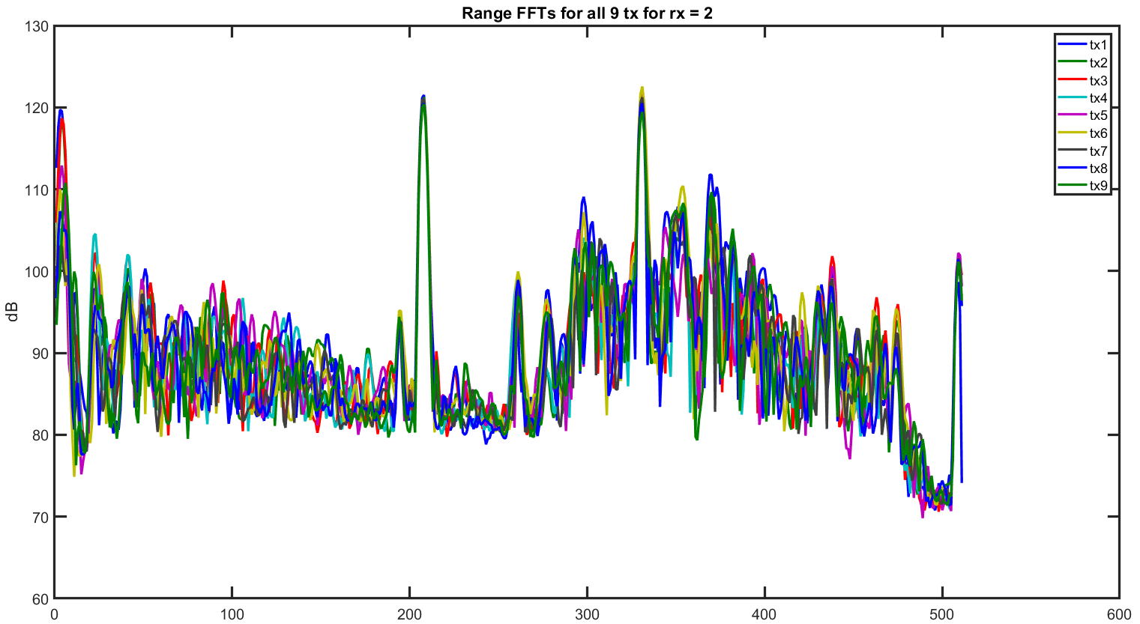
RF Board 1 (good) Range FFTs for Rx = 2

Slide 5
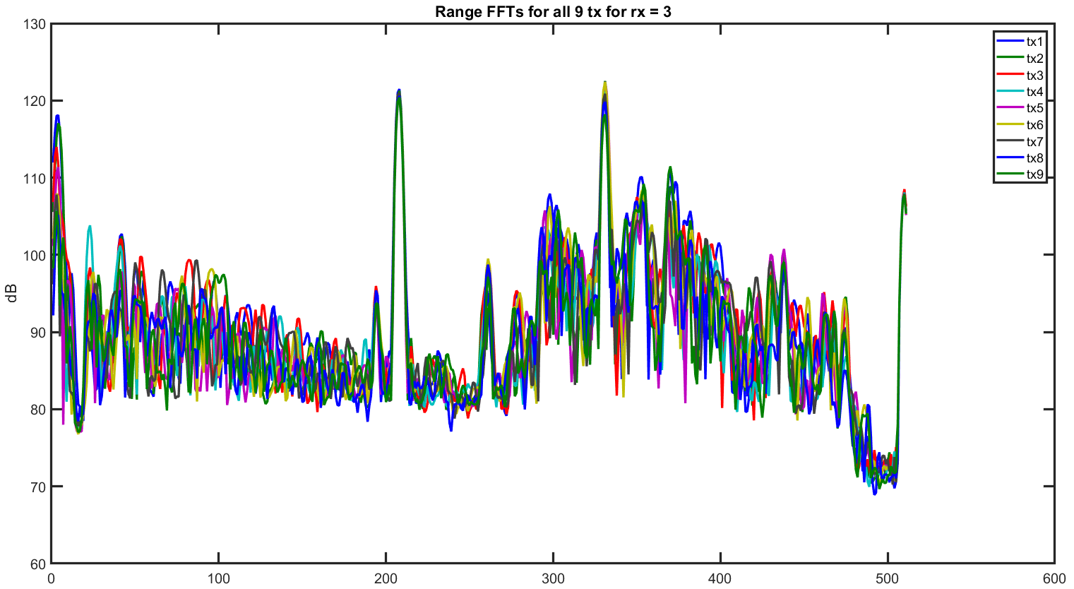
RF Board 1 (good) Range FFTs for Rx = 3

Slide 6
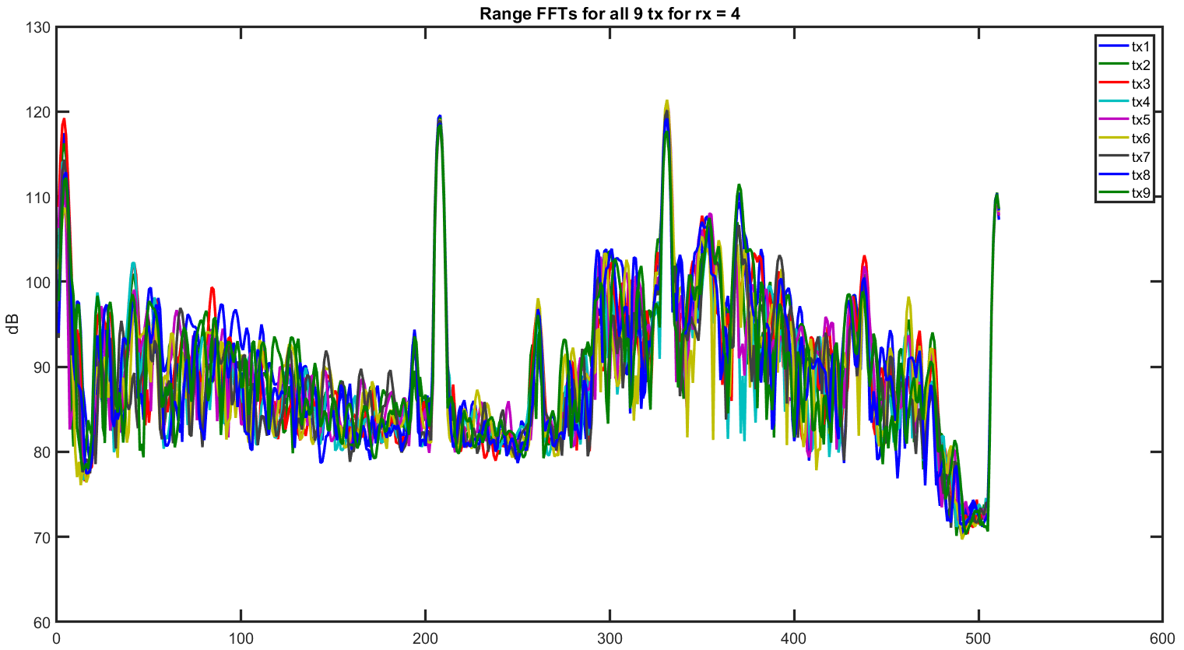
RF Board 1 (good) Range FFTs for Rx = 4

Slide 7
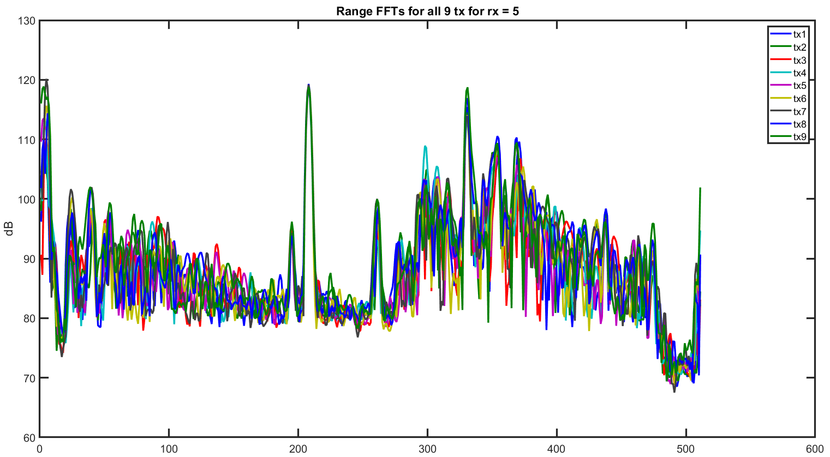
RF Board 1 (good) Range FFTs for Rx = 5

Slide 8
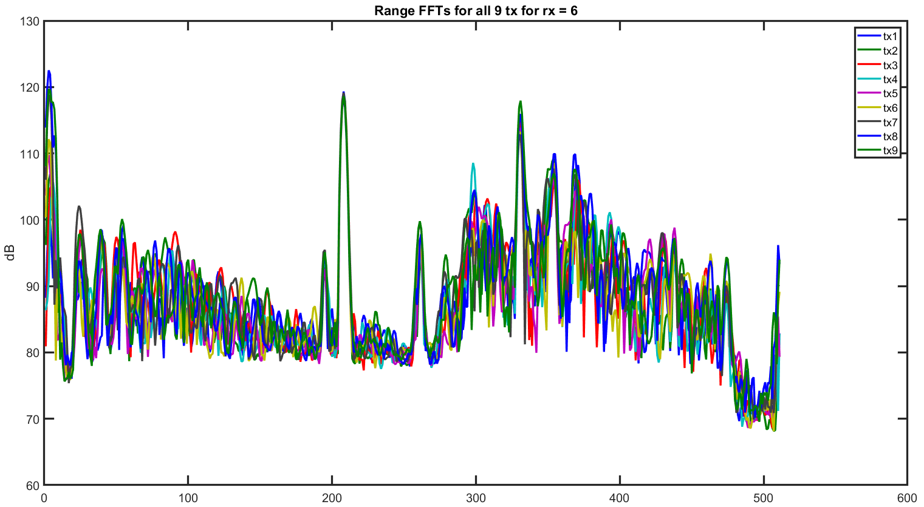
RF Board 1 (good) Range FFTs for Rx = 6

Slide 9
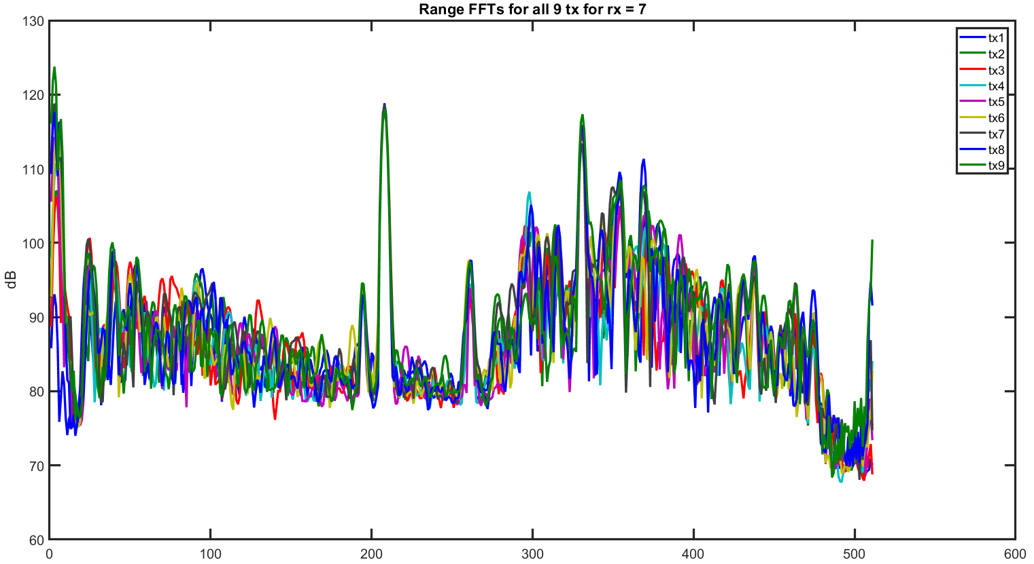
RF Board 1 (good) Range FFTs for Rx = 7

Slide 10
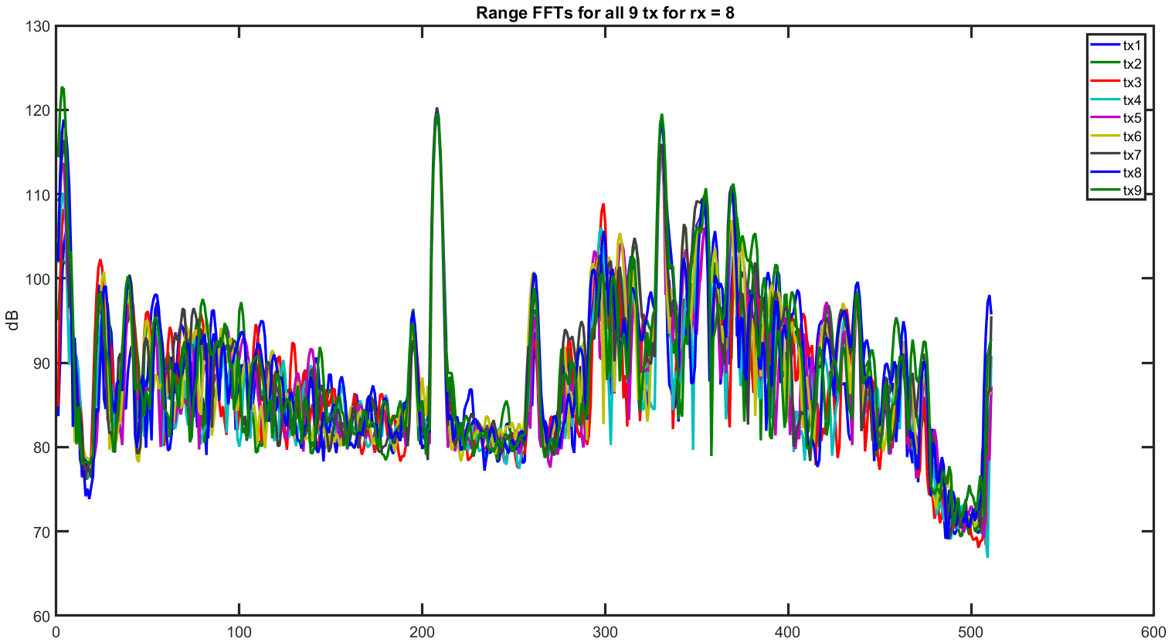
RF Board 1 (good) Range FFTs for Rx = 8

Slide 11
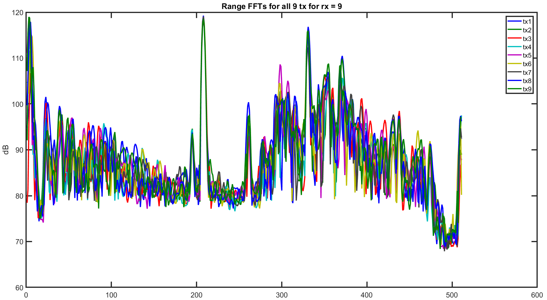
RF Board 1 (good) Range FFTs for Rx = 9

Slide 12
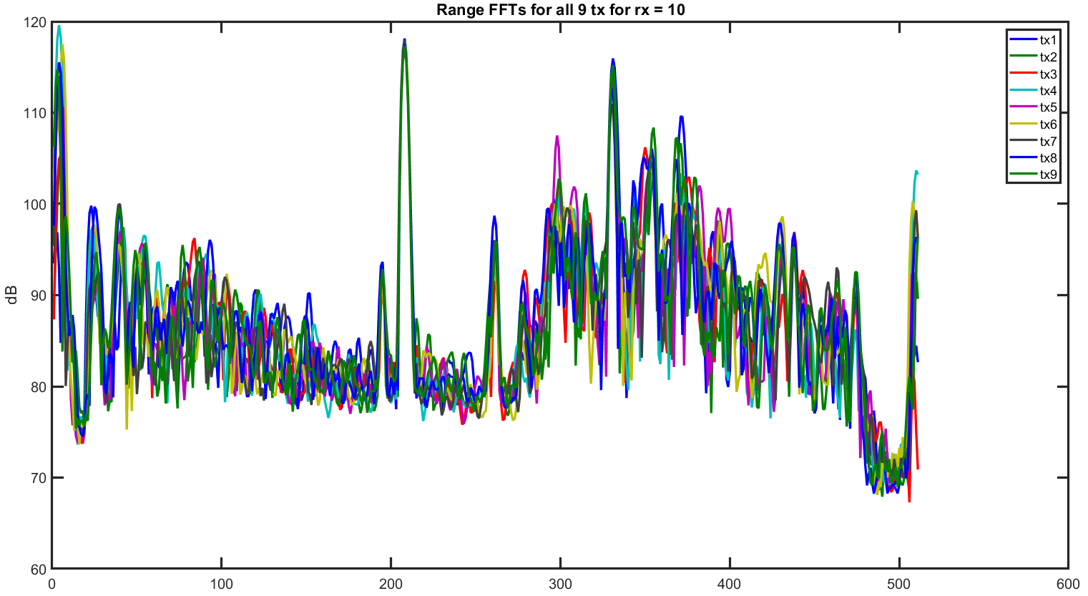
RF Board 1 (good) Range FFTs for Rx = 10

Slide 13
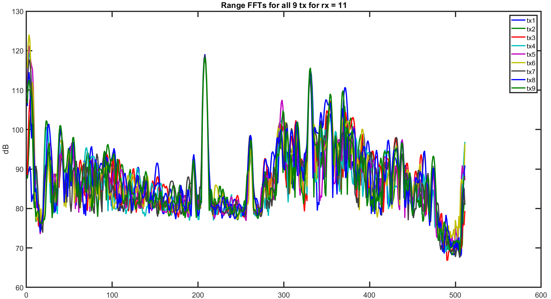
RF Board 1 (good) Range FFTs for Rx = 11

Slide 14
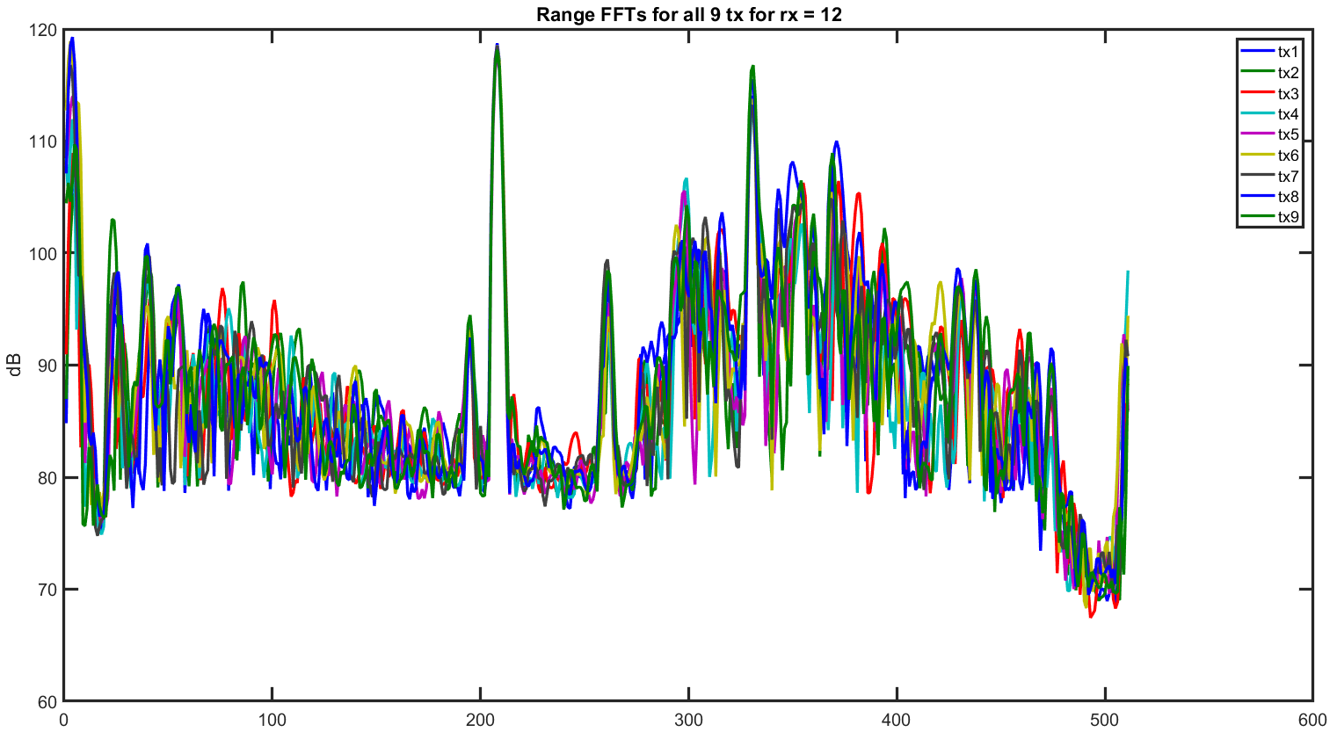
RF Board 1 (good) Range FFTs for Rx = 12

Slide 15
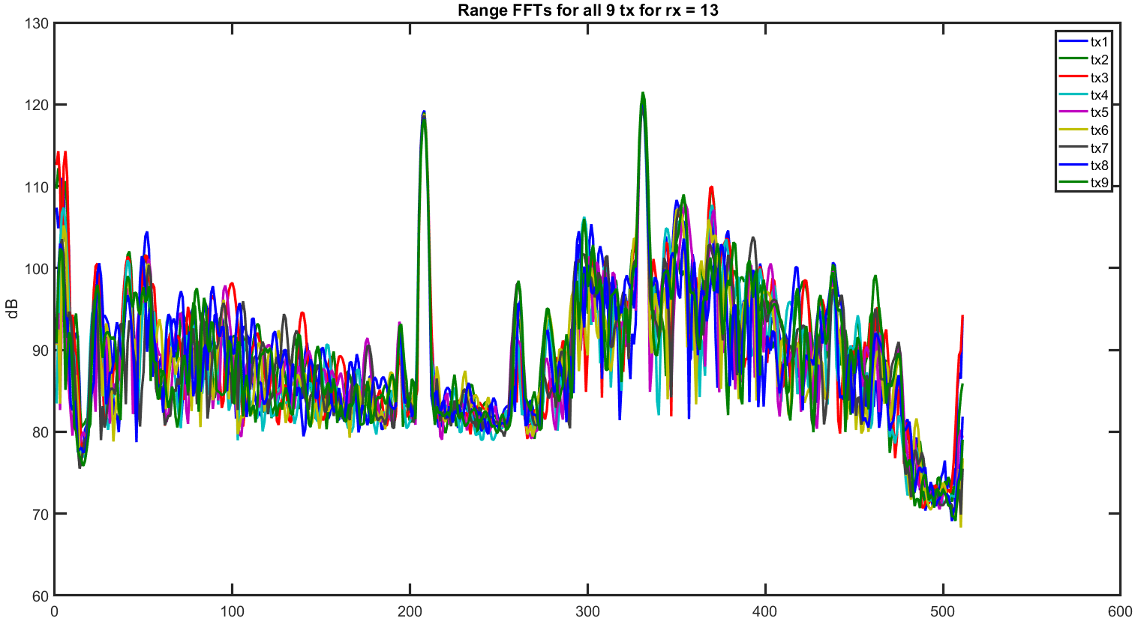
RF Board 1 (good) Range FFTs for Rx = 13

Slide 16
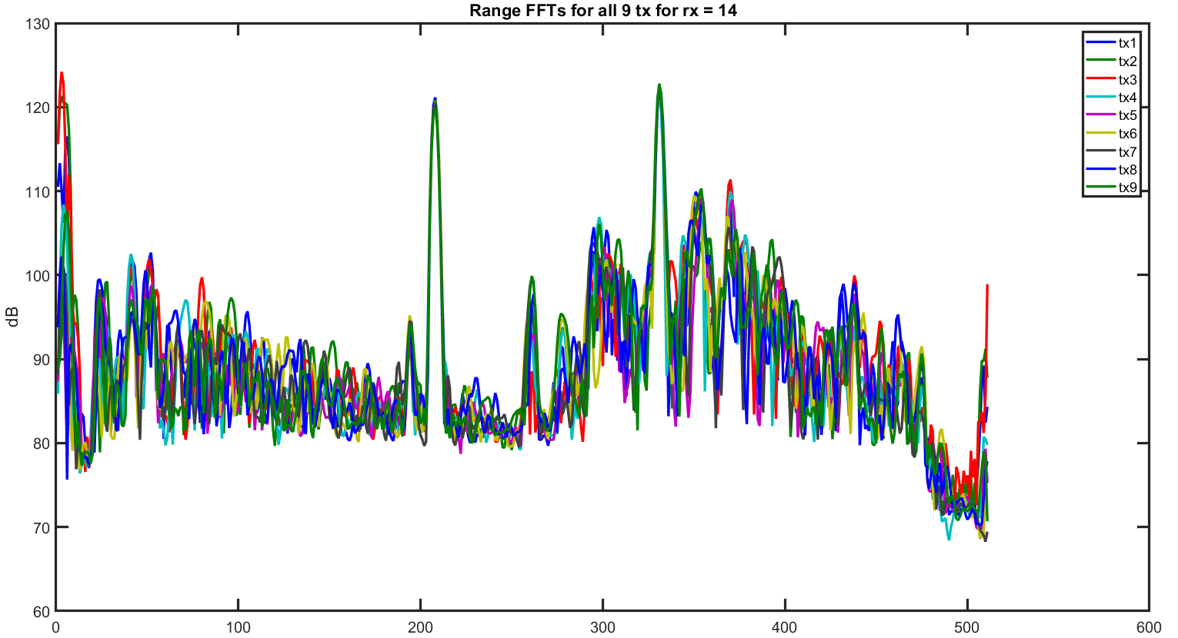
RF Board 1 (good) Range FFTs for Rx = 14

Slide 17
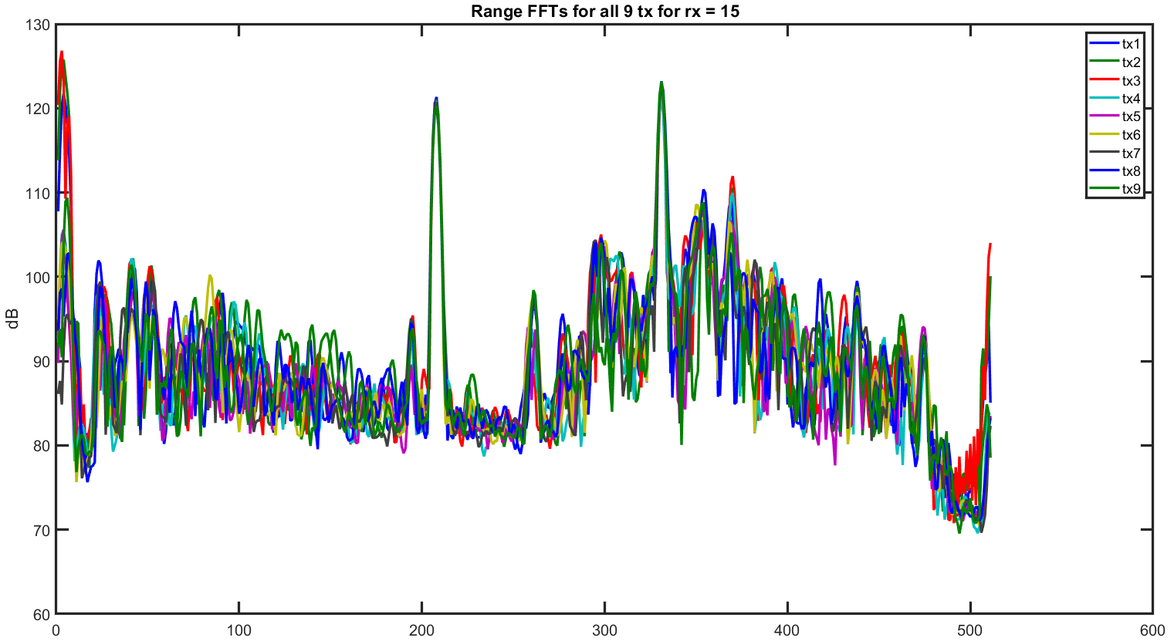
RF Board 1 (good) Range FFTs for Rx = 15

Slide 18
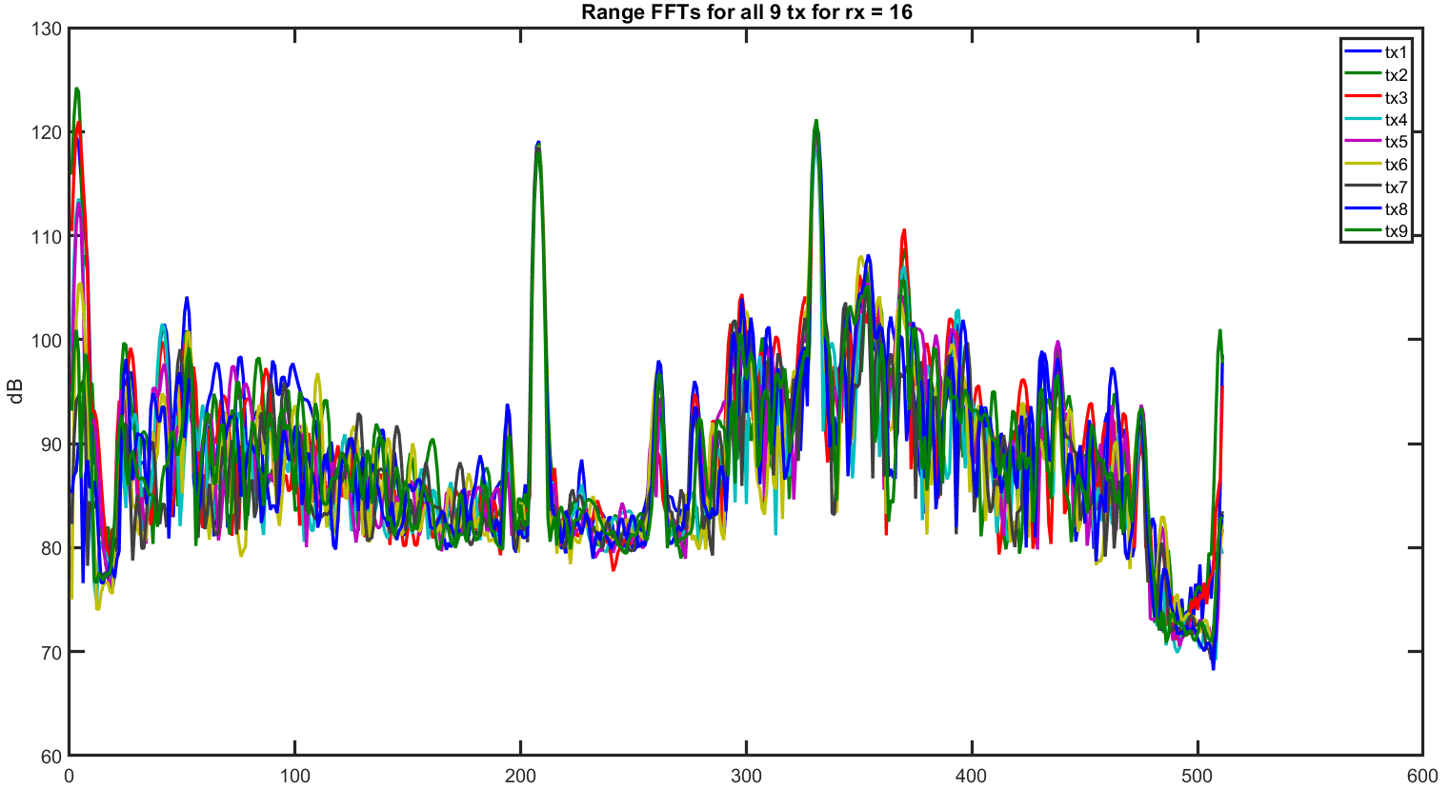
RF Board 1 (good) Range FFTs for Rx = 16

Slide 19
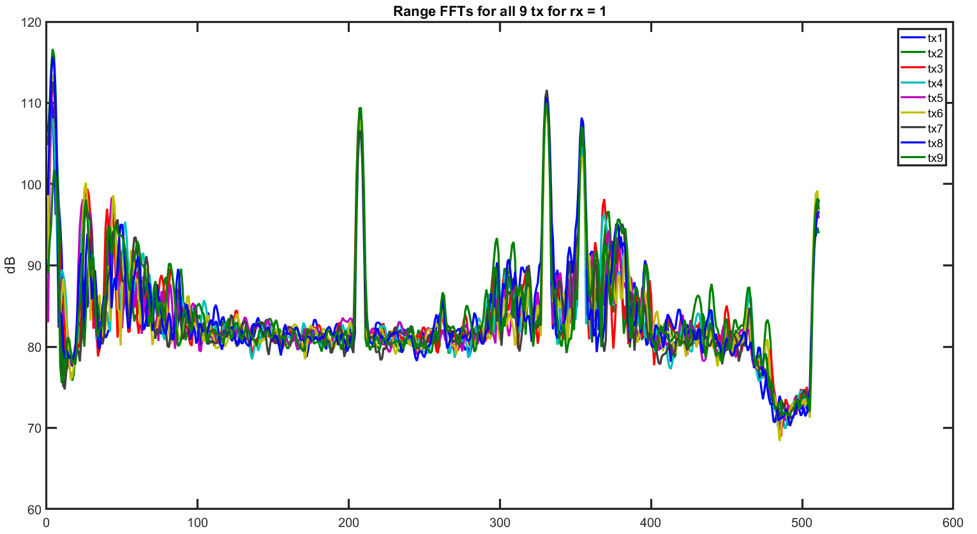
RF Board 2 (bad?) Range FFTs for Rx = 1

Slide 20
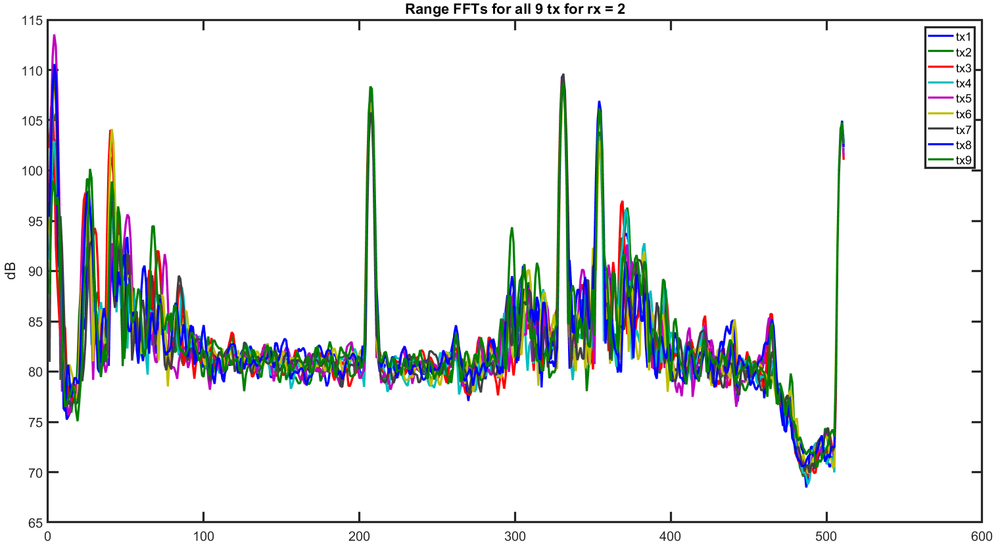
RF Board 2 (bad?) Range FFTs for Rx = 2

Slide 21
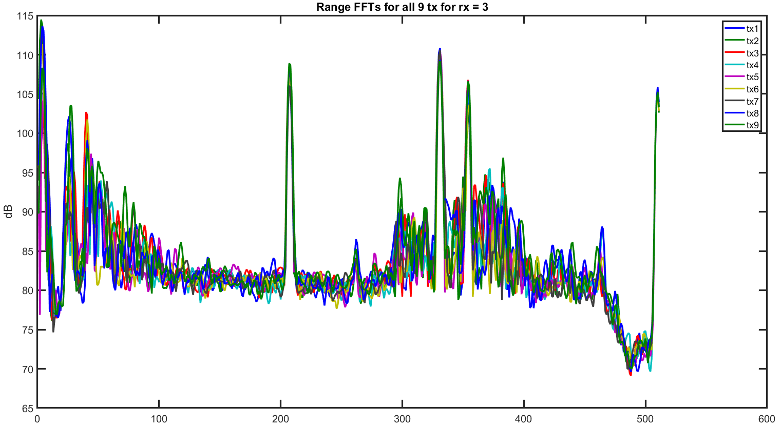
RF Board 2 (bad?) Range FFTs for Rx = 3

Slide 22
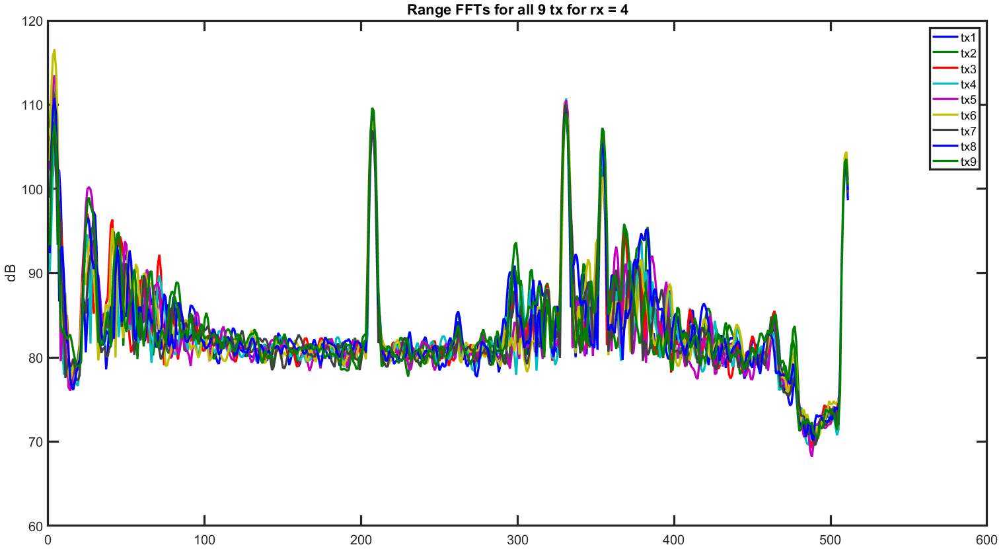
RF Board 2 (bad?) Range FFTs for Rx = 4

Slide 23
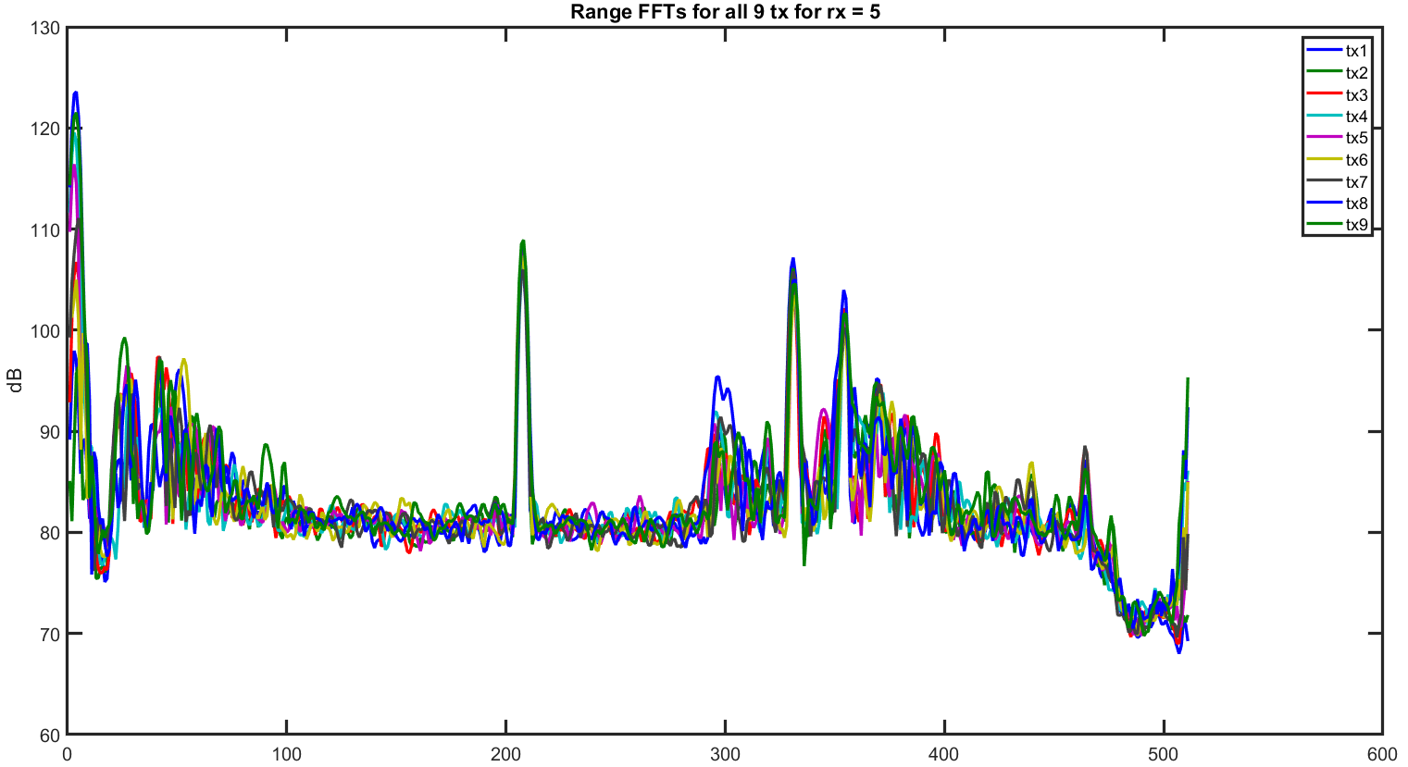
RF Board 2 (bad?) Range FFTs for Rx = 5

Slide 24
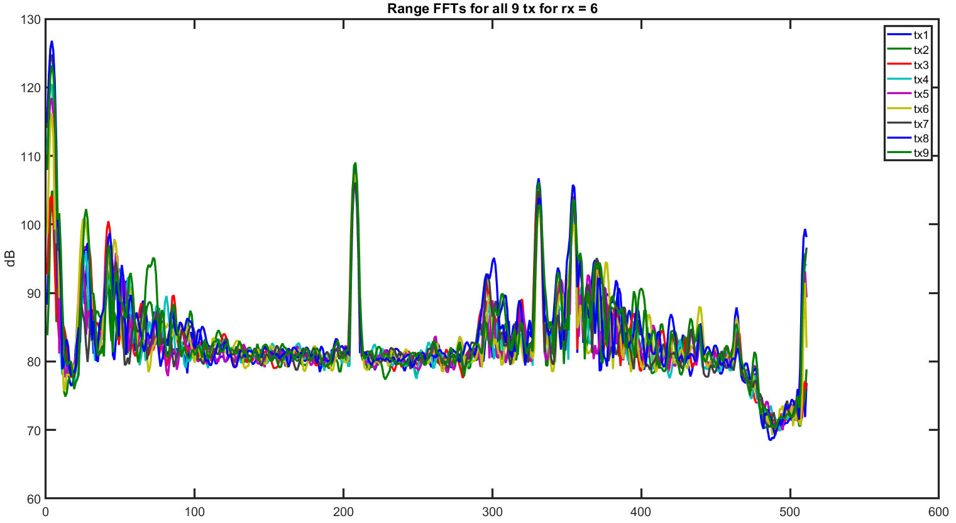
RF Board 2 (bad?) Range FFTs for Rx = 6

Slide 25
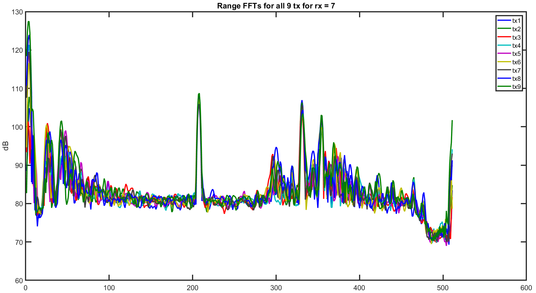
RF Board 2 (bad?) Range FFTs for Rx = 7

Slide 26
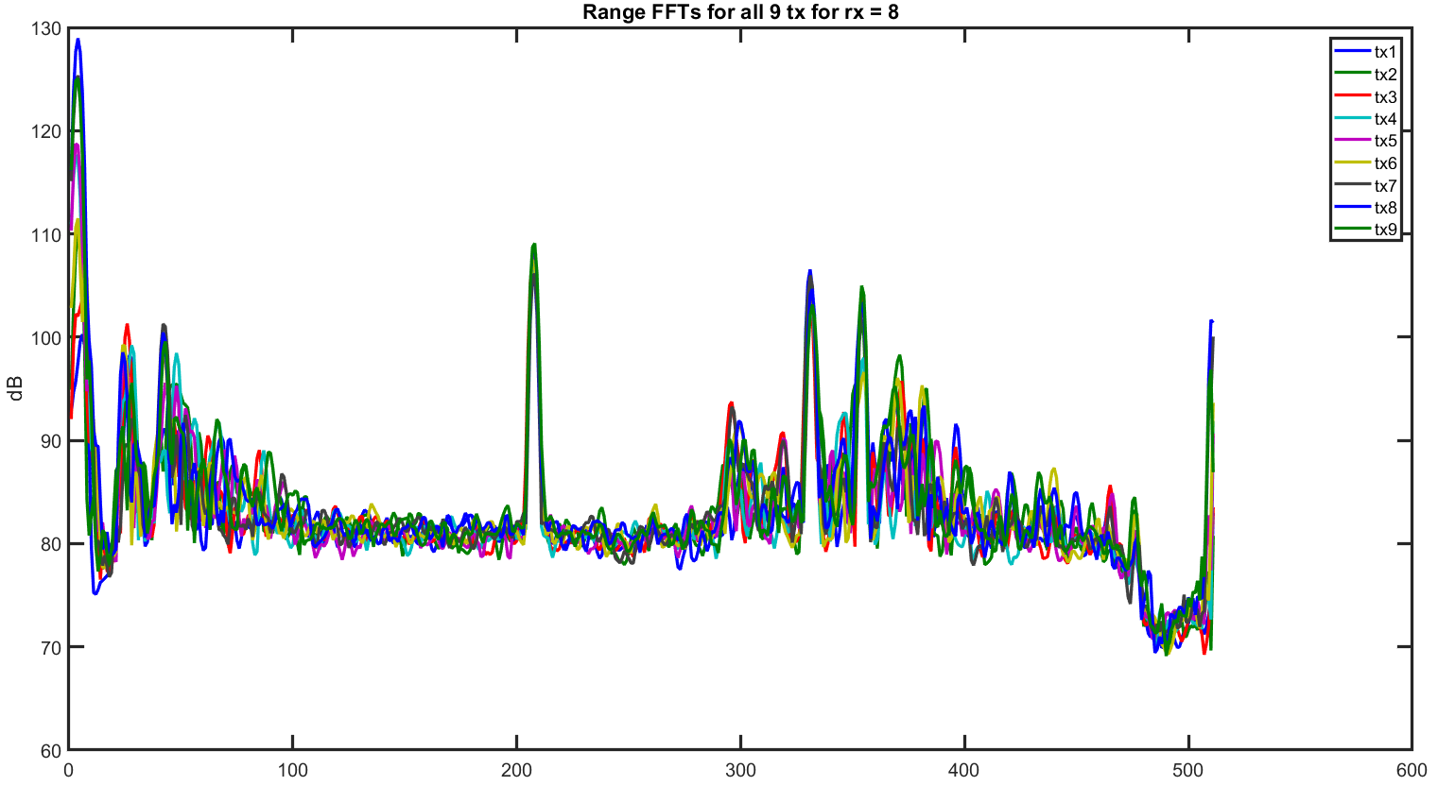
RF Board 2 (bad?) Range FFTs for Rx = 8

Slide 27
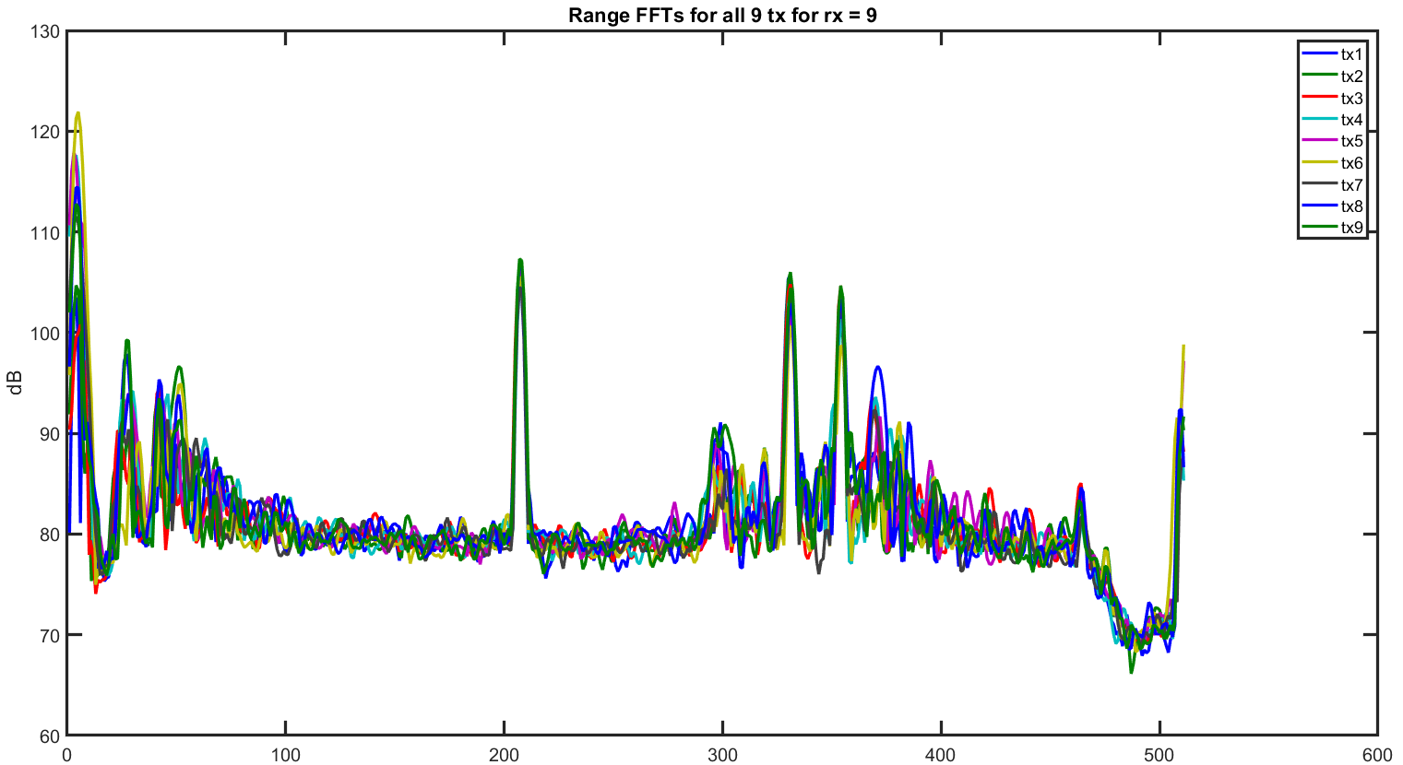
RF Board 2 (bad?) Range FFTs for Rx = 9

Slide 28
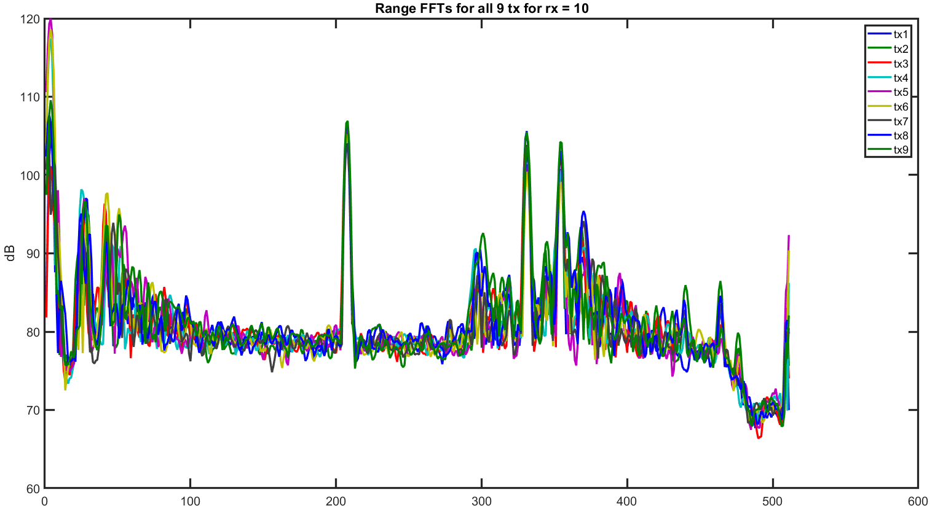
RF Board 2 (bad?) Range FFTs for Rx = 10

Slide 29
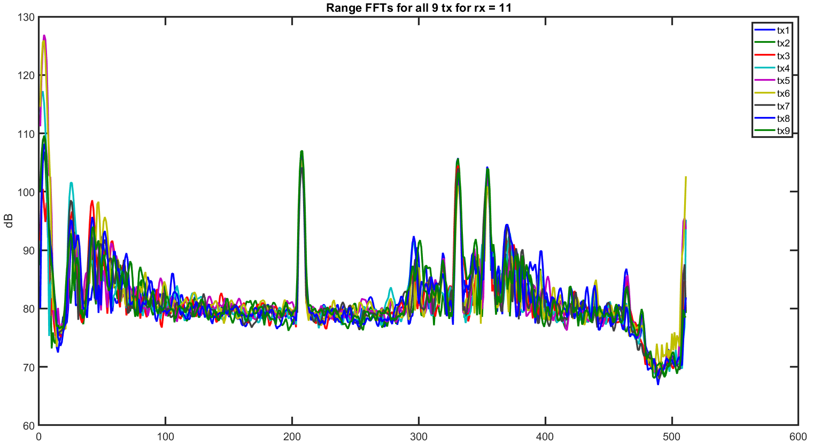
RF Board 2 (bad?) Range FFTs for Rx = 11

Slide 30
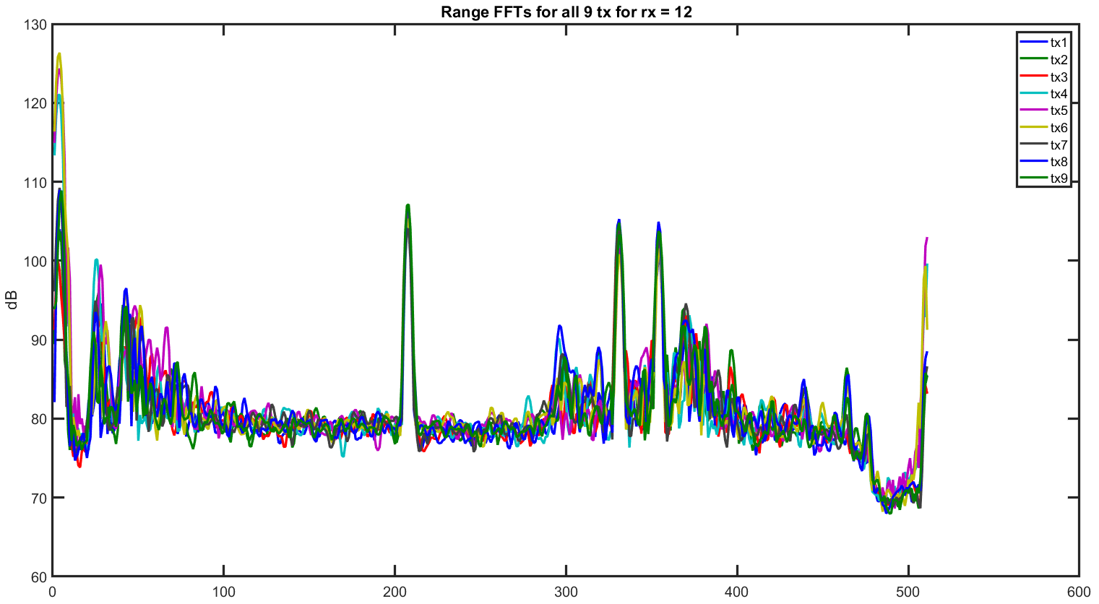
RF Board 2 (bad?) Range FFTs for Rx = 12

Slide 31
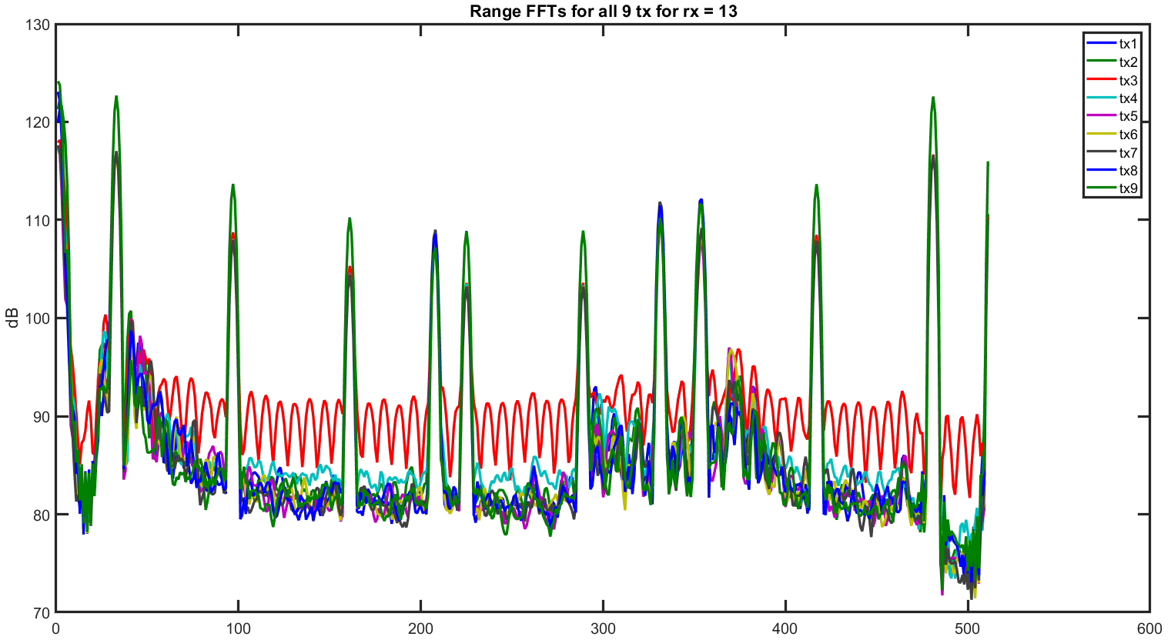
RF Board 2 (bad?) Range FFTs for Rx = 13

Slide 32
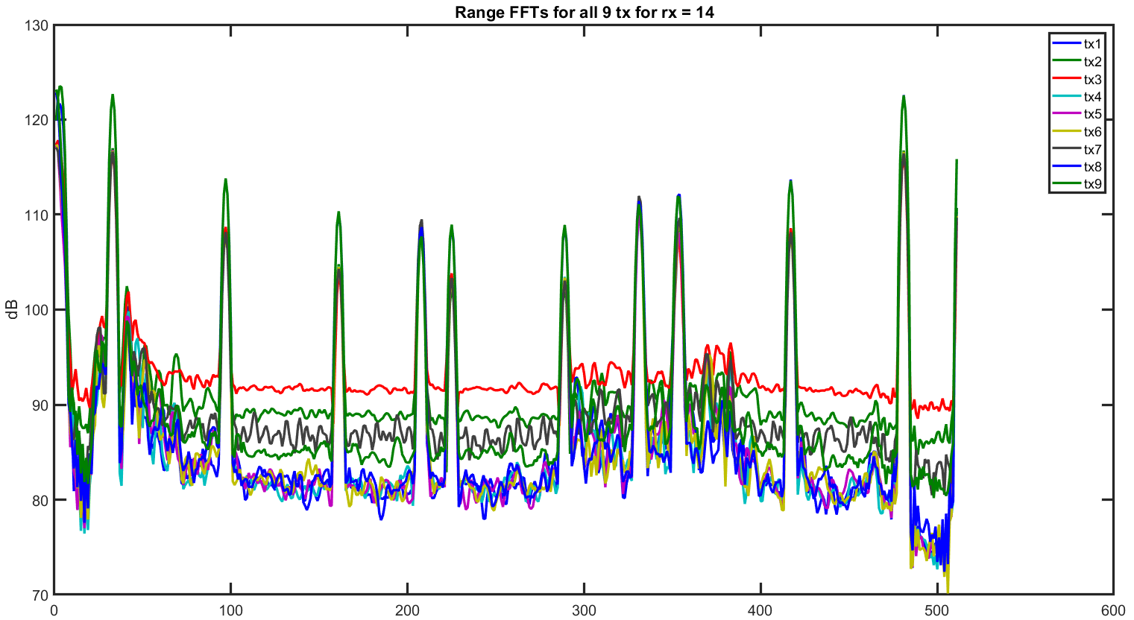
RF Board 2 (bad?) Range FFTs for Rx = 14

Slide 33
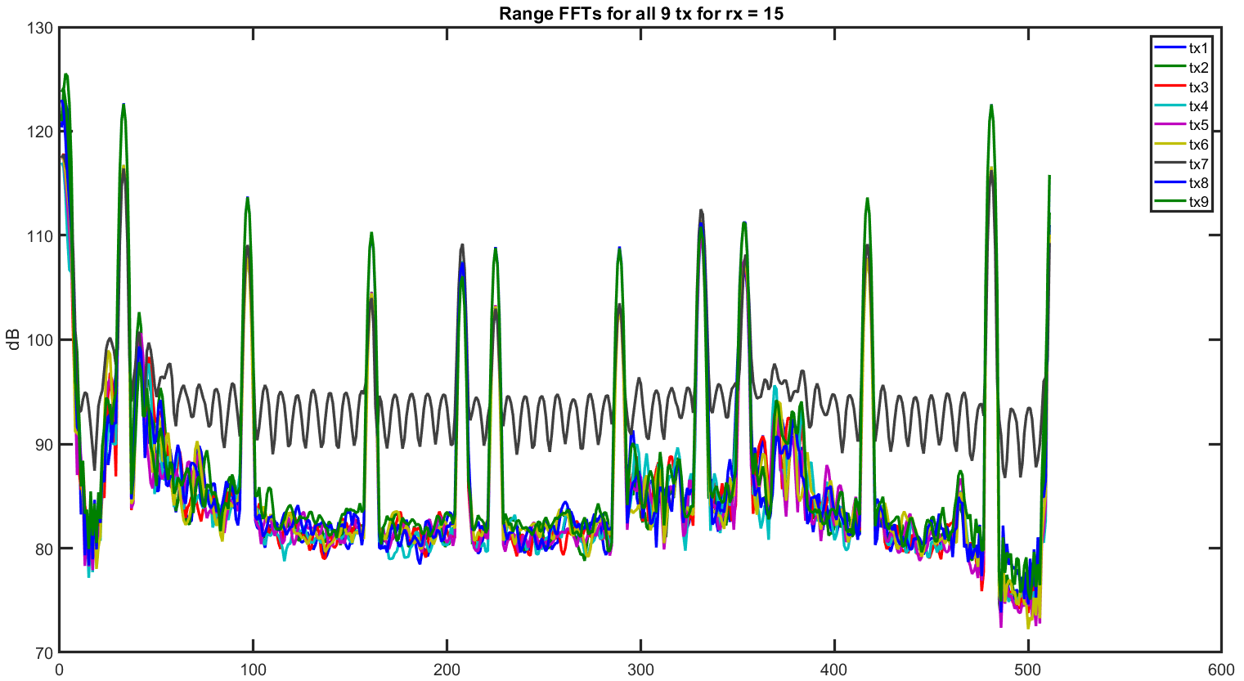
RF Board 2 (bad?) Range FFTs for Rx = 15

Slide 34
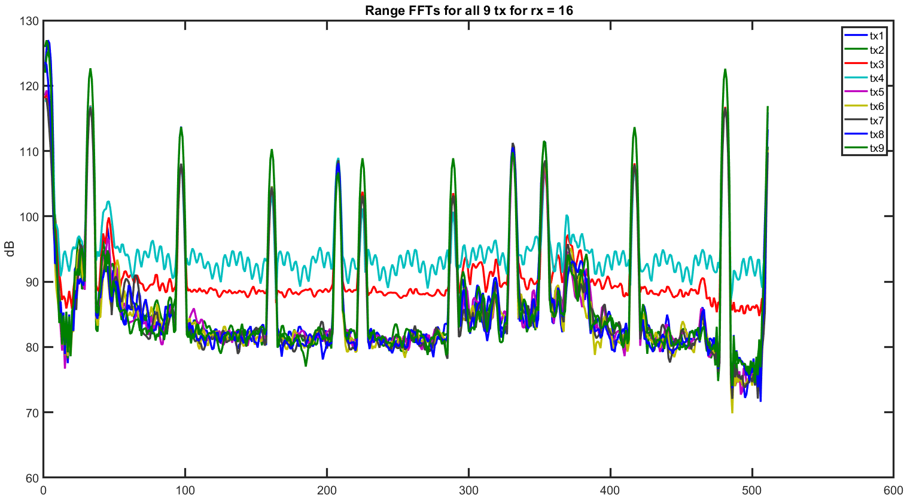
RF Board 2 (bad?) Range FFTs for Rx = 16

